Slide 1
Securing Personas
Professor Clark Thomborson
Primary Representative to the Jericho Forum
for the University of Auckland, since 2005
Presented at Open Group Sydney
17 April 2013

Slide 2
Personas: Four Questions
What is a persona?
Why should I care about any of this?
How should I manage personas for myself, and for my enterprise?
Who can help me?

Slide 3

Persona = mask worn by actor
Thousands of years ago, Roman actors wore personae (masks)
to depict their roles.
A hundred years ago, Carl Jung asserted that, as social beings,
we must hide our true identity:
  A persona is “a compromise between the individual and society as to what a man should appear to be”.

Slide 4
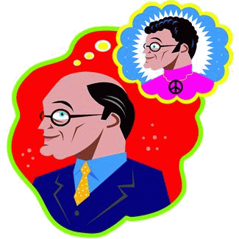
Persona Management: Why?
Today, we have online personas. Difficult decisions, with security and privacy implications.
Choosing which mask to wear
  Deceptive?
Being socially acceptable
  Authentic?
Choosing when to remove our mask
  Secure?
Choosing when to “re-mask”
  Feasible? You can’t force people
  to forget what they have seen!

Slide 5
Persona Management: Hype?
Gartner’s Hype Cycle for Privacy, 2012: “As private and business online interactions increasingly overlap, social media participants face a dilemma:
  How can they manage the communications and interactions of all their different roles?
Persona management helps people establish different personas and channel communications, as appropriate.
For example, a persona manager can ensure that photos from a college reunion
  appear only on social networks where friends participate, and that
  they will not be posted on business-oriented networks.”
greatly increase the likelihood

Slide 6
Persona Management: Feasibility
Effective persona management systems cannot be built until
  we agree on what is socially acceptable.
Persona management systems will be “privacy screens”, not absolute enforcements.
  We cannot force everyone to look away or to forget.
  We can require people to “go behind the screen”
  before starting any private behaviour.
  We can punish exhibitionists and “peeping Toms”.
  We can make it difficult for anyone to peep.
  We can trust our police to detect peeping attempts, but
    will our police (or private guards) be effective?
    will they be trustworthy?
    how much are we willing to spend?

Slide 7
Leakage: A Social Problem
When two or more people are involved in a private activity, any one of them may breach the others’ privacy.
  Any attendee can publish photos of a private reunion!
An individual’s persona manager cannot effectively control postings made by others.
  People at a private reunion could agree on “when, where, and how” to publish photos.
A persona manager should help us to negotiate, and to abide by, a privacy agreement for each type of event in each of our groups.
  That sounds complicated, and yet we do this routinely in our real-world social arrangements.

Slide 8
Persona Management: Feasibility
Can we agree on what is socially acceptable?
  A detailed, global agreement won’t be formed any time soon.
  We might form a rough agreement on general principles for communications about personas.
  Our technology could promote these principles, but will users actively support them?
    The feasibility of persona management is a social, economic and political question, not a technical one!

Slide 9
Global Privacy Principles?
Private information regarding a persona (or multiple personas) may never be exported, except by the society who created it.
  Each society defines what information should be public, what should be private, and what may be declared private by its subject.
Anonymised information may be derived from private information, and should be protected.
An exporter shares the blame, and should make amends, if protected information is ever de-anonymised.
Societies may agree to trust an aggregator to export private or protected information that is created from data provided by the trusting societies.
No intrusions: societies should not export objectionable information to peers who have published a blacklist.
  Superiors may intrude on inferiors, in hierarchical societies.
Societies which do not effectively enforce these principles should be ostracised.
  Enforcement may be social, legal, financial, or technological.

Slide 10
Global Privacy Principles?
Private information is confidential. Exports are controlled.
Private information regarding a persona (or multiple personas) may never be exported, except by the society who created it.
  Each society defines what information should be public, what should be private, and what may be declared private by its subject.
Anonymised information may be derived from private information, and should be protected.
An exporter shares the blame, and should make amends, if protected information is ever de-anonymised.
Societies may agree to trust an aggregator to export private or protected information that is created from data provided by the trusting societies.
No intrusions: societies should not export objectionable information to peers who have published a blacklist.
  Superiors may intrude on inferiors, in hierarchical societies.
Societies which do not effectively enforce these principles should be ostracised.
  Enforcement may be social, legal, financial, or technological.
Anonymised information is protected.
Exporters of protected information are responsible.
Aggregators are trusted.
A right of solitude: exporters must not intrude.
Societies which do not enforce these principles internally will be shunned and ignored by other societies.

Slide 11
Societies and Groups
I’m using the word “society” to refer to a social group of any size that has
  an internal agreement on what information is “private” to the society, and what can be freely exported to outsiders, and
  agreements with other societies, regarding imports and exports of private, protected, and objectionable information.
Examples:
  a country with privacy laws,
  a socially-functional individual,
  an enterprise with a communications policy,
  a socially-acceptable family,
  a congregation in a church.

Slide 12
Individual Privacy
Most countries recognise a personal right of privacy.
  Every person has a private persona who is the only member of its own society.
  Our private persona controls the exports of our personally identifiable information.
  Enforcement is variable: social sanctions, common law, privacy torts, …

Slide 13
Domestic Privacy
Most countries recognise a domestic right of privacy.
  When we enter our home, we enter a private sphere.
  Our family persona shares this sphere with all other personas in our family.
  Enforcement is variable: domestic arrangement, legal intervention, religious sanction and advice.
What you can do:
  teach your kids (and yourself ;-) about internet safety

Slide 14
Bodily Privacy
Most cultures have taboos about nudity and some bodily functions.
  These taboos define objectionable exports from our private persona, family persona, or other (e.g. medical) personas, into our enclosing society.
  Most incorporated societies have a brand image which would be damaged by taboo-breaching exports.
  Enforcement is variable: social sanction, legal sanction, religious sanction, possibly with some technological detection and response.

Slide 15
What you can do about taboos?
Modernise your company communications policy, and your training of employees, to cover social networking.
Perform image analysis, textual analysis, or provenance analysis
  if you can afford the expense, and if you can tolerate some false-positive and false-negative detections of objectionable information.
  e.g. Trustwave’s Secure Web Gateway, Web Content Manager, Email Content Manager.

Slide 16
How many personas do we use?
Do we animate a different persona in each of our societies, and in each context within that society?
  There must be some reusable personas, or we’d never learn the rules of social acceptability.
  We don’t need a complete answer to this question!
A persona-management system should be
  “roughly right” for as many people as possible, and
  “simple enough” to be usable and feasible.
Currently, persona management systems support just two personas: private & employee.
  This seems to be enough for now, but should you plan ahead?
What you can do:
  Be more careful to distinguish your “private persona” from your “employee persona”.
  Decide whether you want to be an early adopter of 2-persona management systems.

Slide 17
2-Persona Systems
If your enterprise supports Bring Your Own Device (BYOD), then …
  Personal-private information is at risk of being confused with corporate information.
Some questions you might ask:
  Should private-persona information be backed-up, or cloud-hosted, by corporate servers?
  Should employee-persona data be manipulated on the device, or is the device merely a “thin client” to a Hosted Virtual Desktop (HVD)?
  Should the presence of a Mobile Device Management app be confirmed, before an employee-persona is allowed to access corporate resources on a mobile device?
  Should employees be trusted (after some training) to properly classify all employee-persona data? Do they need help?

Slide 18
Employee Expectations of BYOD
According to a survey commissioned by Aruba,
  “Almost all (93%) mobile workers want at least some of their personal information accessible on their device to be completely kept from I.T. access.”
Aruba recently announced a BYOD manager that distinguishes two personas
  by contextual cues, including
    Device location
    Application
    User role (with single sign-on)
  The employee persona uses an encrypted workspace.
  The private persona has normal use of the device, but can’t access the workspace.

Slide 19
Gigya’s Persona-Aggregator
Any of your social-network personas will be recognised as agents of the “the same person” when you log into a Gigya-supported website.
Have you ever had trouble remembering which login credential you used, when you first registered on a website that offers to accept your Facebook, Twitter, Google, LinkedIn, Windows, or PayPal personas?
  This is a “single-sign-on” for all of your social-network personas. An attractive service!
  However this service might complicate your life, if you are distinguishing your LinkedIn persona from your Facebook persona.
What you might do:
  Perform a persona analysis.

Slide 20
Persona Analysis
A persona analysis is similar to an entity-relation analysis, with two refinements.
Warning: the next three slides will induce drowsiness in non-analysts.
Do not operate heavy machinery.
Do not operate chainsaws.

Slide 21
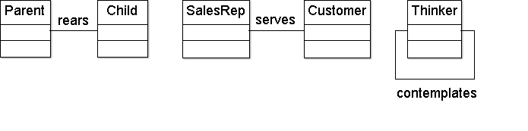
Consider the roles you play…
I have drawn this in UML.
If you prefer ERD, imagine that there are diamonds around my verbs. Maybe add some crows’ feet.

Slide 22
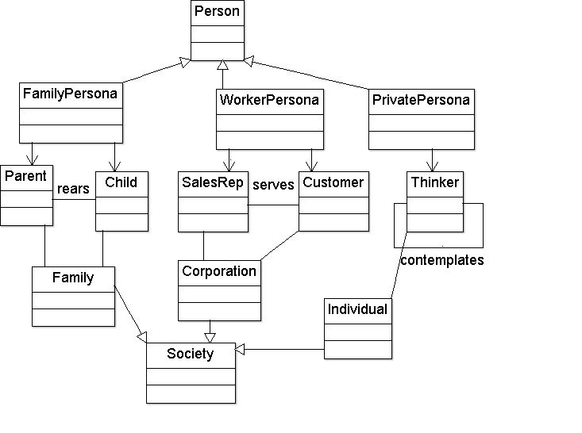
Persona Analysis
Person
Persona
Role
Organisation
(socially-defined)
Society

Slide 23
Security/Privacy Analysis
Three security domains.
Risk analysis:
  Intrusion on Private.
  Eavesdrop on Family.
  Leak from Worker.

Slide 24
Identification of Personas
Identifying a person is not the same as identifying a persona.
  Your person can be identified by a biometric, a password, or a token.
  You are one person, but you have many persona-level identifiers!
    Drivers licence, library card, corporate ID card, credit card;
    Twitter ID, Facebook name, usernames on dozens of other systems.
  A wallet full of cards, and a ragged collection of usernames and passwords – what a security risk!
  What a difficult management problem!
The Jericho Forum offers a way forward.

Slide 25
Identity Commandments v1.0 published May 2011

Slide 26
The Jericho Forum’s IdEA
“The Jericho Forum® Identity, Entitlement & Access Management (IdEA) Commandments
  define the principles that must be observed when planning an identity eco-system.
“Whilst building on ‘good practice’, these commandments specifically address those areas that will
  allow ‘identity’ processes to operate on a global, de-perimeterised scale;
“this necessitates
  open and interoperable standards and
  a commitment to implement such standards by both identity providers and identity consumers. …”

Slide 27
Identity and Core Identity
1. All core identities must be protected to ensure their secrecy and integrity
  Core identifiers must never need to be disclosed and are uniquely and verifiably connected with the related Entity.
  Core identifiers must have a verifiable level of confidence.
  Core identifiers must only be connected to a persona via a one-way linkage (one-way trust).
  An Entity has Primacy [primary control] over all the identities and activities of its personae.
  Entities must never be compelled to reveal a persona, or that two (or more) persona are linked to the same core identity.

Slide 28
Personas: Four Questions
What is a persona?
  The “digital mask” we wear, whenever we act online.
Why should I care about any of this?
  Privacy & security risks, e.g. an inappropriate disclosure to a social network.
How should I manage personas for myself, and for my enterprise?
  Be more aware of how you are currently managing your personas, and consider how it could be more automated and more secure.
  No immediate action is required, because persona management is still in the “technology trigger” phase.
Who can help me?
  The Jericho Forum! Our white papers are free-to-web. You can join our discussions, if your enterprise pays the membership fee.
  Currently 57 members: … EA Principals, Inc. USA; Eli Lilly & Company Ltd USA; Ernst & Young UK; Fraunhofer SIT Germany; …

