Slide 1
A Foundation for System Security
Invited talk at AISC 09
Clark Thomborson
21 February 2009

Slide 2
Questions to be (Partially) Answered
What is security? What is trust?
“What would be the shape of an organisational theory applied to security?” [Anderson, 2008]
What would be the shape of a security theory applied to an organisation?

Slide 3
What is Security?
The first step in wisdom is to know the things themselves; this notion consists in having a true idea of the objects; objects are distinguished and known by classifying them methodically and giving them appropriate names. Therefore, classification and name-giving will be the foundation of our science.
Carolus Linnæus, Systema Naturæ, 1735
(from Lindqvist and Jonsson, “How to Systematically Classify Computer Security Intrusions”, 1997.)

Slide 4
Security Properties (Traditional)
Confidentiality: no one is allowed to read, unless they are authorised.
Integrity: no one is allowed to write, unless they are authorised.
Availability: all authorised reads and writes will be performed by the system.
Authorisation: giving someone the authority to do something.
Authentication: being assured of someone’s identity.
Identification: knowing someone’s name or ID#.
Auditing: maintaining (and reviewing) records of security decisions.

Slide 5
Micro to Macro Security
“Static security”: system properties (confidentiality, integrity, availability).
“Dynamic security”: system processes (Authentication, Authorisation, Audit).
  Beware the “gold-plated” system design!
“Security Governance”: human oversight
  Specification, or Policy (answering the question of what the system is supposed to do),
  Implementation (answering the question of how to make the system do what it is supposed to do), and
  Assurance (answering the question of whether the system is meeting its specifications).

Slide 6
Clarifying Static Security
Confidentiality, Integrity, and Availability are appropriate for read/write data.
What about security for executables?
  Unix directories have “rwx” permission bits: XXXity!
What about security for directories, services, ...?
  Each level of a taxonomy should have a few categories which cover all the possible cases.
  Each case should belong to one category.
Confidentiality, Integrity, XXXity, “etc”ity are all Prohibitions.
Availability is a Permission.
SS
Pro
C
I
X
Per
A
SS
C
X
A
I

Slide 7
Prohibitions and Permissions
Prohibition: forbid something from happening.
Permission: allow something to happen.
There are two types of P-secure systems:
  In a prohibitive system, all operations are forbidden by default. Permissions are granted in special cases.
  In a permissive system, all operations are allowed by default. Prohibitions are special cases.
  Prohibitive systems have permissive subsystems.
  Permissive systems have prohibitive subsystems.
Prohibitions and permissions are properties of hierarchies, such as a judicial system.
  Most legal controls (“laws”) are prohibitive. A few are permissive.

Slide 8
Extending our Taxonomy
Contracts are non-hierarchical: agreed between peers.
  Obligations are promises to do something in the future.
  Exemptions are exceptions to an obligation.
There are two types of O-secure systems.
  Obligatory systems have exemptive subsystems.
  Exemptive systems have obligatory subsystems.
Can peerages be P-secure, and can hierarchies be O-secure?
  Yes, in general, peerages will have some prohibitions and permissions.
  Yes, superiors will often impose obligations on their inferiors.
  So... the type of organisation correlates with, but does not define, the type of requirement. We need a clearer criterion for our classification, if we want a clear taxonomy.

Slide 9
Inactions and Actions
Four types of static security requirements:
  Obligations are forbidden inactions, e.g. “I.O.U. $1000.”
  Exemptions are allowed inactions, e.g. “You need not repay me if you have a tragic accident.”
  Prohibitions are forbidden actions.
  Permissions are allowed actions.
Two classification criteria:
  Strictness = {forbidden, allowed},
  Activity = {action, inaction}.
“Natural habitat”:
  Peerages typically forbid and allow inactions,
  Hierarchies typically forbid and allow actions.

Slide 10
Lessig’s Taxonomy of Control
Governments make things legal or illegal.
Legal
Illegal
The world’s economy makes things inexpensive or expensive.
Moral
Inexpensive
Expensive
Immoral
Our culture makes things moral or immoral.
Easy
Difficult
Computers make things easy or difficult.

Slide 11
Temporal Classification
Prospective controls:
  Architectural security (easy/hard)
  Economic security (inexpensive/expensive)
Retrospective controls:
  Legal security (legal/illegal)
  Normative security (moral/immoral)
Temporality = {prospective, retrospective}.
Organisation = {hierarchy, peerage}.

Slide 12
Reviewing our Questions
What is security?
  Three layers: static, dynamic, governance.
  Static security requirements: (forbidden, allowed) x (action, inaction).
What is trust?
How do organisations provide security?
  Controls: (prospective, retrospective) x (hierarchy, peerage).
What is a secure organisation?

Slide 13
The Hierarchy
Control is exerted by a superior power.
Prospective controls are not easy to evade.
Retrospective controls are punishments.
The Hierarch grants allowances to inferiors.
King, President, Chief Justice, Pope, or …
Peons, illegal immigrants, felons, excommunicants, or …
The Hierarch can impose and enforce obligations.
In the Bell-LaPadula model, the Hierarch is concerned with confidentiality. Inferiors are prohibited from reading superior’s data. Superiors are allowed to read their inferior’s data.

Slide 14
The Alias (in an email use case)
We use aliases every time we send personal email from our work computer.
We have a different alias in each organisation.
We are prohibited from revealing “too much” about our organisations.
We are prohibited from accepting dangerous goods and services.
Agency X
Gmail
C, acting as a governmental agent
C, acting as a Gmail client
Each of our aliases is in a different security environment.
Managing aliases is difficult, and our computer systems aren’t very helpful…

Slide 15
The Peerage
The peers define the goals of their peerage.
If a peer misbehaves, their peers may punish them (e.g. by expelling them).
Peers can trade goods and services.
Peers, Group members, Citizens of an ideal democracy, …
Facilitator, Moderator, Democratic Leader, …
The trusted servants of a peerage do not exert control over peers.
The trusted servants may be aliases of peers, or they may be automata.

Slide 16
Example: A Peerage Exerting Audit Control on a Hierarchy
OS Root Administrator
Auditor
Peers elect one or more Inspector-Generals.
The OS Administrator makes a Trusting appointment when granting auditor-level Privilege to an alias of an Inspector-General.
The Auditor discloses an audit report to their Inspector-General alias.
The audit report can be read by any Peer.
Peers may disclose the report to non-Peers.
Users/
Peers
IG1
IG2
Inspector-General (an elected officer)
Chair of User Assurance Group

Slide 17
Niklas Luhmann, on Trust
A prominent, and controversial, sociologist.
Thesis: Modern systems are so complex that we must use them, or avoid using them, without carefully examining all risks, benefits, and alternatives.
Trust is a reliance without an assessment.
  We cannot control any risk we haven’t assessed ⇒ We trust any system which might harm us. (This is the usual definition.)
Distrust is an avoidance without an assessment.

Slide 18
Security, Trust, Distrust, ...
Our fifth classification criterion is assessment, with three cases:
  Cognitive assessment (of security & functionality),
  Optimistic non-assessment (of trust & coolness),
  Pessimistic non-assessment (of distrust & uncoolness).

Slide 19
Security vs. Functionality
Sixth criterion: Feedback (negative vs. positive) to the owner of the system.
  We treat security as a property right.
  Every system must have an owner, if it is to have any security or functionality.
  The owner reaps the benefits from functional behaviour, and pays the penalties for security faults. (Controls are applied to the owner, ultimately.)
  The analyst must understand the owner’s desires and fears.

Slide 20
Summary of our Taxonomy
Requirements:
  Strictness = {forbidden, allowed},
  Activity = {action, inaction},
  Feedback = {negative, positive},
  Assessment = {cognitive, optimistic, pessimistic}.
Controls:
  Temporality = {prospective, retrospective},
  Organisation = {hierarchy, peerage}.
Layers = {static, dynamic, governance}.

Slide 21
Application: Access Control
An owner may fear losses as a result of unauthorised use of their system.
  This fear induces an architectural requirement (prospective, hierarchical):
  Accesses are forbidden, with allowances for specified users.
  It also induces an economic requirement, if access rights are traded in a market economy.
  If the peers are highly trusted, then the architecture need not be very secure.

Slide 22
Access Control (cont.)
Legal requirement (retrospective, hierarchical): Unauthorised users are prosecuted.
  Must collect evidence – this is another architectural requirement.
Normative requirement (retrospective, peering): Unauthorised users are penalised.
  Must collect deposits and evidence, if peers are not trusted.

Slide 23
Functions of Access Control
If an owner desires authorised accesses, then there will be functional requirements.
  Forbidden inaction, positive feedback (“reliability”)
  If an owner fears losses from downtime, then there are also security requirements.
  Forbidden inaction, negative feedback (“availability”)
Security and functionality are intertwined!
  The analyst must understand the owner’s motivation, before writing the requirements.
  The analyst must understand the likely attackers’ motivation and resources, before prioritising the requirements.

Slide 24
Application: Corporate Communication
Hierarchical communication is very inefficient.
The King is a performance bottleneck.
We want all our employees to share information freely – but without information overload!
Contemporary ECM systems provide virtual “meeting spaces”, “notice boards”, and other information sharing opportunities within the corporate perimeter.

Slide 25
Intercorporate Communication
Q: How do we manage email between hierarchies?
Answers:
Merge/Federate
Subsume
Bridge
Emperor
Company X
Agency Y
Who will be the Emperor = King(X+Y)?
Note: a federation is similar to a merger, where the constitution of the system is its Emperor. The peers agree to abide by the constitution.
Merging won’t solve the problem, until there is one empire.

Slide 26
Email across Hierarchies
Q: How do we manage email between hierarchies?
Agency X
Answers:
Merge
Subsume
Bridge
Company Y

Slide 27
Bridges
Q: How do we communicate between empires?
Answer: Bridge!
Company X
Agency Y
Bridging connection: trusted in both directions.
The person forming the bridge has a separate “persona” who is a low-privilege member of the other corporation.
Bridges are a nightmare for security analysts!
Employees will use hotmail, instant messaging, blogs, USB devices, ...

Slide 28
Trustworthy Bridges
Employees must be able to make trustworthy bridges to any trustworthy external organisation.
Bridges must be subject to managerial oversight.
  Employees must be given guidance.
  There should be whitelists of corporations and bridge technologies, as well as some blacklists.
  Managers will require decision support from “reputation management systems” in order to maintain whitelists and blacklists.
The ECM system must interoperate with reputation systems, workflow systems, customer relationship management systems, human resource management systems, key management systems, and many other systems.
  Standardized interfaces are essential!
  Will we have supplier-driven standards, or will the customers band together to express their own requirements?

Slide 29
The Jericho Forum: Structure
User members are large corporations and a few governmental agencies, who
  Own the Forum;
  Vote on the deliverables;
  Run the Board of Managers.
Vendor members
  Have no votes;
  Participate fully in discussions.
  We now have 12 vendor members, and want more.
Academic members
  Offer our expertise in exchange for information of interest. (Academics trade in ideas, not $$.)

Slide 30
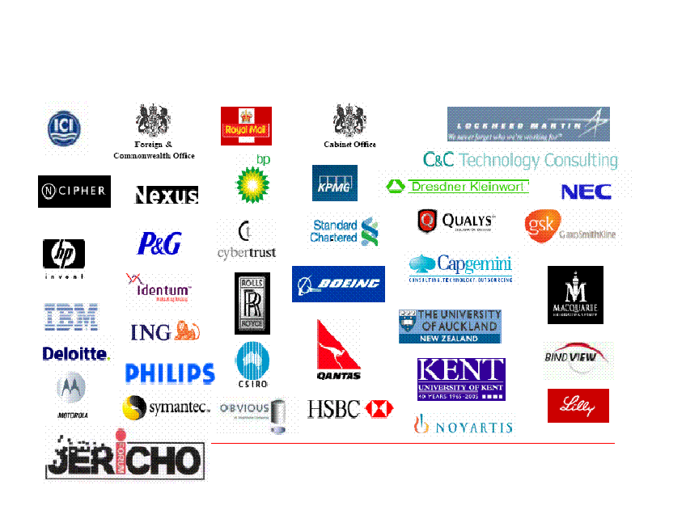
Some Members of Jericho
http://www.jerichoforum.org/

Slide 31
Summary
What is security? What is trust?
  Four qualitative dimensions in requirements: Strictness, Activity, Feedback, and Assessment.
  Two qualitative dimensions in control: Temporality, and Power.
Can security be organised? Can organisations be secured?
  Yes: Static, Dynamic, and Governance levels.
  Hybrids of peerages and hierarchies seem very important.
  Jericho’s Collaboration Oriented Architecture is an intriguing development.

