Slide 1
Dynamic Integration of System Components of a General Theory of Software Engineering in Practice
Case Studies from Three Application Domains
Dr. Anca-Juliana Stoica, Dr. Kristiaan Pelckmans
TOSE Workshop, May 2016

Slide 2
Outline
System Components of a General Theory of Software Engineering
Real World Case Studies
  A. Strategies and Challenges in Designing Communication Solutions for Large-Scale Events
  B. Hybrid Development of Mobile Applications with Software Quality Focus
  C. Building Internet Communities for Students – A Managerial Perspective
Conclusions and Quality Criteria

Slide 3
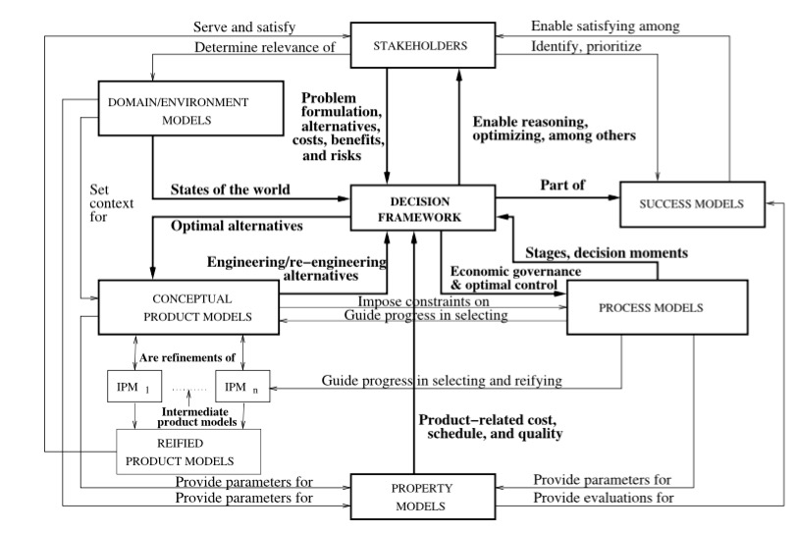
System Components of a General Theory of Software Engineering
Stoica, Pelckmans, Rowe - Science of Computer Programming 101,(2015) 42-65

Slide 4
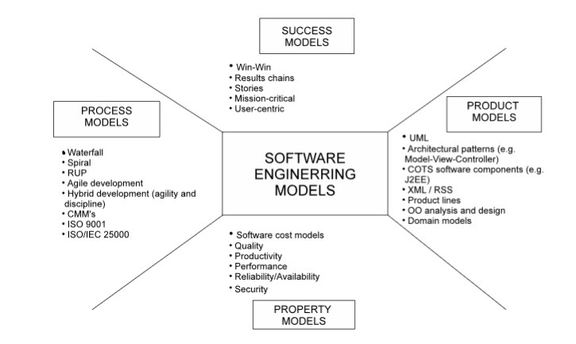
Model System Concept
Models: an abstract description to visualise and reason about the system and its effects.
Views: selected aspects needed to make informed decisions.
Model System: Collection of interconnected and consistent components that work together for defining/developing/delivering a software system.
Actors:
  Stakeholders.
  Developers.
  Users.
Product model:
  Requirement view.
  Specification view.
  Design view.
  Architectural view.
  Real-time design view.
Evaluation:
  Success model.
  Property models.
  Environment model.
Decision Framework.

Slide 5
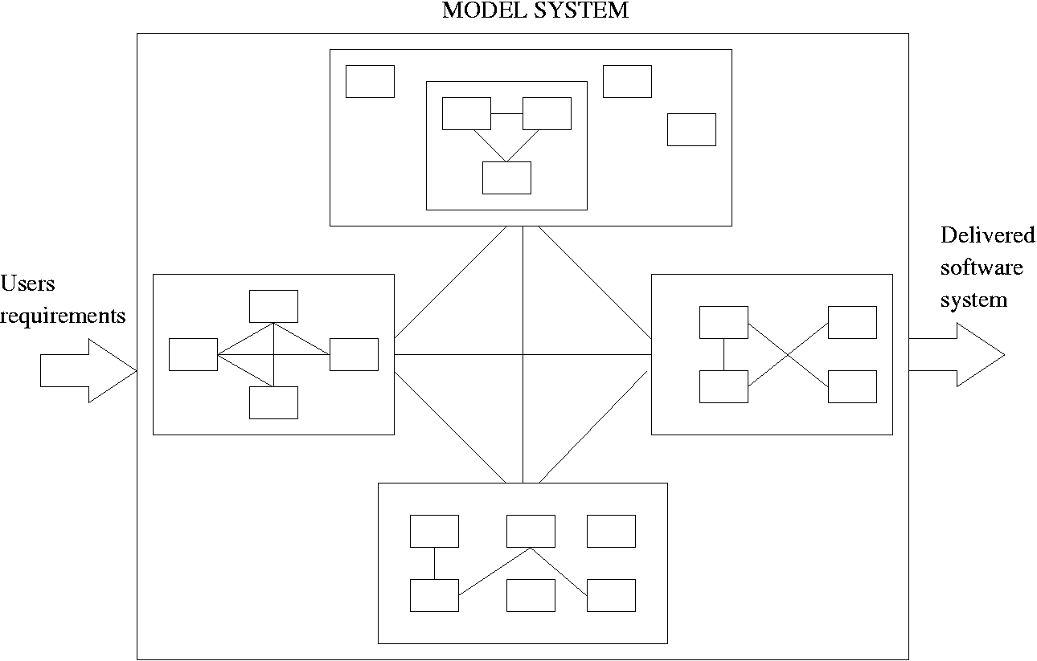
Model System
Delivered Software System
Changing
Requirements

Slide 6
Software Engineering Models
A model is a pattern of something to be made, a description or an analogy used to visualize and reason about the system to be developed and its likely effects
Models are built to help focus on the appropriate set of questions that need answering in order to find the most reliable and cost-effective solutions and to qualify the system against its stakeholders’ views

Slide 7
Model Systems
Benefits: i) model the software development facets and are also used to build the software; ii) allow reasoning, optimization, and decision analysis
Require: model clash analysis in order to validate model compatibility
Please note the difference between “model systems” (an emergent concept) and “system models” (a traditional software engineering concept which essentially applies only to models of the system to be built, like e.g. behavioral, semantic data, or object models)

Slide 8
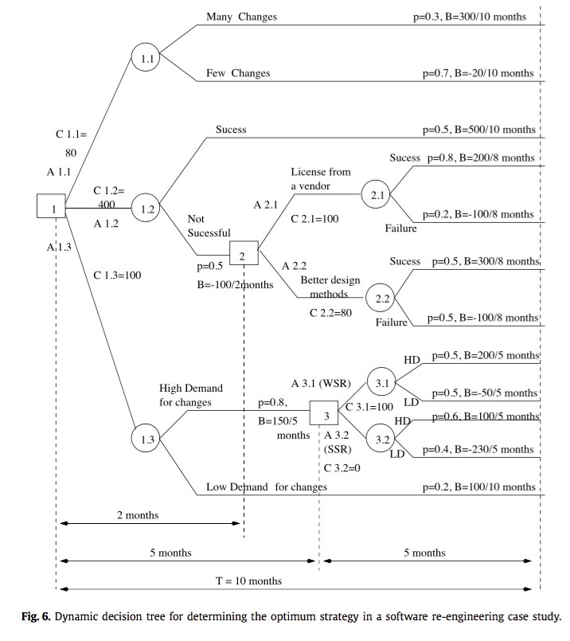
Decision Framework
Decision-under-risk theoretic [von Neumann & Morgenstern, 1944].
Explicit notion of time in the SE process.
Explicit notion of utility in the SE process.
Explicit factoring in of risks and uncertainties in the SE process.
Represent the software decision-under-risk process as a discrete dynamic decision tree (DDT):

Slide 9
Decision Framework
Central governance component for a given software engineering endeavor
  Effectively managing risks and uncertainties related to project success in the building stage
  Design process in an economic perspective: Value of Waiting (VOW) , Value of Information (VOI), and possible outcomes can be coped with explicitly
  Optimal control of modern adaptive software development: dynamic programming; optimal sequence of decisions
while developing an overall framework in which these techniques compatibly reinforce each other.

Slide 10
Outline
System Components of a General Theory of Software Engineering
Real World Case Studies
  A. Strategies and Challenges in Designing Communication Solutions for Large-Scale Events
  B. Hybrid Development of Mobile Applications with Software Quality Focus
  C. Building Internet Communities for Students – A Managerial Perspective
Conclusions and Quality Criteria

Slide 11
Introduction to Case Studies
  Exploratory real-world case studies and their content
  Research questions associated with them
  Contributions of applying SC GTSE in practice
    Developers adapted to the problem statement their design style, process, property, and success models
    Mayor decisions in early project stages and/or high-level design decisions (such as: early architectural design, development platforms, system components, , success criteria, process, system properties) are governed and optimally controlled by the success-critical stakeholders and the application of the decision framework
    Use of blended techniques from plan-driven and agile methods
    Cover a wide range of application domains.
  Limitations – as in most case studies, results are not statistically generalizable across any particular industry or group, but
  Results are theoretically generalizable because they support specific theoretical conjectures.

Slide 12
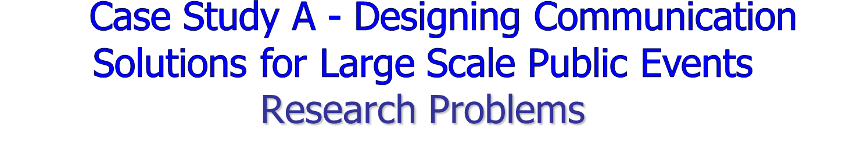
  Study (analyze) communication systems for re-occurring, time-limited and geographically focused, large-scale events. What kind of demands these large-scale events put on communication systems?
  Understand the environment of Large Scale Public Events
  Understand the complex interactions of different stakeholders and their requirements connected to the communication system
  Develop new secure and reliable communication system for large scale public events, satisfying stakeholders’ requirements
  Enhance the experience of visitors attending large-scale events using modern telecommunications and information technology.
Dr. Anca-Juliana Stoica (KTH/ICT)

Slide 13
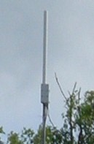

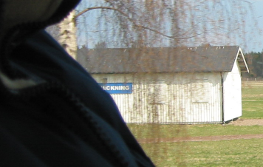
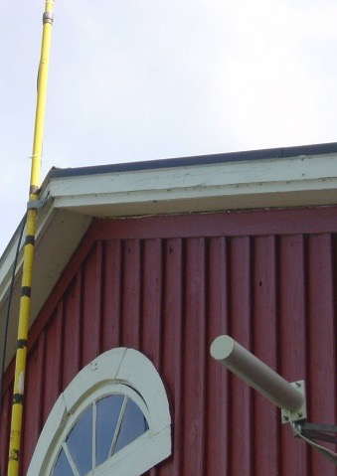










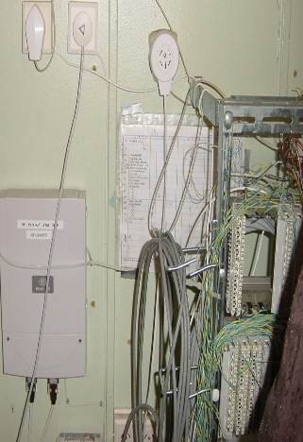
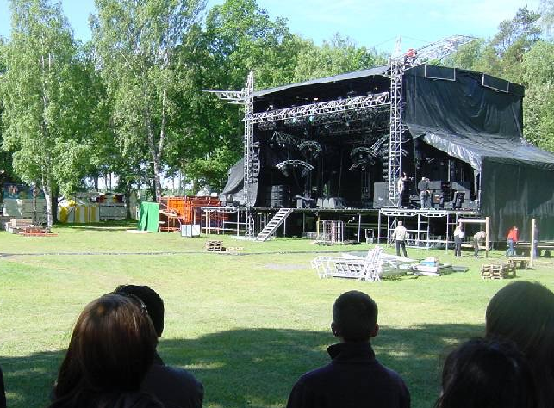
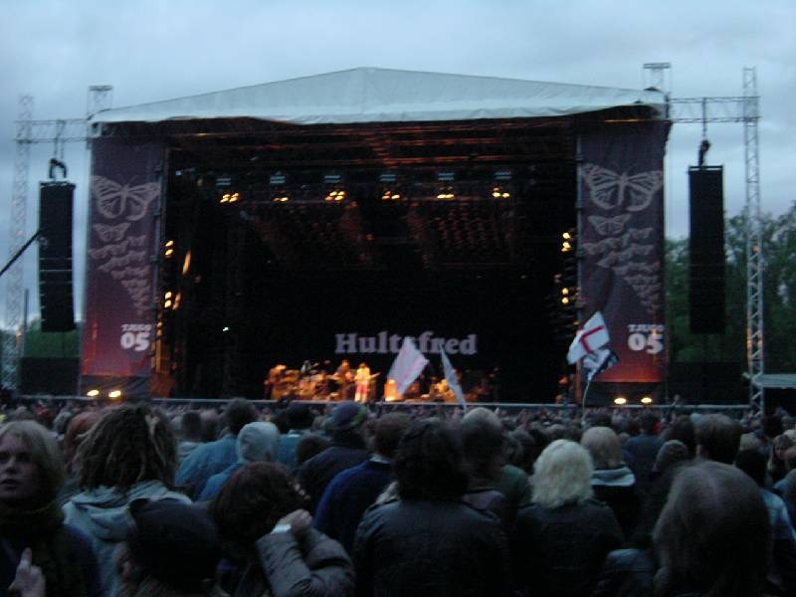
Internal Organizer's Network - W-LAN
s
*
Hultsfred.TV’s
caravan
BTH’s caravan
Check in office
802.11b wireless link
s
*
Other office
Teaterladan stage
Stora dans stage
Festival office
2 Mbps HDSL line
Ethernet
*
Legend
* = Single PC client with external flat panel antenna
s = slave
Pampas stage
Atlantis stage
Hawaii stage
It is possible to connect most clients to either the extranet or the intranet. The details are left out of this figure.
Orinoco and Compex solutions with external antennas to connect buildings
Standard access points for WHAT project roaming and to connect PCs
Dr. Anca-Juliana Stoica (KTH/ICT)

Slide 14
System Life-Cycle Model for Uncertain and Turbulent Environments
Development Stage
Evolution Stage
Stakeholder
Workshops
During Event
Data
Collection
&
Testing
Analysis- Stakeholder/Value Analysis
System
After Event
Design
Analysis- Stakeholder/Value Analysis
Improvements
Real time testing/collecting feedback
Analysis
Screen out improvements
Stakeholder
Workshops
During Event
Data
Collection
& Testing
Real time testing/collecting feedback
Improved
System
Screen out improvements
Prototyping
After Event
Early Archi. Concept
Screen out
Requirements
Analysis
Stakeholder
Workshops
Improved
System
During Event
Data
Collection
& Testing
Strategy
Before Event
Hypothesis
Initial investigation
Event-Related Time
Dr. Anca-Juliana Stoica (KTH/ICT)

Slide 15




Proposed Mobile Operator supported W-LAN Architecture
E
I
R
OSS
Management
GSM/WCDMA
Core Radio Network
BGw
SGSN
GGSN
H
L
R
A
U
C
V
L
R
WLAN
Manager
GMSC
MSC
GSM/WCDMA
Radio Network
EWAS
ASM
Internet
AP
Bridge
Hawaii
Bridge
ASN
Bridge
AP
Router/SG
AP
Admin
AP
Bridge
Teater
Parking
AP
AP
Admin
Admin
Bridge
Pampas
AP
Admin
AP
AP
Bridge
Organizers
Office Net
AP
Admin
AP
Shara
AP
Admin
Bridge
Bridge
AP
Camp, FAid
AP
Bridge
AP
Admin
AP
Bridge
Atlantus
AP
AP
Rest., FAid
Bridge
S Entre
AP
AP
Admin
P Entre
AP
Admin
AP
Admin
AP
Admin
AP
AP
Admin

Slide 16
Case study A - conclusions
  We introduced a system development model for uncertain and turbulent environments to prove the feasibility of new technical, service, and business concepts through an iterative approach in which users and other stakeholders participate through the process and demonstrate the expected benefits and advantages of developing new communication systems architecture and mobile multi-media application services, such as location based services and VoIP applications
  The proposed communication systems/solutions solve key issues: i) organizers want to have one device (end-user terminal) for all communication needs: ii) they also want to maintain only one network that is able to fulfill all their requirements. We proposed W-LAN inter-working with cellular mobile networks that have the capability to solve these issues when Mobile IP based smart phones are used with advanced applications
  Stakeholder/value dependency framework is useful for reasoning about the communication system’s dependability attributes and project scoping
  The development model and stakeholder dependability analysis are key models to identify the tradeoffs which are necessary in order to provide a dependable system that will evolve to meet future requirement changes and will satisfy the stakeholder/ value dependencies.
  The FriendFinder location-based application is expected to be one of the most used applications in grand public events and we proposed: i) how and what components need to be added in cellular mobile networks to support it, and ii) the key contributors that must work together in order to successfully built and deploy the application
Dr. Anca-Juliana Stoica (KTH/ICT)

Slide 17
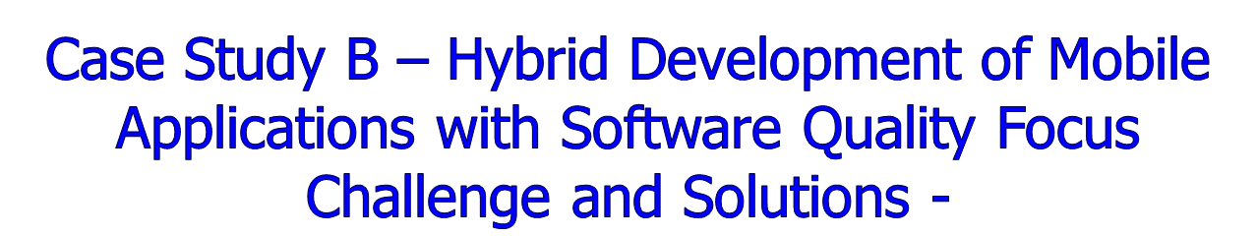
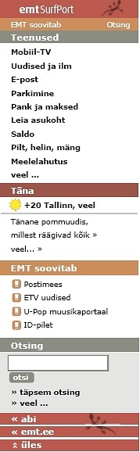
What?
Mobile news delivery systems for communication service providers.
Front-end and back-end development.
Product line development.
Challenge
Balance the agility and plan driven approaches in software development to take advantage of their strengths in a given situation while compensating for their weaknesses
Solutions
  Software risk management approach
  Software quality management approach following quality standards (SQuaRE),
  for structuring projects to incorporate both agile and plan-driven features in proportion to project’s needs.
Models and frameworks
Quality models, metrics and characteristics, project basic data (RSM reports), software quality reports, value-based framework
  Stoica, A.J. (2007). Exploring Quantitative Yields of Software Engineering Methods in the Software Life-Cycle. The first IEEE Computer Society EQUITY International Conference. 19-21 March 2007, Amsterdam, the Netherlands.

Slide 18


Project 1 Project 2
To publish fresh publications, e.g. news articles from news providers, via WAP or GPRS to the customers of a telecommunication company
Publications are delivered to application by RSS and server creates pages that are suitable for mobile stations to read.
To publish Web Logs (Blogs) via WAP or GPRS to the customers of a telecommunication company
Publications are delivered to application by RSS and server creates pages that are suitable for mobile stations to read.
Real-life example for hybrid quality driven development with SQuaRE: models, benefits, guidelines, experience base, evaluation framework

Slide 19
Project 1
  Used techniques:
  Feature Driven Development
  Small team
  Osmotic communication
  Spiking, Walking skeleton
  Information radiators
  Simple design
  Access to expert user
  Estimation using comparison and
  analogy
  Frequent delivery
  Documentation is not so important
  Kick-off meeting
  Status reporting

Slide 20
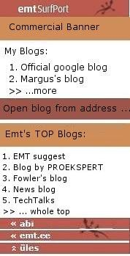
Project 2
  Used techniques and models:
  Feature Driven Development
  Small team
  Osmotic communication
  Spiking, Walking skeleton
  Information radiators
  Access to expert user
  Estimation using comparison and analogy
  Frequent delivery
  Kick-off meeting
  Status reporting
  Code reviews
  Measurements of quality characteristics
  Burn charts
  Initial reqs spec, admin guide, architecture and design model, quality project plan
  Quantitative yields and benefits evaluation using value-based framework (model-based)

Slide 21
Value-Based Framework (VF)
Interrelated software system metrics and models that address:
  Costs (CM)
  Quality (QM)
  Productivity (WM)
  Benefits (BM) from applying better software project quality management
  Resulting value estimation metrics (VM), evaluated over the software life-cycle.

Slide 22
Case study B - Summary
  Our research shows that there are no conflicts between applying ISO/IEC SQuaRE software quality standards and agile software development
  Economic and quality benefits are demonstrated using a value framework as well as software metrics and measurements
  Simple guide to SQuaRE practical use with real-life example is presented
  Evaluation framework for software system projects to decide on the balance between agile and plan-driven approaches is outlined
  Experience base for analysing software system projects is created
  Our work is a step forward in reconciling agile approaches and formal software product quality evaluation that is discussed in ISO/IEC software quality standards.

Slide 23
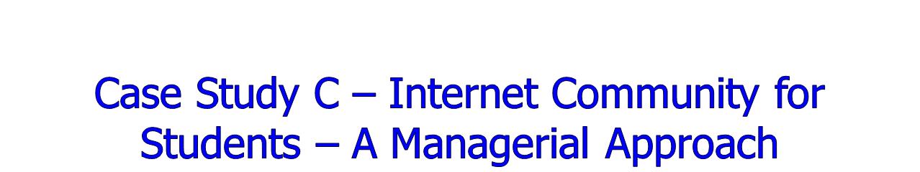
What is it?
A web-based platform for managing student enrolment in courses, and other academic managerial tasks
Design to schedule
Risk driven development
Both front-end (web) and back-end (servers)
Hybrid (agile and disciplined) development
Process guidelines for managing similar web applications development projects.
Application characteristics
Scalability (upgrade easily and transparently)
Maintainability (bug fixing and feature expansion)
Easy to monitor (statistics of system usage)
Consistent structure of user interfaces (standardized browsing)
Maximize communication points (B2S, S2S, U2S)
Increased usability among students, teachers/administrators, student associations, and business world.
Model system concepts are applied for the application design, development, and process management.

Slide 24
Outline
System Components of a General Theory of Software Engineering
Real World Case Studies
  A. Strategies and Challenges in Designing Communication Solutions for Large-Scale Events
  B. Hybrid Development of Mobile Applications with Software Quality Focus
  C. Building Internet Communities for Students – A Managerial Perspective
Conclusions and Quality Criteria

Slide 25
Conclusions and Quality Criteria
Application and validation of the theory quality criteria related to the presented case studies indicate:
Relation to real world (case studies)
Support good decision making (DF)
Formalisms (DF, VF)
Consistency (model clash analysis)
Measurability (utility, process and product metrics)
Predictability (project outcomes, risks and uncertainties)

