Slide 1
What motivates students to study Computer Science? Are there any differences in the reasons what women give for studying Computer Science compared to men?
Sara Hampton

Slide 2
Where did it go wrong
Wikipedia lists many women at the dawn of computing
1842: Ada Lovelace
1893: Henrietta Swan
1926: Grete Hermann
1942: Hedy Lamarr
1943: Gertrude Blanch
Notes:
In the beginning there were many women who excelled at computer science and programming. Although it was uncommon for women to attend university in the 19th Century those that did, like Ada, excelled in all areas of science and medicine.

Slide 3
1997 to 2014
Despite the lack of women in computer science being highlighted as a problem many years ago things do not seem to have changed much. I focused on 8 reviews, articles and books over a spread of 17 years.

Slide 4
The incredible shrinking pipeline
One of the most influential articles and the most cited of the works
The authors performed statistical analysis on data from 1983 to 1994
Their finding showed that in 1983 37% of BA/BS degrees were awarded to women
1994 it had dropped to 29%
Prediction of 58% female graduates of Computer Science in 2007
Notes:
They offer no reason for the statistics and predict that in 2007 (ten years hence from the study) 58% of graduates would be women.

Slide 5
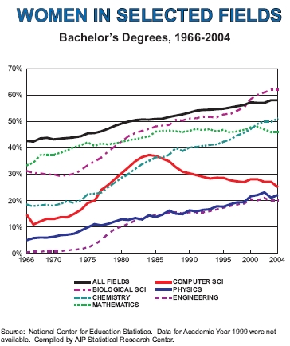
Notes:
The National Centre for Education Statistics shows the reality of women in CS dipping to 25% in 2004.

Slide 6
Unlocking the clubhouse
Method
The book is split into 8 chapters; each tackling an aspect the authors believe contributes to women’s disengagement
The magnetic attraction
Middle and High School:A room of His Own
Computing with a Purpose
Geek Mythology
Living among the Programming Gods: The Nexus of Confidence and Interest
Persistence and Resistance: Staying in Computer Science
A Tale of 240 Teachers
Notes:
The book has a clearly marked section for Methodology where they describe in detail the study and how it was conducted --- 230 interviews conducted with over 100 male and female computer science students over four years (from 1995 to 1999) at Carnegie Mellon University
1. Computers are like magnets to boys
2. Games propel boys, at an early age, into the world of computing and reinforce a general belief that computing is a male activity. The computers at school are surrounded by boys simply using the computer for using the computers sake. Girls are much more sociable beings who prefer to chat with friends
3. Retention is reliant on programming having a purpose – for the greater good
4. Its not an attractive image for a girl to have
5. The males on the course always seemed to know much more
6. The reasons women gave for leaving and staying were varied and the authors were continually surprised by events
7. 240 high school computer science teachers were invited to join a group to assist them in implementing a curriculum in their schools. They learned C++
Careful observation shows that disinterest and disaffection are neither genetic nor accidental nor inherent to the field but are the bitter fruit of many external influences.

Slide 7
8. The book concludes with insightful suggestions for the way that universities can change their CS image and attract and retain more women.

Slide 8
Encouraging women in Computer Science
This study shows that it is the gender stereotypes at a young age that has an effect on women’s decisions not to study CS
Courses aimed at the interests of women
Notes:
This paper doesn't’t really come up with anything new. It looks at the initiatives of the Computer Science faculty and concludes that women do better in computer science when they have completed the universities introductory course.
The mere fact that it is introductory puts off the boys because they already think they are experts and therefore the women are on an even playing field.

Slide 9
So if you are good at computer science why don’t you take it
Lori Carter 2006 study
Method
Results
Conclusion
Notes:
836 calculus and pre calculus in 9 schools
423 female
363 male
50 declined to say a gender
The result showed that the number 1 reason boys wanted to do CS was to create games and girls to use it in another field
Conclusion – the majority of students in the survey did not want to do CS because they have a misconception of what a Computer Scientist does.

Slide 10
Doubt
Notes:
At this stage I was beginning to doubt the validity of my choice of topic. So far from 1997 to 2006 nothing seems to have changed. The studies sugest that change needs to happen and yet I find myself reading a 2010 paper about the deficit of women in CS still!

Slide 11
http://www.npr.org/blogs/money/2014/10/21/357629765/when-women-stopped-coding

Slide 12
So what happened in 1985?
Games
Games
Games
Games
Games
Games
Games
Notes:
Computing had to be fun. Everything about high school education had to be fun and as the pedagogy was dictated mainly by men that fun translated into game programming.
All the studies seem to agree that when games became big in the mid 80s boys began spending increasing amounts of time on the computer and the perception from the adults point of view was that they were an natural. For whatever reason girls did not share in this passion.
An interesting study that I have yet to find is why --- why did these games appeal so much to boys and not to girls. Why did the computer game market not try harder to hook in the female dollar.

Slide 13
Innovations to encourage women to Computer Science
Geek Girls started in 2006 by Leslie Fishlock
CodeEd is a non-profit organisation that focuses on teaching computer science to young girls
Canterbury University Code Club
CS4G
Alice programing
Googles Made With Code
Jewelbots – the programmable friendship bracelet
Notes:
The many hours I spent reading articles and ABSTRACTS I stumbled upon a myriad of initiatives to encourage girls that are now in full swing at some schools
Jewelbots --- may seem like a trivialization of computer science simply to appeal to a demographic but then half the population probably think the same about chasing enemy armies around a screen

Slide 14
For the first time in its history, Berkeley saw an introductory computer science course with predominantly female students – 106 women vs. 104 men. This slight turnaround signals a promising trend in the male-dominated STEM world.
My feeling is that the very title ‘introductory’ would attract those who have little or no experience of Computer Science which is likely not to be the average male freshman.

Slide 15
Heidi and Caitlin
CS Field Guide
CS externals

Slide 16
Unanswered questions
Did the 80s game craze really have a detrimental effect on the way girls engaged with digital technology
Have all these studies really made a difference to the recruitment and retention of girls
Who are the teachers in high school
Full circle
Notes:
Full circle --- how can we persuade those girls who have gone the distance and PhDd themselves to go full circle and return to the classroom

Slide 17
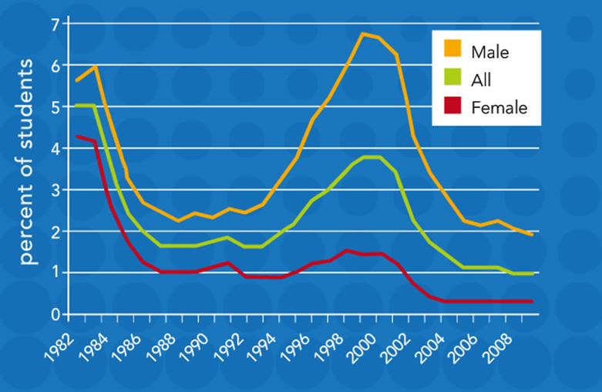
Percentage of American Freshmen Intending to Major in Computer Science

