Slide 1
Investigate the degree to which programming concepts are interrelated
Reshmi Ravi

Slide 2
Recap
Learning Edge Momentum:
Required to fit new material into the context of existing knowledge
Claims that programming concepts are interrelated
Investigate if programming concepts are interrelated?

Slide 3
Related Work
Cognitive Load Theory
High intrinsic load = the student is often required to learn material by understanding its interrelatedness with other concepts and integrating it to learn it
Threshold Concepts
Inform me about concepts that fit the criteria, but where to from here?
Anchor Graphs
Show a natural ordering amongst anchor concepts

Slide 4
Pre-Research Test
Go through the Course Structure and map out the order programming concepts are taught.

Slide 5
Pre-Research Test (cont)
Variables and Expressions
Strings and string manipulation
Functions
Boolean expressions and if statements
While Loops
GUI
Nested Loops
Data structures – tuples, dictionaries
File processing
Lists and list manipulation
COMPSCI 101 (Python) – University of Auckland
Variables and Expressions
Conditional Code
Functions
Loops and Iteration
Strings
Tuples
Dictionaries
Lists
Files
Programming for Everybody (Python) - Coursera

Slide 6
Pre-Research Test (cont)
Variables and Expressions
Methods
Objects
Boolean expressions and if statements
While Loops
Interfaces
Data structures – Array lists, 2D arrays
Classes, objects and Fields
User Input and File processing
COMP102 (Java) – University of Wellington

Slide 7
Variables and Expressions
Strings and string manipulation
Functions
Boolean expressions and if statements
While Loops
GUI
Nested Loops
Data structures – tuples, dictionaries
File processing
Lists and list manipulation
COMPSCI 101 (Python) – University of Auckland
Variables and Expressions
Conditional Code
Functions
Loops and Iteration
Strings
Tuples
Dictionaries
Lists
Files
Programming for Everybody (Python) - Coursera
Variables and Expressions
Methods
Objects
Boolean expressions and if statements
While Loops
Interfaces
Data structures – Array lists, 2D arrays
Classes, objects and Fields
User Input and File processing
COMP102 (Java) – University of Wellington

Slide 8
RESEARCH QUESTIONS
1. Are certain programming concepts interrelated?
File Processing
2. Is the degree of interrelatedness of programming concepts independent of the programming language used?

Slide 9
Methodology
Go through assessments to see what programming concepts do students have to know, integrate to implement a successful solution for the problem for two programming languages
Python and Java
Go through Lab Exercises in COMPSCI 101
Choose one exercise from one laboratory exercises that meets the learning outcome specified for that laboratory.
Examine the programming concepts, and the syntax that the student needs to know
Develop a resultant anchor graph for Java and Python

Slide 10
Case study #1: File Processing
Example: Read all the words in a file and create a file that contains all the words which are palindromes

Slide 11
Lists
Data Structures
Data
Sequence
Instruction
Variable
Object
Function Call
Equality
Files
Expression
Iteration and Loops
String and String manipulation
Assignment
Boolean Operators
If statements
Statements
Opening, reading, closing and writing to a File
Python

Slide 12
Array
Data
Sequence
Instruction
Variable
Strings
Data types
Function Call
Data structures
Expression
Equality
Iteration and Loops
Files
Assignment
Boolean Operators
Exceptions
If statements
Statements
Opening, reading and writing to a File
Java
Object
Notes:
Open/red - Files as objects, and this understanding that you only read a file till has input – so you need to understand and use exceptions and iterating through the file, reading only the words– then assign it to a data structure which just has words – iterate through the data structure, nested loops to go through the string - understand that it is a sequence of characters and check for equality

Slide 13
Programming concepts
The programming concepts that are needed to solve that problem for both the languages are very similar.
Need to know about Exceptions for Java
Need to understand the idea of reading a file, checking for palindromes and then writing to a file.

Slide 14
Language Related Elements
Java
Explicit type declaration
Use of “;”
Scanner object - testing before reading, loops to next token
Printwriter
Exceptions
Loops – iterator, Boolean condition, increment, decrement
Nested loops
Array
Python
Indentation
Reading files - Open(),read(),split()
List
String manipulation - slice

Slide 15
Findings
The programming concepts to solve a problem are interrelated.
Reflect on preceding programming concepts
Integrate with new concepts
The programming concepts to solve a problem in Java and Python are very similar with few differences.
String slicing vs the use of nested loops
Open(),read(),split(), write() vs Scanner, Printwriter object
These language related differences may increase the degree where the student has to combine the syntax and concepts correctly; but they still have to have the essential understanding for each concept

Slide 16
Limitations
The case study was picked from a laboratory exercise at the end of the course
Challenging
Will integrate preceding concepts
Only one case study
External Validity

Slide 17
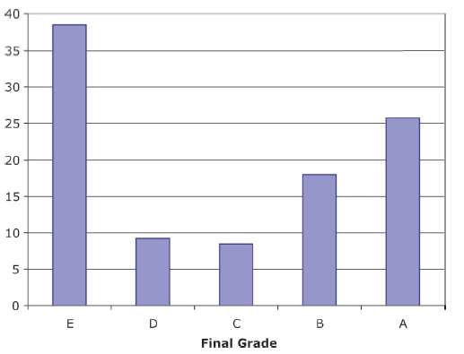
Conclusion
Programming concepts are tightly interconnected as Robins claims.
It is fair to say that some language related elements can increase the cognitive load.
But if the courses are taught in a format which follows the tightly integrated order, why the grades?
Is the graph really bimodal?
Expecting too much?

