Slide 1
Is Computing for Social Good the Solution to Changing Misinformed Perceptions?
Compsci 747
Presented by: Nazish Khan

Slide 2
What is The Problem?

Slide 3
Common Perceptions
-Web browsing
-Games
-Hacking
Boring
Irrelevant
Solitary
Mindless button pushing
Male Dominated
Notes:
Buckley, Goldweber, Guzdial, Walker
These studies just state these viewpoints of CS, without any proof behind it.
A study by Galpin and Sanders about the perceptions of computer science at a South African university contradicts such statements.
The study investigated students’ attitudes at the beginning and towards the end of first year courses.
Sample consisted of 46 students (31 male students and 15 female students).
They show results which conclude that only 8 students found the course unenjoyable. A majority of students responded with positive replies regarding the courses.
Majority of the students thought of programming as the leading topic for course content as well as job opportunities. Researchers suggest that a breadth first approach may be better in providing an overall view of the CS discipline.
Female students showed a significant change in their assessment of their own understanding of CS.

Slide 4
Media Influence
McLeod and Lang (2013) discuss the existence of IT stereotypes in television shows
Notes:
They aimed to investigate:
If there is a difference between the portrayal of male and female IT experts on television?
If this provides an insight into why the percentage of females in IT is falling?
Television has a wide reach in the community. There is evidence from previous research studies that media does have an influence on career and subject choices for students.
Study included:
Review of 5 television shows shown on Australian television (NCIS, Criminal minds, Bones, The IT Crowd, Leverage
Results:
Media did not stereotype women in IT as heavily as males.
Male experts were shown outside their offices more than females (having a social life)
Common themes were technical speech, consumption of junk food, being single, and dark/basement labs
Majority of the respondents could not identify these IT characters, illustrating that the profession itself is not highly recognizable (confused them with science)

Slide 5
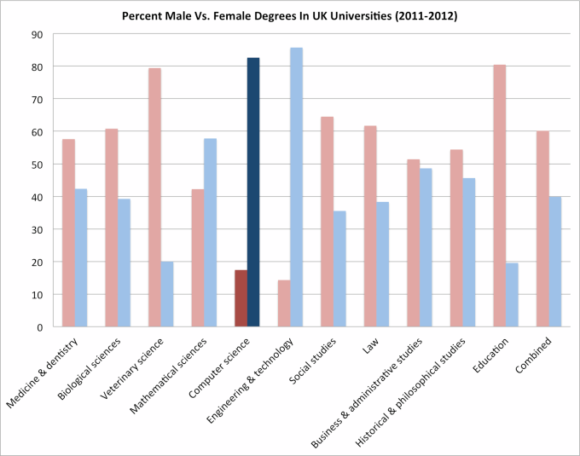
Uneven Gender Population
Source: https://gigaom.com/2014/08/21/eight-charts-that-put-tech-companies-diversity-stats-into-perspective/
Source: http://techcrunch.com/2014/02/21/women-outnumber-men-for-the-first-time-in-berkeleys-intro-to-computer-science-course/

Slide 6
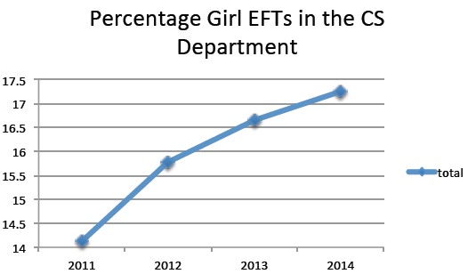
CS in UoA?
Notes:
These are percentages of women in CS courses by year and level, but aggregated across all courses *excluding* 111.
Total number of female students in CS department.

Slide 7
Gender Gap
Selby et al. (1997) state:
Current problems in CS discipline
BUT construct validity?
Peckham et al. (2007) claim:
CS is a male-oriented discipline
Underrepresented groups such as women and non-white population are judged against
No proof?
Notes:
Selby et.al have conducted a study in NZ including staff and students at University of Waikato and students from Hamilton Girls High school.
Gender gap is built due to the following factors:
General lack of knowledge by high school girls about career prospects in computer industry
Incorrect image of CS illustrated
Perceived lack of confidence amongst female students despite their obvious abilities and successes
Lack of women lecturers
Seeing computing as a male domain
Internal validity is not strong because they wanted to measure what works for current Compsci students but instead they ended up finding problems and making recommendations for improvement.
Peckham et al. suggest:
Interdisciplinary studies in problem domains of clear benefit to society, as a path to introduce computer science to a broader range of students. They help circumvent the stereotypical thinking many students have about computer science.
It is very important to take into account the different goals, values and learning styles of the target population of students.

Slide 8
Unlocking the Clubhouse
Study by Margolis and Fisher (2002)
1994-1997
Multiyear project to understand and improve situation of women in CSE
Boys Invent Things, and Girls Use Things Boys Invent
Computing with a Purpose
Can a creative person, a “people person,” care about the world and people and be happy in computer science?
Notes:
At the turn of the century, women are surfing the web in equal proportion to men, and women make up a majority of Internet consumers.
Yet few women are learning how to invent, create, and design computer technology.
Conducted more than 230 interviews with over 100 male and female students over four years at Carnegie Mellon University.
At each step from early childhood through college, computing is both actively claimed as “guy stuff” by boys and men and passively ceded by girls and women.
For most women students, the technical aspects of computing are interesting, but the study of computer science is made meaningful by its connections to
other fields.
Connecting computing to other fields and working within its human and social contexts make the study of computer science compelling and meaningful for them.

Slide 9
Limited Resources
Focus on technicalities in introductory courses
Syntax
Languages
Dull and irrelevant textbook examples
“There isn’t a textbook out of the 60 I have on my shelf that makes me see computing as socially relevant” - Buckley (2009)
Lack of domain knowledge for instructors
Notes:
Technicalities
Quite a big problem
During the first few classes, students should ideally encounter the flood of opportunities to tackle world issues using a combination of programming, algorithmic and problem solving skills.
Course content either challenges the stereotypical myths about the discipline or reconstructs it in an even stronger way.
Goldweber argues about the importance of first day activities for setting the tone for an introductory course.
Textbooks
There is an obsession with games like Tetris, food and animals – according to Buckley et al (2008).
Depicts the lack of context and social relevance
Illustrates a need for customized resources
Guzdial states that developing resources from the scratch is quite challenging, but the results can be shared between institutions.
Domain knowledge
Instructors would need to be aware of interdisciplinary information or get help from other faculties in order to create resources
Possibility of increase pressure and workload for them trying to integrate social aspects into technical concepts.

Slide 10
So What Can Be Done?

Slide 11
Context Computing
Guzdial (2006) discusses development of contextualized computing education at Georgia Institute of Technology
Computing and Science majors
Engineering students (using MATLAB)
Liberal arts/Architecture/Management students (using media computation)
Google’s (2014) study examines what really matters for women who choose Computer Science
Notes:
Context computing refers to relating computing to a familiar context that helps students understand it more effectively. These contexts provide a relationship to the concept being studied with the outer world. They are seen as the surrounding pieces to an individual puzzle piece in order to complete the puzzle.
Guzdial (2006)
Observed success rates above 80% in the MATLAB and media courses, which shows how implementing context-based computing attracted and retained a diverse range of students.
Google (2014) identifies the top four influencing factors for women to choose and stay in the field of CS:
Social encouragement – positive reinforcement of CS pursuits from family and peers
Self perception – an interest in puzzles and problem solving and a belief that those skills can be translated to a successful career
Academic exposure – the availability of and opportunity to participate in CS coursework
Career perception – the familiarity with and perception of CS as a career with diverse applications and a broad potential for positive societal impact
These results are somewhat similar to Papastegiou’s study.

Slide 12
Evolution of Social Relevance
Not a new concept
Schneiderman (1971) argued that CS should include social relevance and implications to the field
Socially Relevant Computing
Buckley (2004, 2008, 2009) discusses this concept in numerous papers
Notes:
Schneiderman
Began a new course ‘Applications’ at State University of New York where students were asked to individually select a project in an application field that they found interesting
Students became deeply involved in their projects and felt that they were working on something that was their own. This caused them to be highly motivated and worked hard.
Students recognized the complexity of the real world as there was no solution to the problems, only ways to help improve the situation.
Socially relevant computing
Buckley et al. suggest that students can see the discipline as a means of using technology to solve problems of personal interest and problems that are significant to communities at large.
Real-life problems are too compound to be solved by an individual, but the desire to make a difference is enough of an encouragement.

Slide 13
Computing for Social Good
CSG-Ed
Goldweber (2013) defines CSG as ““an umbrella term meant to incorporate any educational activity, from small to large, that endeavours to convey and reinforce computing social relevance and potential for positive societal impact”
Radioactive Mice
Red Cross Disaster Relief
Use of Nuclear Power
Water Pollution
Ad hoc emergency Wi-Fi networking
Voting simulation
Notes:
CSG
Computer science can be the vehicle carrying passengers towards a certain, important destination.
Students in medicine work towards finding a cure for cancer or AIDS or other diseases. The CS curriculum needs to inspire such foreseen goals within students that give them a long-term purpose.
A crucial problem is to satisfy students with different goals, values and learning styles. Technical as well as social aspects.
Another problem is the delay in including CSG concepts only later on in the curriculum at some institutions, mainly in third year courses. This doesn’t allow first year entrants to experience the social side to computing.

Slide 14
First Day Activities
Is the discipline reiterating myths or reinventing the image about CS?
Integrating social problems into class activities
Reuniting Families Problem (Goldweber, 2012)
No formal assessment of this study
Notes:
It is important to clarify misconceptions about the field in the first class itself so the students have an unambiguous viewpoint of what the discipline is about, what will be expected of them and how they can have societal impact in the world.
An example where students in groups of 3-4 are asked to think about a natural disaster and devise a protocol for workers to reunite families.
Helps them learn algorithm design, repetition, selection and problem simplification while interacting with the problem at a practical level.

Slide 15
Humanitarian Projects
Capstone course at University of Buffalo (Buckley et al., 2004)
Communications device for David
Child-centered version of communications device (focusing on audio feedback and graphics)
DISCO – choice making environment (using light, music and sound)
Difficulty level?
Student experience?
Large classes?
Notes:
All of these projects resulted in vast changes in the self-perception of students, by participating in the community and being able to help others, they were able to see themselves as good citizens.
Furthermore, students are able to see the work they have done as important and suddenly, developing something and delivering it to a client is not irrelevant and small anymore
Additionally, with a real client being involved in the scenario, students are compelled to understand their requirements and develop a plan and high-level design before they implement anything

Slide 16
Meaningful Assignments
Layman et al. (2007) state that meaningful assignments “seeks to engage the student by appealing to their practical nature and/or their desire to help society”.
Introducing real-world relevance into assignments
Issues
Assignment difficulty level?
Realistic portrayal of social issues?
Notes:
Assignments are quite key in establishing the image of a course since students spend hours on assignments, constructing strong opinions about the course.
Even more important than lectures, some may say?
Ideally, the difficulty level of meaningful assignments should be at the same level as traditional assignments
But simplifying the context may cause the socially relevant problem to become unrealistic
Balance is required between both these measures
Researchers have discussed that integration of CSG can be done without introducing new levels of complexity or extra cognitive load, only with a little creativity

Slide 17
Do CSG-Ed Projects Work?
Limited literature
One study that examines if students are actually interested in socially relevant problems? Rader et al. (2011)
CSG based projects not preferred especially against game-based projects
However, females ranked humanitarian projects positively overall
Interest in socially-relevant projects seemed to be high
Internal validity?
Notes:
Introduced humanitarian projects into CS1 and SE course and surveyed students about their preferences and experience with the projects.
The difference in opinion between genders exists despite getting positive responses from almost all students when surveyed about their interest in socially-beneficial projects:
79% CS1 students responded affirmatively
88% of SE Search and Rescue project students
93% of SE Disaster Management project students.
CS1 students found the nature of open-ended projects being complex to understand
Internal validity:
Lack of female participation

Slide 18
Summary
Image of computing
Attracting and retaining students
Literature Gap

Slide 19
Questions?

