Slide 1
DNS Cache Poisoning Attack Reloaded: Revolutions with Side Channels
Presented by Peirong Zhao

Slide 2
DNS
DNS as a phone book for the entire Internet.
How DNS works?
Record stored in resolver.
Notes:
DNS creates a one-to-one mapping between domain names and ip address. translating domain names that can be understood by humans into IP addresses that can be understood by machines. eliminating the need for users of the Internet to have direct access to IP addresses that are difficult to read and understand.
The DNS resolver stores responses to IP address queries for a certain amount of time. This allows the resolver to respond faster to future queries and eliminates the need to communicate with the many servers involved in a typical DNS resolution process. The DNS resolver saves the response in its cache for as long as the specified time to live (TTL) associated with the IP address, and this time long for NS record could be up to 1 day or longer.
One of attack techniques is to impersonate the IP address of an authoritative domain name server and send a fake response message to the resolver to be stored in the cache, pointing the IP address to their own server. This way, network users who want to access the domain name will go to the wrong IP address and server.

Slide 3

DNS Cache Poisoning
What is DNS Cache Poisoning?
Two ways to defend:
DNSSEC
Source Port Randomization

Slide 4
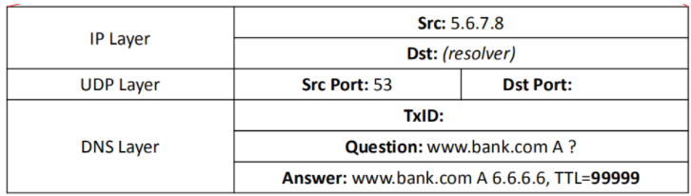
Destination port and Transaction ID are both unknown, if the attacker want to get over this, there are 232232 possibilities in total, which is really hard to achieve.
Notes:
The fake response made from attacker should be like this. Since the Source Port Randomization has been applied to DNS Resolver to help defending.
Destination port and Transaction ID are both unknown, if the attacker want to get over this, there are 232232 possibilities in total, which is really hard to achieve.

Slide 5
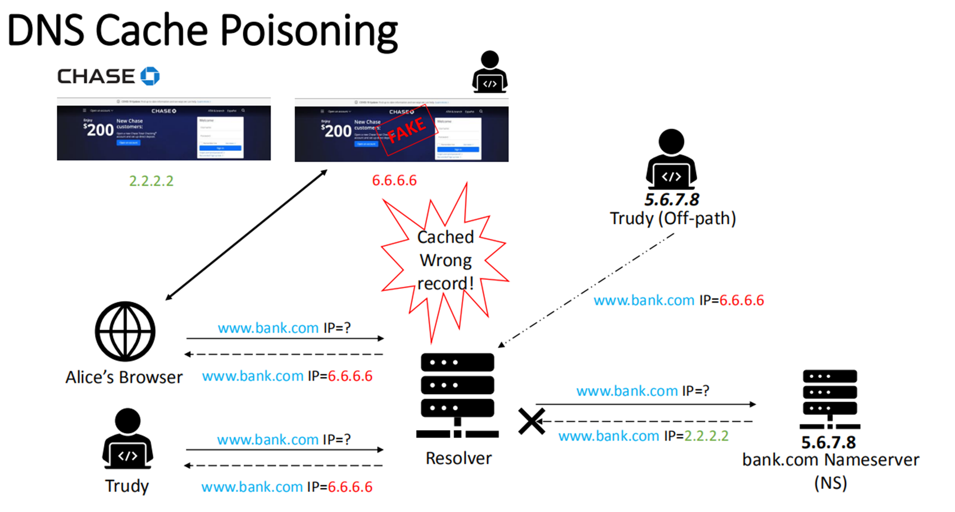

Slide 6
Side Channel DNS Attack —— SAD DNS
Use the network side channels which involve in modern operation system to bring the DNS Cache Poisoning back again.
This attack allows an off-path attacker to infuse fake DNS records into the cache
Make wiretapping and tampering available
Defeats the most effective and commonly used defense - source port randomization
Notes:
SAD DNS attacks allow attackers to redirect any traffic (initially directed to a specific domain) to their own servers and then become man-in-the-middle (MITM) attackers to make wiretapping and tampering available

Slide 7
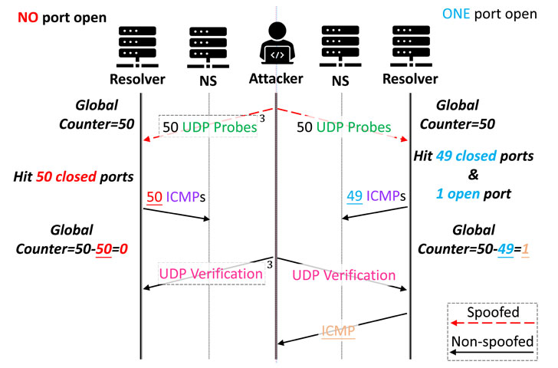
The SAD DNS attack requires a hacked machine in the network, such as a public wireless network in a public place. Side channels in the network stack are then used to scan and discover which ports can be used to initialize DNS queries and subsequently inject a large number of fake DNS responses by exposing the hacked TxID.
Notes:
The paper's team discovered a new flaw, detect the open port first through the ICMP side channel, and then guess the corresponding transaction ID, so that there are only 217 possibilities in total.

Slide 8
SAD DNS attack effects all layers of caches in DNS infrastructure, including the most popular BIND, Unbound, and dnsmasq.
Attack relies on the two fundamental components: (1) inferring source port of a DNS query; (2) extending attack window.
Forwarder attack
Resolver attack
Notes:
such as DNS forwarder and resolver caches, and a wide range of DNS software stacks,

Slide 9
Defenses
In the article's comparative analysis, the author team noted the weakness of all major operating system kernels under the attack, and they successfully scanned out the open ports using 600 milliseconds and injected the rogue records using 200 milliseconds.
Off-path attack: DNSSEC, 0x20 encoding, DNS cookie
Disallow ICMP, best practice in configure RRL

Slide 10
Criticism
Easy to defend
DNSSEC is wide used nowadays

Slide 11
THANK YOU

