Slide 1

DNS Cache Poisoning Attack Reloaded: Revolutions with Side Channels
Seminar and Peer Review

Slide 2
introduction
The Domain Name System convert human-readable web addresses into IP addresses.
Today, DNS hosts many other security-critical applications
DNS also plays a vital role in TLS trust.
Damage to the integrity of DNS records will bring catastrophic security risks.
Fake certificates issued by attackers will affect public key encryption technology.

Slide 3
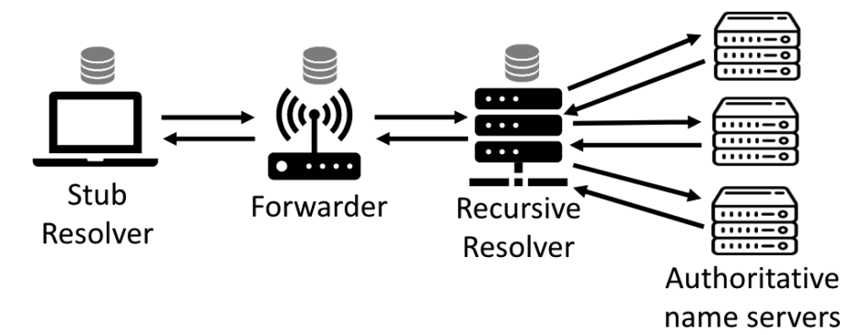
DNS cache poisoning attacks
Modern DNS infrastructures have multiple layers of caching, and client applications often initiate DNS queries to the local operating system stub resolver
The stub resolver does not perform any iterative query but forwards the request to the upper recursive resolver.
DNS forwarders usually exist in Wi-Fi routers and maintain a dedicated DNS cache.
recursive resolver completes the real work of iteratively querying authoritative name servers.
Then the answer is returned and cached in each layer..

Slide 4
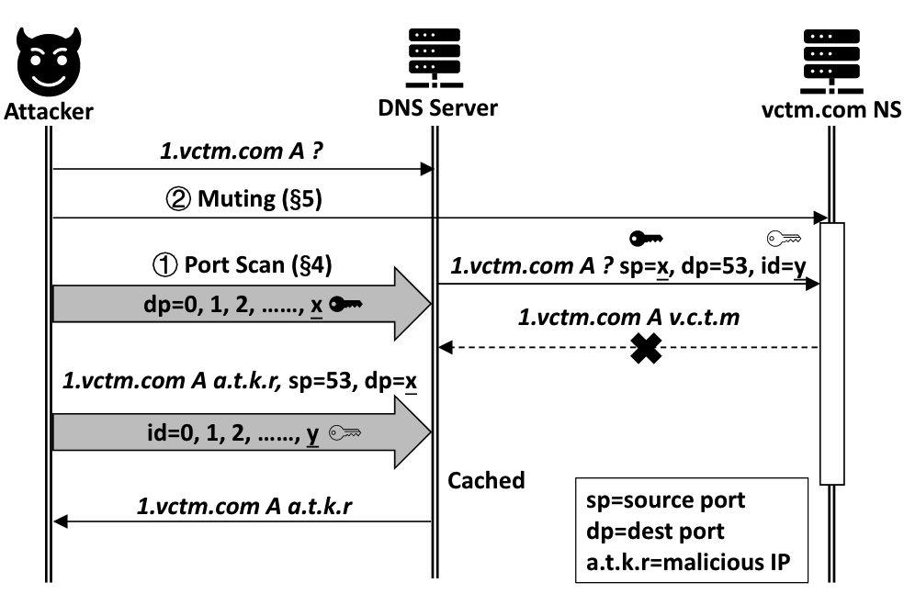
ATTACK OVERVIEW
this attack method always starts from triggering one of them to send a DNS query
Infer the source port: use a new universal side channel in the network stack to scan and discover the source port used to initiate DNS queries.
Expand the attack window: attack takes time to infer the source port and inject malicious DNS replies. extend the attack window to at least a few seconds allowing the actual chance of cache poisoning. Once the source port number is known, attacker can simply intercept many forged DNS replies

Slide 5
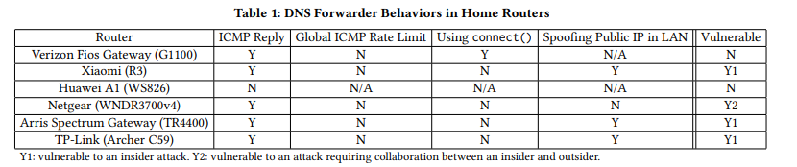
Attack detail 1
INFERRING DNS QUERY’S SOURCE PORT
Analysis of UDP Source Port Scannability:
ICMP Rate Limit Challenge:
Vulnerable DNS Forwarder and Resolver Population

Slide 6
Attack detail 2
EXTENDING THE ATTACK WINDOW
Extending Window in a Forwarder Attack
The attacker first sends the address of his domain to the forwarder, which will eventually trigger the upstream resolver to query the authoritative name server controlled by the attacker.
Extending Window in a Resolver Attack
if the RRL limit is reached, the response is either truncated or discarded.
DNS queries at a rate higher than the configured limit, this feature can be maliciously used to disable the DNS.

Slide 7
Solution and defend method
The proposed attack is basically a non-path attack
Mitigated by additional randomness and cryptographic solutions.
The combined function of DNSSEC and DNS cookie defeat most off-path attacks.
not allow outgoing ICMP replies at all. The cost may be the loss of some network troubleshooting and diagnostic functions.
use RRL to prevent attackers from easily disabling authoritative name servers.
Other simple mitigation strategies include: (1) Set DNSq query timeout. The disadvantage is that more retransmission queries may be introduced, and the overall performance will be worse. (2) Use anycast method.
uses an intrusion detection system (IDS) and an intrusion prevention system (IPS)

Slide 8
criticism
Lack of comparison between Side Channels attacks and traditional DNS Cache Poisoning Attack
Restricted by many factors. Such as Network delay, data encryption.
Cannot have a great impact on most of the DNS
it is very simple to effectively defend against this attack

