Slide 1
To Err.Is Human: Characterising the Threat of Unintended URLs in Social Media
Authored by Beliz Kaleli et al.
Presented today by Denise Jarry

Slide 2
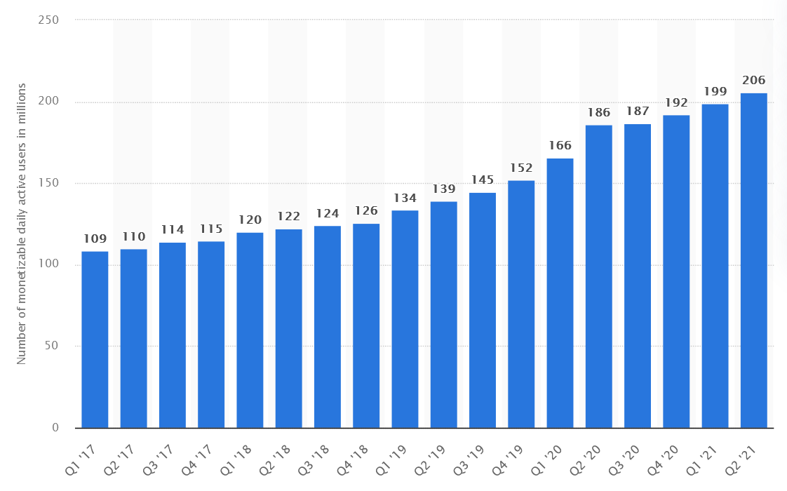
Motivation
Social media platforms are huge and are growing
Ideal target for attackers
This article has found an attack vector with the way clickable links are automatically rendered

Slide 3
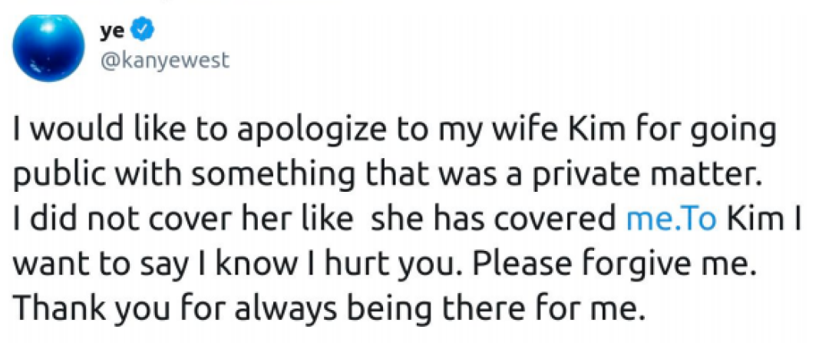
Background
Top Level Domain (TLD)
The last label in a domain name
Some TLDs are valid dictionary words (e.g. it, online)
Clickable link rendering
Automatically identify text that corresponds to a clickable link
On Twitter, last substring needs to be a valid TLD
www.twitter.com
Unintended URLs
According to authors, they are caused by forgetting a space after a full stop: “typo”

Slide 4
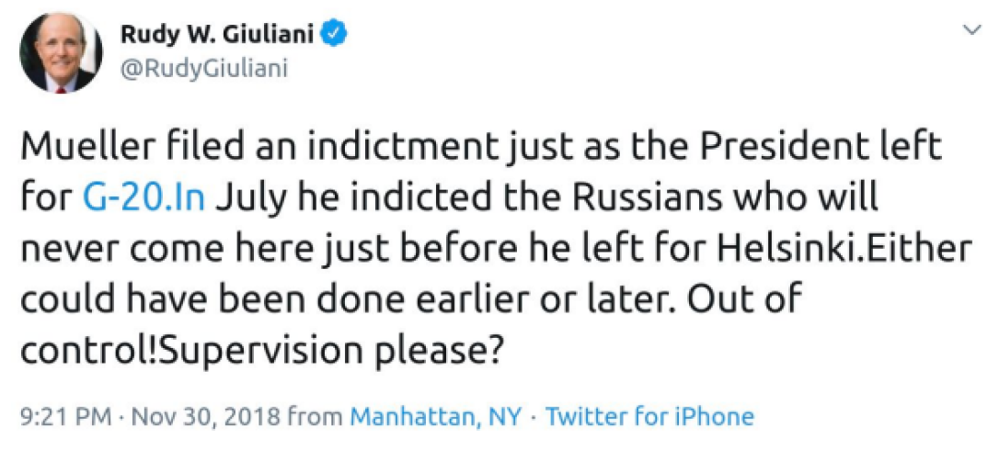
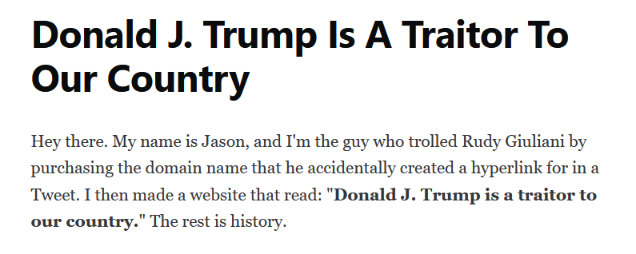
Problem

Slide 5
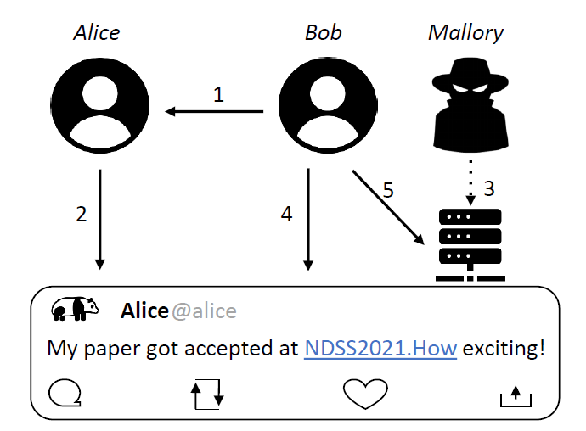
Problem
Bob follows Alice
Alice makes a tweet with a typo – creating an unintended URL
Mallory sees the tweet, registers the domain, populates with malicious content
Bob sees the tweet and clicks the link
Bob is exposed to the malicious content
Content could be:
Politically damning (like Rudy Giuliani)
Defamatory or offensive
A phishing site
Bob might trust the content because he thinks it was posted by Alice!

Slide 6
Solution

Slide 7
Solution
Machine Learning Classifier
that can distinguish between intended and unintended URLs
Authors used it to conduct an analysis of the problem
Implemented as a browser extension to warn users when they write a Tweet

Slide 8
Machine Learning Classifier
Labelled
Intended URL
Unlabelled
Unknown tweets with a URL
Classifier
Classification Decision
Unintended URL
Labelled training data
“ground truth dataset”

Slide 9
Machine Learning Classifier
Labelled
Intended URL
Prefiltering Step
Heuristics to bypass classifier
Tweet filtered out if URL:
starts with www
ends with .com or .org
has TLD that is a non-dictionary word
These heuristics immediately identify an intended URL
Unlabelled
Unknown tweets with a URL
Classifier
Classification Decision
Unintended URL
Labelled training data
aka ground truth dataset

Slide 10
Machine Learning Classifier
Classifier
Training Data
Classifier compares features of unlabelled tweet with features in the training data to make a classification decision
Labelled
Intended URL
Unlabelled
Unknown tweets with a URL
Classifier
Classification Decision
How training data was collected:
Sample of tweets from Twitter API
Passed through pre-filtering
Only want to include data relevant to the classification decision
1,068 tweets collected
Authors discussed and come to agreement on labels
644 intended, 424 unintended
Unintended URL
1,068 tweets
Labelled training data
aka ground truth dataset

Slide 11
Machine Learning Classifier
Labelled
Intended URL
Unlabelled
Unknown tweets with a URL
Classifier
Classification Decision
Unintended URL
Labelled training data
aka ground truth dataset
94% Accuracy

Slide 12
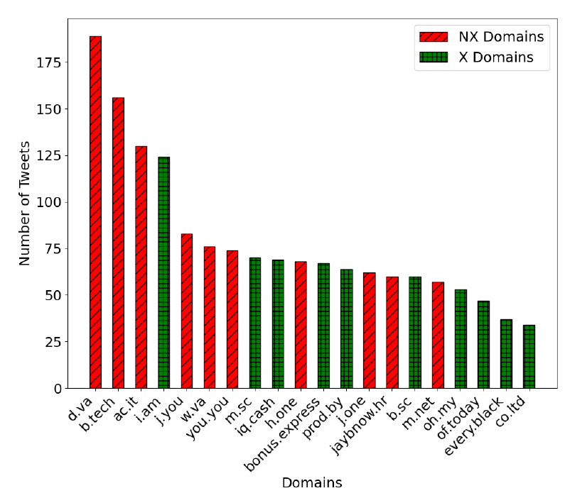
Problem Analysis
Ran for 7 months
Authors used the classifier to analyse tweets as they were posted in real time
Key Findings
26,596 unintended URLs posted on Twitter
Most common domain names: d.va, b.tech
Reasons other than typos
Video game character (d.va)
Instagram handles have full stops
This can create a URL when posted on Twitter
Common acronyms (b.tech)
Not a typo
False positive

Slide 13
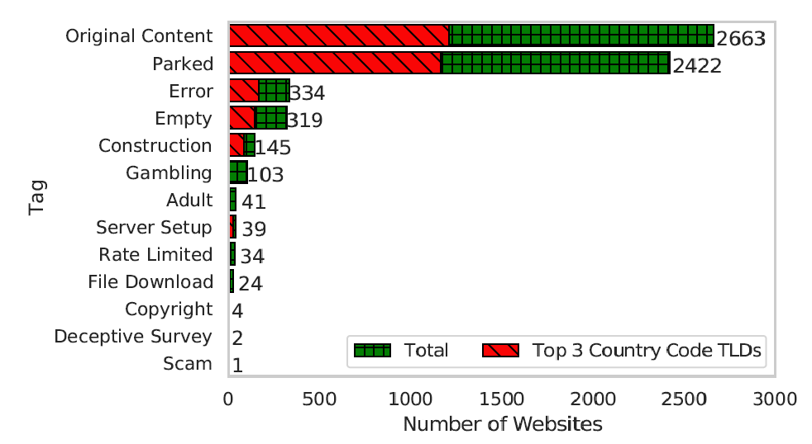
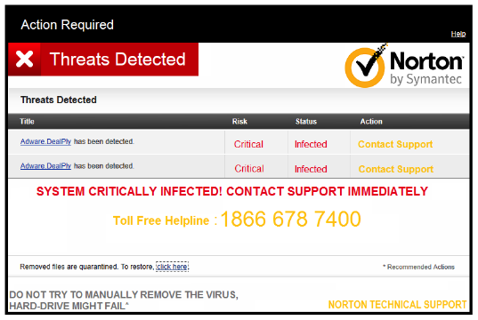
Problem Analysis: URL Content
Crawler looked at the content of the unintended URL websites
Concerning: 39.5% of the URLs they crawled led to domain parking webpages
Previous work has shown that domain parking webpages commonly serve malicious content
Content of unintended URL websites

Slide 14
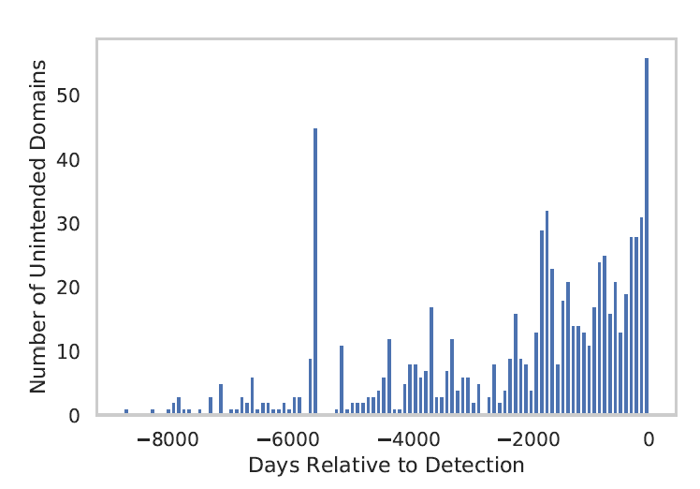
Problem Analysis: URL Registration Date
Registration date of unintended URL domains
Most registered up to 5 years ago
There was no attack here – the poster just accidentally typed a registered domain
Spike in registrations at day 0
Suggests an attack!

Slide 15
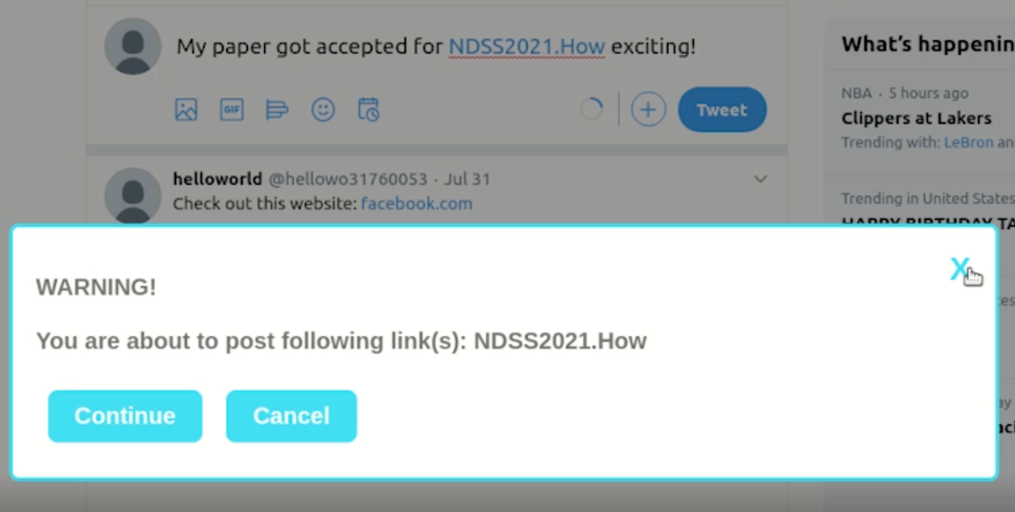
Browser Extension
TypoNoMo Chrome extension
JavaScript Click handler on ‘Tweet’ button
Passes the text through the pre-filtering
Runs the pre-trained classifier
Makes a classification decision
Intended or unintended?
Shows warning message if unintended URL is detected

Slide 16
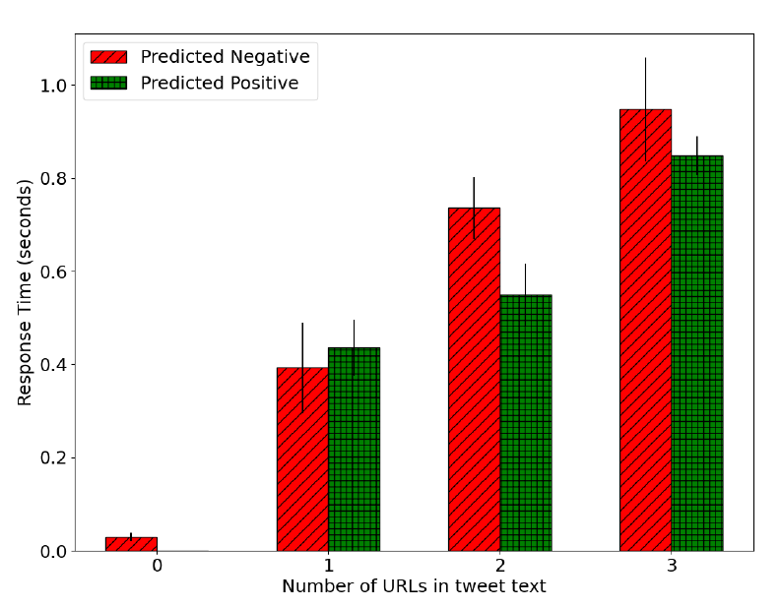
Browser Extension Performance Impact
Multiple scenarios tested
No URLs
1 URL
2 URLs
3 URLs
Worst case scenario
3 URLs = 3 classification tasks
Results in just under 1 second delay
Most users would only rarely see the popup
Authors argue it does not impact UX
They think Twitter should implement it natively

Slide 17
Criticism

Slide 18
Issues
Prefilters URLs with non-dictionary TLDs as intended
What about user misspelling? Text speech?
What about domains like lol, ooo, lgbt, google, fyi, aws
All considered non-dictionary words by the authors
Unintended URL with non-dictionary TLD will immediately get misclassified during the prefiltering step
Only 5 / 20 of the top unintended domains were due to typos
Authors barely acknowledge this
They push forward with the typo detecting classifier solution
d.va – no typo for the user to fix!

Slide 19
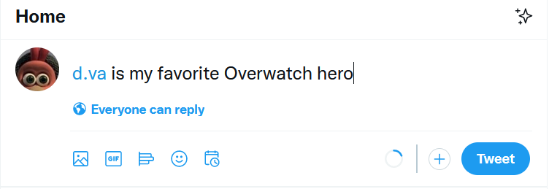
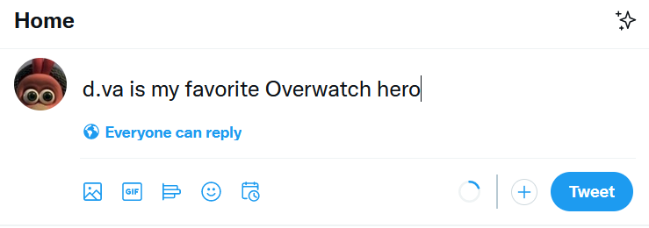
Improvements: Simpler Solution
Simple!
More usable feature that Twitter might actually implement

Slide 20
Improvements: Improve non-dictionary TLD prefiltering step
Consider that humans misspell words and use text speech
Authors need to increase the size of their dictionary
Add TLDs like lol, ooo, lgbt, google, fyi, aws
Dynamic dictionary instead of static .txt file
Detects new text speech or words becoming popular online
Adds them to the dictionary
.txt file used as a dictionary by the browser extension

Slide 21
Thanks for listening

