Slide 1
Examining Mirai’s Battle over the Internet of Things
04/10/2021
Louis Wang
COMPSCI726
Seminar
Harm Griffioen & Christian Doerr from University of Potsdam

Slide 2
01
Introduction
02
Solution
Contents
03
Criticism
04
Limitation & mitigation

Slide 3
Introduction
/01
Motivation
Background knowledge
Problem

Slide 4
Introduction
More IoT devices exposed to the Internet
Easily breached and exploited without strong security policies
The emergence of Mirai botnet changed the Internet threat landscape.
Mirai has compromised thousands of IoT devices
Can be used as nodes to launch massive DDoS attacks

Slide 5
Motivation
Increased awareness and security will reduce the likelihood of being attacked.
Botmasters can only grow their botnets by destroying control of existing devices.
The need to examine the battle for these vulnerable IoT devices between Mirai and its variants.

Slide 6
Background Knowledge
What is Mirai and How it works:
Self-propagating: A malicious program that replicates itself by finding, attacking and infecting vulnerable IoT devices (worm).
Botnet: the infected devices are controlled via a central set of command and control (C&C) servers.
Made of two key components:
Replication module
Attack module

Slide 7
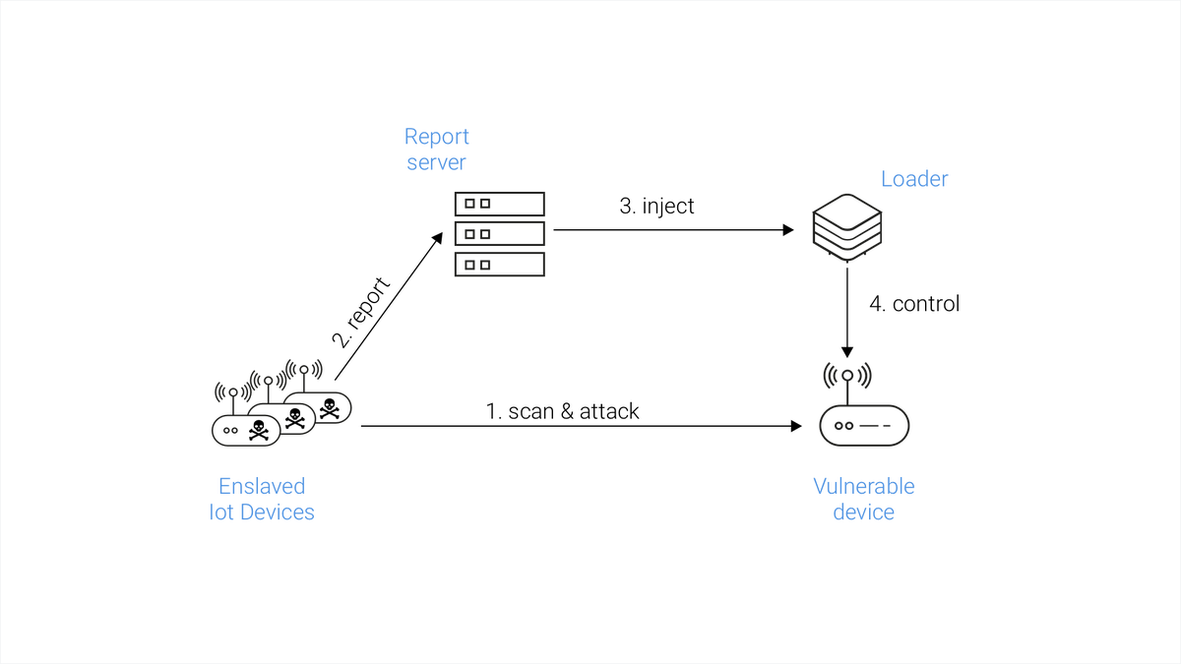
The replication module

Slide 8
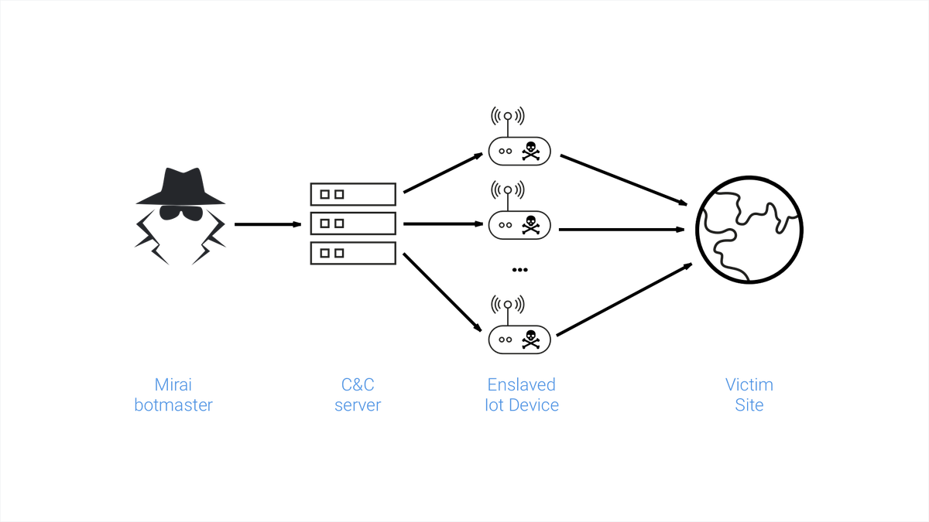
The attack module

Slide 9
Background Knowledge
Variants
The source code published
Experimented and clone created
The fight for control
Actor-specific modifications

Slide 10
Problem
Examine the war between Mirai and its silbings to know the scope of such infections.
How to learn about the lifetime of the infection and reinfection behaviour of IoT devices？

Slide 11
Solution
/02
Core idea
Detailed techniques

Slide 12
Solution
Mirai’s behavior:
Closes the entry point
Start a continuous scan for other devices
A random number generator (RNG) used in this step to choose a random source port in the range of [1024, 65535]
Establishes a connection with the C&C server

Slide 13
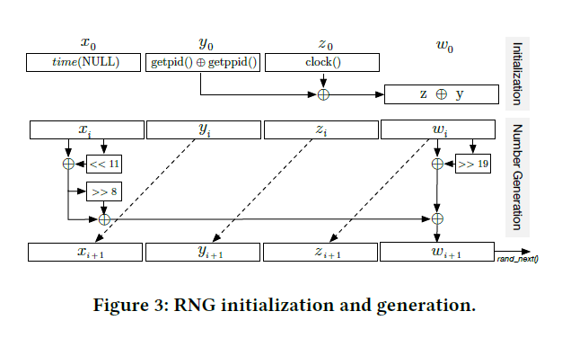
Core idea
Based on one core feature:
random number generator (RNG)
used in the Target Selection and Randomness Generation phase of the Mirai botnet attack.
The inner workings are depicted in figure below, which shows the state initialization and the generation routine.
This design will cause severe flaws allowing the authors to gather information to learn the precise moment of compromisation, which they use to understand the lifetime of infections.

Slide 14
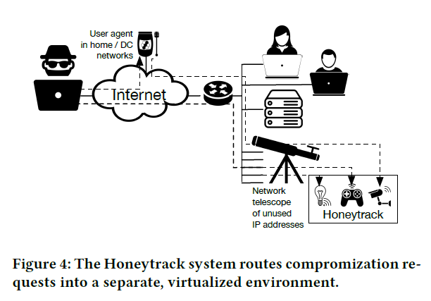
Detailed techniques
Dataset
Telescope
The Honeytrack IoT system
Netflows
Infected devices, RNG analysis
此处为文本占位符示意，文字内容本身无实际意义……
Verification and coverage analysis, blacklisting analysis

Slide 15
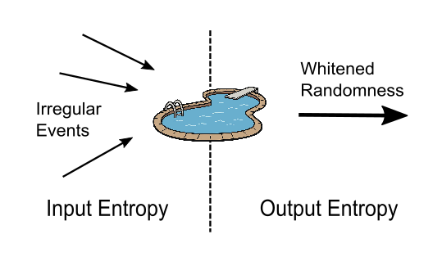
Attacking PRNG
Random numbers and seed
Entropy

Slide 16
Attacking PRNG

Slide 17
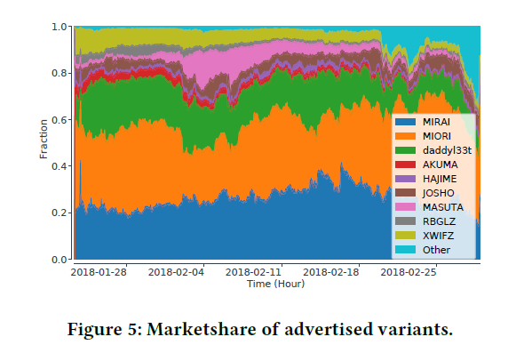
Mirai’s battle over the IoT

Slide 18
Mirai’s battle over the IoT
Compatibility of Malware
Concurrent infections
Infection characteristics
Transitions between botnets

Slide 19
Mirai’s battle over the IoT
01
Regional biases
02
Increasing your market share
03
Watching and learning from your competitors
Customization and Evolution
04
Keeping the net alive
05
Loading infrastructure
06
Honeypot evasion

Slide 20
Criticism
/03

Slide 21
Criticism
01
The structure of the article is slightly confusing
Apr-Jun
02
Lack of explanation of a few basic concepts
Jul-Sep
03
No feasible mitigation measures have been proposed
Oct-Des
04
Lack of vision of future state

Slide 22
Limitation and mitigation
/04

Slide 23
Limitation and mitigation methods
Eliminate default credentials
Blacklist mechanism
The blacklisting mechanism that exists in Mirai and its variants will affect the discovery of new variants.
Force the use of automatic
update policies
Adopt a rate-limiting policy

Slide 24
Thanks
Louis Wang
04/10/2021

