Slide 1
Alice in WarningLand: A Large-Scale Field Study of Browser Security Warning Effectiveness
Article written by: Devdatta Akhaw, Adrienne Porter Felt
Published in: Proceedings of 22nd USENIX security Syposium
August 14-16. Washington, D.C, USA
Presenter: Mo-Hong Tzou

Slide 2
Summary
Browsers:
  Google Chrome
  Mozilla Firefox
Type of Warnings:
  Malware
  Phishing
  SSL (Secure Socket Layer)
Recorded via in-browser telemetry
  Data collected only consisted of:
    Type of OS the user uses
    Number of times a user sees, click through or leaves a type of warning
    (G.C Only) measure the amount of time spent on warnings
    Does NOT collect users’ personal demographics
    Does NOT record browsing habits

Slide 3
Statistics
25 million warning impressions
No of users:
  Approx 1% of Firefox users opt to share data
  Google chrome warnings on individual clients:
    Malware: 2,148,026
    Phishing: 204,462
    SSL warnings: 4,491,767
Users continued through:
  1/10 of Mozilla Firefox’s malware and phishing warnings
  1/4 of Google Chromes‘ malware and phishing warnings
  1/3 of Mozilla Firefox’s SSL warnings
  70.2% of Google Chromes’ SSL warnings

Slide 4
Results and Observations
Number of clicks?
  Mozilla Firefox requires 3 clicks
  Google Chrome requires one
  However, decided that this was not the cause for the difference
    G.C malware and phishing warning vs M.F malware and phising warnings
    2 clicks vs 1 click result: G.C did not have lower clickthrough rates

Slide 5
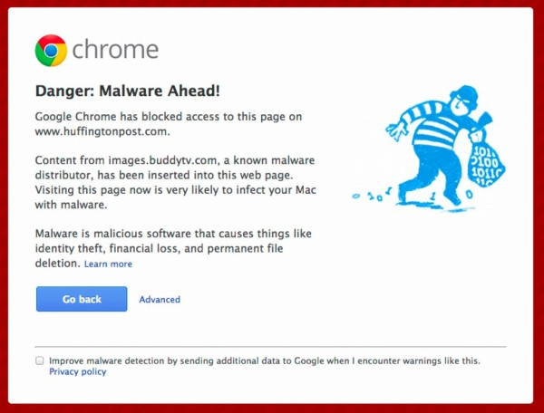
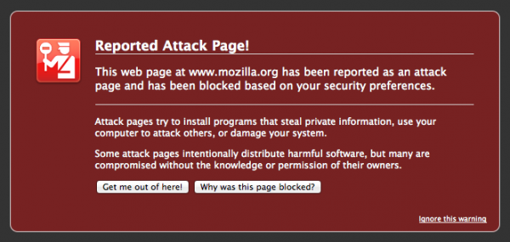
Results and Observations
Warning Appearance
  Decided that it was likely to contribute; not the sole or primary factory (only 10%)

Slide 6
Results and Observations
Remembering Exceptions
  Mozilla Firefox has the ability to remember the exceptions the user has made
Example: User visits two websites, gets SSL warnings. Denies the first and clicks through the 2nd 9 times
  M.F: 50% clickthrough rate (after remembering exception)
  G.C: 90% clickthrough rate (due to no ability to remember exception
Implications:
  Increase in false positives
  Warning fatigue

Slide 7
Results and Observations
Different demographics
Only accounts for a few points
Same demographic applies to malware and phishing warnings

Slide 8
Suggestions and Recommendations
Number of Clicks
  Increasing the amount of clicks is unlikely to effect the users’ decision to move forward
Warning Fatigue
  Limit the number of warnings a user sees
  Introduce a “Remember exception” like in Firefox
“More Information”
  No meaningful impact
  Not many people view this
  Should not hide detail in this section

Slide 9
Conclusion
Security warnings are useful
Not all users are “oblivious”; in fact, many users do read the warnings (for the first few times)
  Example: G.C has different warnings for different errors
  M.F does not
Introduce a “Malware Download Warning”
  For malicious executables
  Only on IE
  Clickthrough rate under 5%

Slide 10
Critical Appreciation: Certificate Pinning
Pinned certificate: preloaded HTTP Strict Transport Security sites
  User CANNOT click through SSL warnings on sites protected by these features
    Covers private data eg. Google, PayPal, Twitter
Google Chrome has a list of pinned certificate
  20% of all Google Chrome SSL warnings are non-bypassable
Mozilla Firefox does not come with many
  1% of Mozilla Firefox SSL warnings are non-bypassable

Slide 11
Critical Appreciation: Certificate Pinning
Mozilla Firefox uses see more warnings (for critical websites)
-> Therefore, clickthrough rate will be lower
Accounts for 15 points of the 37 points gap difference

Slide 12
Critical Appreciation: Certificate Pinning
However, is this right?
G.C displays an SSL message that CAN NOT be clicked through
-> Ergo, this means a 0% clickthrough rate?
Therefore, the 15 points is not accounted for

Slide 13
Question & Questions?
Question: how much information would you want to see on a security warning?
Questions?

