Slide 1
An Empirical Study of Visual Security Cues
to Prevent the SSLstripping Attack
Dongwan Shin and Rodrigo Lopes
In
Proc. 27th Annual Computer Security Applications
Conference, (Orlando, Florida, 2011), ACM, 287-296.
Presented by:
Ilya (Michael) Litvinenko

Slide 2
SSLstripping
a. Type of MITM attack:
2
1
Web
Browser
Web
Server
Attacker
Our user/victim
  b. Semantic attack- targets how humans assign meaning to the content
  User interaction – Authors’ focus
  Attack mechanism: the attacker strips users’ session of its security

Slide 3


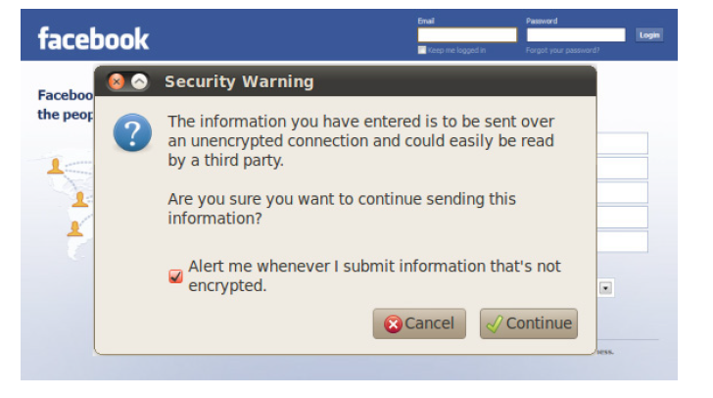
Existing visual cues
1. Lock icon
2. Extended validation certificates
3. Pop up warning windows
(e.g. Mozilla Firefox, Internet
Explorer, Google Chrome)
Authors’ focus for the comparison
with their approach

Slide 4
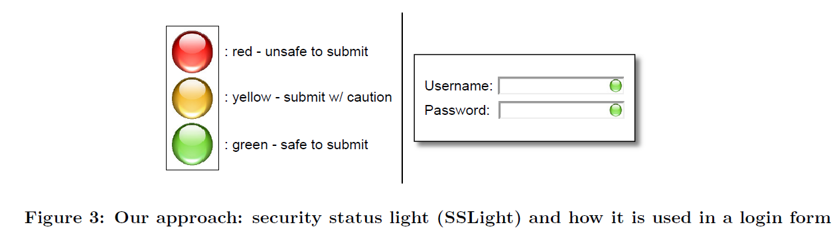
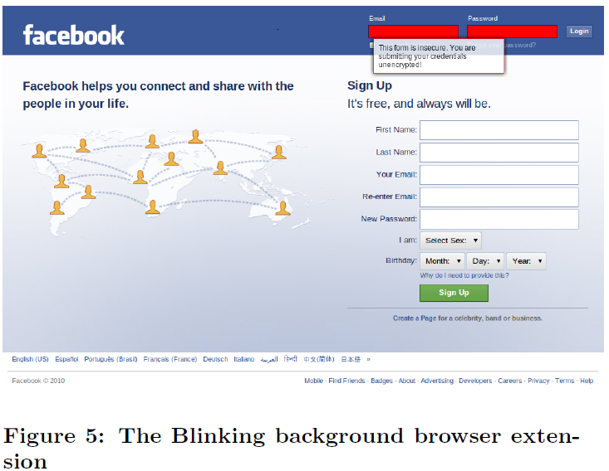
Suggested solution
Security status light (SSLight):
Google Chrome web browser extension
analyzes web page source code and output an evaluation based on the comparison web page’s address and login form’s action data
ads a ‘traffic light’ cue to login form field
The traffic light extension
The Blinking background extension

Slide 5
Experiment design
Purpose – to compare effectiveness of the existing solutions with SSLight
Case study :
100 people divided into 4 groups
Using facebook with SSLstripping injected
In the end users are asked questions about
understanding secure form submissions
The First Hypothesis to prove:
General awareness of secure form submissions
Notes:
I am going to focus on the experiment design because I have a criticism in there
But let me give you the overall experiment design first and then I will criticise

Slide 6
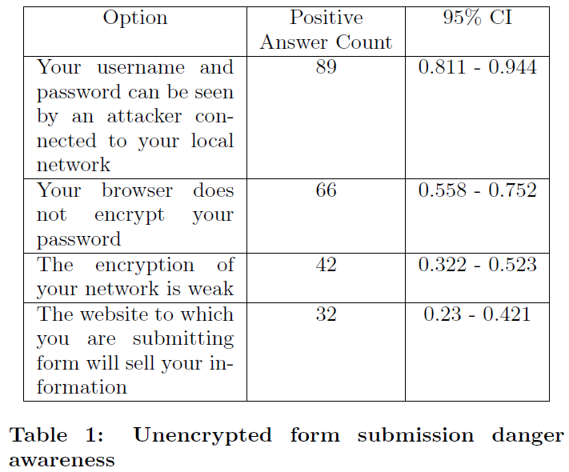
Critique: Hypothesis 1
The Authors state that the user will know the difference between encrypted and unencrypted credential submission when they log in to a website.
Task: Select all options which indicate unencrypted form submissions.
The Authors then state – from these results, our first hypothesis is confirmed, and we can assume that the average user is aware of the dangers of submitting data over the network using forms over plain http.
I think that the difference and awareness of the dangers are two different things.
Hypothesis one is not well supported. That makes me wonder about all their conclusions

Slide 7
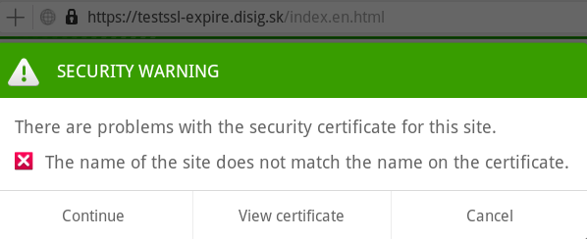
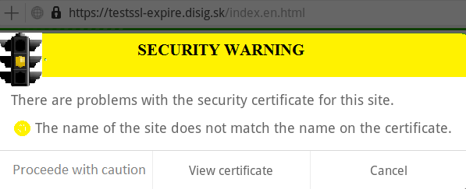
Appreciative comment
The authors say that the traffic light metaphor can be used for making better decisions when submitting the sensitive information.
I think it is a generalizable idea with a broader context which is wider than the submitting of the sensitive information.
For example we could use that idea in security warning messages of the web browsers.
Example of SSL certificate warning for Dolphin web browser
Suggested example using traffic light metaphor
Notes:
7

Slide 8
A question.
Considering that SSLight solution partially helps to prevent MITM attack and can be compromised,
is it better to have it? Will it give user a false assurance ?

