Slide 1
OpenID and the Enterprise:
A Model-based Analysis of
Single Sign-On Authentication
By Jacob Bellamy-McIntyre, Christof Luterroth ,Gerald Weber
In the proceedings of the 2011 15th IEEE International Enterprise Distributed Object Computing Conference
Pages 129-138

Slide 2
Summary Of the Paper
This paper presents:
“General modeling approaches for SSO”
“Model based analysis principles”
“Findings about OpenID security problems”

Slide 3
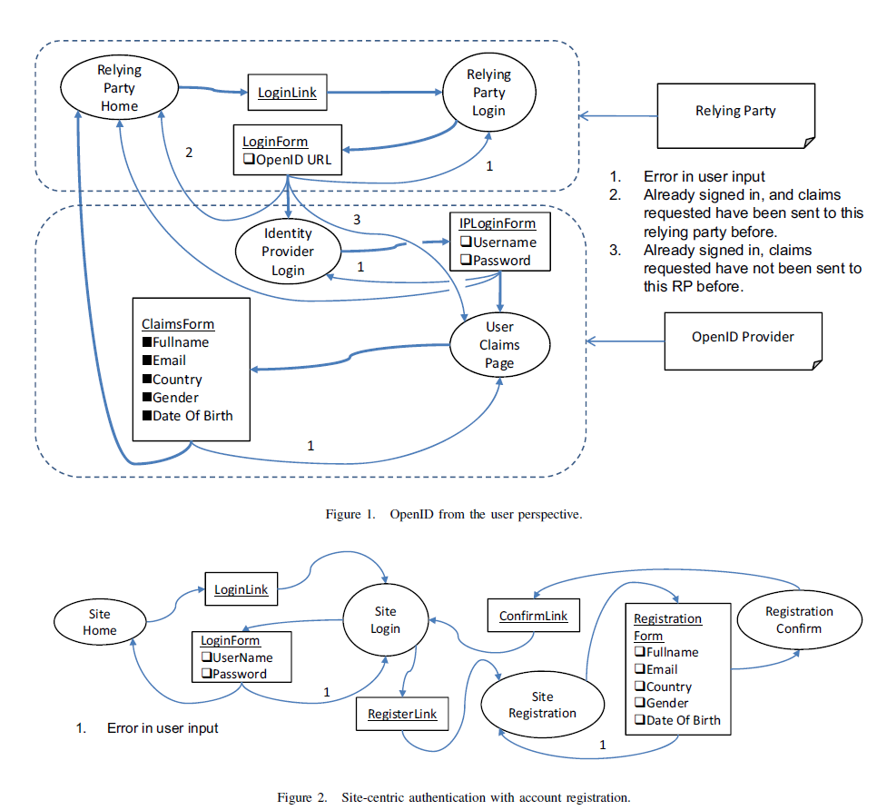
Positives Of the Paper (1)
User Perspective Models
Contrasts between SSO and SCA.
Shows and abstracts user perspective and paths.
Bring to light security risks.

Slide 4
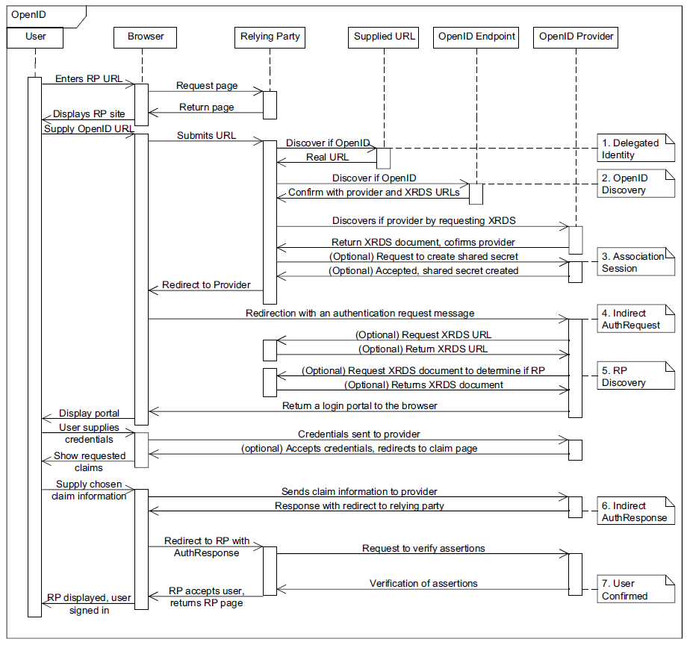
Positives Of the Paper (2)
System Perspective Model
Shows internal workings of the system.
Highlights possible ambiguities within the protocol.
Highlights security risks.

Slide 5
Criticisms of the Paper
A criticism of the paper I found was:
  A small sample size for an experiment done on the vulnerabilities of current Relay Parties.
  The subsequent conclusion derived from the experiment is therefore unjustified.

Slide 6
Question
What are the advantages and disadvantages of using a centralized SSO (with a pre-existing authentication agreement) vs. a decentralized SSO (without a pre-existing authentication agreement)? And what considerations should an Enterprise take when choosing to employ either of the protocols?

Slide 7



