Slide 1

A review of Your Phone is My Proxy: Detecting and Understanding Mobile Proxy Networks
Paper By Mi Xianghang, Siyuan Tang, Zhengyi Li, Xiaojing Liao, Feng Qian, and XiaoFeng Wang
Presented by Dennis Xu

Slide 2
Contents of this Seminar
Pages 3: Motivation for this paper
Pages 4: Contributions of the paper
Pages 5-6: Background knowledge
Pages 7-13: Measurement infrastructure for mobile proxy (solution)
Pages 14-15: Findings of the paper
Pages 16-18: Mitigations for stakeholders
Pages19-20: Conclusion

Slide 3
The motivation for this paper
There is a rising proxy service called Residential proxy service that has been gaining popularity where it provides a infrastructure where customers’ network is relayed through millions of other residential IP proxies.
Different from VPNs where they are deployed in a data center, residential proxies can on an address or cellular networks.
These proxies can be anything that connects to the internet.
There are quite a lot of mobile proxy peers in this service. This can pose a major security concern for the users.
However, there has been little effort to explore the extent of the involvement of the mobiles in the proxy network. The privacy and security of the end user and phone is also a source for concern.

Slide 4

Contributions of the paper
This is the first in-depth study on the topic of mobile devices as proxy peers. This is an app monetization method with little public details.
The techniques used for the identification of mobile SDKs and android proxy apps as well as profiling their behavior and analyzing their traffic relay are quite novel. The techniques can be integrated into a system for detection of android proxy apps and address their potential security concerns
The findings of this paper are quite novel, and they bring to attention the security and privacy concerns of mobile proxy ecosystem.

Slide 5
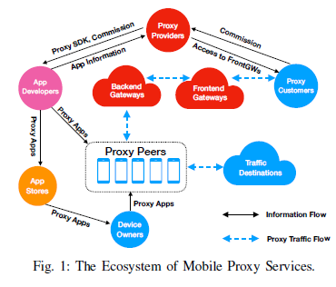
Background knowledge (1)
The ecosystem of mobile proxy service is a residential proxy network that is built on mobile SDKs and mobile apps.
The services proxy providers give is a subscription that allows their customers to relay traffic through proxy networks using mobile devices as an exit node.
Mobile proxy providers build up their network through two unique channels. One is to distribute their own self-created mobile app. The other is to provide a proxy SDK on popular OS to monetize 3rd party apps.

Slide 6
Background knowledge (2)
App developers can interact with the proxy provider to integrate the proxy SDK into their app for revenue.
The revenue was 300$ for 10K users every month back in June 2019. but since September 2019 the price has gone up to 500$ for 10K users every month.
However, note that once the proxy SDK is integrated, the developer have no control over the traffic relay amount or behavior
For the proxy app to work, users must agree with their privacy terms. However, users usually do not know that the app will be relaying traffic, and even if they do know, they have no control over the amount, what, and when the traffic relay happens

Slide 7
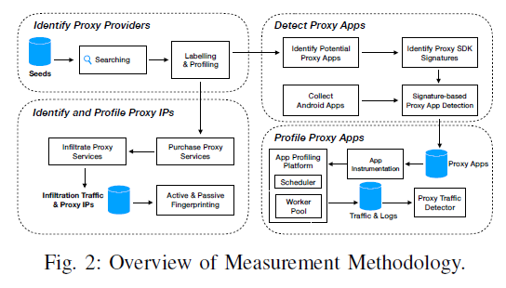
Measurement infrastructure
The measurement infrastructure that is shown by the paper has a total of four components
It will first search for any previously unknown proxy provider, from a single or multiple seeds.
Then it will identify the proxy IPs from the providers.
Other than the identification, it will also detect the proxy apps with high confidence
Lastly it profiles the detected proxy apps using a set of techniques that give high confidence.
We will also be discussing the limitations of this measurement infrastructure.

Slide 8
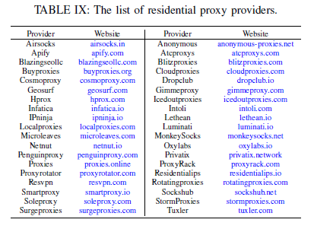

Measurement infrastructure Finding unknown proxy providers
The study used a previous studies already identified residential proxy provider as a seed.
From there, they recursively collected search results from “similar website lookup services” until there were no new finds
Total of 38 proxy providers were collected.
Four of them supported mobile proxy services (Oxylabs, Luminati, MonkeySocks, and IPninja)

Slide 9
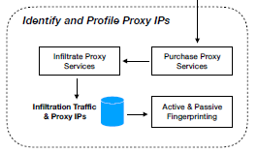
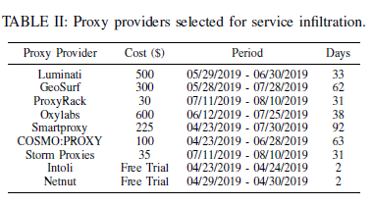
Measurement infrastructure Identifying proxy IPs
From the previous step of finding 38 proxy providers, 9 were selected due to their scale or because they had mobile proxy SDKs
The study had paid for a subscription for 7 providers with the other 2 being free trials
This step is to infiltrate a proxy service provider and try to extract IP address and fingerprinting all the other proxy peers it is relaying traffic information to and from.
The device/OS was also fingerprinted as well.
A method called traffic milking was used, where controlled web clients would send infiltration probes through proxy network to another controlled web server.

Slide 10
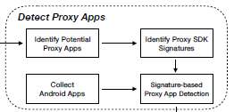
Measurement infrastructure Detecting proxy apps
This step is for the detection of the programs of proxy apps.
There is an assumption that proxy peers need to communicate with a proxy gateway to relay traffic.
This is a two-step process.
We first need to find IP addresses associated with the proxy providers. After which, they then search for the apps/programs which are either embedding their payload the gateway address of the provider or it communicates with the provider directly.
After we have a confirmation between the linked apps discovered to collect the proxy SDK signatures as fingerprints.
We then use the discovered signatures and compare them with a randomly sampled APK group of 2M from 1.3M apps from Androzoo.
The precision of the detector is verified to be correct in identifying which APKs were proxy apps which was 1,387 APKs.

Slide 11
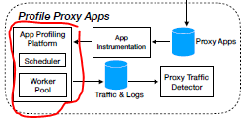
Measurement infrastructure Profiling (1) proxy apps
In this step, there is a toolchain introduced for three scenarios
Scenario 1: This can help manual confirmation of linked programs identified in previous step to indeed be proxy apps.
Scenario 2: It will also support dynamical verification of detected proxy APKs by observing their relaying behaviors and traffic.
Scenario 3: The toolchain will also help setup control experiments to understand if the proxy SDKs can adjust their relay to system environments
For the second scenario of the toolchain, there was the implementation of a MITM accessing the TLS-secured for the sake of control plane communication.
There is also an app profiling platform that supports the toolchain consisting of scheduler and workers
They will run the app APK inside an emulator and record and see if there are any differences when the system environment changes

Slide 12
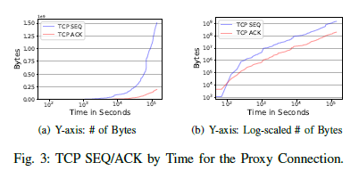
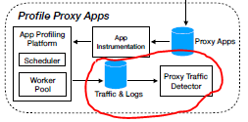

Measurement infrastructure Profiling (2) traffic detector
The detector in this step must be able to separate the background traffic from the relaying traffic.
After which is a two-step process.
We need to first identify the network traffic (proxy connection) between the proxy network, then the second step, find the communications (relayed traffic) between destination and proxy peer.
We separate the background and relay traffic by running several android emulators, one without the proxy app, and the others each with a different proxy app from the same provider. By using differential analysis, we can separate the non-proxy connection out from the proxy connection.
To capture proxy connections, we needed three metrics: the gap in the bytes between TCP SEQ and TCP ACK (ConnGap), the gap ratio between TCP SEQ and TCP ACK (ConnGapRatio), and the connection lifetime in seconds (ConnLifetime). With the thresholds ConnGap >= 1MB, ConnGapRatio>= 6, ConnLifetime>= 1,000sec
To capture relayed connections, two metrics are needed: relayedTiming being the timing gap between the handshake of a connection and the last packet received from a proxy connection and RelayedTrafficGapRatio is the amount of proxy traffic minus the relayed traffic as a percentage of relayed traffic. With the thresholds relayedTiming <= 0.05secs and RelayedTrafficGapRatio <= 7%

Slide 13
Measurement infrastructure Limitations
The way of identification for proxy service providers is not the best, as it may miss out on dark web proxy service providers
The proxy app detector is dependent on the robustness of the proxy SDK signature. For every new SDK on the market, a new signature must be added to the library to detect them again.
This current infrastructure can only target Android.
The proxy app traffic detector was run in an emulator environment. They may not achieve the same results in a real-world environment due to the different amount of traffic.
For any ethical concerns, the study has submitted IRB applications and has gotten approval.

Slide 14
Findings (1) Analysis of the mobile proxy program
These are the findings made through measuring the maliciousness of proxy programs and through the reverse engineering of proxy SDKs
Finding I: Proxy apps have hundreds of millions of installs in total, but many have been unpublished from Google Play, likely due to violation of Google Play’s developer policy.
Finding II: Malicious mobile apps are abusing the proxy ecosystem to monetize their user base while integrating proxy SDKs can damage the reputation of benign mobile apps.
Finding III: Proxy SDKs deploy various tricks to keep relaying traffic in the background without users’ notice.
Finding IV: Proxy SDKs’ user consents are ambiguous as most users cannot capture the intention of relaying traffic.
Finding V: Most users are not willing to relay traffic through their devices, not to mention using cellular data.
Finding VI: Proxy SDKs consume a non-negligible amount of cellular data, and it is out of device owners’ control.

Slide 15
Findings (2) Analysis of the mobile proxy traffic
By analyzing the identified proxy apps, and by taking a closer look at the relaying protocol and traffic, here are some findings:
Finding VII: Suspicious advertisement frauds contribute most to relaying traffic, followed by search engines, traveling, shopping, social networks, and email services.
Finding VIII: Proxy SDK X has been integrated into multiple apps and stealthily relays network traffic without any user consent.
Finding IX: Many cellular proxies and IPv6 proxies are observed in our infiltration.
Finding X: Cellular proxies are highly evasive and only a negligible portion are alarmed by VirusTotal.

Slide 16
Mitigations for stakeholders
The study had uncovered some security and privacy concerns for users because of mobile proxy network.
At the time of study, there was no current industry-wide guideline for a trusted mobile proxy network.
There are three stakeholders in this case: App developers, App marketplace and proxy service providers.
Next are some suggestions for guidelines for the stakeholders.

Slide 17
Mitigations for proxy providers
Three suggestions were made.
First is allowing the proxy SDK to be configurable for both app developers and end users. They can fine tune what data is collected and the traffic relay policy. User consent should also be clear and unambiguous with considerations for non-experts.
Second is a strict vetting of proxy app candidates should be implemented. As if a malicious app serves as a proxy peer, the ecosystem can be used for malicious activity
Last is a deployment of a watcher of traffic data being relayed between proxy peers. Checking for any malicious traffic.

Slide 18
Mitigations for App developers and App Store
For the App developers, the suggestion was simply that they should scrutinize a proxy SDK before the integration of it into their app. This is especially important for the user data access and traffic relaying policies and user consent.
For the App store, the idea was the implementation of a proxy SDK detection service in their app vetting procedure. This can help to protect users against a potential collusion between app developers and proxy service providers.

Slide 19
Conclusion (1)
There is a mobile proxy ecosystem that is built upon mobile proxy SDKs as well as mobile proxy apps.
In this new ecosystem, normal users’ phones can become a proxy peer that can relay unknown or malicious traffic
In the study, the development of a measurement infrastructure for detecting Android proxy apps has quite the novel approach to detecting Android proxy apps.
There were four discovered proxy providers that are offering mobile proxy SDKs as a monetization channel (Luminati now called bright data, MonkeySocks, Oxylabs, Ipninja has no movement since 2019).

Slide 20
Conclusion (2)
The SDKs were integrated into 963 android apps with a monthly payment of $50K per 1Mill MAU (monthly active users)
48.43% proxy APKs were flagged by 5 anti-virus engines as malicious. (adware, PUP, trojan, clickers, virus)
User study shows that user consent texts are ambiguous as users can't tell the intention of using their device to relay traffic
There was a fifth proxy SDK that relayed traffic without showing any notifications. The traffic was mostly ad frauds as well.
The stakeholders in this space should take actions to address the security concerns

Slide 21
Thank you for listening. Questions?

