Slide 1
Mobile App Squatting
Name matters！
Louis Wang
COMPSCI 702 Seminar

Slide 2

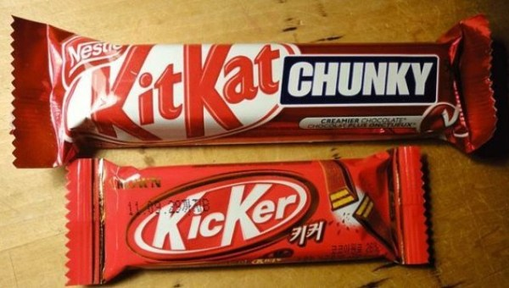
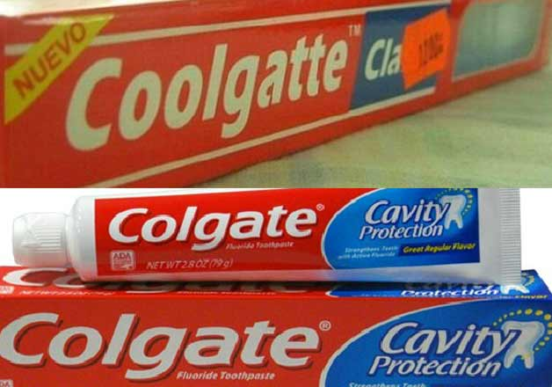
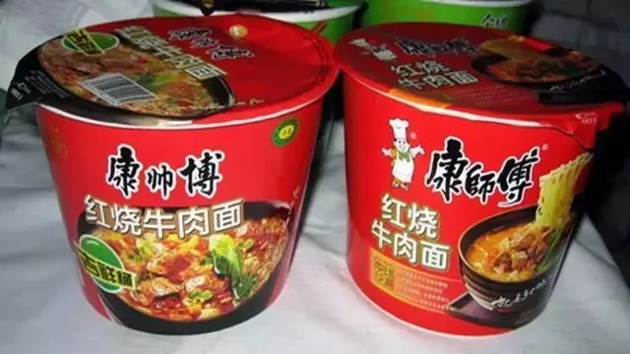
Fake brand names

Slide 3
Introduction
/01
What exactly is App Squatting? From Domain Squatting onwards.

Slide 4
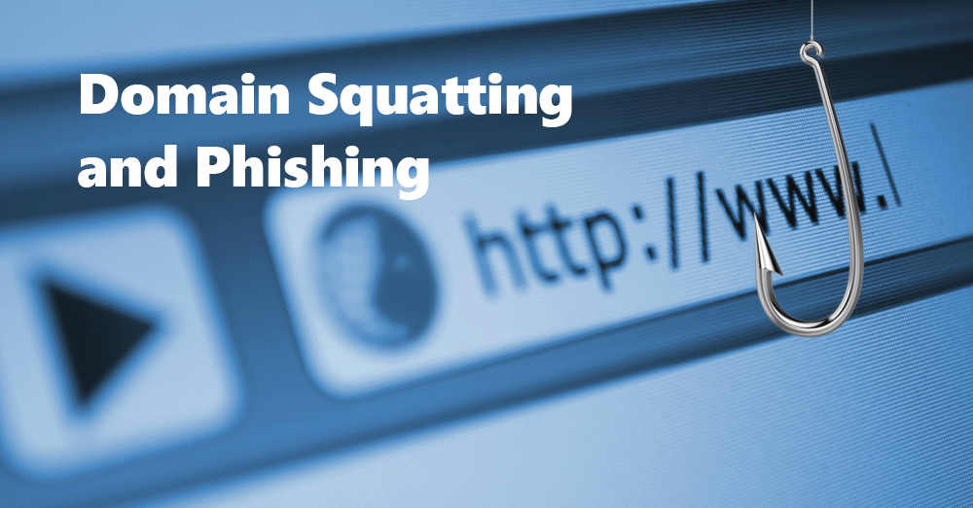
Domain Squatting

Slide 5
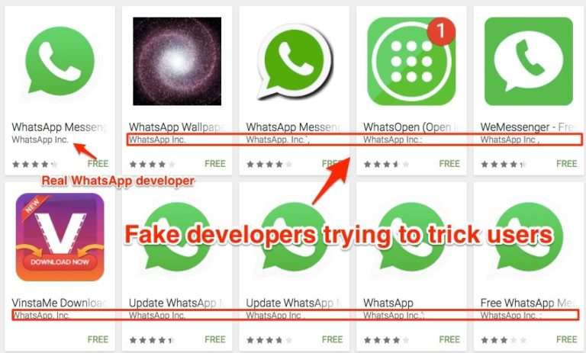
Fake apps already appear in the store

Slide 6
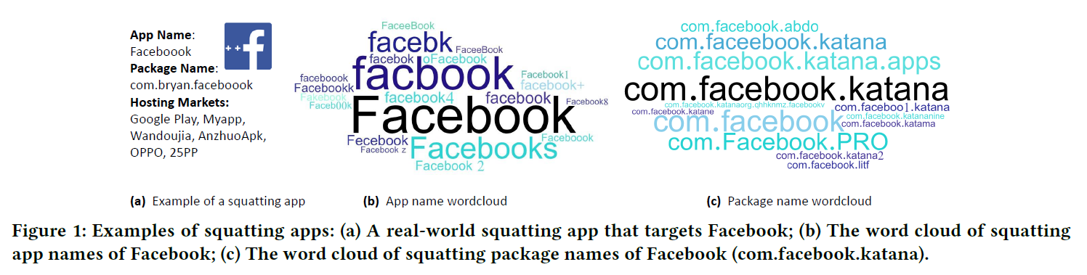
Example of squatting apps

Slide 7
Achievements
The first comprehensive study of App Squatting attacks
Designed AppCrazy
Generated 224,332 potential squatting names for 426 apps
Discovered 10,553 squatting apps
Totally up to over 10 million downloads

Slide 8
Squatting Generation Models
/02
To know how these fake names generated.

Slide 9
Squatting Generation Models
How these fake names generated
If they take 36 characters (26 letters and 10 numbers) as substitutes, then a 5-letter word will generate thousands of deformed words.
URLCrazy
Own Models
Low Accuracy
Low Recall
Mutation-based squatting
Combosquatting
Generates many types of name variations that are never matched
Ignores common patterns in app naming
Based on either typographical errors or abusing the pronunciation similarity of different words
Rely on the combination of recognizable brand names with other keywords (as originally proposed in)

Slide 10
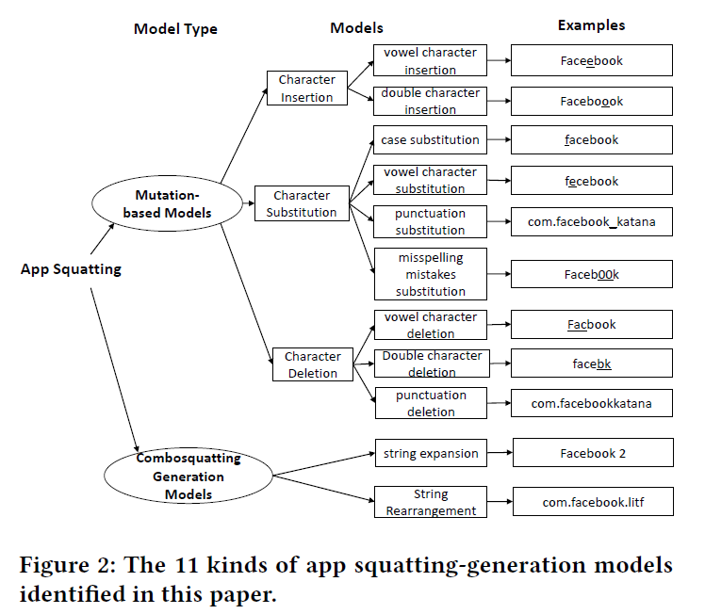
Squatting Generation Models

Slide 11
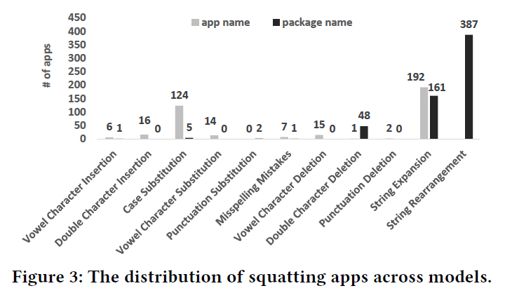
Squatting Generation Models

Slide 12
Advantages of AppCrazy
Model Efficiency
Keyword Efficiency
All of the 11 generation models are effective
Out of 1,442 deformed strings generated by AppCrazy, 46 strings are effective in discovering squatting apps
The number of identified squatting apps
Could identify 946 squatting apps

Slide 13
Research Questions
/03
Perform a large-scale measurement of app squatting abuse in the wild

Slide 14
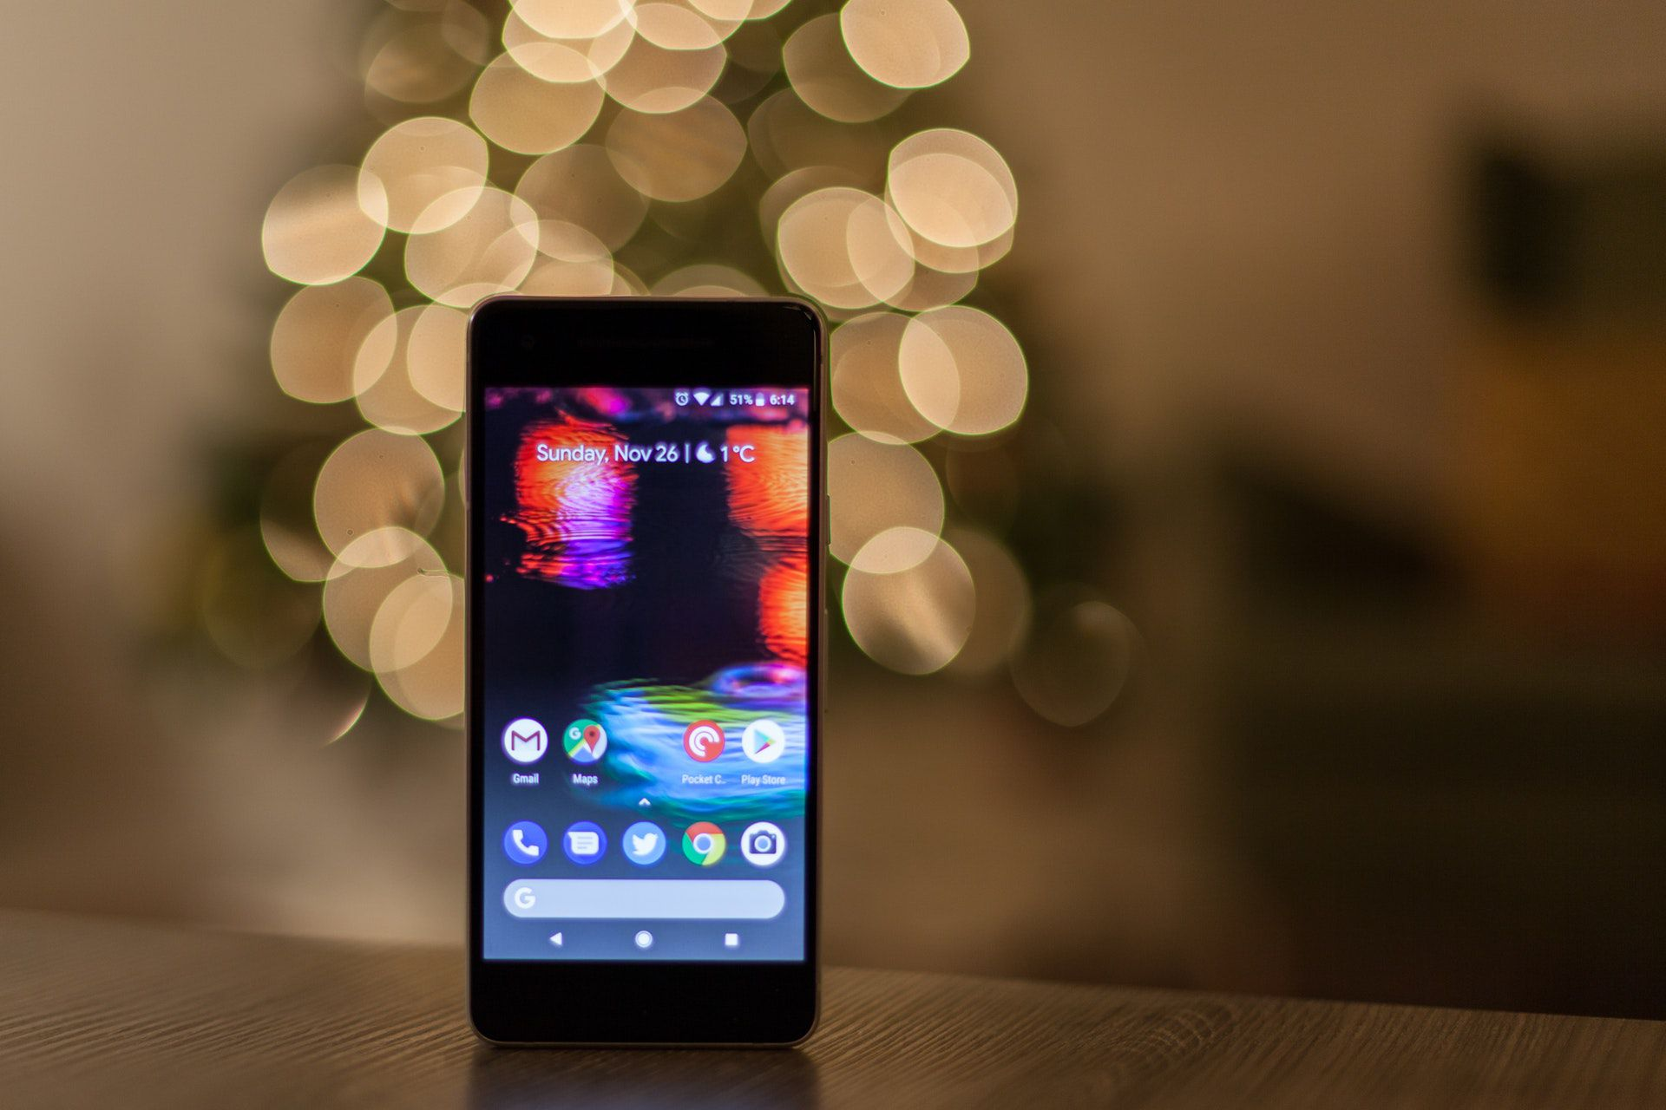
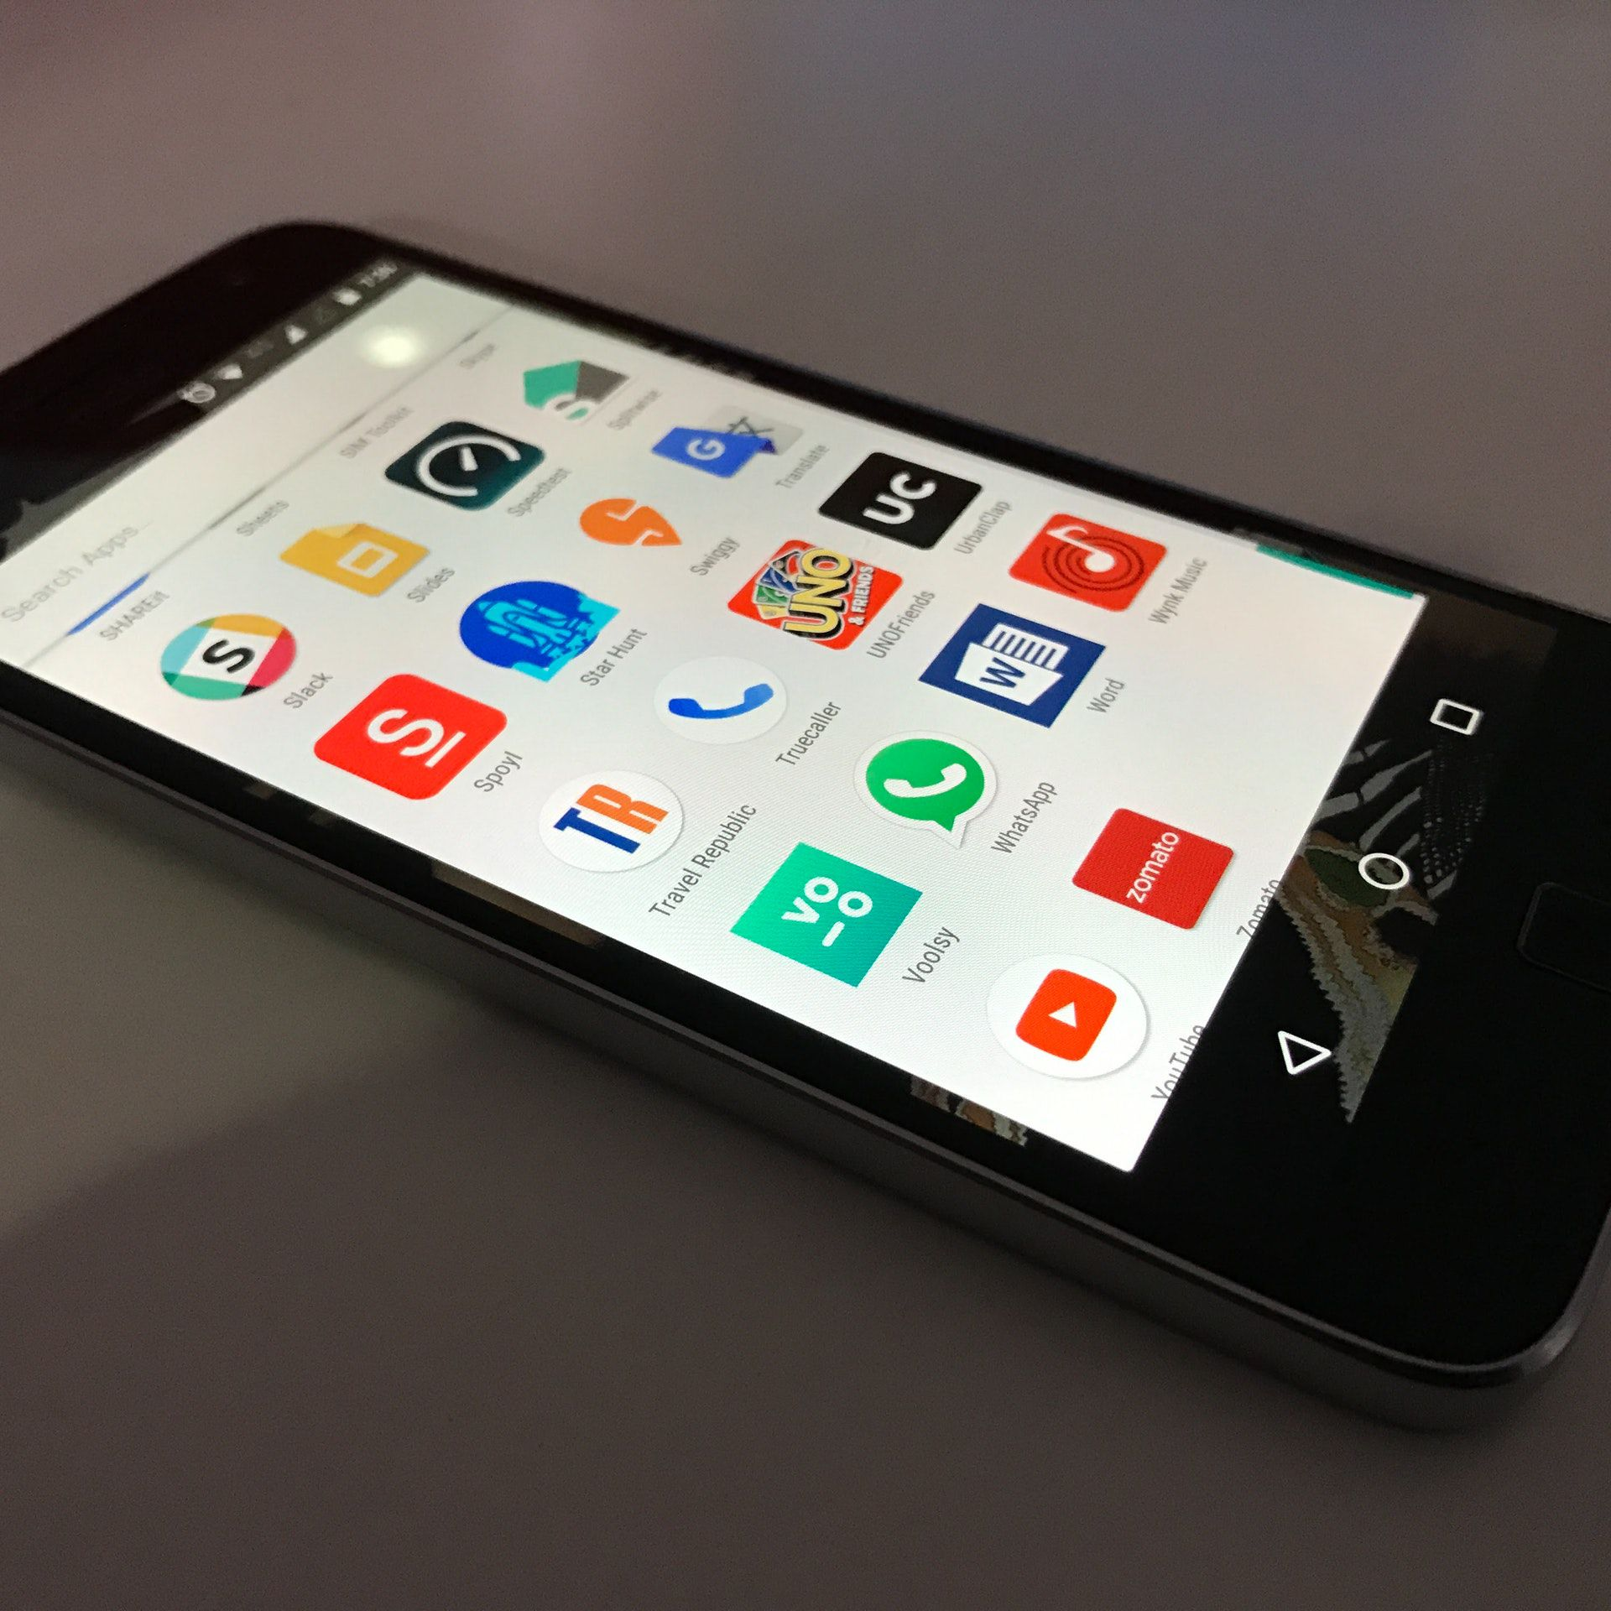

Measuring Squatting Apps
RQ1: Distribution of Squatting Apps
RQ2: App squatting vs. App Popularity
RQ3: Malware Presence

Slide 15
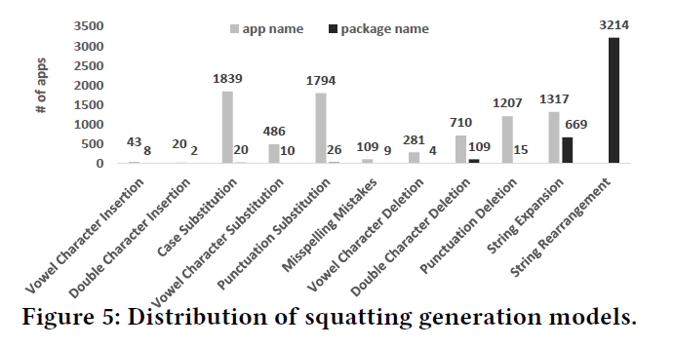
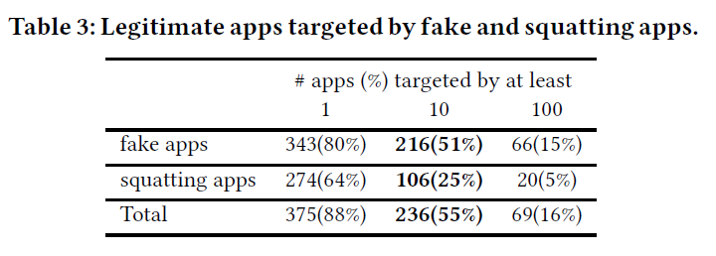
Distribution of Squatting Apps
Fake vs. Squatting
Most Popular Squatting Patterns

Slide 16
Measuring Squatting Apps
RQ1: Distribution of Squatting Apps
RQ2: App squatting vs. App Popularity
RQ3: Malware Presence

Slide 17
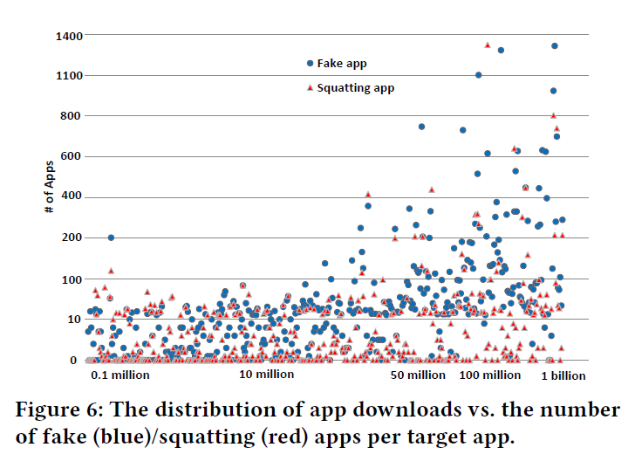
App squatting vs. App Popularity

Slide 18
Measuring Squatting Apps
RQ1: Distribution of Squatting Apps
RQ2: App squatting vs. App Popularity
RQ3: Malware Presence

Slide 19
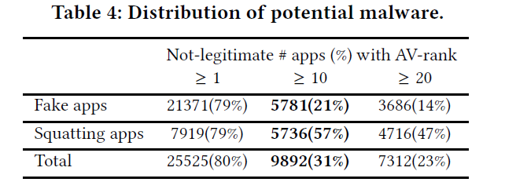
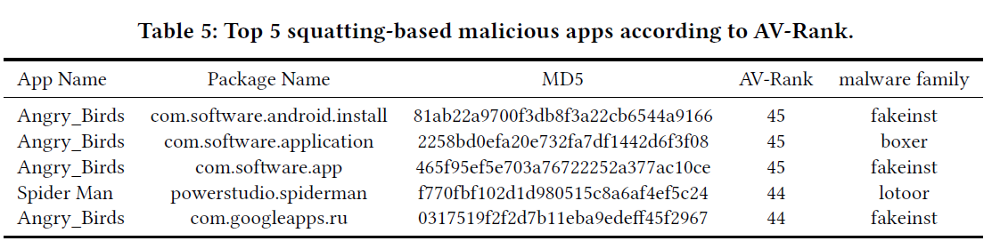
Malware Presence

Slide 20
Characterizing The Impact
RQ4: Presence of Squatting in App Markets
RQ5: Impact on App Downloads

Slide 21
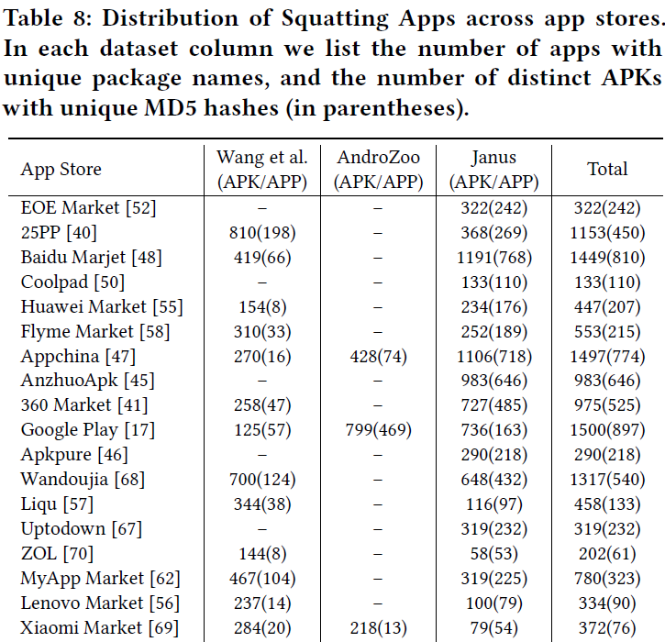
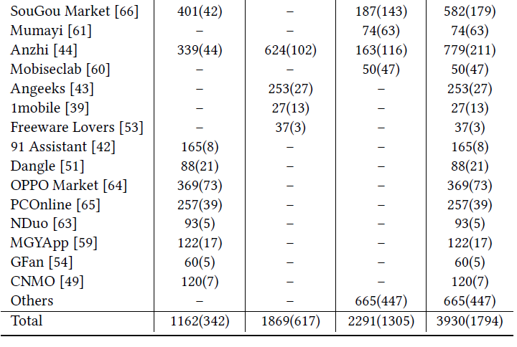
Presence of Squatting in App Markets

Slide 22
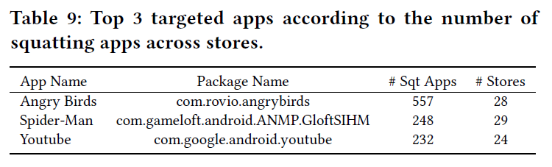
Presence of Squatting in App Markets

Slide 23
Characterizing The Impact
RQ4: Presence of Squatting in App Markets
RQ5: Impact on App Downloads

Slide 24
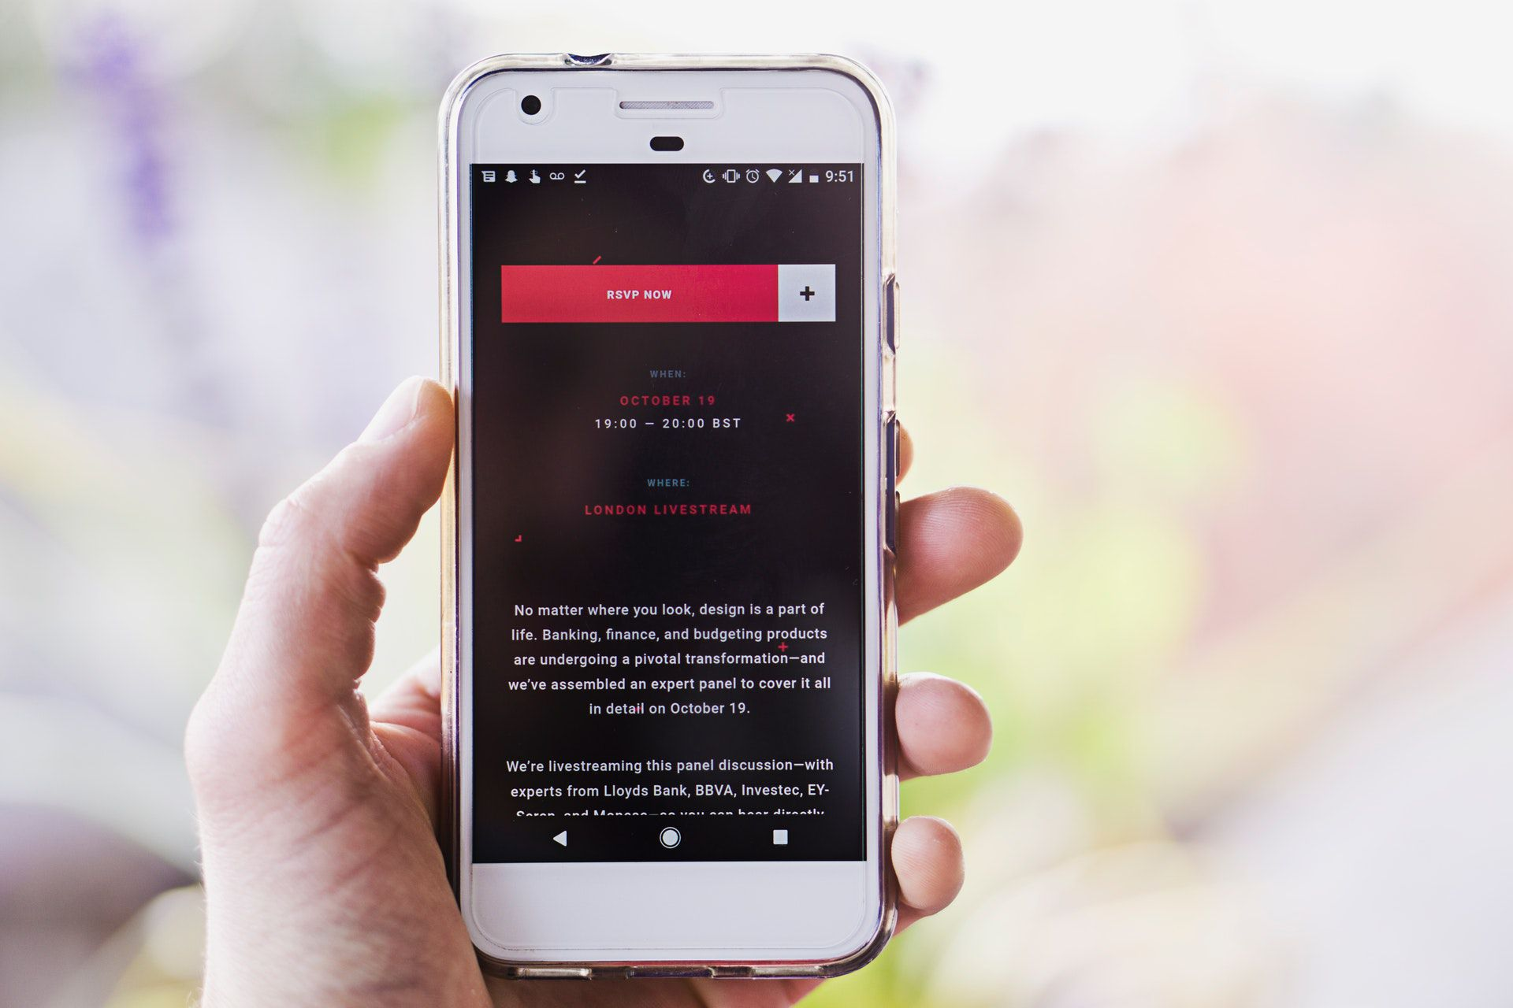
Impact on App Downloads

Slide 25
Solutions
/04
Methods to mitigate the severity of app squatting

Slide 26
Solutions
App Market Maintainers
AppCrazy
Need to design
policies to regulate app naming schemes.
It is still possible that the generation
models are incomplete, and other sophisticated methods exist.
App Developers
White list
Mitigation
&
Implications
Limitations
Be aware of squatting abuse and take the responsibility to search for and report squatting apps to market maintainers
Incompelete white list used in filtering false positives
Mobile Users
Mainly on popular apps
Learn more about app squatting attacks
Attackers primarily target
these well known apps

Slide 27
Q&A
/05

Slide 28
Thanks
Louis Wang
COMPSCI 702 Seminar

