Slide 1
Data and Associations
Jim Warren
Professor of Health Informatics

Slide 2
Outline
Big Data
Bayes’ Theorem and associations
Looking at associations
Looking at data over time

Slide 3
Objectives
To be able to describe options for display of large and complex data to aid human understanding, including
  Display of probabilistic linkage among elements
  Display of temporal change
  Use of animated displays to view successive slices of a large data set while moving through time or spatial dimensions

Slide 4
‘Big Data’
Every day, we create 2.5 quintillion bytes of data — so much that 90% of the data in the world today has been created in the last two years alone. This data comes from everywhere: sensors used to gather climate information, posts to social media sites, digital pictures and videos, purchase transaction records, and cell phone GPS signals to name a few. This data is big data.

Slide 5
Some domains
Some domains swimming in Big Data
  Astronomy
    SKA will generate a few Exabytes per day and 300-1500 Petabytes of data per year to be stored
  Weather and climate modelling
  Biomedicine
    Genomics, proteomics, metabolomics (-omics)
  Healthcare delivery
  Retail and marketing
  Finance and economic modelling

Slide 6
Bayes Theorem
Associations affect our expectations
This can be quantified with conditional probability
  Consider the probability, P, of a diagnosis, Dx, being valid, given a patient exhibiting a symptom, Sy:
    P(Dx|Sy)= [P(Sy|Dx) × P(Dx)] / P(Sy)
    Posterior probability can be quite different than the a priori P(Dx)
  So we might have P(flu)=0.05, P(fever)=0.04
    With P(fever given flu)=0.5,
    P(flu given fever) = [(0.5)(0.05)]/(0.04) = 62.5%
Bayes’ Theorem

Slide 7
Using conditional probability
Conditional probability is very context dependent
  Won’t be the same in Poland as South Africa, or in winter as summer
Can learn from data the number to apply Bayes Theorem
  Count number of flu cases and number of patients with fever symptoms
    Divide by total for P(Dx) and P(Sy), aka ‘prevalence’ of each
  Count number of cases with flu and fever
    Divide by number of cases with flu to get P(Sy | Dx)
But your estimation is only as good as your data
  Did fever always get recorded? Was every flu recorded and correctly diagnosed?
  And you have to assume the new context is similar to the one where you ‘learned’ (estimated) the parameters

Slide 8
Probability in user interaction
Can use a priori prevalence and posterior probability as basis for layout decisions
  E.g. intelligent split menu: offer most likely item selections at top
  MS Word does a heuristic split menu with a few common and/or recently used fonts at top
  Can estimate contextually-likely actions for right-click options, or to offer help topics
I developed Mediface a few years ago
  Used General Practice electronic medical records to estimate prevalence and conditional probabilities on diagnoses, symptoms and treatments

Slide 9
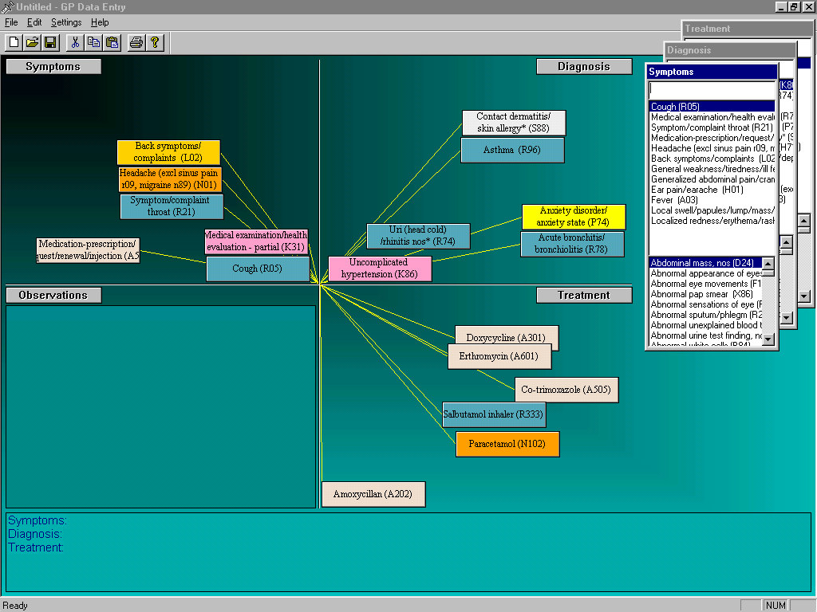
Mediface

Slide 10
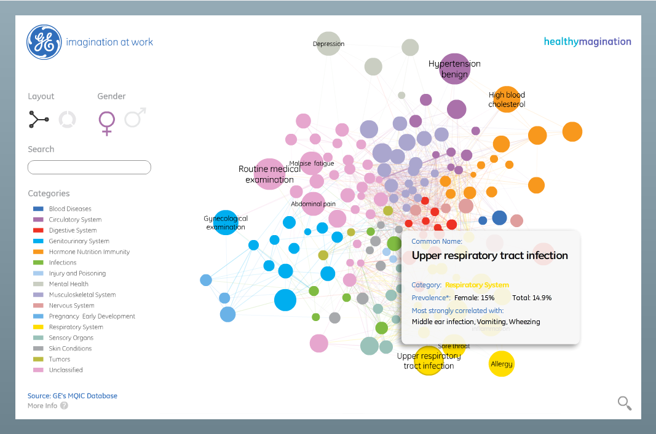
GE / MIT unlocking big data
http://www.gereports.com/the-magic-of-big-data-ge-mit-unveil-new-way-of-visualizing-disease/
http://visualization.geblogs.com/visualization/network/

Slide 11
Working with Bayesian Networks
You can visualise a series of Bayes Theorem based associations
  Tools like Nettica will learn these from data and give you a GUI to explore the data
    You can provide some initial network structure (hypothesized associations) or let it guess (but it might get causality the wrong way around)
E.g. we looked at Victorian (i.e. Melbourne area) hospital discharges for patients admitted to emergency departments (ED) with stroke
  [next 2 slides]: note comparison of ‘death’ discharge/separation outcome for cases with priority of ‘resus’ (needing to be resuscitated) versus merely ‘semi-urgent’ at hospital ‘X’
    62.1% versus 8.3% death rather than other separation code
    Also note different input distribution of stroke type – about 4 times as many Intracerebral hemorrhage (ICH) in the Resus cases; and very different ED LOS (length of stay) distribution

Slide 12
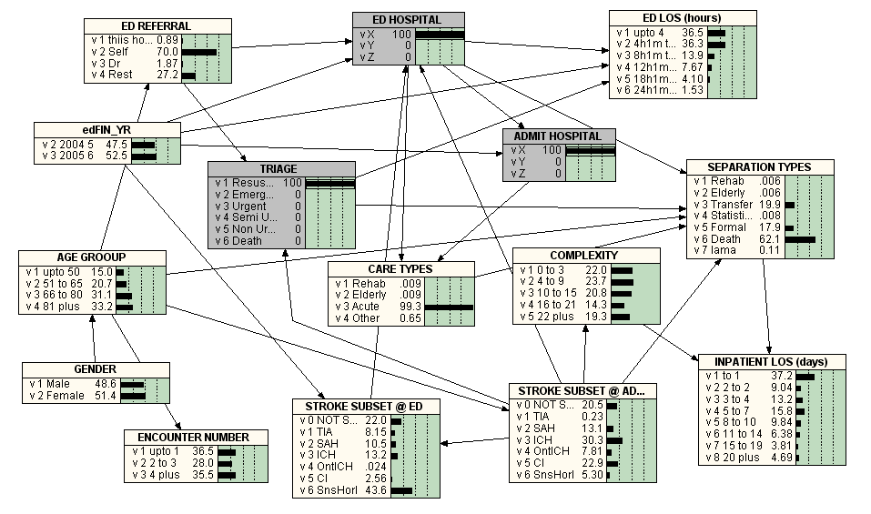
Triaged as ‘Resuscitation required’

Slide 13
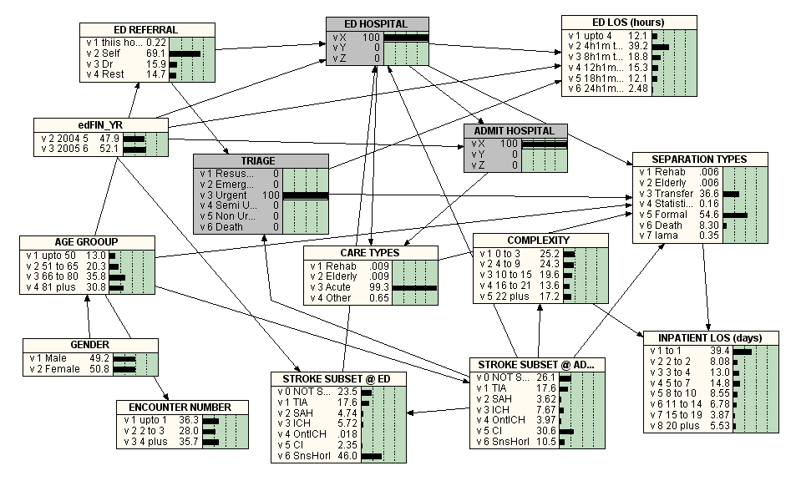
Triaged as ‘Semi-urgent’

Slide 14
ChronoMedIt: Assessing suboptimal long-term condition management
Criterion
E.g. in management of hypertension (high blood pressure)
Unsustained Treatment
Failure to Measure
Sustained Failure to Meet Target
Contra-indicated Treatment
Lapse, low medication possession ratio (MPR)
Didn’t measure blood pressure (BP) often enough
Measured BP, but it stayed too high
Treated, but maybe have drug-drug interaction
Model of criteria for long-term treatment
  Use an ontology (in Protégé/OWL) to hold parameters of treatments, problems and measurements

Slide 15
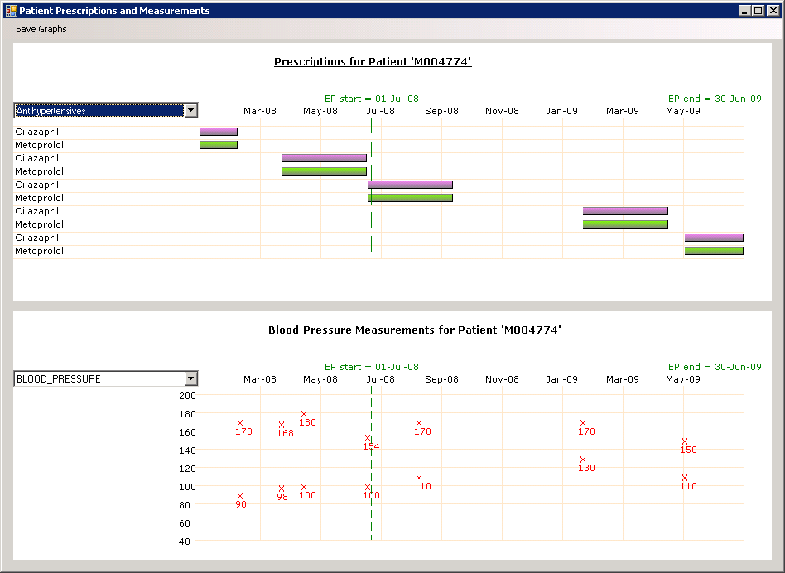
Example visual presentation of a case with low Medication Possession Ratio (MPR)

Slide 16
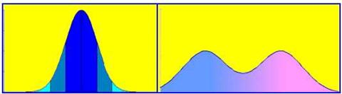
Seeing is easier (with the right representation)
Two distributions, same mean
OK, you could use the standard deviation to detect the difference
But the actual frequency distribution explains the difference more fully and it’s more reliable that the user would notice the difference
Mean = x_{m}

Slide 17
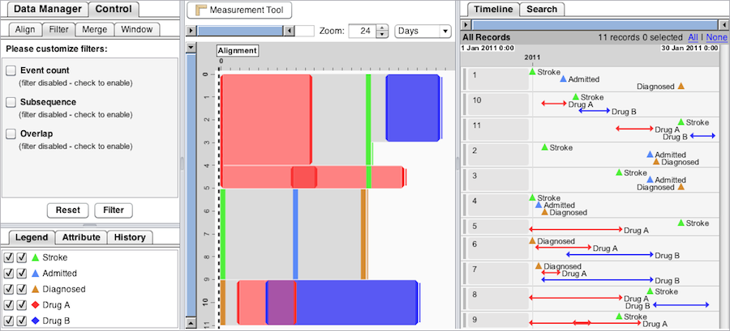
EventFlow
Exploring Point and Interval Event Temporal Patterns over multiple patients
http://www.cs.umd.edu/hcil/eventflow/

Slide 18
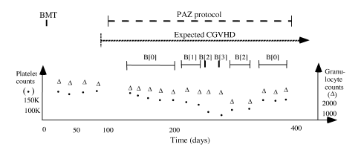
Temporal abstraction
Process individual data points to infer semantics on time intervals (Yuval Shahar)
  E.g. levels of bone marrow toxicity (B(x)) following a Bone Marrow Transplant (BMT) as computed on a time series of platelet count and granulocyte count measures over the duration of a treatment protocol (PAZ) for graft rejection (chronic graft versus host disease, CGVHD)

Slide 19
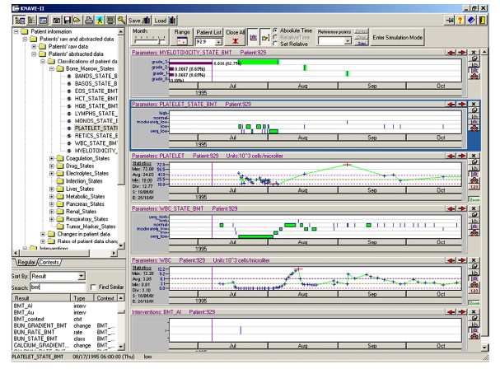
KNAVE-II: interface to distributed knowledge-based interpretation and summarisation

Slide 20
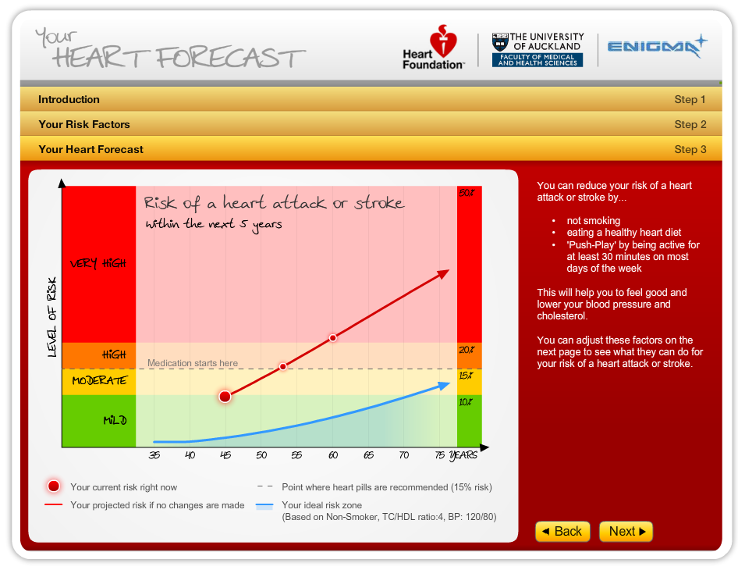
Prediction over time with option for ‘what if’

Slide 21
What’s behind the prediction?
Logistic regression
  Log of the odds of an outcome (e.g. a cardvascular disease event, such as a heart attack) as a weighted function of a number of risk factors (blood pressure, smoking, cholesterol, etc.)
  Weights are learned by fitting to population health data
For the scientific mind, seeing the 95% confidence interval of a Beta may be the way to go, but most people will appreciate the graphics

Slide 22
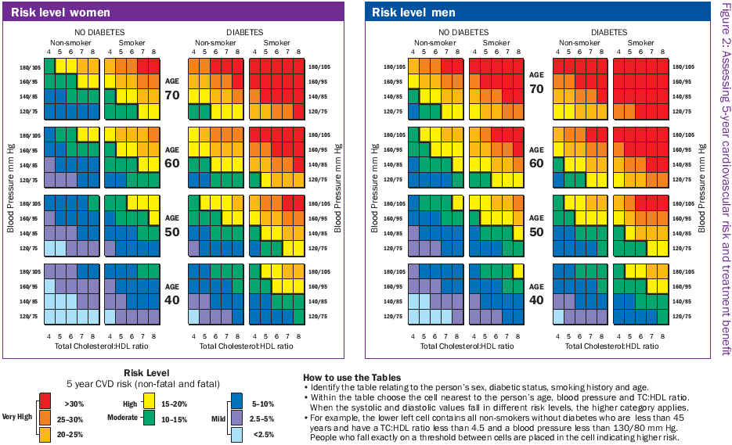
PREDICT – based on population data

Slide 23
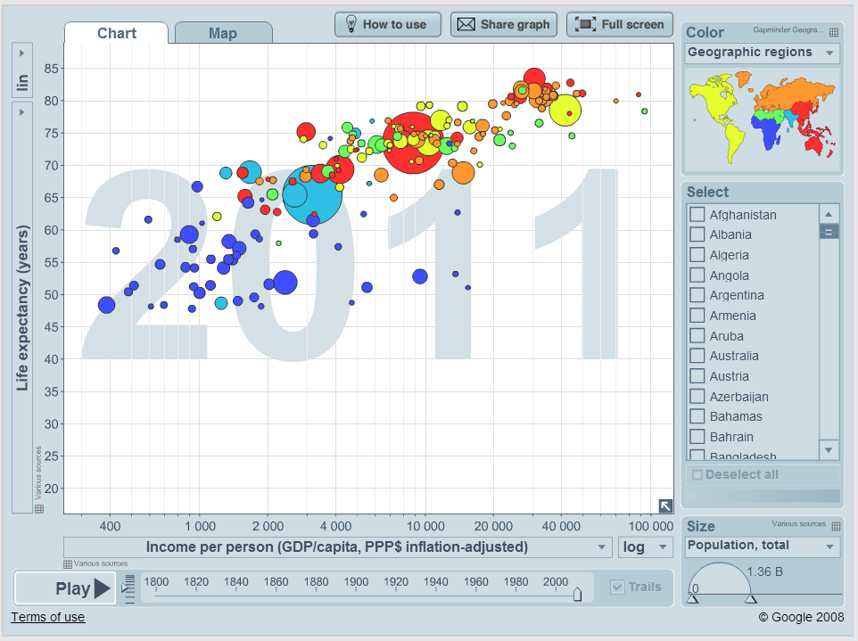
Power of animating data: GapMinder
http://www.gapminder.org/ http://www.ted.com/talks/hans_rosling_at_state.html

Slide 24
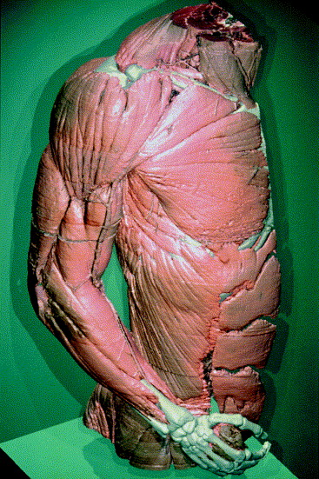
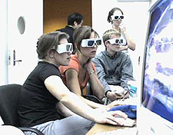
3D/VR renderings
Visible Human project involved CT, MR and cryosection images of representative recently deceased individuals
  Can be rendered as 3D models
  Can be navigated for medical
  education as alternative (or in
  addition to) using real cadavers

Slide 25
Conclusion
The world is increasingly ‘drowning’ in data
  Well, not ‘drowning’ – but at least there’s a lot of missed opportunity from data not being reviewed
Statistical models can add summarisation and inference to the raw data
  Putting semantic labels on time intervals and adding predictions
Interactive visualisation lets us filter, do ‘what-if?’ scenarios and review slices of time
  Animations and 3D reconstructions give us dimensional (time-space) experience of data

