Slide 1

COMPSCI 345 / SOFTENG 350
Review for mid-semester test
AProf Beryl Plimmer

Slide 2
Test review lecture format
Review the learning objectives of each of the lectures and assignment 1
Ask specific questions as we go

Slide 3
L1: Introduction
Meet the lecturers
Be able to define HCI
Be able to articulate the importance of HCI to the success of modern software
Be aware of the course structure and organisation
Appreciate the role of the assessable components in your learning of HCI

Slide 4
L2: Discovery
To develop a set of skills for systematic analysis of a problem domain to discover HCI issues and requirements
To understand perspectives on data collection including types of stakeholders
To be able to collect data by interviews, focus groups and questionnaires

Slide 5
L2 Discovery
Stakeholders
  Primary, secondary, facilitator, indirect
Filters
  Physical, cultural, functional, informational
Methods of collection
  Observational – direct and indirect
  Elicitation - direct (structure and unstructured) indirect (open ended, constrained

Slide 6
L3: Discovery 2
Task Analysis
Storyboarding
Use Cases
Primary Stakeholder Profiles

Slide 7
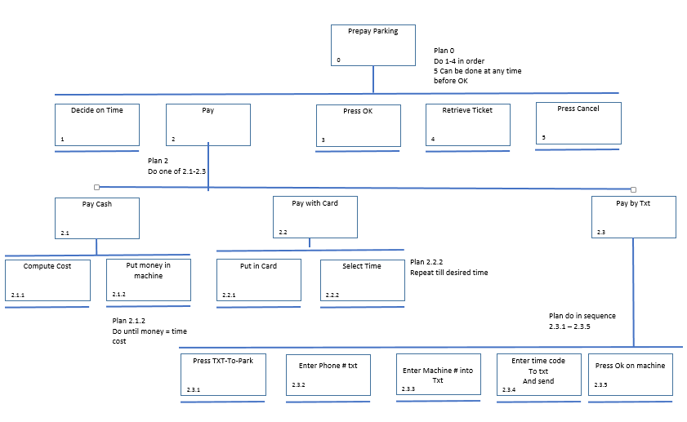
L3: HTAs – Assignment Answer

Slide 8
L4: Usability evaluations
Be able to define usability
Be able to describe aspects and measures of usability
Appreciate that usability depends on context
Be able to compare the major types of usability evaluation
  Heuristic evaluation
  Usability tests
  Analytical performance measures (Fitts’ and Hick-Hyman’s Laws)

Slide 9
L4 Usability Evaluations
Usability factors
  Fit for use, ease of learning, efficiency of use, memorability, error frequency and severity, subjective satisfaction
Types of usability evaluations
  Heuristic evaluations
  Performance measures – Fitts’ Law, Hick-Hyman Law ; KLM and GOMS
  Usability studies
  Comparative studies

Slide 10
L5 Heuristic evaluations
  To be aware of a range of heuristic evaluation options appropriate to the analysis and design phase
  In particular well known heuristics of usable systems
    Nielsen’s heuristics
    Schneiderman’s rules
To understand the difference evaluation challenges of early prototypes with limited functionality

Slide 11
L5 Heuristic Evaluations
Accuracy?
Heuristic Guidelines
  Schneiderman’s & Nielson’s
Evaluating Prototypes
  Wizard of Oz
  Semi functional prototypes

Slide 12
L6: Usability testing
Be able to articulate why and when to do usability testing
Be able to develop usability testing plans (continues next lecture)
Be able to write usability test reports (continues next lecture)

Slide 13
L6 Usability Testing
When to test
Why test
Usability testing tools and facilities
Making use of what you learn

Slide 14
L7: Usability testing – planning & reporting
Be able to develop usability testing plans
Be able to write usability test reports
Understand the nature of human research ethics requirements when conducting studies on humans

Slide 15
L7 Usability test details
Participants
Tasks
Questionnaires
Analysis
Report
Process – plan, script, ethics, professionalism

Slide 16
Half time entertainment
Computer says NO (little Britian)
https://www.youtube.com/watch?v=sX6hMhL1YsQ
https://www.youtube.com/watch?v=AJQ3TM-p2QI
There are lots more of these.

Slide 17
L8: Conceptual design
To appreciate role of Conceptual Design prior to Physical Design
To be equipped with a set of methods for Conceptual Design
  Particularly personas and scenarios

Slide 18
L8: Conceptual Design
Structuring the information space
  Card sorts, semantic networks etc
Personas
  Created from ….
  Contain….
Scenarios
  Created from …
  contain

Slide 19
L9: Physical design
To appreciate the value of prototyping (especially paper prototyping) to the design process
To be aware of the different types and options in prototyping and be able to choose the most appropriate ones for specific design problems
To be able to develop useful prototypes for eliciting user feedback

Slide 20
L9 Physical Design
Making paper prototypes
Advantages and disadvantages of paper prototypes
Other non functional (or semi functional) prototyping tools
  Advantages and disadvantages
Depth versus breath prototyping
  Wire framing
  Patterns

Slide 21
L9: Design principles 1
To be able to apply design principles in the context of user interface design tasks
To be able to characterise key design principles for effectiveness and efficiency
To be able to conceptualise design principles in terms of an interaction framework

Slide 22
L9 Design principles
Framework for design principles
Key design principles
  comprehensibility, learnability, effectiveness, efficiency
Effectiveness/Usefulness
  Utility, Safety, Flexibility, Stability
Efficiency/Usability
  Simplicity, Memorability, Predictability, Visibility

Slide 23
L11 Visual Perception
What are the two stages of the visual system?
How do luminance and colour effect visual perception?
What is the difference between central and peripheral vision?
How do we read?

Slide 24
L11 Visual Perception
Stages of vision
  Physical receptors, processing and interpretation
Physical
  Cones and rods
  Central and peripheral
  Luminance and colour
  Detail and movement
Interpreting
  Context and clues
  Reading

Slide 25
L12 Aesthetics
What is aesthetics?
What are the principles of aesthetics?
Why is aesthetics important to HCI?
Do people agree on aesthetically pleasing?

Slide 26
L12 Aesthetics
Aesthetically pleasing interface is perceived as
  More usable, trustworthy and error tolerance is increased
Principles
  Balance, emphasis and unity
Components
  Foreground: text, colour & images, lines and borders, forms and controls
  Background

Slide 27
L13 Grouping
When and where is grouping critical in UI design?
What techniques can be used to sort things into groups?
How can you visualize the groups?
What visual clues can you use to indicate things belong together or apart?

Slide 28
L13 Grouping
Information architecture
  Hierarchy, network, trees
Grouping on screen Gestalt principles
  Proximity
  Similarity
  Common Fate
  Closure
  Good Continuity
  Area
  Symmetry
  Surroundedness
  Prägnanz

Slide 29
Assignment 1
To apply usability testing methods
  Become familiar with heuristic evaluation tools
    HTAs
    Check list and templates
  Reflect on the content of a good user testing plan
    Components, process

Slide 30
Finally
Do your revision
Ask questions and discuss via Piazza
Relax – you will perform better
  But not too much you also need a bit of stress to focus
  Smile ☺

