Slide 1
HCI Design Patterns and
Standards
Jim Warren
Adapted from slides by Beryl Plimmer, ref Heim 5.6 & usability.gov

Slide 2
Quick summary of accessibility
Screen readers work by getting the HTML or other rendering information
The basics are
  Clean HTML or app forms
  Well structured – i.e. use <h1> <h2> etc.
  Alt Tag visual elements such as images
  Meaningful labels
  Good tab order

Slide 3
What is inaccessible?
Flash – in principle you can make it accessible, but in reality this is super difficult
Anchor text that lacks descriptiveness
  E.g. a sequence of links all labelled
  “Read more…..” or “PDF”
Untagged graphics
Using (untagged) graphics for navigation

Slide 4
Agenda
Patterns
  Predefined guides as to how to do things
Standards
  Rules about how to do things

Slide 5
Learning outcomes
Explain how and why patterns are used in UI design
Describe the contents of a typical pattern
Describe what standards you are likely to have to comply with

Slide 6
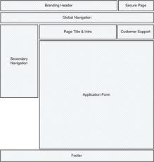
Design Patterns
First proposed by Christopher Alexander for architecture.
Adopted by other disciplines as ways to describe common problems and solutions
Software patterns
HCI patterns

Slide 7
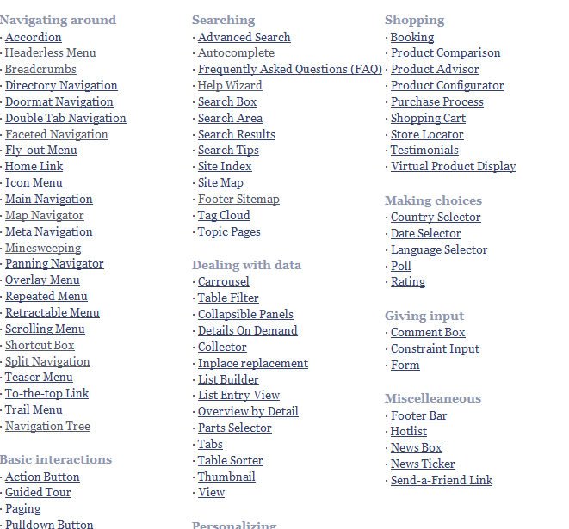
Libraries of patterns
Welie
For each pattern Welie gives information such as
  Problem
  Solution
  Use when
  How
  Why
  More examples
  Implementation
  Literature
  Comments
http://www.welie.com/patterns/index.php

Slide 8
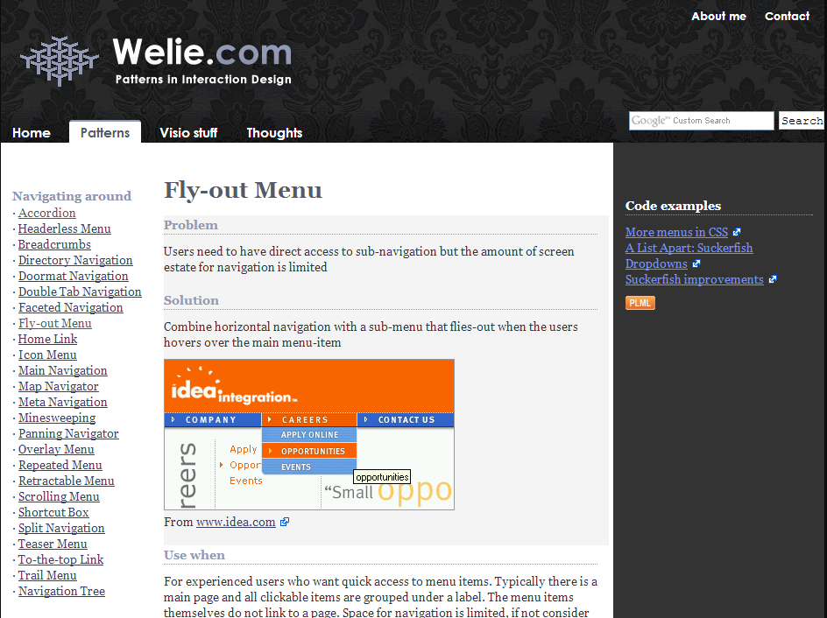

Slide 9
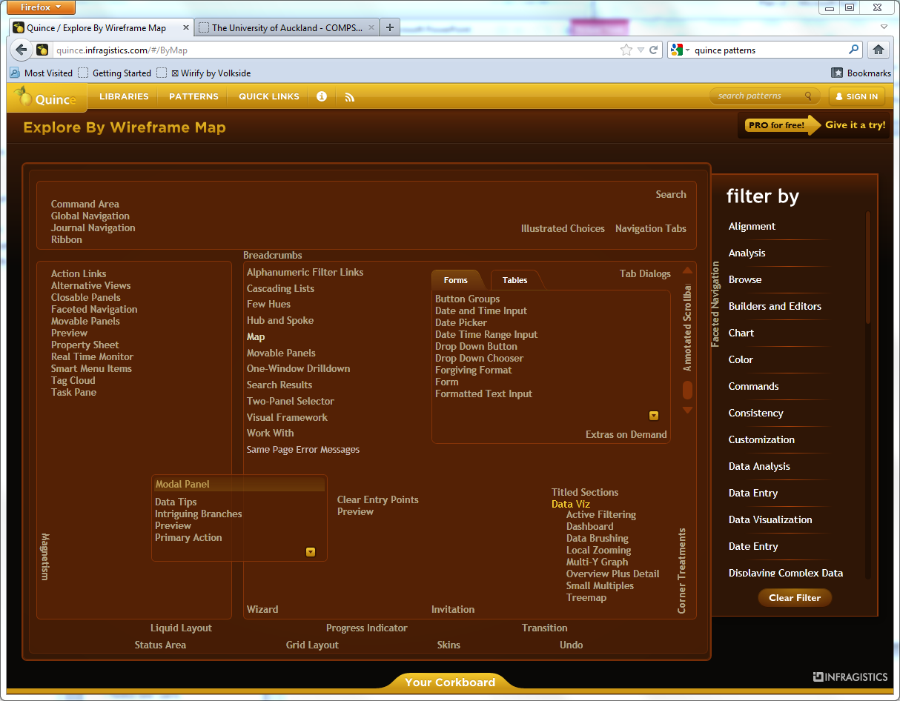
Quince
Another major pattern library
Patterns indexed by
  Wireframe →
  Tag (semantic map)
  Alphabetical
  http://quince.infragistics.com/

Slide 10
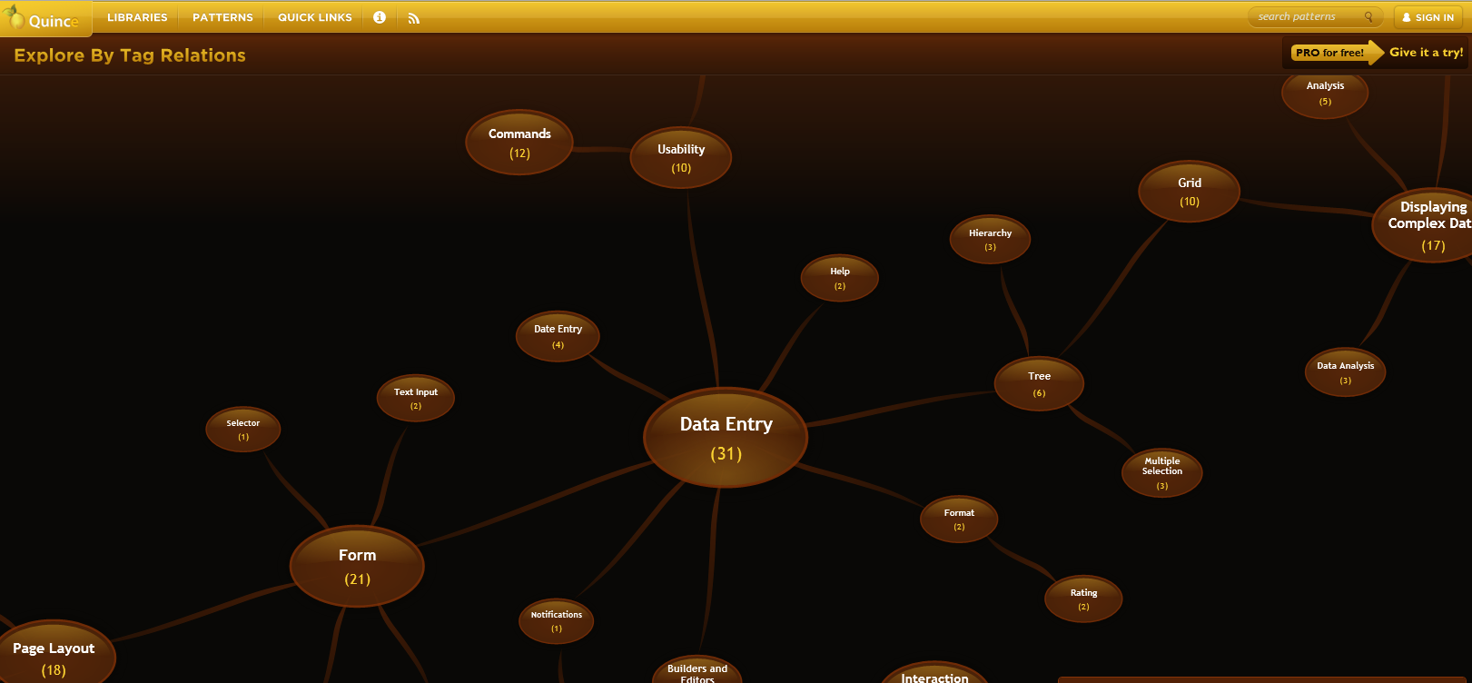
Quince tag explorer

Slide 11
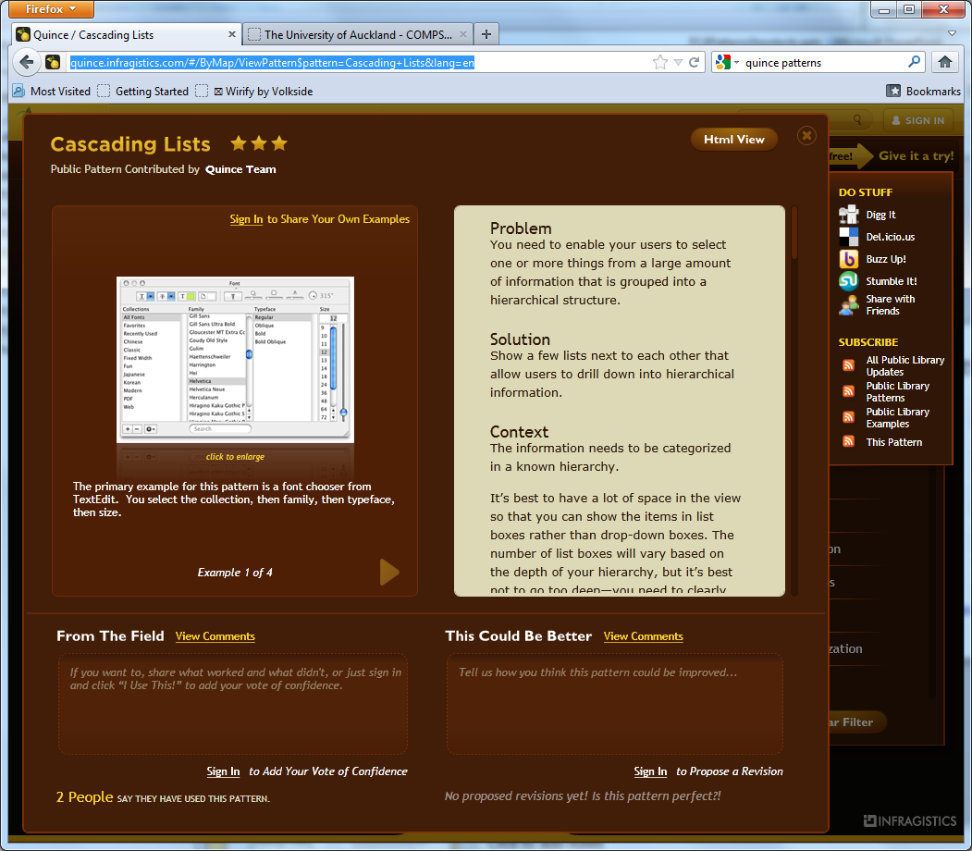
Each pattern
Problem
Solution
Context
Rationale
Implementation
http://www.welie.com/patterns/showPattern.php?patternID=map-navigator
http://quince.infragistics.com/#/ByMap/ViewPattern$pattern=Date+Picker&lang=en

Slide 12
Patterns
Provide a solution or solutions
  May or may not include code for implementation
Give you design ideas
Defining patterns for a large system or website will lead to
  Consistency
  Therefore better usability
For any size of application
  Learn from experience
  Solutions that have proven popular for problems you might not even have yet perceived

Slide 13

Standards
Many organizations (particularly government) require software to be standards compliant!
Standards bodies
  W3C world wide web consortium
  ISO standards
  Governments
    UK
    USA
    New Zealand
  Operating Systems

Slide 14
What is a ‘standard’ anyway?
Can be ‘informal’ or ‘defacto’
  It’s common, so it’s ‘standard’
  Sometimes will be antagonistic competing commercial blocks
Can be formal through endorsement by…
  A national or international body
    ANSI (American National Standards Institute)
    ISO (International Standards Organisation)
  A community run by a not-for-profit company (or less formally constituted but somehow well recognised)
    W3C, Health Level 7
Incidentally, just because a vendor says they comply to a standard, it doesn’t mean they do so fully
  Standards compliance testing is an industry of its own!

Slide 15
W3C
http://www.w3.org/standards/
Free!
Technical
Comprehensive
Detailed
Well respected

Slide 16
Web Content Accessibility Guidelines
WCAG 2 at a Glance
http://www.w3.org/WAI/WCAG20/glance/
Perceivable
  Provide text alternatives for non-text content.
  Provide captions and other alternatives for multimedia.
  Create content that can be presented in different ways,
  including by assistive technologies, without losing meaning.
  Make it easier for users to see and hear content.
Operable
  Make all functionality available from a keyboard.
  Give users enough time to read and use content.
  Do not use content that causes seizures.
  Help users navigate and find content.
Understandable
  Make text readable and understandable.
  Make content appear and operate in predictable ways.
  Help users avoid and correct mistakes.
Robust
  Maximize compatibility with current and future user tools.

Slide 17
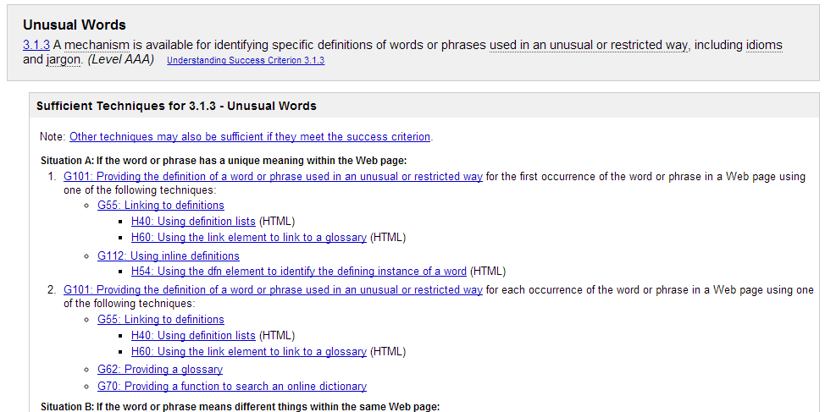
WCAG snippet

Slide 18
ISO
Not free
ISO/TR 16982:2002 Ergonomics of human-system interaction—Usability methods supporting human-centered design
  High level, for UX designer, systems analysts etc.
ISO 9241 Ergonomics of Human System Interaction.
  Includes detailed recommendations from hardware to people

Slide 19
Government
Mostly concerned with accessibility
  Disability Discrimination Act UK
  Section 508 of the Rehabilitation Act (USA)
  http://webstandards.govt.nz/

Slide 20
Government
Legislation together with pressure groups have had some remarkable successes
Windows 7 has ‘windows navigator’ built in
iPad/Phone/Pod have touch accessibility for visually impaired
  This is really impressive!

Slide 21
Operating Systems
Microsoft
  http://msdn.microsoft.com/en-us/library/aa511258.aspx
Apple
  https://developer.apple.com/library/mac/documentation/userexperience/conceptual/applehiguidelines/UEGuidelines/UEGuidelines.html
Android
  http://developer.android.com/guide/practices/ui_guidelines/index.html

Slide 22
From Apple…
In this case, more like a ‘guideline’ than a protocol for a standard, but enforced – for instance – by the App Store design review
Embrace Modelessness
  Users appreciate apps that allow them to be in control and they generally dislike apps that wrest control away from them too often. One of the most common ways that apps take control away from users is by overusing modes that require users to follow a specific path.
  Occasionally, modality is unavoidable, such as when a serious condition arises that jeopardizes the user’s data…
  Think carefully about an app design that requires users to enter modes frequently. In general, you don’t want users to experience your app as a series of disjointed tasks. You also want to avoid chopping up the user’s workflow by requiring too-frequent transitions into and out of modes. As much as possible, reserve modes for small, self-contained tasks that users are likely to want to finish all at once.
  Balance modelessness with the need for a distraction-free experience. Sometimes, users appreciate an isolated, self-contained environment in which to accomplish a task. Your challenge is to provide a mode that’s both discrete and full-featured. Users don't appreciate finding that they need to exit a mode to get information (or perform a subtask) that’s required to accomplish the modal task…
  Clearly indicate the current mode. If users can enter different modes in your app, make it easy for them to tell at a glance which mode they’re in….

Slide 23
Standards / community example
Drupal (http://drupal.org/)
  Open source content management system (CMS) for websites and applications
  100s of modules contributed to be international online community
With a wide community using the same modules
  Achieve consistency
  And a community to consult if things aren’t working
Wide range of modules means you can tack together functionality pioneered by others very quickly

Slide 24
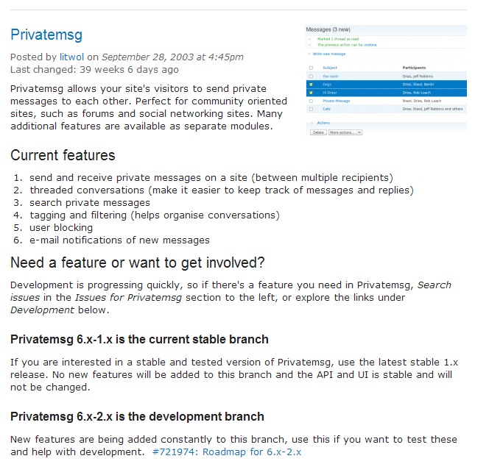
A drupal module

Slide 25
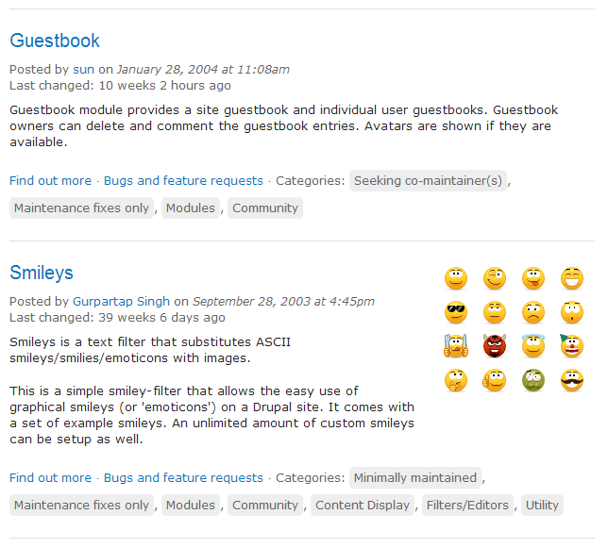
Some more drupal modules
  From the same search (filtered on ‘community’)

Slide 26
Advantages
Using patterns and standards
  Not reinventing the wheel
  Future-proof your designs
  Makes entry to markets easier

Slide 27
Summary
Explain how and why patterns are used in UI design
  To provide design ideas and solutions
  Standardize across a system/site
  Avoid common errors
Describe the contents of a typical pattern
  Problem
  Solution
  Context
  Rationale
  Implementation
Standards may be imposed by software purchasers usually
  W3C or similar
  Government standards

