Slide 1
Lecture 5
Interaction Frameworks
Frameworks for understanding interaction
Coping with complexity
Jim Warren
Reference (and slide template and initial version of some slides): Heim, Chapters 2.1-2.2

Slide 2
Learning objectives
To be able to conceptualise user interaction with a computer interface in terms of an execution / evaluation cycle of action
To be able to articulate, identify and exploit ways in which users deal with the complexity of the user interface through:
  Mental models
  Mapping
  Semantic and Articulatory distance
  Affordances

Slide 3
Frameworks for Understanding Interaction
Execution/Evaluation Action Cycle
Interaction Framework

Slide 4
Frameworks for Understanding Interaction
A framework is basically a structure that provides a context for conceptualizing something
  E.g. to conceptualize how we interact with computers
We can use these frameworks to:
  Structure the design process
  Help us to identify problematic areas within the design

Slide 5
Execution/Evaluation Action Cycle (EEC)
Donald Norman (1990) The Design of Everyday Things
The structure of an action has four basic parts:
  Goals: We begin with some idea of what we want to happen; this is our goal.
  Execution: We must then execute an action in the world.
  World: To execute and action, we must manipulate objects in the world.
  Evaluation: Finally, we must validate our action and compare the results with our goal.

Slide 6
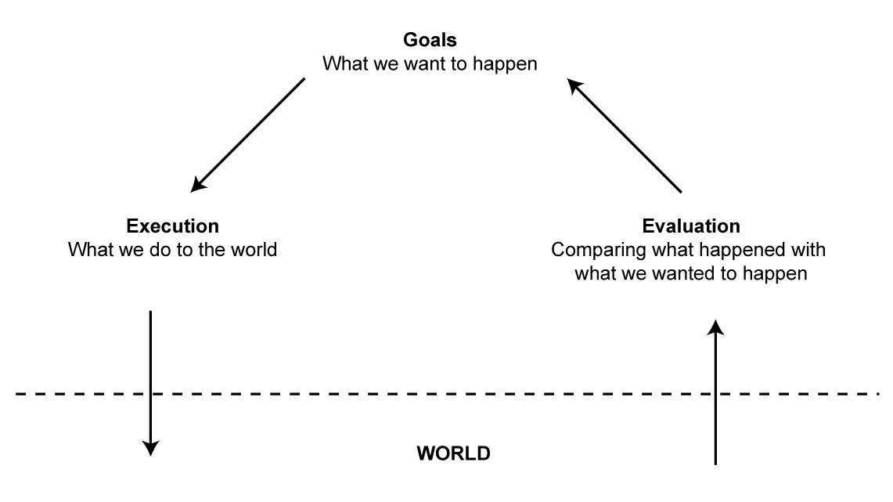
Execution/Evaluation Action Cycle (EEC)

Slide 7
Execution/Evaluation Action Cycle (EEC)
Goals do not specify particular actions
  They must be transformed into intentions that specify the actions that lead to the completion of the goal
  Goals and intentions do not have a one-to-one relationship
“Delete text” goal
  Intention that involves the Edit menu
  Intention that involves the Delete key
Goal > Intention > Actions > Execution

Slide 8
Execution/Evaluation Action Cycle (EEC)
Evaluate Results
  Perceive new state
  Interpret what we perceive
  Evaluate new state with goal
Perceive > Interpret > Evaluate

Slide 9
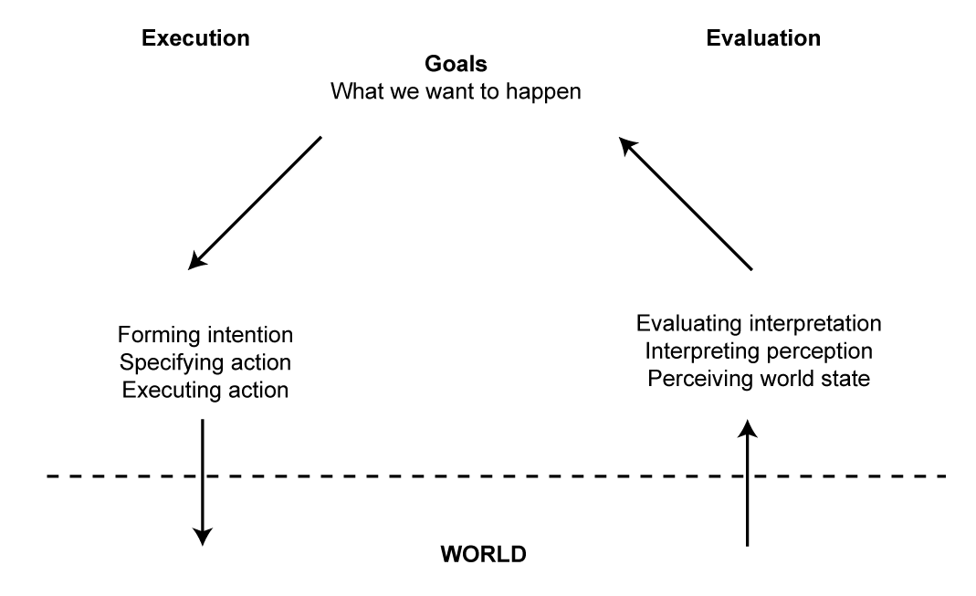
Execution/Evaluation Action Cycle (EEC)
Seven Stages of Action

Slide 10
Execution/Evaluation Action Cycle (EEC)
The seven stages form a cycle
The cycle can be initiated at any point
  Some goals are data-driven - initiated when an environmental event is perceived
  Others are goal-driven - initiated when the person conceives of a new goal

Slide 11
Gulf of Execution
Difficulties arise from the gulfs between mental representations in the user’s mind and physical components of the states of the system
  Goal = save a file
  Intention = use the file menu
  Action = click the save option
Is there a save option in the file menu?
  If not, our intention will be frustrate

Slide 12
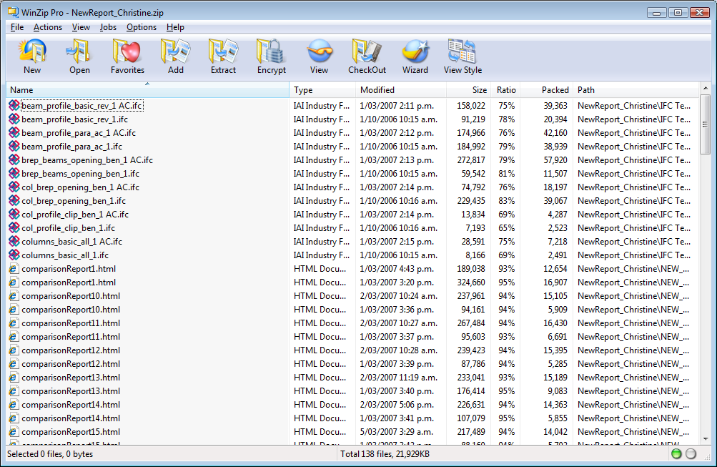

Slide 13
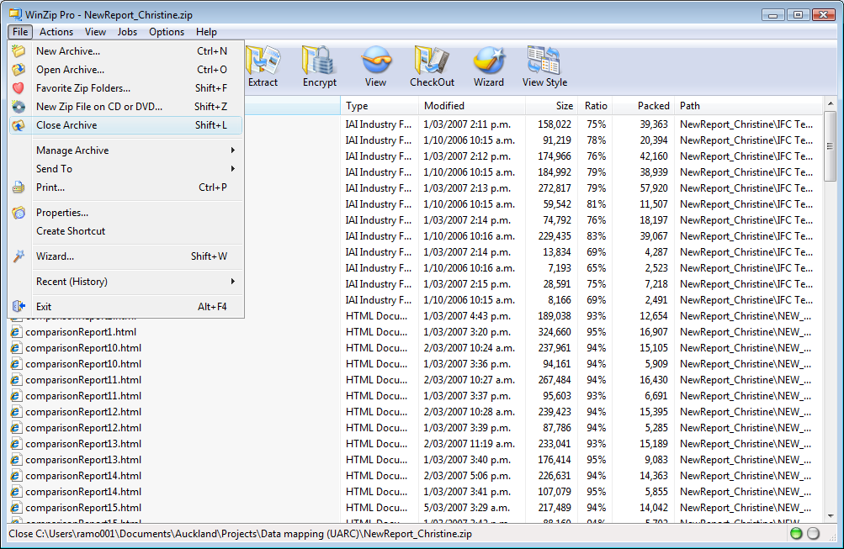

Slide 14
Gulf of Evaluation
An interface should allow the user to perceive and interpret the state of the system
Given a particular interface design, how easily can you:
  Determine the function of the device?
  Determine what actions are possible?
  Determine mapping from intention to physical movement?
  Perform the action?
  Determine whether the system is in the desired state?
  Determine the mapping from system state to interpretation?
  Determine what state the system is in?
(Norman, 1990)
‘Modes’ can contribute gulfs here (e.g. is the system in CAPS LOCK mode?)

Slide 15
Coping with Complexity
Mental Models
Mapping
Semantic and Articulatory Distance
Affordances

Slide 16
Mental Models
A mental model is a cognitive representation of something that defines a logical and believable estimation as to how a thing is constructed or how it functions
  Transparent objects expose their functions
    Bicycles
  Opaque objects hide their functions
    Computers

Slide 17
Mental Models
Mental models are:
  Unscientific—They are often based on guesswork and approximations.
  Partial—They do not necessarily describe whole systems, just the aspects that are relevant to the persons who formulate them.
  Unstable—They are not concrete formulations, but evolve and adapt to the context.
  Inconsistent—They do not necessarily form a cohesive whole; some parts may be incompatible with other parts of the same model.
  Personal—They are specific to each individual and are not universal concepts that can be applied generically.
Designs that align with a user’s mental model will be easier for him or her to use

Slide 18
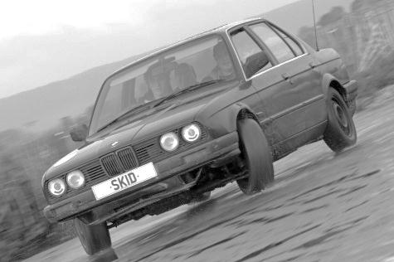
Automobile driving mental model
Most drivers won’t bother to understand the actual mechanism by which a car works and can get by with a simplified mental model
  Push accelerator to go
  Push break to slow/stop
  Turn steering wheel to
  veer left and right
This breaks down on snow and ice
  ABS serves somewhat to bring the behaviour back into alignment with simple mental model

Slide 19
Nielsen: Mental models (www.useit.com)
The word "Google" is usually the top query at other search engines, and words like "Yahoo" and "Bing" score high on Google.
  Why do people search for a website if they already know its name?
  Many users have never formed an accurate model of how the "type-in boxes" on their screen function. When they type stuff into a box, they sometimes get where they want to go.
Netflix is a mail-order service for renting movies on DVD. However, Netflix works differently than typical e-commerce sites:
  When users added a film to their Netflix "queue," they used a mental model of an e-commerce shopping cart to predict what would happen: nothing. Adding stuff to the cart doesn't cause you to receive that item in the mail. You first have to proceed through checkout and confirm that you want it.
  In reality, however, Netflix will immediately mail you the DVD that's on top of the queue. Later, when you mail it back, they'll send you the next movie in your queue, without you having to go to the site and do anything. That's why they have the "queue" feature instead of a standard shopping cart.
  (see also http://en.wikipedia.org/wiki/Netflix#Dynamic_queue.2C_subscription.2C_and_delivery_methods)

Slide 20
Word processor mental model
Originally needed to win over people used to typewriters
  So ‘cut’ and ‘paste’ were meant to be literal
  But we accepted as a ‘bonus’ that the metaphor breaks down in part when everything scoots ahead after the insertion point
Nowadays, not that many people are really thinking back to typewriters
  Maybe there’s an opportunity to reconceptualise the mental model!
Nonetheless, using the user’s language is part of fitting their mental model

Slide 21
There will always be a mental model
The user will adopt some mental model of the system
  It will usually be simplistic and an analogy to something more familiar
  It provides them a basis for ‘problem solving’
    To guess what actions are available, how to perform them and what outcomes are likely to result
Your users will act more intelligently if they’re able to successfully align a mental model to your system’s behaviour
  Otherwise they’ll have to adhere strictly to the bounds of their training, and will have no clear idea of what happens outside of their immediate experience with the system

Slide 22
Usability testing and mental models
Usability testing can reveal the user’s mental model
  Think aloud protocol is particularly useful
    User says what they think they are going to do / achieve
As a designer you have a choice when user’s mental model misaligns with system
  Change the system to align to the mental model, or
  Try to change the user’s mental model
    Might use graphical metaphors to promote the ‘right’ mental model
    Might accept that certain training or documentation is required
    Might also try to minimize the damage of common ‘wrong’ mental models

Slide 23
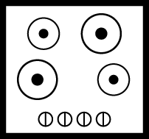
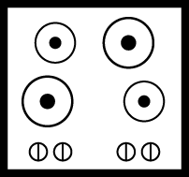
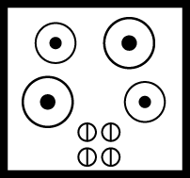
Mapping
The concept of mapping describes how we make connections between things
Proper mapping can increase the usability of an interface
Arbitrary mapping Arbitrary mapping improved Natural mapping
Use natural mapping whenever possible

Slide 24
Semantic and Articulatory Distance
Semantic Distance
  The distance between the functionality of the device and what we actually want to do
    Does it take a lot of steps or a few to accomplish a goal?
Articulatory Distance
  The distance between the physical appearance of an interface element and what it actually means (does)
    Will the user find the association of the function and its appearance on the interface natural (or is the icon and/or label difficult for them to associate with its function)?

Slide 25
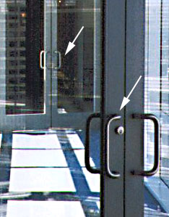
Affordances
The affordances of some interfaces can be intuitively understood: a steering wheel affords turning, and a door bell affords pushing.
These connections allow us to make predictions about the results of our actions and help us to create usable mental models.
http://chicago.cbslocal.com/2014/01/15/would-be-burglar-thwarted-after-pulling-door-marked-push/

Slide 26
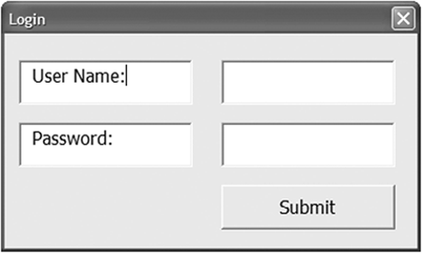
Affordances
Affordance Confusion - when certain aspects of an object do not work in a way in which we assume they should
Norman considers an affordance to be a relationship between an object and a user, not a property of an object
  A lot depends on the user’s prior experiences

Slide 27
Affordances
What may be an affordance to one person may not be to another
The perception of affordance fosters usability
The affordances a user may need must be present
Affordances must not contradict the user’s expectations

Slide 28
Summary
Choose the interaction style which best suits needs of intended user
Focus on reducing Gulf of Evaluation
Focus on reducing Gulf of Execution
Achieve alignment of user’s mental model and how the system can be operated
Achieve low semantic and articulatory distances
Provide affordances that the user recognises

