Slide 1
Lecture 7
Physical Design
Prototypes
Low-fidelity prototypes
http://www.interaction-design.org/encyclopedia/contextual_design.html
Heim, Chapter 5.3

Slide 2
Learning objectives
To appreciate the value of prototyping (especially paper prototyping) to the design process
To be aware of the different types and options in prototyping and be able to choose the most appropriate ones for specific design problems
To be able to develop useful prototypes for eliciting user feedback

Slide 3
Physical Design
The physical design involves:
  What it will look like
  What components it will require
  How the screens will be laid out
We use the following tools during this phase:
  Low-fidelity prototypes
  Evaluations
  Wireframes
  Functional prototypes

Slide 4
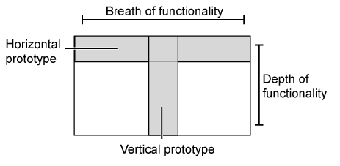
Physical Design - Low-fidelity prototypes
Nielsen distinguishes between two types of prototypes
  Horizontal
    Full breadth of functions in the design, but probably at the cost of detail
  Vertical
    Drill down on one area of the design
    This is key if one area is particularly novel and is critical to the success of the design

Slide 5
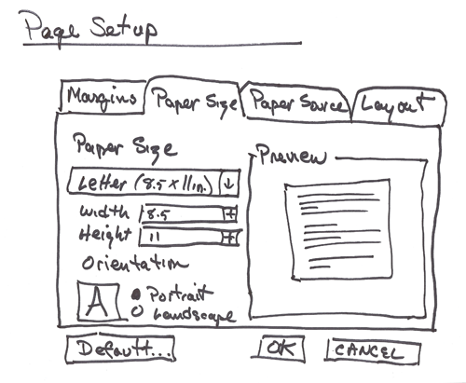
Physical Design - Low-fidelity prototypes
The three main criteria for low-fidelity prototypes:
  Easy and inexpensive to make.
  Flexible enough to be constantly changed and rearranged.
  Complete enough to yield useful feedback about specific design questions.

Slide 6
Physical Design - Low-fidelity prototypes
People are more comfortable criticizing paper prototypes
You will have to make some decisions before you begin:
  What feedback do you need at this point in the design process?
  How much of the design should you prototype?
  Should you cover all of the areas but without great detail (breadth vs. depth)?
  Should you cover one area in great detail?
These questions will help you to define the scope of the prototype and focus on what you want to accomplish

Slide 7
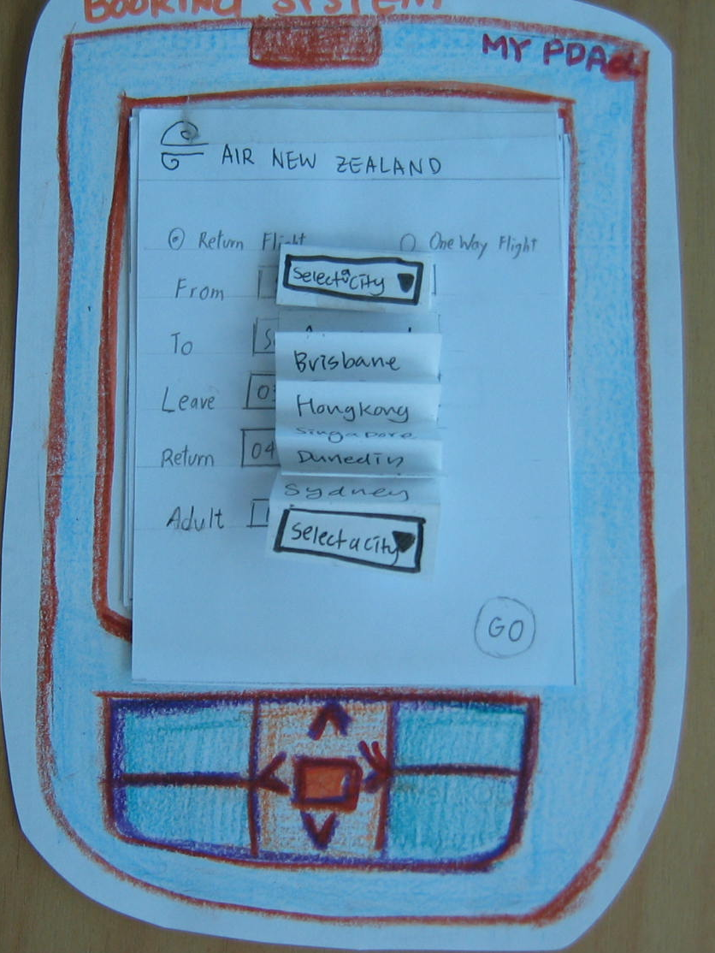
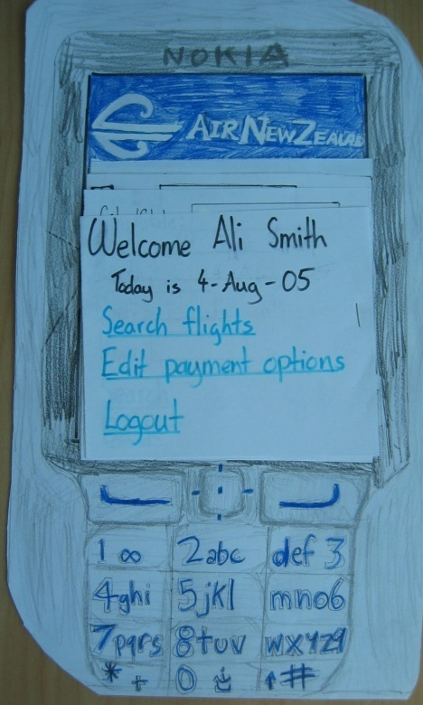
How to make a low-fi prototype
Pen, paper, coloured pencils, scissors, cellotape …..
  Just like primary school ☺
  Phone interface for airline booking

Slide 8
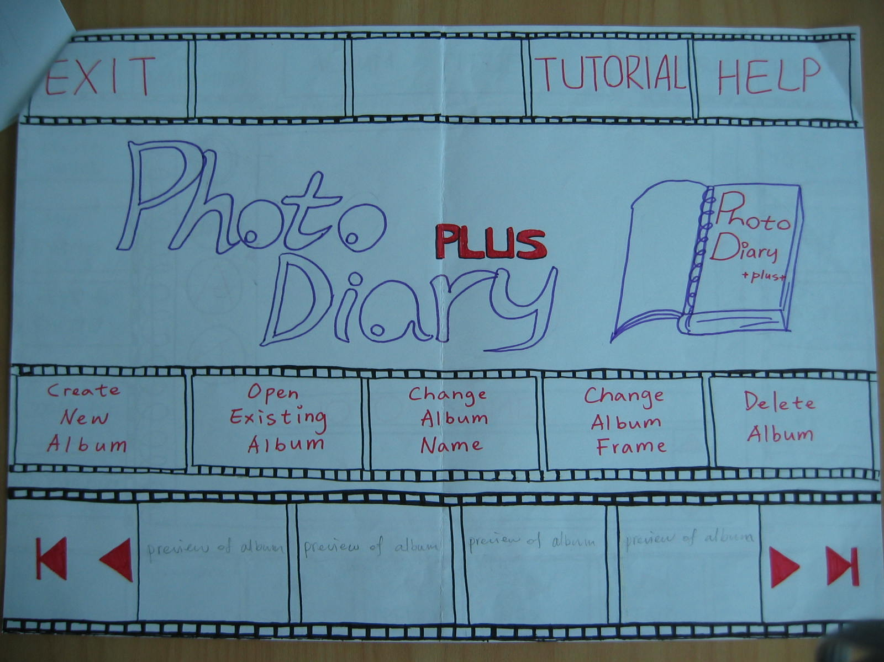
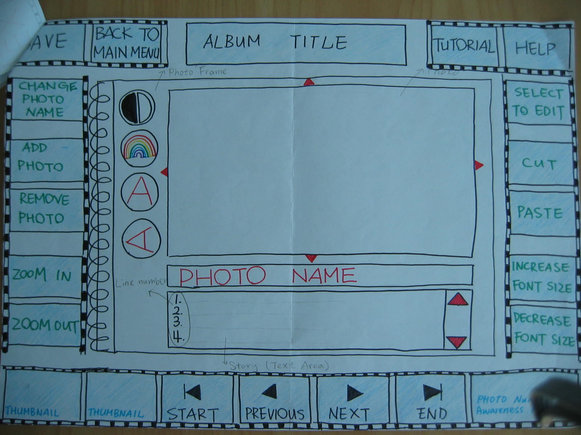

Slide 9
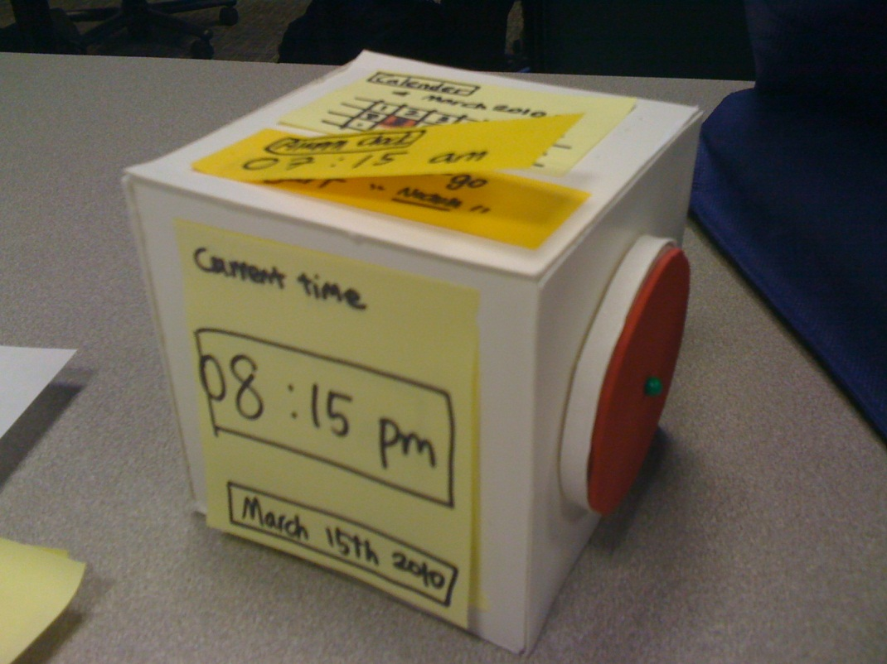
Post-its in paper prototypes
As if they were invented for the task!
  Can layer them to show pop-ups or other dialogue progression
  Can stick them on top
  to revise a screen
  Cut into strips for
  pulldown menus

Slide 10
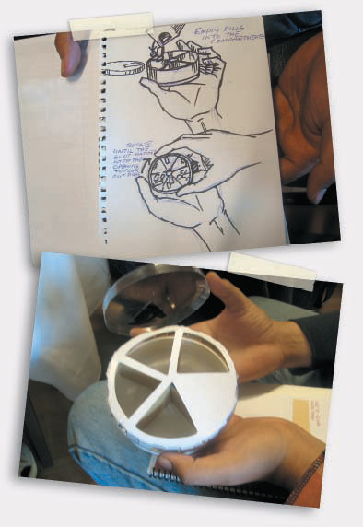
Make a device
Use the cornflakes box, a hunk of polystyrene ……
Paint/ draw on the controls
Stick on junk
Use buttons to represent dials
Nancy Frishberg, Prototyping with junk, Interactions,2006, V13:1 Pp 21 – 23, ACM

Slide 11
Half-time entertainment
Wizard of Oz with paper prototype
  https://www.youtube.com/watch?v=GrV2SZuRPv0&eurl=http://deeplinking.net/paper-web

Slide 12
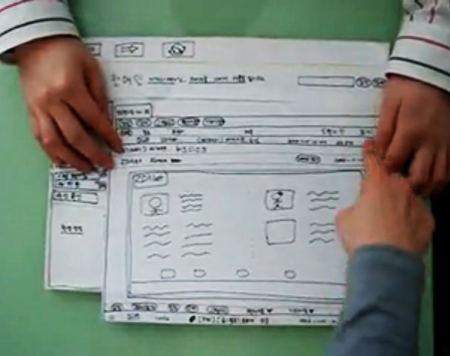
Using the lo-fi prototype
Ideal to have one person act as ‘the computer’ and operate the prototype in response to user actions
  Another person can focus on interacting with the user/subject and taking notes
  (or a 3rd person for notes if
  available)
Can modify the prototype
on-the-fly in response to
user feedback
  Particular advantage of
  paper here!

Slide 13
Physical Design - Low-fidelity prototypes
Advantages of paper prototypes:
  They can be used early and often.
  They are inexpensive and easy to create.
  They make design ideas visual.
  No special knowledge is required; all team members can create them.
Disadvantage of paper prototypes:
  They are not interactive.
  They cannot be used to calculate response timings.
  They do not deal with interface issues such as color or font size.

Slide 14
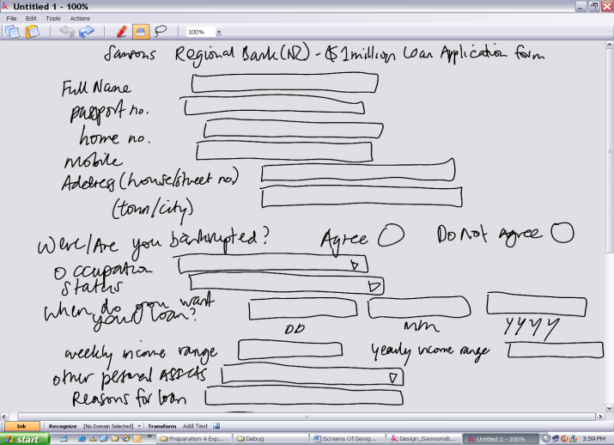
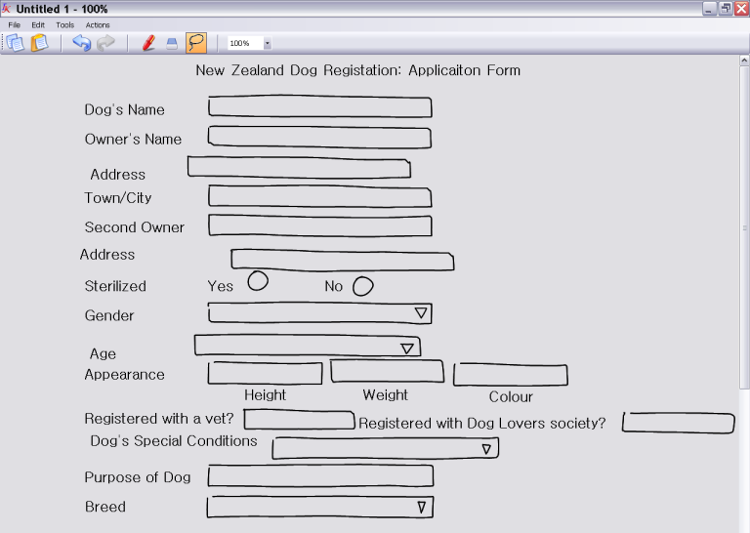
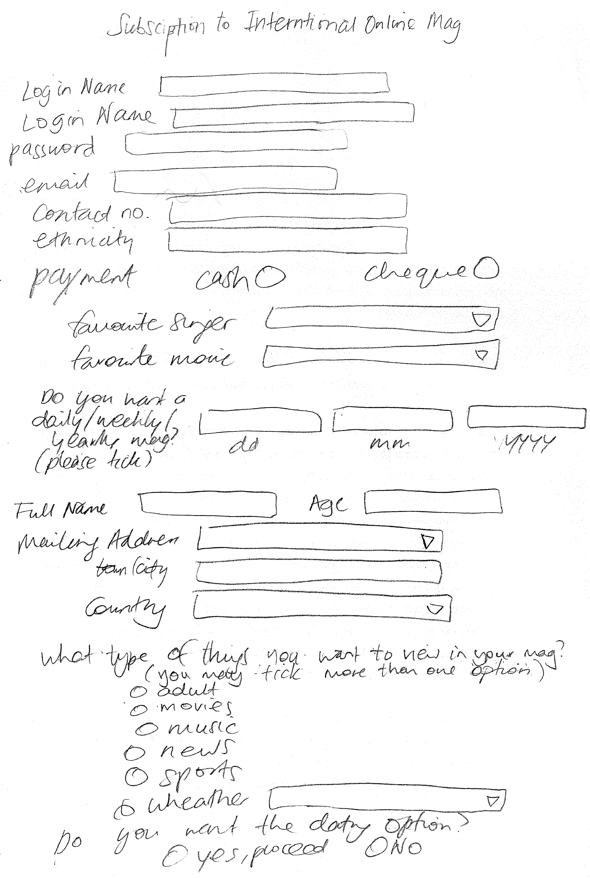
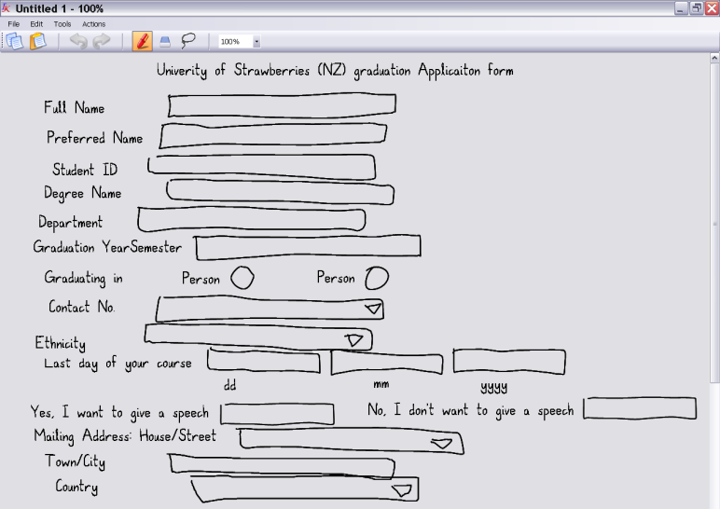
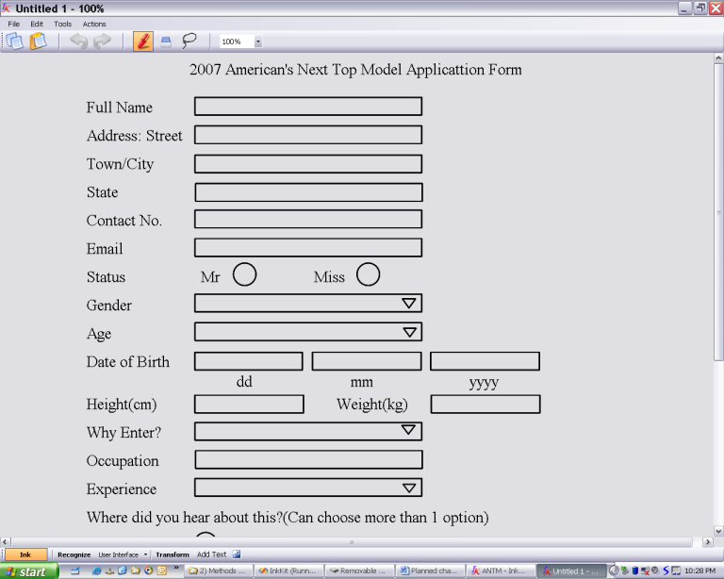
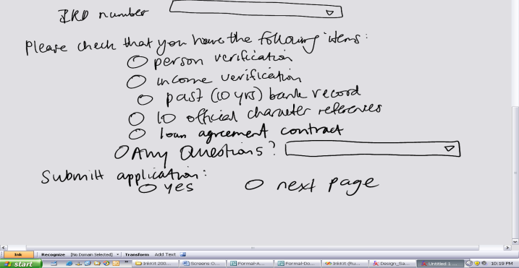
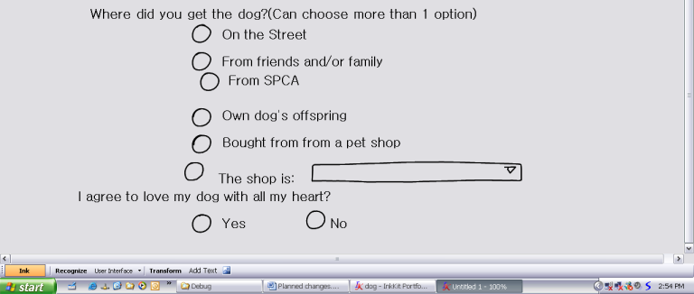
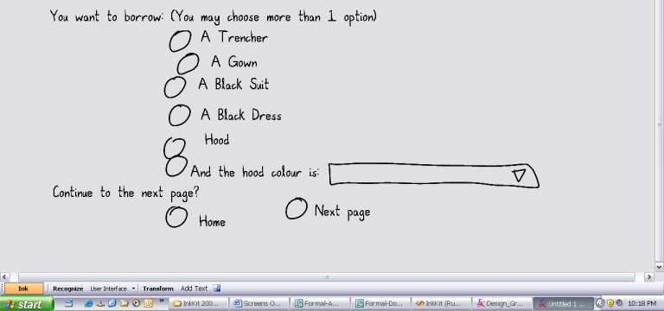
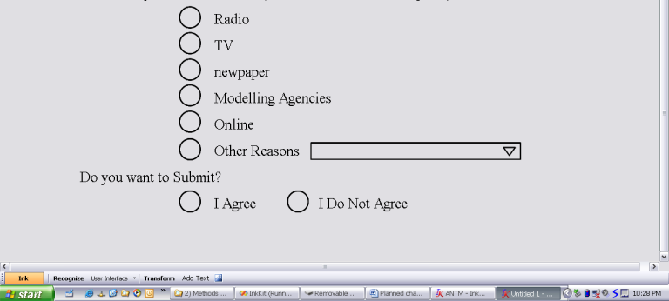
What happens as you ‘tidy’ a prototype?
Yeung, L., B. Plimmer, B. Lobb, and D. Elliffe, Effect of Fidelity in Diagram Presentation in HCI 2008, D. England, Editor. 2008, BCS: Liverpool. p. 35-45.
http://www.bcs.org/upload/pdf/ewic_hc08_v1_paper4.pdf

Slide 15
Electronic prototypes
If you still want it quick and easy but want more interactivity than paper
  And/or you’re still not convinced to use paper
  Or you have to email the prototype to the user and do the session remotely by Skype!
PowerPoint is good
  Slideshow is a reasonable metaphor for sequence of screens
  Can insert action buttons or hyperlinks to traverse between slides in non-linear fashion to simulate an application
    Moving in the direction of a ‘functional prototype’
  Can get fine control of graphics and layout

Slide 16
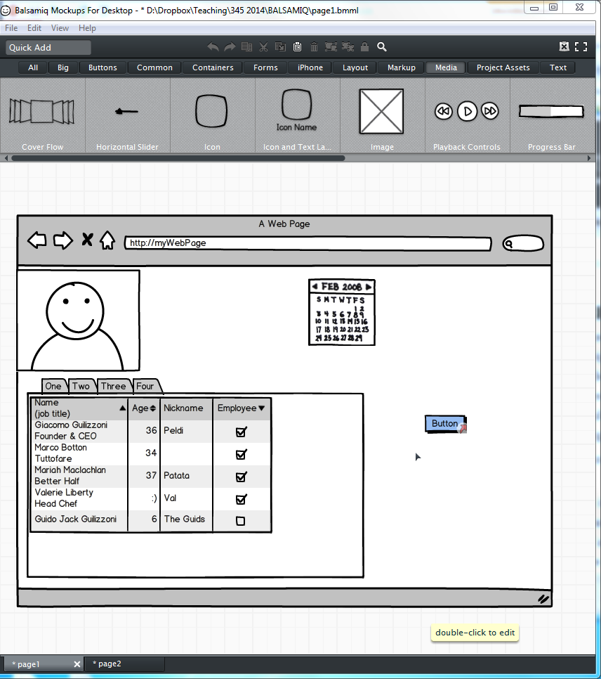
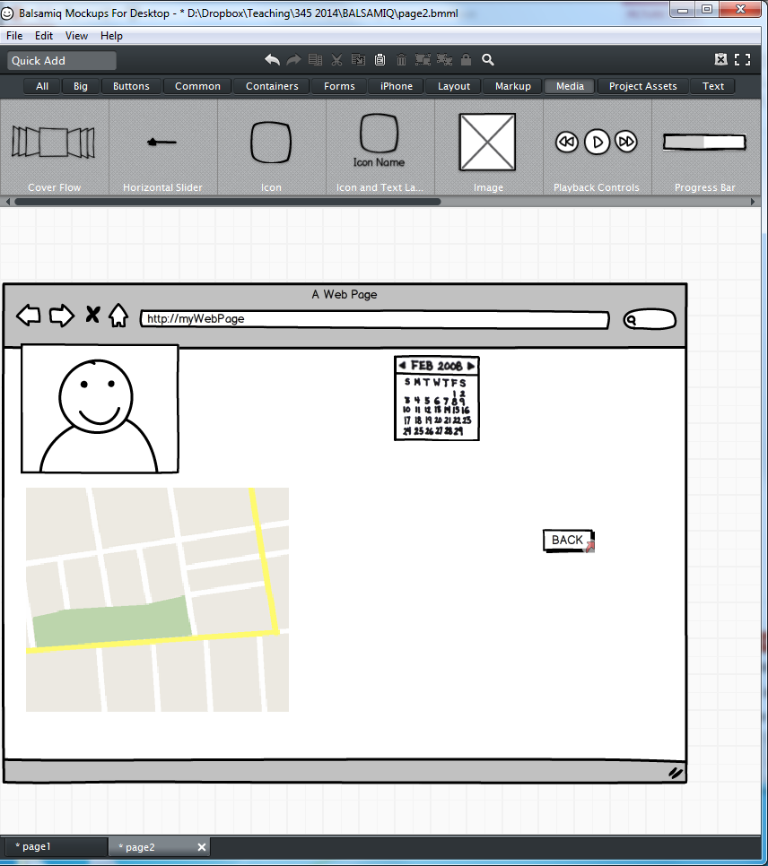
Computer-based ‘paper prototyping’
Balsamiq.com
  I used for a fairly large commercial project
  Not really a fan
    Much slower than paper
    Too higher fidelity to be a sketch, but not real --- ‘no mans land’.

Slide 17
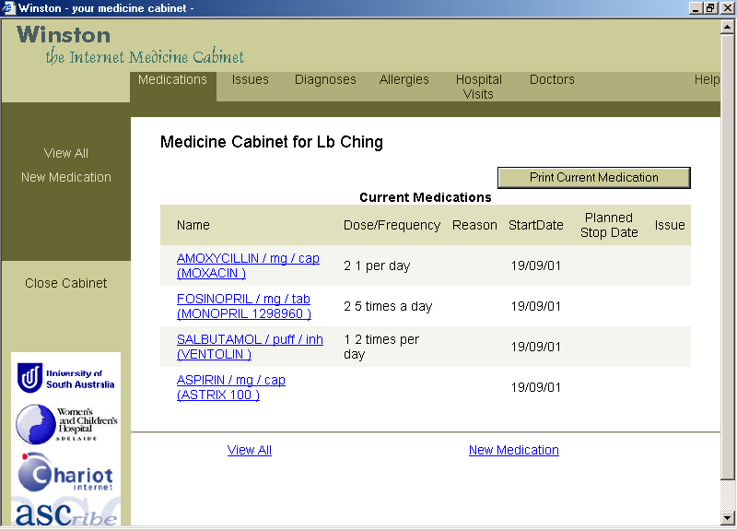
Prototypes and data
You need to put realistic data elements on your prototype screens
Distracting to users if the data don’t make sense with respect to important aspects of the application

Slide 18
What happened?
Number of changes
Enjoyment

Slide 19
Summary
Low-fidelity prototypes are a powerful tool for physical design
Users are inclined to criticize informal (esp. paper) prototypes more than formal prototypes
  I.e. you learn the most when showing users paper prototypes!

