Slide 1
Lecture 6
Conceptual Design
Brainstorming
Card sort
Semantic networks
Personas
Scenarios, flowcharts and cognitive walkthroughs
Both of these are excellent
http://www.interaction-design.org/encyclopedia/card_sorting.html
https://www.interaction-design.org/encyclopedia/personas.html

Slide 2
Learning objective
To appreciate role of Conceptual Design prior to Physical Design
To be equipped with a set of methods for Conceptual Design
  Particularly personas and scenarios

Slide 3
Avoid Technology Myopia
Interaction designs must be sensitive to:
  Human-human communication
  Implicit Knowledge
  Non-technical aspects of work
Integrate technology and human activities carefully

Slide 4
Conceptual Design
Conceptual design involves
  Structuring the information space
  Creating alternative solutions
  Determining which design concept to pursue

Slide 5
Conceptual Design
The tools involved in conceptual design:
  Brainstorming
  Card sort
  Semantic networks
  Personas
  Scenarios
  Flowcharts
  Cognitive walkthroughs

Slide 6
Conceptual Design - Brainstorming
Team activity
  Get out possible ideas
    Minimize critical thinking at this stage
    Any idea is ‘good enough’ to write down
  May use storyboarding
    Making like a comic strip of the interaction concept
    Or any sort of diagramming that denotes the idea
Can work in parallel by breaking into subgroups or individually to scribble ideas on butcher paper or post-its
Brainstorming sessions generate a lot of material that must then be filtered and organized

Slide 7
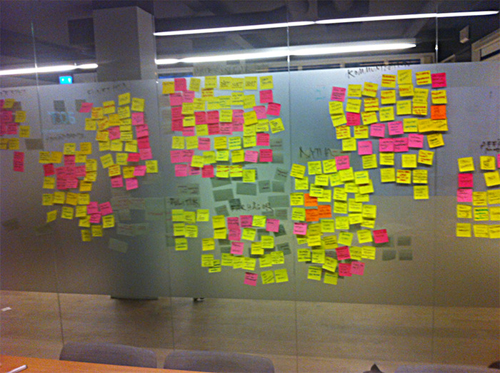
Post-its grouped at the end of a brainstorming session

Slide 8
Conceptual Design – Card Sort
Card Sorting can be used to discover user-centered groupings
Card sorting can be used to organize the information collected in the discovery phase
Used to define groupings for menus, controls and Web page content
Used to generate labels for menus, buttons and navigation links

Slide 9
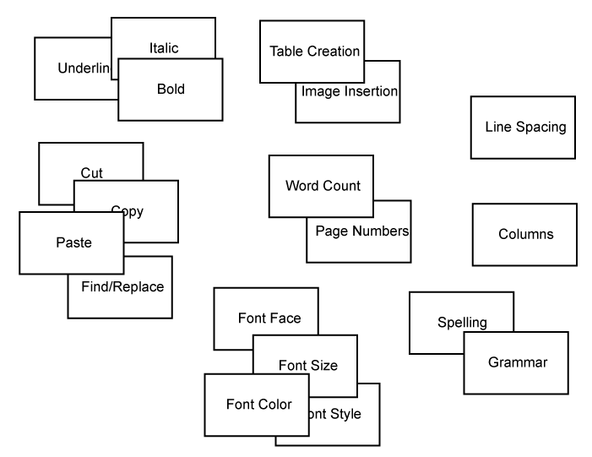
Conceptual Design – Card Sort
Result of a card sort

Slide 10
Conceptual Design – Card Sort
Advantages of card sorting sessions:
  They are quick and easy to perform.
  They can be done before any preliminary designs have been made.
  They will let you know how people organize information.
  They will expose underlying structures.

Slide 11
Conceptual Design – Card Sort
Disadvantages of card sorting sessions:
  They only involve the elements that you have written on the cards.
  They suggest solutions that imply structures.
  They become difficult to navigate / interpret with more categories.

Slide 12
Card Sorting
Is useful for all sorts of organizing tasks.
My grad students have recently used it for
  Categorizing computational features in to a library (about 120 features of an ink stroke you can compute – length, corners,……)
  Categorizing related literature in robot programming languages
Do it on paper - there is something about the moving the paper around physically that helps.

Slide 13
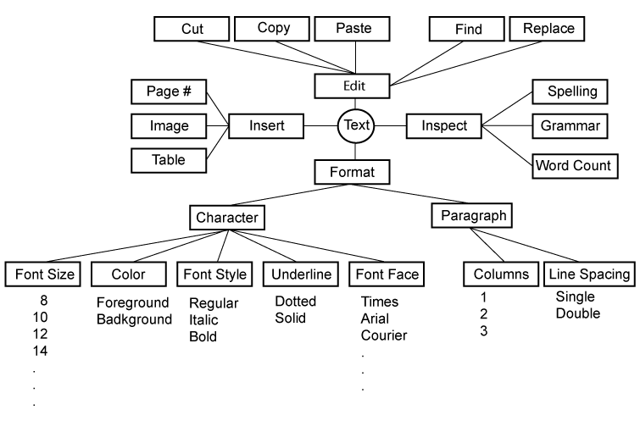
Conceptual Design – Semantic Network
A semantic network is a web of concepts that are linked through association.

Slide 14
Conceptual Design – Semantic Network
Advantages of semantic networks:
  They allow an easy way to explore the problem space.
  They provide a way to create clusters of related elements.
  They provide a graphical view of the problem space.
  They resonate with the ways in which people process information.

Slide 15
Conceptual Design – Semantic Network
Disadvantages of semantic networks:
  They require knowledge of the problem space.
  They can lead beyond the problem space.
  There is no formal semantics for defining symbol meaning
    Could get formal by using UML, but would tend to stifle the process
    Can transform your card sort into a semantic network by using post-its, sticking them to a large piece of paper and drawing lines.

Slide 16
Conceptual Design – Personas
Personas are archetypes of actual users, defined by the user’s goals and attributes.
“Personas are derived from patterns observed during interviews with and observations of users and potential user (and sometimes customers) of a product”
(Cooper & Reimann, 2003, 67)

Slide 17
Conceptual Design – Personas
Expected to have:
  A name (and preferably a photo!)
  Goals and motivating forces
  Behaviours and a personality
  Any relevant background
    E.g. their past experience with other software (and how they felt about it!)
They should be a ‘3-dimensional’ person that can serve as a reference
  “Will this design work for Tim?”

Slide 18
Conceptual Design – Personas
Personas should be a reflection of the information derived from the data collection activities
Should be able to point to a direct one-to-one relation with an observed user behavior or statement
  Otherwise, may be erroneous and will lead to incorrect design decisions
Yet you have to make them 3-dimensional
  You need to have enough there to inform the design decisions
Can be a synthesis of characteristics observed over multiple users/potential users

Slide 19
Conceptual Design – Personas
Advantages of personas:
  They are quick and easy to create.
  They provide a consistent model for all team members.
  They are easy to use with other design methods.
  They make the user “real” in the mind of the designer.
    i.e. a basis for our ‘empathy’ as designers
Disadvantages of personas:
  They can be difficult to create if the target audience is international (or just diverse in whatever way)
  Having too many personas will make the work difficult.
    6-8 is usual
  There is a risk of incorporating unsupported designer assumptions.

Slide 20
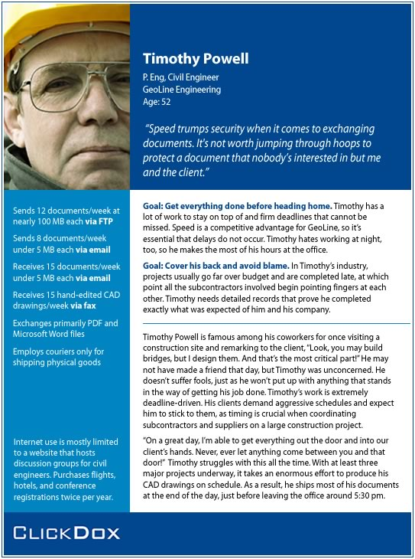
Persona example
© http://chopsticker.com/
Notes:
Relate to the civil engineering database from earlier lectures

Slide 21

Persona example
© http://chopsticker.com/
Notes:
Relate to the civil engineering database from earlier lectures

Slide 22
Conceptual Design – Scenarios, Flowcharts, and Cognitive Walkthroughs
Scenarios
  A description in ‘plain English’ of a typical task
  It describes
    The basic goal
    The conditions that exist at the beginning of the task
    The activities in which the persona will engage
    The outcomes of those activities
Scenarios afford a rich picture of the user’s tasks

Slide 23
Scenario example
Accessing Design Files from a remote server
PACT Analysis
People: Design engineer on a project
Activities: Using the DMS (document management system) to identify released document set for a design part
Context: Remote site work environment, independently managed work activity
Technology: Mobile interface to previous PC-based DMS
Scenario
Tim Powel [Engineer] is on site discussing construction of ‘Bridge D’ ‘Deck’ with contractors. Doesn’t believe that they have all the documentation and needs to check their set of documents against the master set. Uses mobile device to access DMS and authenticates with the system. Selects project ‘Bridge D’ and design part ‘Deck’. Requests the set of released documents to be identified. Works through the identified set of documents checking document codes, release date, and versions with the contractor. Identifies no anomalies with the contractor’s set and completes programme task.

Slide 24
Scenario context / limits
A scenario should be ‘situated’ with one or more of your personas
  You visualise Tim being the end user working through that scenario
  How do you interpret the Scenario differently if it starts
    ‘The engineer’
    ‘Tim Powel’
The main difference between a use-case and a scenario is that the scenario uses a persona’s name the use-case is abstracted to the role (e.g. engineer)
A scenario should specify the interface details as little as possible
  They are much more about what’s getting done as compared to how the user is manipulating the system to do it
  A good design will be one that makes the scenario’s task activity natural and efficient for our persona

Slide 25
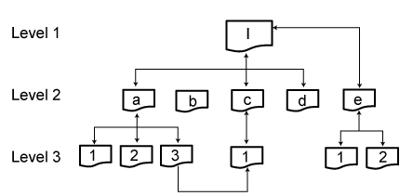
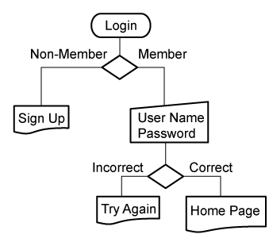
Conceptual Design – Scenarios, Flowcharts, and Cognitive Walkthroughs
Flowcharts can be:
  Simple network diagrams that identify the pages of a Web site and the navigational links between them
  Sophisticated diagrams that capture conditional junctures and computational processes

Slide 26
Conceptual Design – Scenarios, Flowcharts, and Cognitive Walkthroughs
Cognitive walkthrough - the evaluator follows the various scenarios using the flowcharts or the low-fidelity prototypes
The evaluator takes the part of the primary stakeholder and tries to accomplish that stakeholder’s various tasks

Slide 27
Iteration
By running the scenario we discover
  Weaknesses in the flowchart (or more advanced prototype) for accomplishing the scenario
  This implies where and how something has to change
We may change the flowchart / prototype
We may adjust the scenario (and/or persona)
We may change the functional requirements
  Expand, contract or otherwise adjust the scope of the entire system development effort (if we have the freedom to do so)

Slide 28
Summary
User centered design approach helps identify real user requirements at conceptual design stage and beyond
Personas and scenarios are key elements of an iterative approach to conceptual design
  The personalizing of the interaction experience allows us as designers to empathize with the potential user.

