Slide 1
Usability Testing
Planning and Reporting
Notes from
http://www.usability.gov/methods/test_refine/learnusa/testplan.html

Slide 2
This is too good to miss
http://www.youtube.com/watch?v=sfSJP8avHWI

Slide 3
Learning objectives
Be able to develop usability testing plans
Be able to write usability test reports
Understand the nature of human research ethics requirements when conducting studies on humans

Slide 4
Plan EVERYTHING
Use a template such as at http://www.usability.gov/methods/test_refine/learnusa/testplan.html
Fill in ALL the bits – even those that are completely obvious

Slide 5
Details
Scope
  Name of application or website
  How much or what are you testing
Purpose
  Broad
    “Can users complete the order?”
  Narrow
    “Can they find the shopping basket?”
Schedule & Location
  When and where
Sessions
  How long (should be less than one hour)
Equipment
  Exactly what equipment is needed
    Computer(what), video, Morae
Participants
  What type of people are you looking for
    Typical users?
    Convenience participants (e.g. students, other employees)

Slide 6
Details
Scenarios
  How many and what type of tasks (see next slide)
Metrics
  What will you measure/collect
    Errors
    Time
    Observations
    Questionnaire
Roles
  How many people do you need?
    Participant guide
    Observer

Slide 7
Task Design
Be specific*
  “enrol in COMPSCI345 at the University of Auckland”
  “what lecture room(s) are COMPSCI345 lectures in?”
Record Completion Paths
  Step through the task yourself
    Record different routes to successfully complete
    Time yourself
  Note things you think are difficult or confusing
    You are, in effect doing a Heuristic Evaluation (assignment 1 is pretty much this with thorough documentation and a heuristic evaluation template)
    Remember these are notoriously inaccurate (users will surprise you)
  Do not show these to participants
* See next slide

Slide 8
Task Selection
Utterly central to what you will learn in the usability test
There just isn’t time / resources to do usability testing on everything
Select the tasks that are ‘make-or-break’ for the application
You’re looking for the risk
  What’s novel? What will differentiate this product?
  If you’re in a ‘safe’ zone where you’re emulating well-established interaction patterns, then you’ll learn less
    Then again, still can be important to check that you got it right!

Slide 9
Task Order
For you assignment you need to think carefully about task order.
  Do you want to fix the order – eg everyone does cash, then credit card then txt
  Do you want to ‘latin square’ – eg every variation of order (there are six)
  What do you think the difference would be?
    This is called the learning effect.

Slide 10
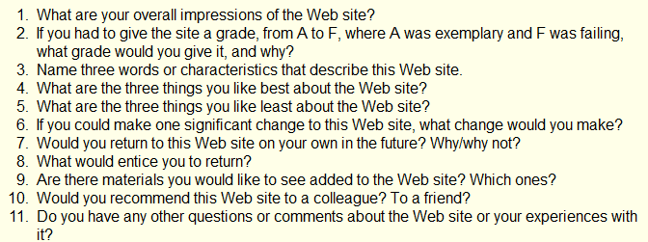
Questionnaire
The easiest way to gather satisfaction data is a questionnaire
There are several ‘standard’ questionnaires
  http://www.usabilitynet.org/trump/documents/Suschapt.doc
  http://www.w3.org/WAI/EO/Drafts/UCD/questions.html#posttest

Slide 11
Questionnaire – open and closed
Open questions (as per previous slide) give you rich qualitative data
  Best for finding the seeds of resolutions to problems
Closed questions allow you to quantify
  Would you recommend this website to a friend? [Circle one] YES NO
Yes/No is OK, but better to use Likert scale
  This website is easy to use: Strongly Agree Agree Disagree Strongly Disagree
  Converts to scores (1-4, 1-7, etc.), can report mean and other statistics and graphs
There’s a whole world to writing questionnaires; starter: http://www.terry.uga.edu/~rgrover/chapter_5.pdf

Slide 12
Logistics
Don’t under-estimate the practical problems
  If you get something wrong you can lose a lot of time (and, in most situations, money) having to reschedule
    Running a quick pilot or walkthrough can help here
Have you figured out…
  How to pay / reward participants?
  Any catering for longer session (including your staff if the experiment is in the ‘field’)?
  Do you have enough power points and battery life?
  Enough storage capacity (e.g. on your digital camera)?
  The time and ability to ‘reset’ in between participants?

Slide 13
Details (not on that sample template!)
Analysis plan
  How are you going to turn the raw observations into assessment against your usability requirements, and into recommendations?
  It’s one thing to declare ‘time’ as a metric and plan to collect video, but have you defined exactly which elements of the task you are timing, and the protocol for marking the task time?
    Is your method practical and accurate? Will it support the overall purpose of your usability test
  What is your plan for how to report the findings
    What, to whom, when and toward what follow-up action?

Slide 14




Half time entertainment
https://www.youtube.com/watch?v=3Qg80qTfzgU

Slide 15
Write a Script
Back to the test plan…
Script the usability study EXACTLY
  Greeting
  Ethics
  Task instructions
  Questionnaire
If you don’t have a script you WILL get lazy and miss instructions for later participants.

Slide 16
Pilot Test
Try the whole thing out on one or two people (or more if it’s a really important and large usability study)
After first person fix obvious problems
  If very few corrections needed in test plan then you can go straight to testing
  But it is much better to do a second pilot than discover major problems half way through

Slide 17
Analyse Results
Task time and success
Errors – you’ll want counts and to form categories
  Wrong navigation
  Problems finding particular features
  ……….
Questionnaire analysis
  If around 10 people or less, show raw data, mean and standard deviation
  If more than 10 people, box plots or frequency distribution graphs might be appropriate

Slide 18
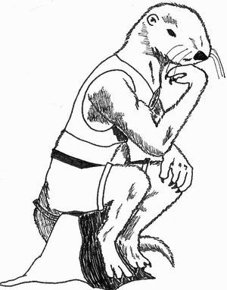
Think!
The big picture
What have you found?
What is worth fixing?
  Is there a business case?
How could the problems be alleviated?

Slide 19
Report
Document
  Detailed report of everything you have found
    Three formats here
      http://www.usability.gov/templates/index.html
    Remember numbers are very convincing, compare:
      Several people had trouble finding the shopping basket
      3 out of 7 people abandoned the task because they couldn’t find the shopping basket. For the other 4 the average time to find the shopping basket was 3.59seconds (longest 8.0 seconds)
Video
  Imagine clipping together the 7 people looking for the shopping basket icon … with puzzled looks on their faces!

Slide 20
Ethics
If you are doing a study with living (human or animal) participants in a university you will probably need ethics approval
  Can be quite a lot of paperwork, and takes a while to get an answer (which is usually to revise and re-submit!)
  You will need such approval for a study to be part of your dissertation or thesis
  Many journals require such approval to publish
Quite a few companies have similar requirements
This is why for your assignment you are not testing on others – though you could ask classmates…

Slide 21
Research ethics basics
Informed consent
  Participant knows what they are ‘in for’
    Task, time, why you’re doing it (even though you may be allowed to ‘deceive’ them about some aspect of the task)
    Confidentiality of their data
    Compensation (if any)
Participant is clear that they are not compelled to participate
  This is a bit of a trick in lecturers experimenting on their students! (or doctors on patients, or bosses on their employees)
  They need to know that they can refuse, or withdraw (even retrospectively!) without jeopardising the key service (healthcare, education, employment)
Anonymous questionnaires, esp. in public, are probably the easiest from an ethics perspective

Slide 22
Ethics application
Explains protocol and goals: essentially like a test plan
  And so it’s helpful to complete one because it acts as a check on your plan
Particular focus on issues such as who has access to the data and the risk (and benefits, if any) to participants
Research organisations (University, District Health Board) have standing committees to review applications
  Have representatives from a range of perspectives: clinical, legal, statistical (and Maori in NZ)

Slide 23
Professionalism
(in usability test reporting)
Treat participants with respect
  Assume they are not idiots, it is the software that is wrong
Treat developers with respect
  They may have put their heart and soul into the product and worked overtime to get if finished for you to pull it apart
Make sure your report is
  Fair and accurate
  Tidy
  Free from grammar and spelling errors

Slide 24

In the real world
If you can’t do a ‘real’ usability test
  Get your mates, Mum, Dad, Aunty Flo to try it
Tune-in to your own usability experiences
  Note what was really easy
    that’s a sign of good usability
  Note what is annoying you
  Note when you are trying to do something you have done before and can’t remember how.

Slide 25
Summary
Evaluate usability early and often in development and [preferably staged] roll-out
  Also evaluate alternatives before making a decision to purchase/adopt a system
In more formal settings, you need a complete and detailed testing plan
Heuristic evaluation is a handy intermediate level between just asking a couple people for feedback and doing a full-blown usability study

