Slide 1
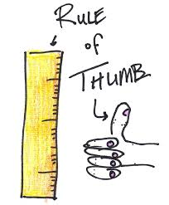
Lecture 5
Heuristic evaluations & Early prototype Evaluations
Heim, Chapters 5.4-5.6

Slide 2
Learning objectives
  To be aware of a range of heuristic evaluation options appropriate to the analysis and design phase
  In particular well known heuristics of usable systems
    Nielsen’s heuristics
    Schneiderman’s rules
To understand the difference evaluation challenges of early prototypes with limited functionality
Be aware of the requirements for assignment 1

Slide 3
Heuristic evaluations
Expert evaluation
  An expert looks at a system using common sense and/ or guidelines (e.g. Nielsen’s Heuristics)
  More http://www.upassoc.org/upa_publications/jus/2008november/JUS_Kirmani_Nov2008.pdf
Expert - reviewer
First law of usability:
Heuristic evaluation has only 50% hit-rate
Predicted
problems
False problems
Actual
problems
Missed problems

Slide 4
Evaluation – Heuristic Evaluation
Heuristic evaluations are performed by usability experts using a predetermined set of criteria designed to measure the usability of a proposed design.
The evaluator follows a scenario through the design and tests each step against the heuristic criteria.
Carrying out a heuristic evaluation is an excellent way to get an understanding of a system that you are going to usability test….
  But be careful, it can prejudice your study design
Or a heuristic evaluation can be stand-alone with the evaluator making observations and recommendations based on their experience.

Slide 5
Evaluation – Nielsen’s Heuristics
In collaboration with Rolf Molich, Jakob Nielsen developed a set of 10 heuristics for interface design.
The revised set based on an analysis of 249 usability problems.
http://www.useit.com/papers/heuristic/heuristic_list.html

Slide 6
Nielsen’s Heuristics
Visibility of System Status
Match between System and the Real World
User Control and Freedom
Consistency and Standards
Error Prevention
Recognition Rather Than Recall
Flexibility and Efficiency of Use
Aesthetic and Minimalist Design
Help Users to Recognise, Diagnose, and Recover from Errors
Help and Documentation

Slide 7
Nielsen’s heuristic #2
Does the vocabulary match the user’s expectations and knowledge?
  Are you calling the objects on the screen by terms that the user understands (and finds natural)?
    E.g. ‘student #’ or ‘user id’ or ‘UPI’
Does the workflow match the task?
  Will the user have all the required information at the time I am asking?
  Are they copying from a paper source that lays out the material differently than my data input screen?
  Am I making them stop in the middle of a task they’d rather not interrupt?

Slide 8
Nielsen heuristic #6
If I can put the item on a dropdown list, then I should
  Why make them type it in and maybe choose an option that’s not available?
Show the user something
  Maybe you’ll get lucky and it’ll be just what they want!
  E.g. I hate a search that makes me specify whether I want those options available starting with ‘A’ or ‘B’ etc. (or even worse, just a blank)
    You can give me shortcuts to those, but have an alphabetic list visible (maybe have most frequent, or last selected options at very top!)
Basically, use menus and lists instead of relying on blanks

Slide 9
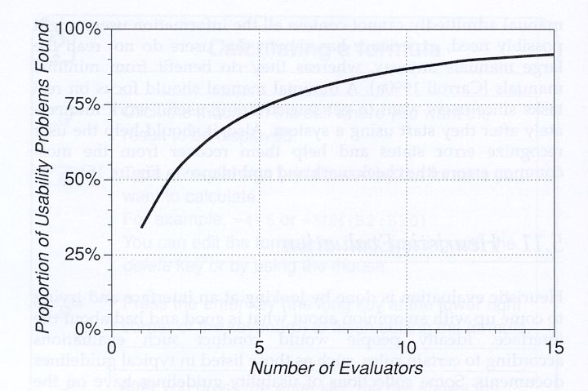
Nielsen’s Advice for Heuristic Evaluations
Use multiple independent evaluators
Use an observer to record evaluator
Go through the interface several times
Compare interaction against list of heuristics
Use heuristics specific to design
List heuristic problems and how the heuristic is violated
In assignment 1, we have you heuristically evaluate the interface

Slide 10
Shneiderman’s 8 Golden Rules
Strive for consistency
  E.g. exact same terms for objects, same command syntax throughout
2. Enable frequent users to use shortcuts
3. Offer informative feedback
4. Design dialogs to yield closure
5. Offer error prevention and simple error handling
6. Permit easy reversal of actions
7. Support internal locus of control
  Make users initiators rather than responders (e.g. direct manipulation!)
8. Reduce short-term memory load
  What the user needs to know should be readily visible

Slide 11
A world of heuristics
Can be devised for more specific domains
  For physical format – e.g. web pages http://www.psu.edu/webconference/Web2004/Materials/Heuristic.pdf
    Domain specific concepts like good background graphics
    ‘Housekeeping’ like correct spelling & grammar
    May want to evaluate the search function
  For task domain – e.g. in health…
    Is patient name and date-of-birth clearly visible at all times?
    Does the interaction fit to clinical workflow?
Can be quite long
  About 100 heuristics for mobile apps:
  www.tmap.net/sites/tmap.../Checklist_Mobile_App_Testing_0.docx

Slide 12
Evaluating Prototypes
Evaluating early prototypes is a bit different to evaluating fully functional systems because of the lack or limited functionality.
The system could just be a block of wood with some dials drawn on it!
Or could be a semi functional prototype in a prototyping environment or UI design tool

Slide 13
Half time distraction
Pay no attention to that man behind the curtain”
  www.youtube.com/watch?v=YWyCCJ6B2WE

Slide 14
Wizard of Oz prototype evaluation
“Can make a ‘functional’ prototype where a key function is performed by a human, Wizard of Oz
  This was done for early testing of speech-to-text interfaces (a ‘listening typewriter’)
  The speech-to-text function was implemented by a good [human] typist!
Great for testing usability of systems with an AI before the AI is implemented
  E.g. in some types of video games
The less realistic the prototype the more creative user feedback you will receive
  So really good for disruptive technologies.

Slide 15
Functional prototypes
Functional prototypes are interactive prototypes that represent various degrees of functionality
Functioning prototypes can be created using
  Prototyping tools ( eg Balsamiq see next slide)
  Or RAD environments, such as:
    Microsoft
      Visual Studio
    Adobe
      Flash
      Dreamweaver
      Director

Slide 16
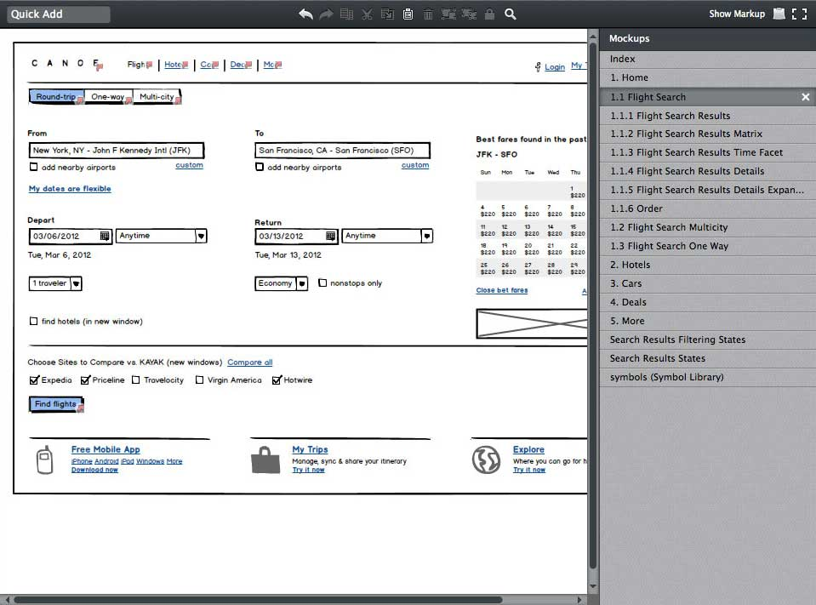
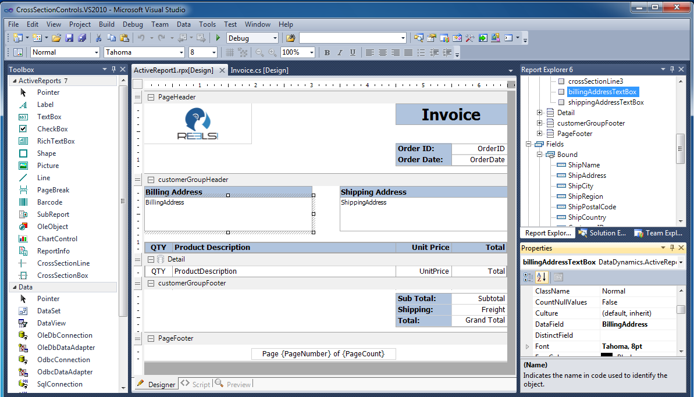
Prototyping tools
Advantage
  Closer to the real interface and can explore the functionality a bit more
Disadvantage
  Lock down the design, therefore inhibit creativity
Balsamiq
Visual Studio

Slide 17
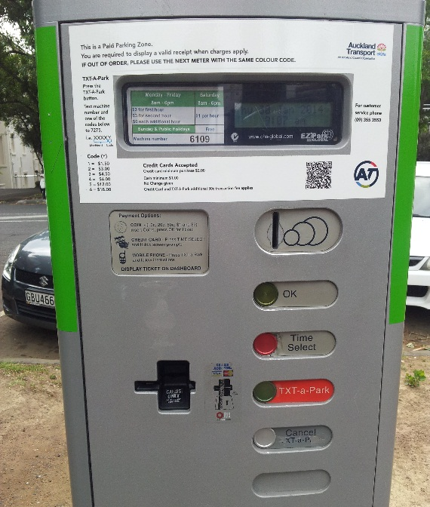
Assignment 1
The purpose of assignment 1 is to get you to DO some of this.
Your job is to analyse a UI and then plan a usability test for parking meters on Princes St.
  HTA of the interface.
  Heuristic evaluation of the interface
  Plan a usability test (we will cover this in the next couple of lectures).
Full specification https://www.cs.auckland.ac.nz/courses/compsci345s1c/assignments/
Due 11:59pm on Sunday 23 March 2014 https://adb.auckland.ac.nz/

Slide 18
Summary
Heuristic evaluations are
  Expert reviews and often include
  Modelling the interface (eg HTA)
  Evaluating against a set of guidelines
    ….
    ….
  Early prototype evaluations vary from functional systems evaluations depending on the stage of development and amount of functionality provided.
Assignment 1 requires you to undertake a heuristic evaluation and plan a usability test

