Slide 1
L4 Usability Evaluations
Introduction
Notes from
Heim Chapter 8 and
http://www.usability.gov/

Slide 2
Learning objectives
Be able to define usability
Be able to describe aspects and measures of usability
Appreciate that usability depends on context
Be aware of the major types of usability evaluations

Slide 3
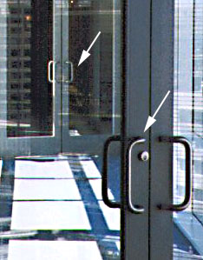
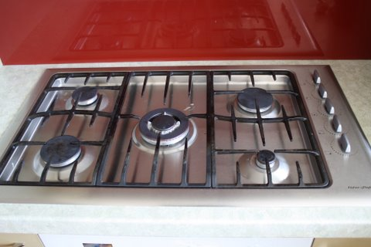
What is the point?
To ensure that users can use the system as intended!
There are many examples of bad usability.
Often problems can be very easily solved!

Slide 4
The first time you user test your own software
You will be horrified at how bad it is!
You will find most of the problems are easy to fix
You will become intolerant of poor usability!
(Well, maybe that’s not all true, but that’s the general direction…)

Slide 5
What is usability?
Usability is the measure of the quality of a user’s experience when interacting with a product or system (www.usability.gov 2006)
Usability is a quality attribute that assesses how easy user interfaces are to use (Nielsen 2003)

Slide 6
Usability Factors
Fit for use (or functionality) – Can the system support the tasks that the user wants to perform
Ease of learning - How fast can a user who has never seen the user interface before learn it sufficiently well to accomplish basic tasks?
Efficiency of use - Once an experienced user has learned to use the system, how fast can he or she accomplish tasks?
Memorability - If a user has used the system before, can he or she remember enough to use it effectively the next time or does the user have to start over again learning everything?
Error frequency and severity - How often do users make errors while using the system, how serious are these errors, and how do users recover from these errors?
Subjective satisfaction - How much does the user like using the system?

Slide 7
Fit for use
Does the system function as expected
  Do the users meet their goals in a timely fashion?
Finding ‘bugs’ - otherwise know as errors is NOT the goal!
  usability testing ≠ system testing
  But you are aiming to elicit any usability problems if they’re there
Keep in mind: What are the system goals? E.g.
  To achieve a specific state
    Book a flight
    Pay someone the correct amount
  To participate in a computer mediated experience
    Play games

Slide 8
Setting usability goals
Not necessarily a 1-dimensional measure; may have multiple threshold requirements
  Average = 2 /hour
  Over 50% less than 1 /hour
  Less than 5% over 5 /hour
Can have varying levels of success
  E.g. minimum: not worse than the old way!
User errors per hour using the system
Unacceptable
Minimum
Target
Exceeds
5
4
3
2
1
0
Current value
Planned value
Optimal

Slide 9
Ease of learning
Do you expect to have to read a manual or the help?
  Or an online tutorial, or take a training class, or use the help hotline?
How much time are you prepared to invest in
  Learning a new interface?
  Finding something on a web site?
What are your usability expectations for a
  programming IDE?
  a mobile phone?

Slide 10
Efficiency of use
Do you use the self checkout at the supermarket?
Do you use ATM machines?
Is it quicker to order a pizza over the phone or on line?
Which of these is cheaper for the retailer?
How about business processes.
  If every academic member of staff at UoA (3000) wastes 10 hours a year because the performance review system has a poor interface
  3000*10 = 30,000/1700(work hrs per year) = 17.64 years work

Slide 11
Memorability
Are there some things you just can’t remember how to do?
A good interface is one where you remember or can, with prompts, recall what to do
‘Good enough’ is contextual
  If most users are expected to use a feature a often, they shouldn’t have much trouble retaining how to use it
    Catering for infrequent users puts on the pressure
  For me (Beryl Plimmer) functions related to end-of-semester marks can be a problem
    Probably use max of twice a year
    Only get to use the feature a handful of times before the system changes!

Slide 12
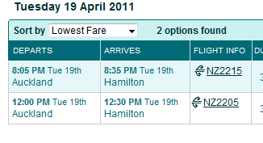
Error frequency and severity
How frequently do users make errors?
  Touch phone typing ☹
  Long and complicated forms
    It might reduce errors to have dropdown lists to choose from
    But it might be slower than entering with auto complete.
What is the cost of errors
  A patient suffers seizures because a
  drug-drug interaction was missed!
  Booking a flight for 8pm when
  you wanted 8am
Midday? Midnight?

Slide 13
Human error - slips and mistakes
Slip – I knew how to do that, but I failed
  understand system and goal
  correct formulation of action
  incorrect action
Mistake – I didn’t really know what I was doing
  may not even have right goal!
Fixing things?
slip – redesign interface to make task easier to execute
mistake – need to help the user better understand the system
© 2004 Dix et al.

Slide 14

Half time entertainment
Computer Animal interaction
http://m.youtube.com/watch?v=GrM2mh0Sy9Y
  (thanks hngo423)
Mancini, Clara. "Animal-computer
interaction: a manifesto."
interactions 18.4 (2011): 69-73.
http://gamesforcats.com/
  And just for fun – try it on your cat and record the results
  Unscientific cat-computer interaction survey https://docs.google.com/forms/d/1ixd-u847gMCltFkfhnXuzWPr5ljApOWpETvgtnIO3ZA/viewform

Slide 15
Subjective satisfaction
If users like the interface
  They will make less errors
  They will persist longer when they are having problems
Aesthetics – how nice it looks is incredibly important in this respect
  There can be a lot underpinning a perception of looking ‘nice’
    Good Contrast / font size, clean layout, good grouping
    Appropriate language
    Good fit to workflow
  ‘Ugly’ may mean fatiguing, inefficient or apt to produce errors

Slide 16
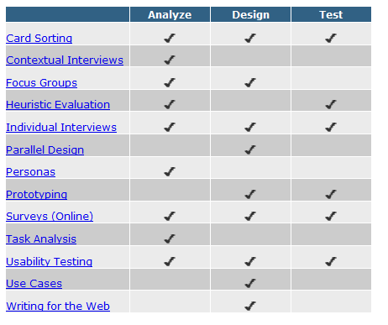
Types of Usability Evaluations
Heuristic evaluations
Performance measurements
Usability studies
Comparative studies
http://www.usability.gov/methods/

Slide 17
Heuristic evaluations
Expert evaluation
  An expert looks at a system using common sense and/ or guidelines (e.g. Nielsen’s Heuristics)
Covered in next lecture
Expert - reviewer
First law of usability:
Heuristic evaluation has only 50% hit-rate
Predicted
problems
False problems
Actual
problems
Missed problems

Slide 18
Performance Measurements
I.e., an analytical performance measurement that can be extracted directly from the interface as compared to an empirical performance measurement observed in a usability study
  Fitts’ Law is the classic performance measure for time to complete the task of pointing at an object
  Hick–Hyman Law time taken to make a decision (e.g., that is the object I want!)
There are other more comprehensive models we won’t cover here
  KLM – keystroke-level model
  GOMS – goals, operators, methods and selection rules

Slide 19

Fitts’ Law
Fitts’ Law is the classic performance measure.
  Time to target depends on target width (W) and distance to move pointer (D) (see tutorial exercise)
  It is a very valuable measure for designing
    Control size and location
    Its also fun to play with!
2
1
3

Slide 20
Hick–Hyman Law
The time it takes for a person to make a decision as a result of the possible choices
Particularly important for menus
  Although log2 only holds if menu is sorted in a logical order (e.g. alphabetical) – otherwise search time is linear!
Other factors
  Recognition time: for icon or word
  Consistency is good: spatial memory is very powerful –
    Knowing it’s at the left/right side, top/bottom

Slide 21
Usability studies
Empirical user test
  Get real users to try to perform specified tasks
  Observe and record
  Ask their opinion
Analyse results
  What is causing problems?
  How can you fix them?

Slide 22
Usability studies
Specific tasks
  Observed
  Recorded
  Measured
  Think-aloud
I try this
because ...
User doesn’t
notice ...
Facilitator
Listens
Asks as needed
Logkeeper
Listens
Records problems
User
Performs tasks
Thinks aloud

Slide 23
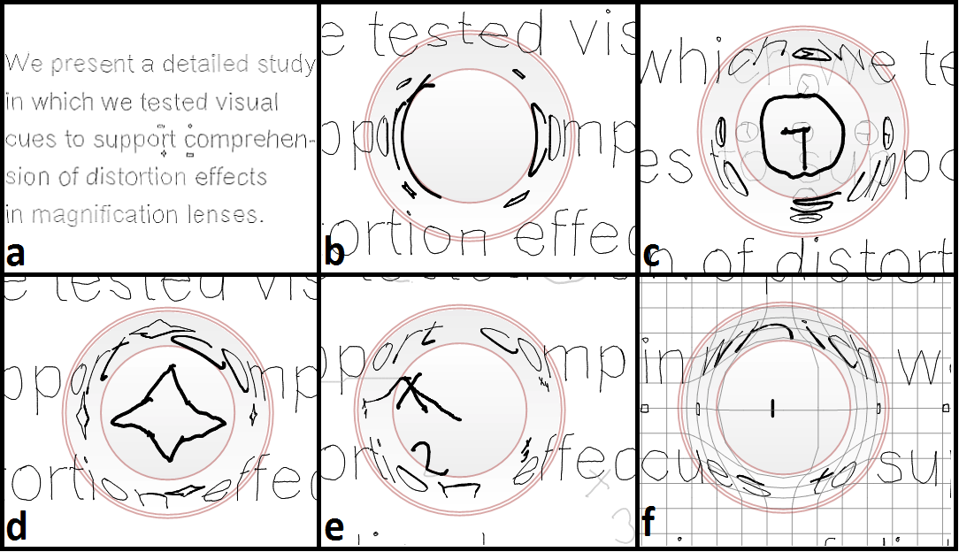
Comparative Studies
Evaluate the efficacy of two (or more) systems
or more often very fine-grained interaction techniques
Which of these magnification lenses is the most effective?
This is covered in the advanced class (CS705/SE702)
Schmieder 2014 Reducing Screen Occlusions on Small Displays, PhD Thesis

Slide 24
Evaluation
Evaluation is an integral part of the development process and can take the form of an informal walkthrough or a more structured heuristic evaluation.
Formal usability testing can begin once a prototype has been developed.
Evaluation of an existing system is often part of the analysis stage
Starting the evaluation process early in the design phase fosters better design because decisions can be tested before its too expensive to make changes

Slide 25
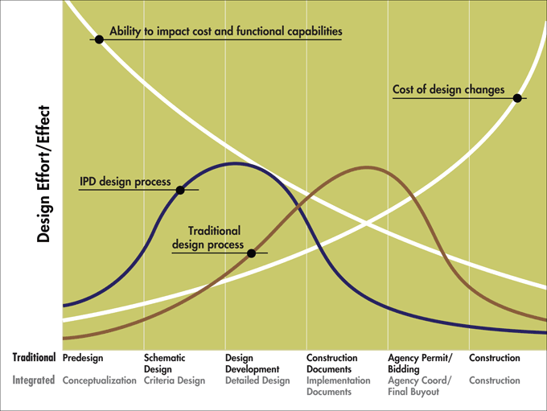
MacLeamy curve
From the construction industry, but fits well to construction of software, too!
MacLeamy 2004
IPD=integrated project delivery

Slide 26
Next
Overview of usability testing
  What you might find out
  How you might use it
Planning and performing a usability test
  You have to do write a plan for one in Assignment 1.

