Slide 1
Lecture 3
Discovery
Interpretation
Documentation
Heim, Chapters 4.3 - 4.4
and Dix et al, Chapter 15

Slide 2
Interpretation
By the end of this lecture you will be able to describe each of the following.
Task Analysis
Storyboarding
Use Cases
Primary Stakeholder Profiles

Slide 3
Interpretation - Task Analysis
Task analysis is a way of documenting how people perform tasks
A task analysis includes all aspects of the work flow
It is used to explore the requirements of the proposed system and structure the results of the data collection phase or document an existing system

Slide 4
Interpretation - Task Analysis
Task decomposition
  A linear description of a process that captures the elements involved as well as the prevailing environmental factors.
Hierarchical task analysis (HTA)
  HTA provides a top-down, structured approach to documenting processes.

Slide 5
Task decomposition
Include the following in a task decomposition
  The reasons for the actions
  The people who perform the actions
  The objects or information required to complete the actions
Task decompositions should capture:
  The flow of information
  Use of artefacts
  Sequence of actions and dependencies
  Environmental conditions
  Cultural constraints

Slide 6
Task decomposition elements
Goal – top-level goal of the task being analysed
Plans – the order and conditions for proceeding with the sub-tasks
Information – all the information needed to undertake the task
Objects – all the physical objects involved
Methods – the various ways of doing the sub-tasks

Slide 7
Textual HTA description (from Dix et al.)
Note this section of Dix is on the Cecil pages for the course
Hierarchy description ...
0. in order to clean the house
1. get the vacuum cleaner out
2. get the appropriate attachment
3. clean the rooms
3.1. clean the hall
3.2. clean the living rooms
3.3. clean the bedrooms
4. empty the dust bag
5. put vacuum cleaner and attachments away
... and plans
Plan 0: do 1 - 2 - 3 - 5 in that order. when the dust bag gets full do 4
Plan 3: do any of 3.1, 3.2 or 3.3 in any order depending
on which rooms need cleaning
N.B. only the plans denote order or selection (ifs)

Slide 8
Generating the hierarchy
1 get list of tasks
2 group tasks into higher level tasks
3 decompose lowest level tasks further
Stopping rules
How do we know when to stop?
Is “empty the dust bag” simple enough?
Purpose: expand only relevant tasks
Motor actions: lowest sensible level

Slide 9
Tasks as explanation
imagine asking the user the question:
what are you doing now?
for the same action the answer may be:
typing ctrl-B
making a word bold
emphasising a word
editing a document
writing a letter
preparing a legal case

Slide 10
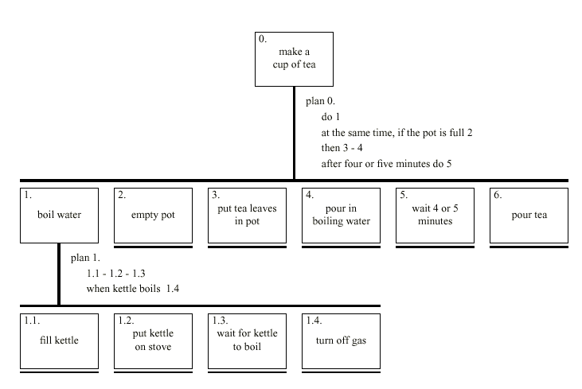
Diagrammatic HTA

Slide 11
Refining the description
Given initial HTA (textual or diagram)
  How to check / improve it?
Some heuristics:
  paired actions e.g., where is `turn on gas'
  restructure e.g., generate task `make pot'
  balance e.g., is `pour tea' simpler than making pot?
  generalise e.g., make one cup ….. or more

Slide 12
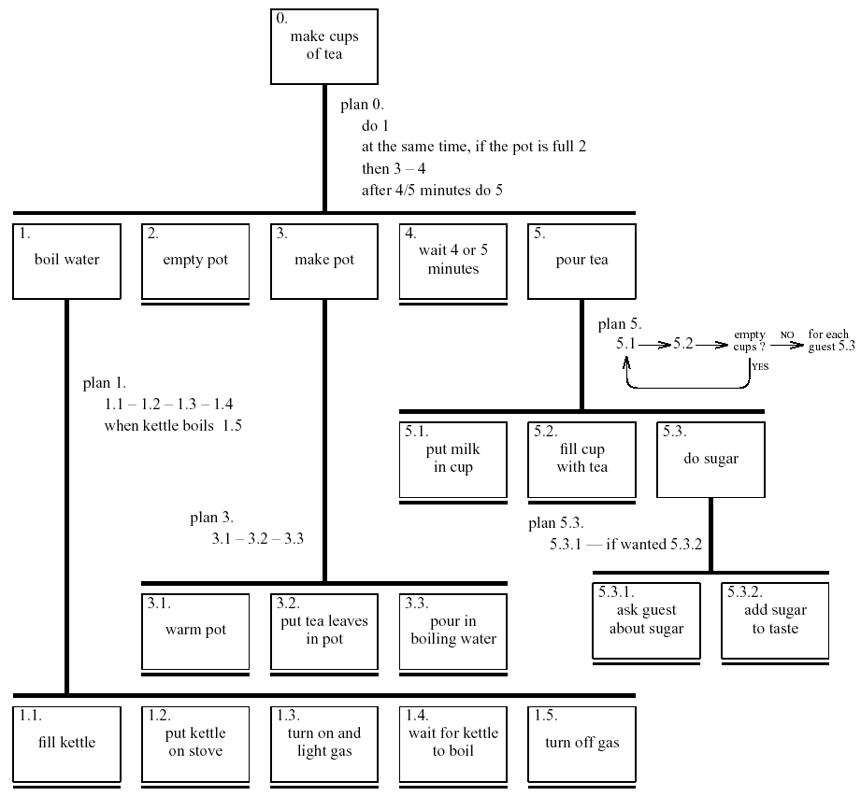
Refined HTA for making tea
This is what is required for Assignment 1

Slide 13
Types of plan
fixed sequence - 1.1 then 1.2 then 1.3
optional tasks - if the pot is full 2
wait for events - when kettle boils 1.4
cycles - do 5.1 5.2 while there are still empty cups
time-sharing - do 1; at the same time ...
discretionary - do any of 3.1, 3.2 or 3.3 in any order
mixtures - most plans involve several of the above

Slide 14
Diagram Notation
Element to be decomposed
Bottom of the hierarchy denoted by underline
Notice – no vertical line here
Different style of plan
Plans sits beside vertical
Numbering 1 – 1.1 – 1.1.1 ….

Slide 15
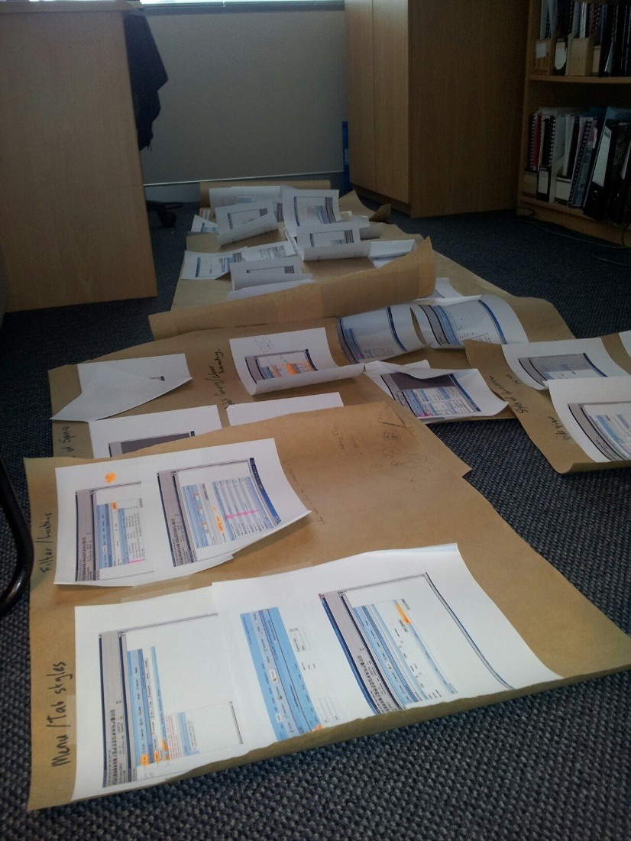
Half time entertainment
Important factoids you don’t need to know
http://www.nzherald.co.nz/opinion/news/article.cfm?c_id=466&objectid=11213878
In reality it is often
  Messy
  Confusing.

Slide 16
Interpretation - Storyboarding
Storyboarding involves using a series of pictures that describes a particular process or work flow
  Can be used to study existing work flows or generate requirements.
  Can facilitate the process of task decomposition
  Used to brainstorm alternative ways of completing tasks.

Slide 17
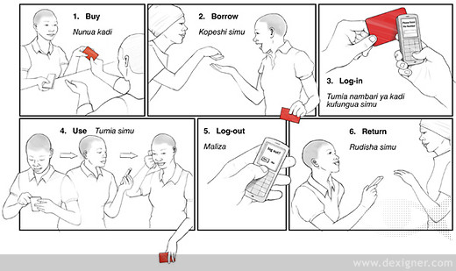
Storyboard
Example of a method for people who don’t own a cell phone handset to buy access for voice, SMS, etc. - http://www.dexigner.com/news/20788

Slide 18
Interpretation – Use Cases
Use cases represent a formal, structured approach to interpreting work flows and processes
  Designed to describe a particular goal and explore the interaction between users and the actual system components.
Jacobson et al. (1992)
Incorporated into the Unified Modeling Language (UML) standard.

Slide 19
Interpretation – Use Cases
The two main components of use cases are the actors and the use cases that represent their goals and tasks.
  Actors: similar to stakeholders, but can also include other systems, networks, or software that interacts with the proposed system.
  Use Cases: Each actor has a unique use case, which involves a task or goal the actor is engaged in.
    Describe discrete goals that are accomplished in a short time period
    Describe the various ways the system will be used and cover all of the potential functionality being built into the design

Slide 20
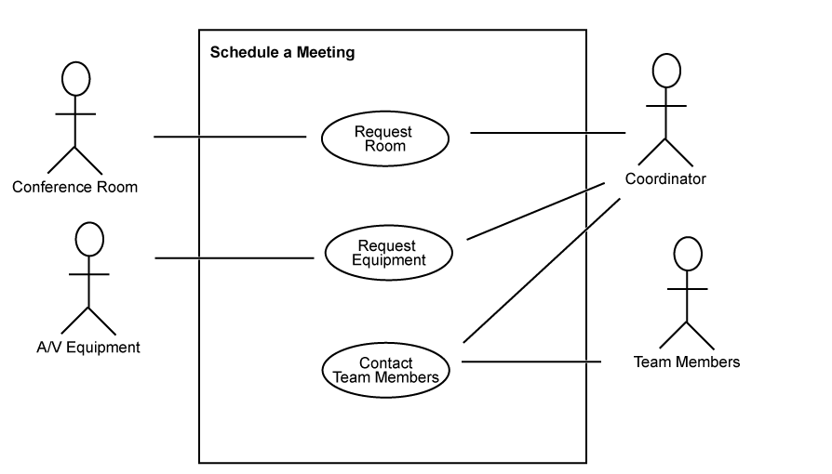
Interpretation – Use Cases
Notice we use a stickman symbol for the equipment!
Use case diagram of “schedule a meeting” process.

Slide 21
Use cases
The diagram provides an overview of the entities and their relationships through activities
This can be used to develop and explore scenarios
  Basic path – the steps proceed without diversions from error conditions
  Alternative paths – branches related to premature termination, choosing a different method of accomplishing a task, etc.
    E.g., what if the equipment isn’t available?

Slide 22
Interpretation - Primary Stakeholder Profiles
Primary Stakeholder Profiles are used to define the target user
The constructs covered include:
  Context of use
  Cognitive ability
  Physical ability
  Individual profile

Slide 23
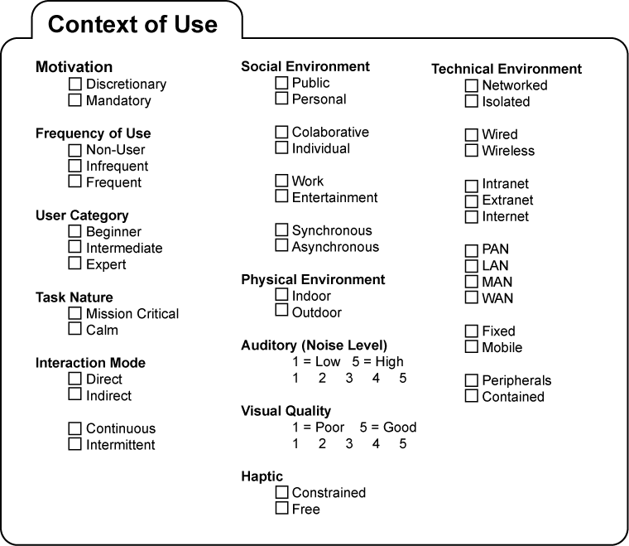
Interpretation - Primary Stakeholder Profiles

Slide 24
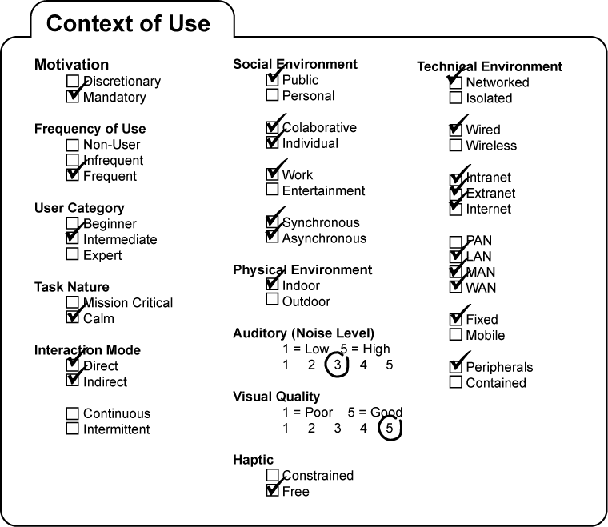
Interpretation - Primary Stakeholder Profiles
Context of Use for a common office desktop system

Slide 25
Primary stakeholder profile – cognitive and physical ability
Cognitive
  Education level
  Computer literacy
  Typing ability
  Cognitive style (e.g. Visual, Linguistic)
Physical ability
  Visual acuity, colour vision, auditory capability
  Motor ability

Slide 26
Primary stakeholder profile – individual profile
Age
Gender
Occupation
Interests
Country, language
Ethnicity, religion, socio-economics
These profile elements move us toward personas (and, with the context, toward scenarios) for Interaction Design

Slide 27
Documentation
Collating all the data and intermediate documents from the Discovery Phase
Working documents include
  Results of interviews, focus groups and surveys
  Results of brainstorming, task analysis, use case diagramming and primary stakeholder profiles
Collate into
  Mission statement
  Requirements document
  Project management document
  Usability guidelines

Slide 28
Documentation
Mission Statement
  Project goals:
    What is the value proposition?
    What needs will the new system address?
    How will it address these needs?
  Project scope
    What does the proposed design include or exclude?
    What are the external constraints such as time and finances?
    How will you decide when it satisfies the design proposal?

Slide 29
Documentation
Requirements Document
  Requirements
    Functional – what features must be present?
    Information – what information is needed to carry out the functions? And what outputs are required by the stakeholders?
    Physical – what’s it run on? (may need to accommodate organisation’s ‘legacy’ systems)
  Inputs/outputs – data format / translation issues?
  Constraints – physical, financial, time, data storage, networking, etc.

Slide 30
Documentation
Project Management Document
  Definition of the tasks involved in the project
  Risk – what could go wrong?
  Evaluation criteria and methods – what will constitute ‘success’?
  Implementation – e.g. phased in one department at a time
  Training
  Maintenance
  Future needs – anticipated requirements beyond the bounds of the ‘project’ per se

Slide 31
Summary
Crucial to identify all stakeholders in a project
Utilize a wide range of collection techniques to understand the needs of a project
HTA, storyboarding and use case techniques allow for interpretation of collated data

