Slide 1
Lecture 2
Discovery
Discovery Phase Framework
Collection
Heim, Chapters 4.1 - 4.2

Slide 2
Learning Objectives
The voyage of discovery is not in seeking new landscapes but in having new eyes.
(Proust, 1982)
To develop a set of skills for systematic analysis of a problem domain to discover HCI issues and requirements
To understand perspectives on data collection including types of stakeholders
To be able to collect data by interviews, focus groups and questionnaires

Slide 3
Discovery
During the collection portion you will formally identify:
  The people who are involved with the work
  The things they use to do the work
  The processes that are involved in the work
  The information required to do the work
  The constraints imposed on the work
  The inputs required by the work
  The outputs created by the work

Slide 4
Discovery
You will then interpret the information by:
  Creating descriptions of the people who do the work
  Describing the different goals involved in the work
  Documenting the work step by step
  Creating different stories about how the various aspects of the work are done
  Creating charts and diagrams of the work flow
  Tracing the different stories identified with the various people through the charts and diagrams

Slide 5
Discovery Phase Framework
The frame of reference must come from the observation and not be imposed on it
During the discovery phase we must find out what we will need to know about the work that people do
  We must understand what data is needed to create the design
  We must create the proper tools to gather and interpret that data

Slide 6
Exploring the Work Domain
Identify all stakeholders
  The people that are involved either directly or indirectly in the work flow
    The people who do the work
    The people who manage the people who do the work
    The people who are affected by the output of the work
    The people who will benefit in some way from the work

Slide 7
Exploring the Work Domain
There are four types of stakeholders:
  Primary—The person who uses the design directly
  Secondary—The person who either supplies input or receives output from the design
  Facilitator—The person who maintains or develops the design
  Indirect—The person who is affected by the use of the design but has no contact with it, such as the user’s superior or coworkers and the client who is paying for the project (the client may or may not also be the primary stakeholder)

Slide 8
Exploring the Work Domain
The primary stakeholders should have the most impact on the eventual design.
A new system that is not designed to be integrated with the work that other people in the company do may cause needless disruptions
All stakeholders should be considered during the design

Slide 9
Exploring the Work Domain
Understand the competition
  Learn from other design solutions
  Assess both the positive and negative aspects
  Respect copyrighted material and intellectual property
    You may need the help of your company’s legal team to sort out the right balance of ‘learning from others’ versus original design if you feel the competitor has got it right!

Slide 10
Organizing the Discovery Process
Filters
  Physical—We can describe the physical aspects of the activity.
    Where is it done?
    What objects are involved?
  Cultural—We can look at the activity in terms of the relationships among the people involved.
    Are some people in a position to orchestrate and evaluate the performance of other people?
  Functional—We can also look at these activities in terms of what actually happens.
    Do some people create things?
    Do other people document procedures and communications?

Slide 11
Organizing the Discovery Process
Filters
  Informational—We can look at these activities in terms of the information that is involved.
    What information is necessary to perform a task?
    How does the information flow from one person to another?
    How is the information generated?
    How is the information consumed?

Slide 12
Organizing the Discovery Process
The data collected must be organized and transformed into information
The tools we will explore include the following:
  Task analysis
  Storyboarding
  Use cases
  Primary stakeholder profiles
Interpretation means going from data to design requirements

Slide 13
Collection - Methods of Collection
Methods of Collection
  Observation: Valuable information can be obtained by watching people perform their activities in the context of the work environment.
  Observations can be made directly during the work day or indirectly using video and auditory recordings.
  Elicitation: Elicitation methods also involve direct and indirect methods of investigation, such as interviews, focus groups, and questionnaires.

Slide 14
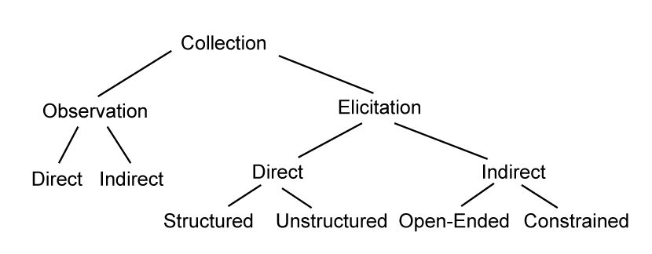
Collection - Methods of Collection

Slide 15

Collection –
Observation
Direct—Ethnographic
methods involve going to
the work site and
observing the people and
the infrastructure that supports the work flow
Indirect—You can use indirect methods of observation by setting up recording devices in the work place
  The use of indirect methods may require a significant degree of transparency

Slide 16
Collection - Observation
Concerns about Ethnographic Observations
  Your presence will affect the people you observe (positive and negative)
    ‘Hawthorne effect’ – employees act differently when ‘management’ is observing their work
  Your presence can become annoying
  It can raise questions with the ‘consumer’
    E.g. in health care – who’s that man in the corner?

Slide 17
Collection - Observation
Distributed Cognition - the tendency to off-load cognitive tasks to objects in the environment (e.g. post-its, calendar, whiteboard) or to distribute them among team members or coworkers

Slide 18

Half-Time Entertainment
My Blackberry is not working
https://www.youtube.com/watch?v=kAG39jKi0lI

Slide 19
Collection - Elicitation
Tools for eliciting information from the various stakeholders:
  Direct
    Interviews
    Focus groups
  Indirect
    Corporate documentation
    Logs and notes
    Questionnaires

Slide 20
Collection - Elicitation – Direct - Interviews
Be polite and courteous during interviews (people will judge the eventual software product by how you treat them at this stage! And people can be quite threatened that automation will take their job!)
Interviews
  On-site interviews: may help people remember aspects of the job
  Away from job site interviews: not interrupted by normal work related events

Slide 21
Collection - Elicitation – Direct - Interviews
Interviews
  Open-ended questions: can be used to explore issues and elicit rich information about complex topics
  Closed-ended questions: can generally be answered with a polar yes/no response or a simple description.

Slide 22
Collection - Elicitation – Direct - Interviews
Interviews
  Unstructured Interviews/Open-Ended Questions: Early in the design process interviews are generally loosely structured.
  Structured Interviews/Closed-Ended Questions: As the design process proceeds, interviews can become more structured and focused on specific details and areas of the design.

Slide 23
Collection - Elicitation – Direct - Interviews
Interviews
  Predefined Scenarios: The interviewer can use predefined scenarios to stimulate conversation and gain insight
  Focus of Interview: It is important that the purpose of the interview is clearly defined
  Wrap-Up: It is important to share your thoughts about the results of the interview, what will happen next and the timeframe
  Try to keep the interview under an hour
  Avoid leading questions that bias the result

Slide 24
Collection - Elicitation – Direct – Focus Groups
Focus Groups
  Require a moderator/facilitator to keep discussion on track
  Maintain spontaneity
  Have clearly defined outcomes
  Provide participants with a context for the project
  Work best if the participants have a ‘peer’ relationship
    If line workers won’t speak freely in front of line supervisors, then put them in two separate focus groups

Slide 25
Collection - Elicitation – Direct – Focus Groups
The advantages of focus groups:
  They are relatively inexpensive and easy to set up.
  They can be used early in the design process to help to identify and prioritize features.
  They help you to gain insight into people’s attitudes and motivations.
  They make it clear an opinion is an ‘outlier’
The disadvantages of focus groups:
  They only represent the views of one particular group.
  They are not statistically significant.
  They do not provide information about usability.

Slide 26
Collection - Elicitation – Indirect
Corporate Documentation—Information can be collected indirectly through corporate documents that reference policies and procedures.
Logs and Notes—Indirect methods can also include user participation;
  Ask people to keep a log of specific activities
  Collect (or photograph) the notes people make to remind them of procedures and policies
    sticky notes tacked onto a computer
    reminders stuck on a corkboard

Slide 27
Collection - Elicitation – Indirect - Questionnaires
Questionnaires are familiar
Questionnaires can contain open and closed questions
Questionnaires can include the following:
  Mutually exclusive choices (radio buttons)
  Non–mutually exclusive choices (checkboxes)
  Ranges (overlapping, open-ended)
  Scales (Likert scales, semantic differential scales)
  Short-answer fill-ins
  Comments

Slide 28
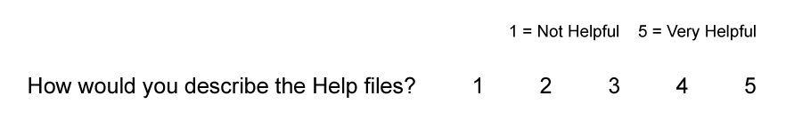
Collection - Elicitation – Indirect - Questionnaires
The following are guidelines for defining scales:
  Identify the scale and the significance of the units
  Use the most intuitive order
  You can use positive or negative scales or a combination of the two
  Use odd numbers when you want to allow neutral responses.
  Use even numbers when you want to force a choice of positive or negative.
  Provide a not applicable (NA) response when appropriate.
  Do not use too many degrees within the scale; seven is considered a general limit.
Likert scale.

Slide 29
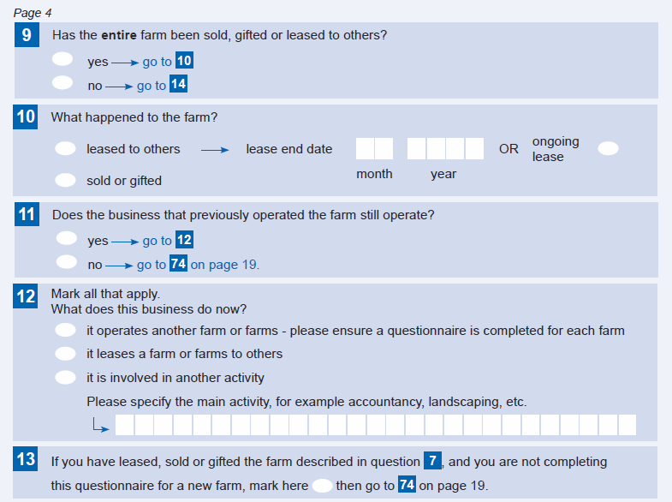
Survey form from www.stats.govt.nz

Slide 30
Collection - Elicitation – Indirect - Questionnaires
Advantages of questionnaires:
  They do not involve face-to-face contact and can be administered remotely.
  They can be used to supply information for primary stakeholder profiles.
  They can be used to ascertain whether proposed solutions will meet with acceptance as well as to elicit new ideas.
  They can also be used to double-check the feedback obtained from one-on-one interviews.
  They can reach a large audience with relatively little expense.

Slide 31
Collection - Elicitation – Indirect - Questionnaires
Disadvantages of questionnaires:
  Vague questions will return ambiguous responses that will serve no useful purpose or the design.
  People do not like to fill out long questionnaires.
  Closed-ended questions can restrict responses.
  Open-ended questions can be hard to quantify.

Slide 32
Collection - Elicitation – Indirect - Questionnaires
Guidelines for questionnaires:
  Be consistent.
  Phrase instructions clearly.
  Speak the user’s language.
  Avoid jargon or technical terms.
  Order the questions beginning with the easy or less controversial ones.
  Use logical grouping.
  Avoid compound questions.
  Use appropriate form elements, for example, radio buttons, checkboxes, and so on.
  Use an appropriate scales for questions with discrete responses.
  Avoid overlapping ranges.
  Include a “None of the above” when appropriate.
  Be sensitive to the balance of positive and negative questions

Slide 33
Survey tools
SurveyMonkey
  Popular solution to let you design and distribute questionnaires
  Runs ‘in the cloud’
LimeSurvey
  A free online tool that can be installed directly onto the researcher’s system, thus avoiding storage of data in the cloud (better control of confidential data)

