Slide 1
Lines and Borders
COMPSCI 345 / SOFTENG 350
Prepared by Safurah Abdul Jalil

Slide 2
Learning Outcomes
What is wire framing and why do you do it?
Why do you use lines and borders?
What are some of style options?
How are lines and borders used in Data Tables

Slide 3
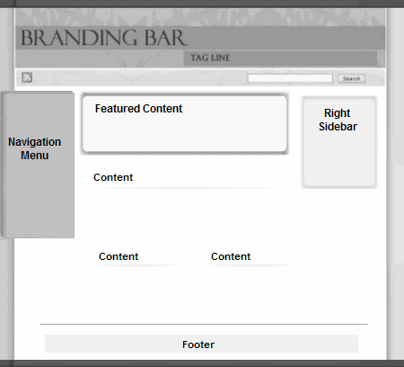
High level Layout
Wire framing your site (or system) is an important first step in design
http://www.usability.gov/methods/design_site/define.html

Slide 4
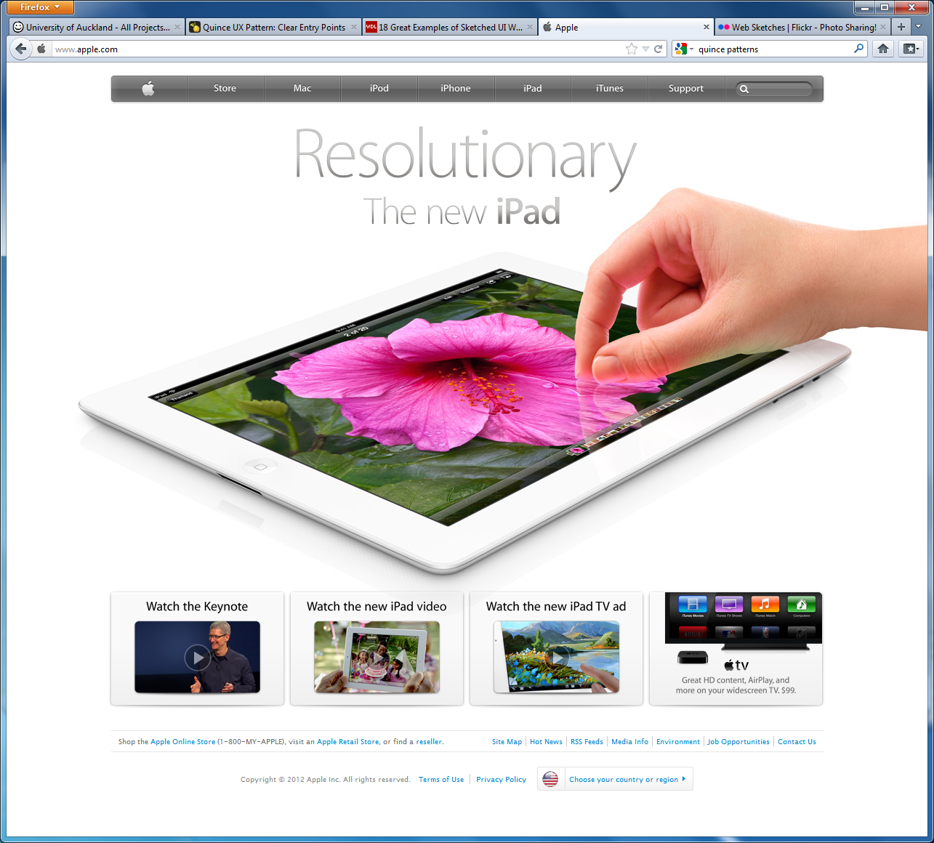
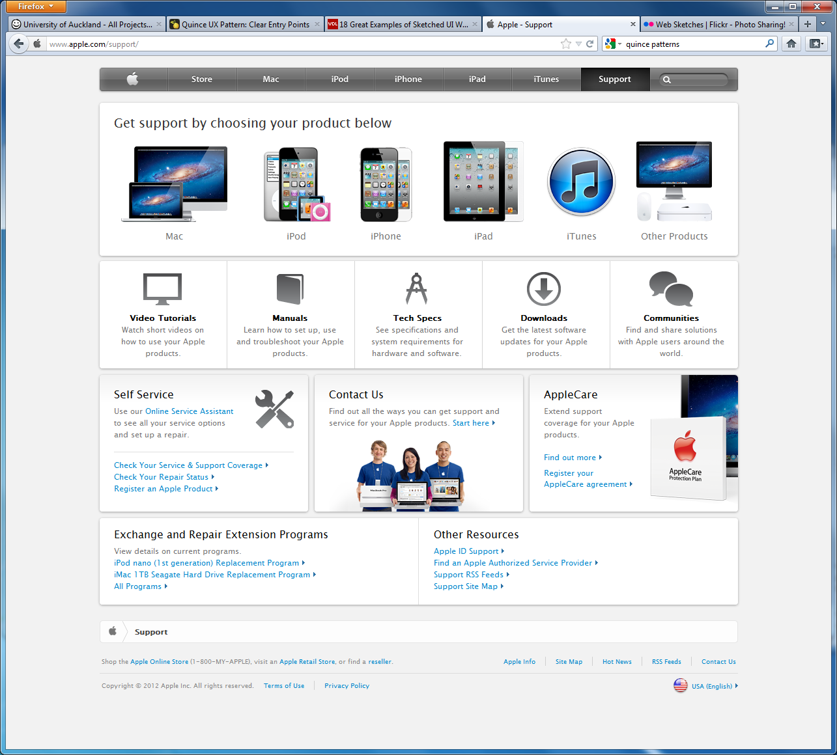
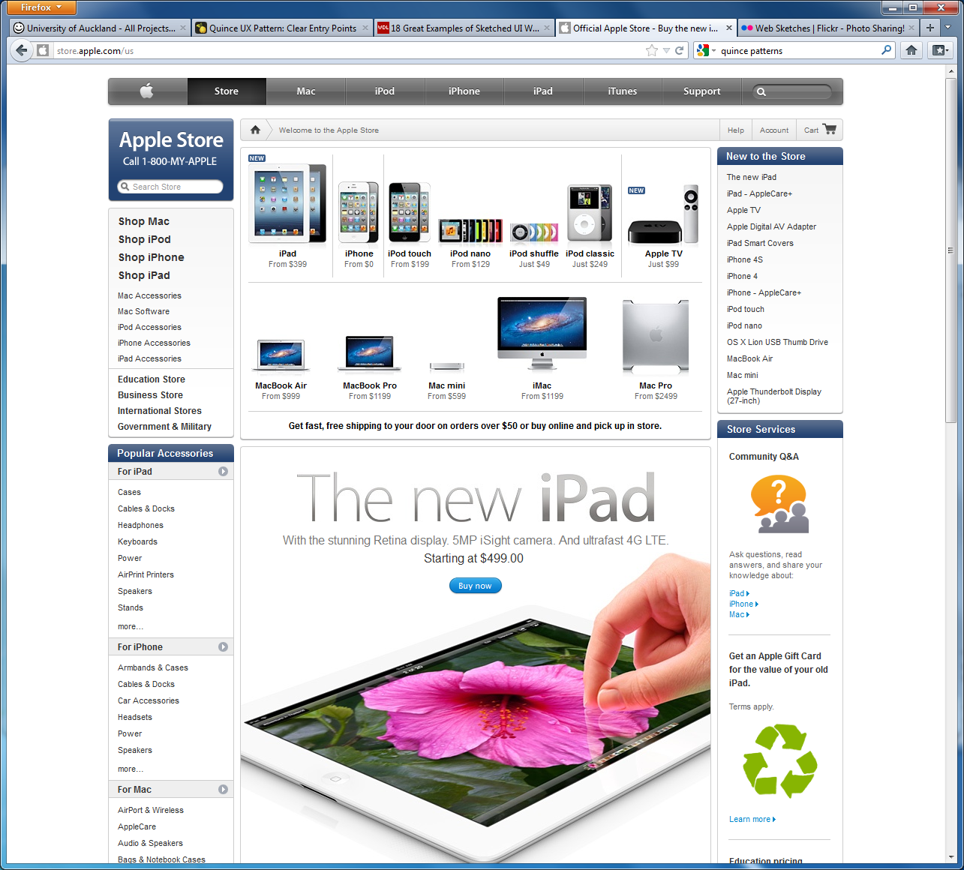
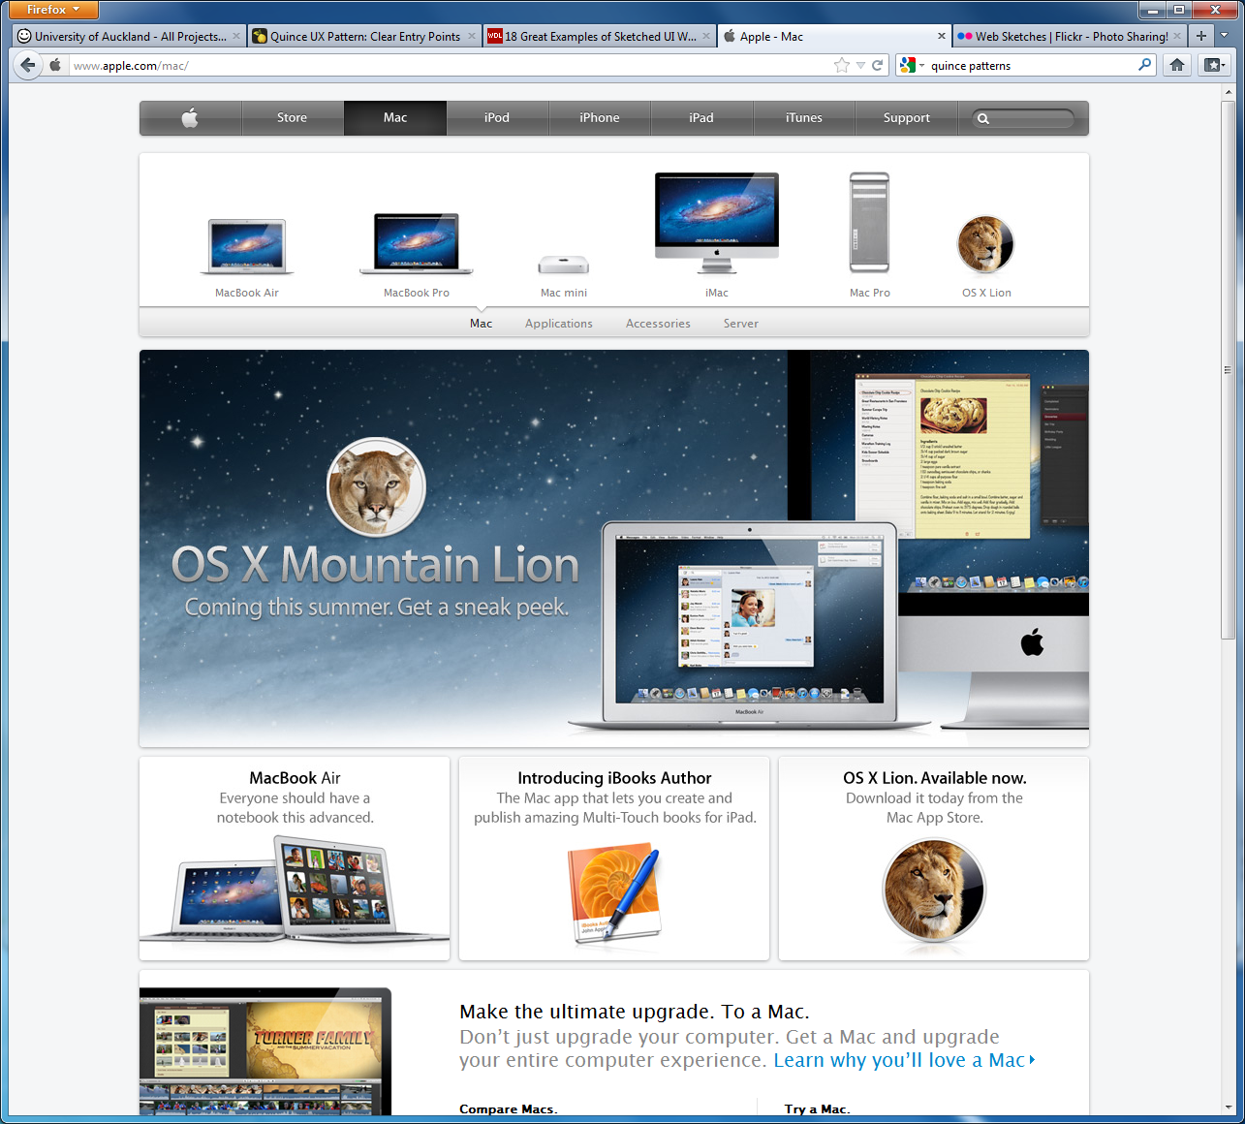
Analysing existing pages
Quite a range of layouts but a consistent feel
www.apple.com/

Slide 5
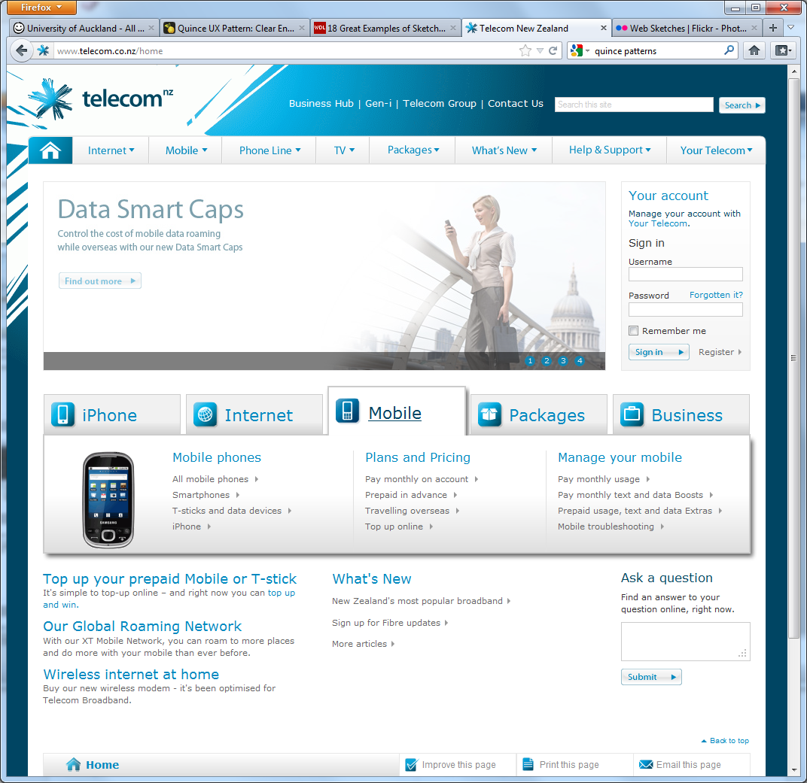
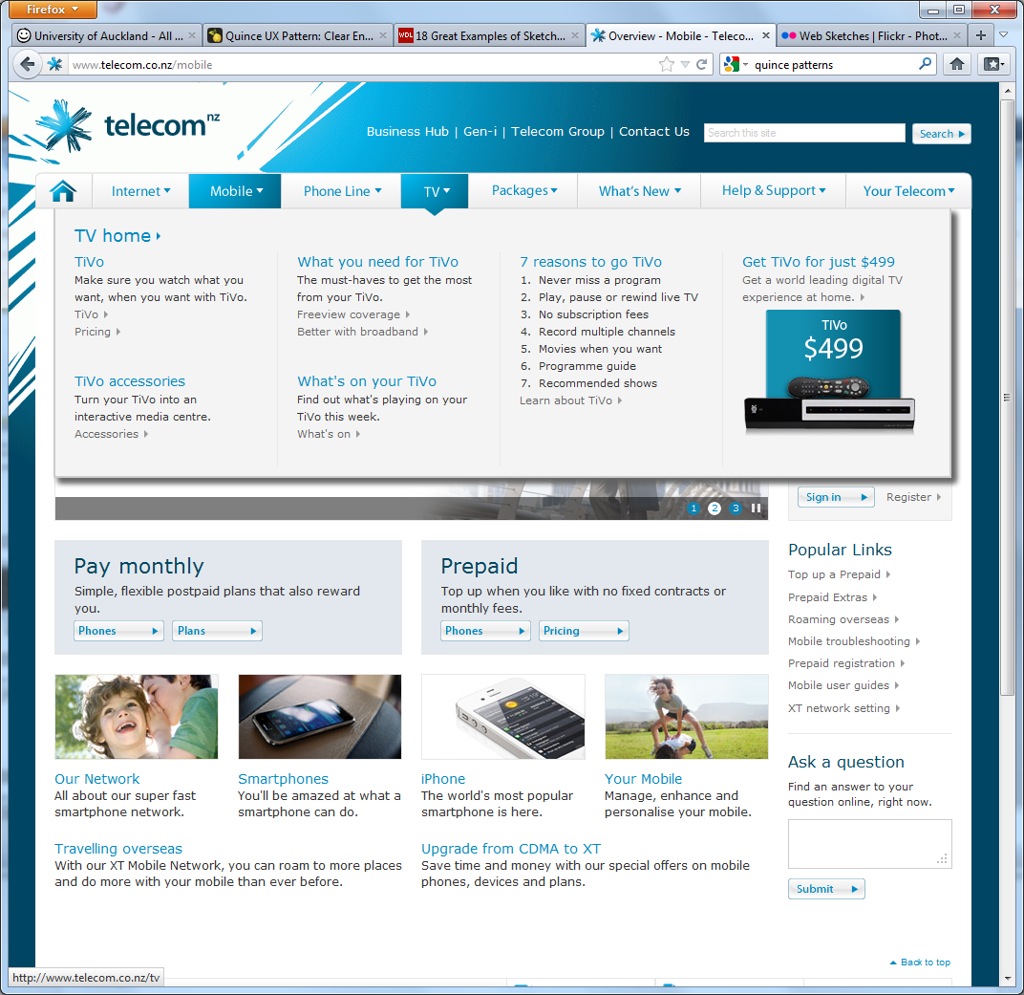
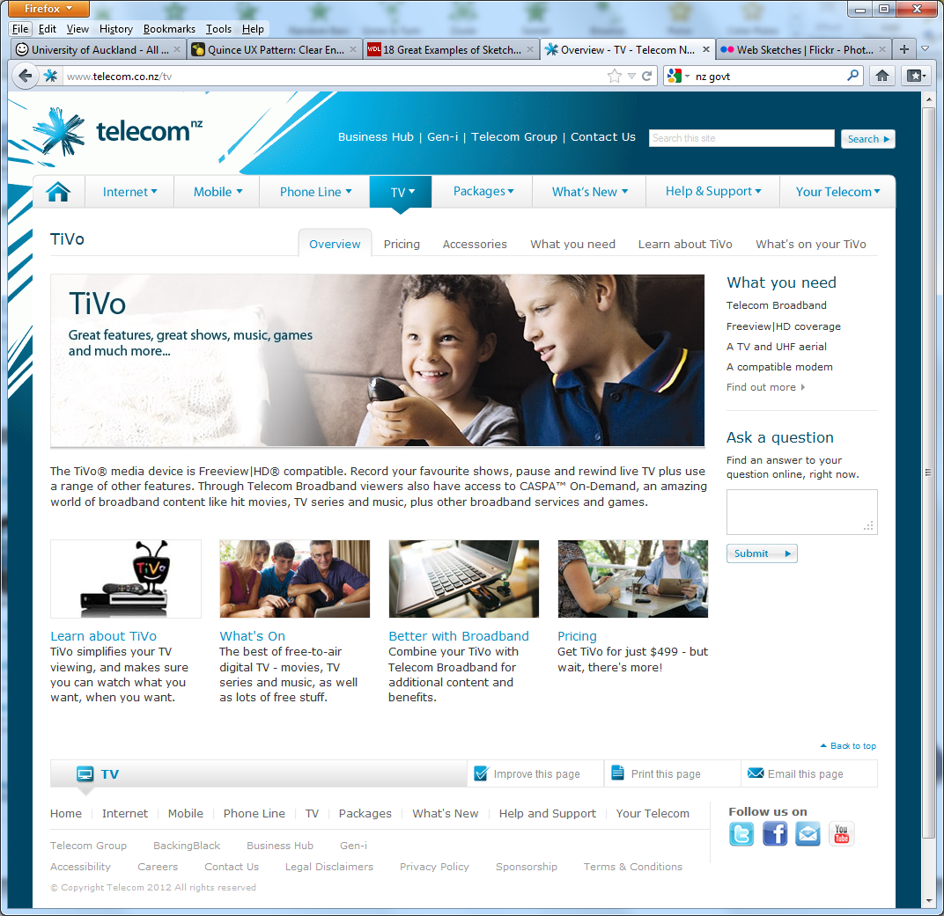
More consistency
Nice menus
www.telecom.co.nz/

Slide 6
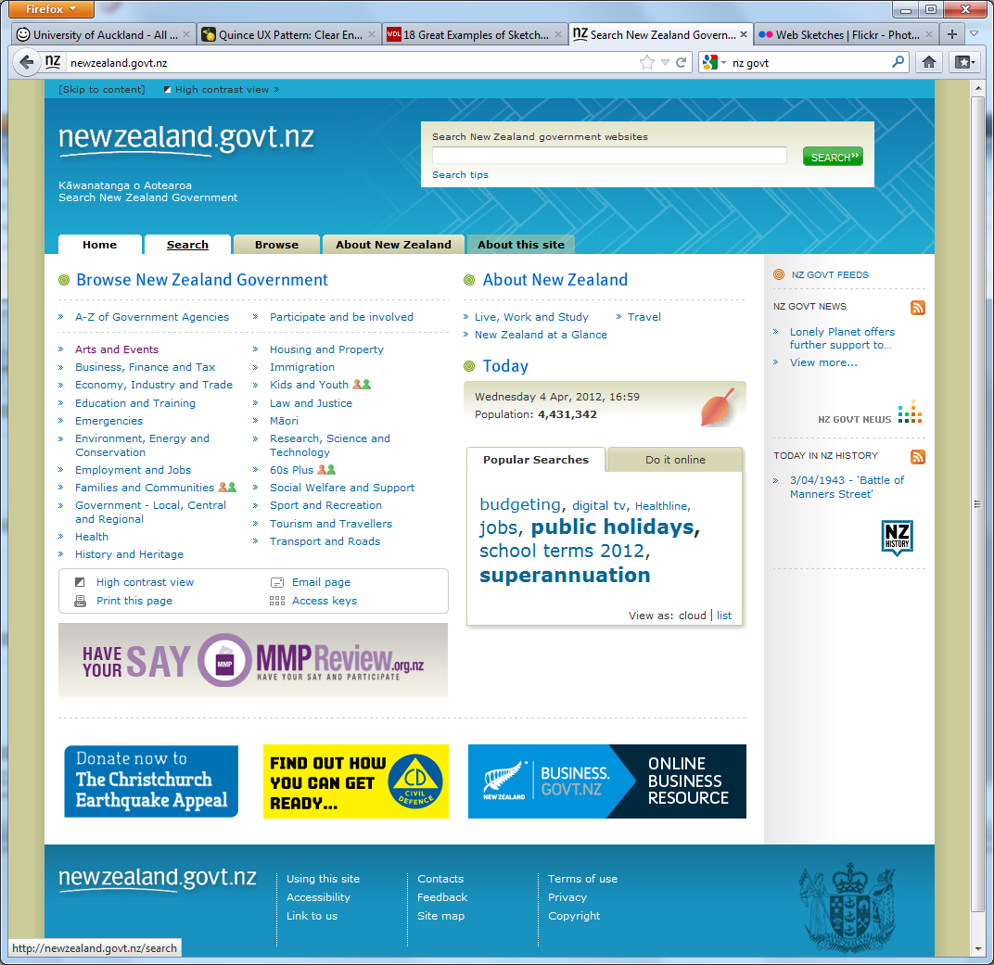
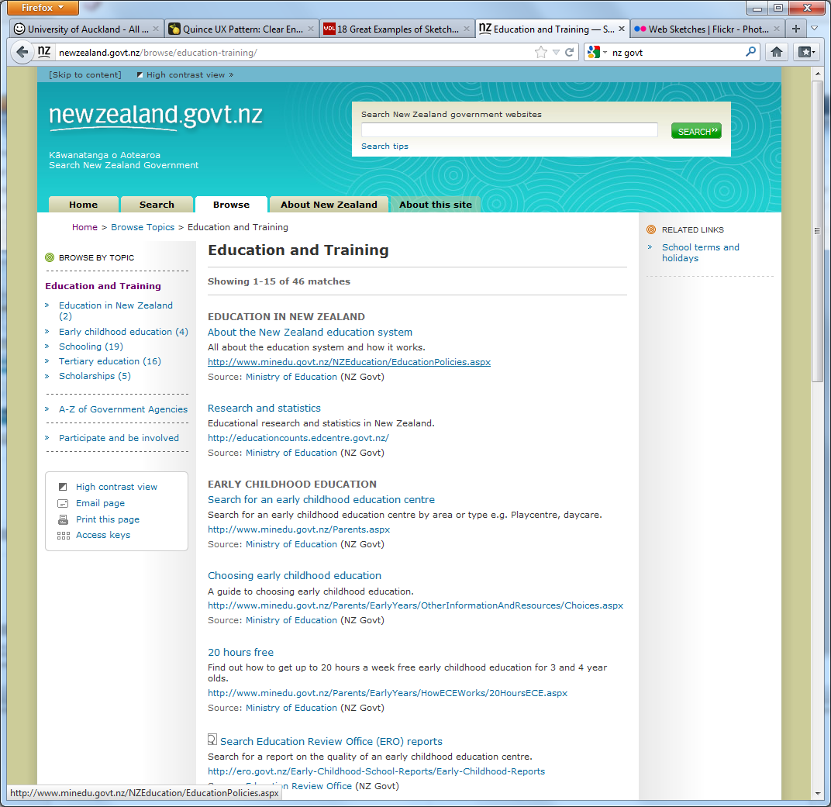
Functional
(ugly)
http://newzealand.govt.nz/

Slide 7
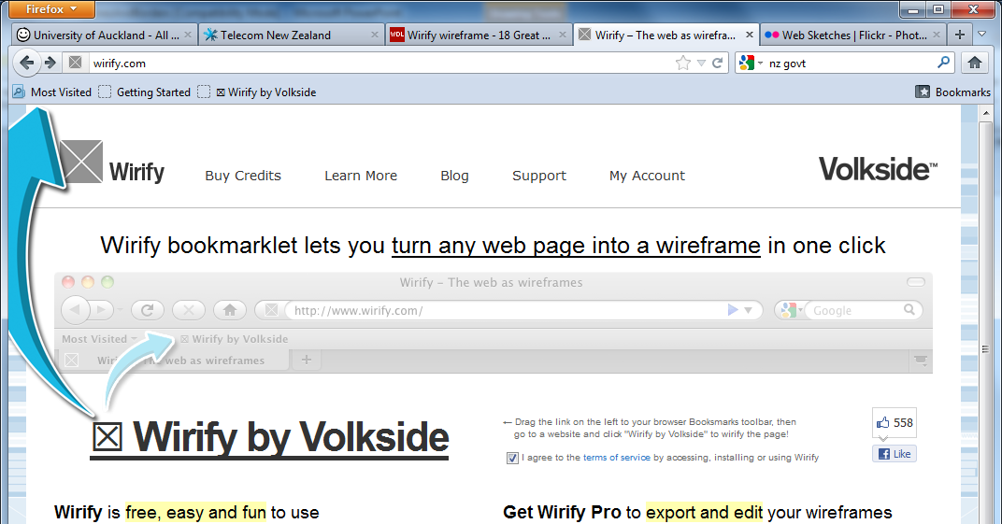
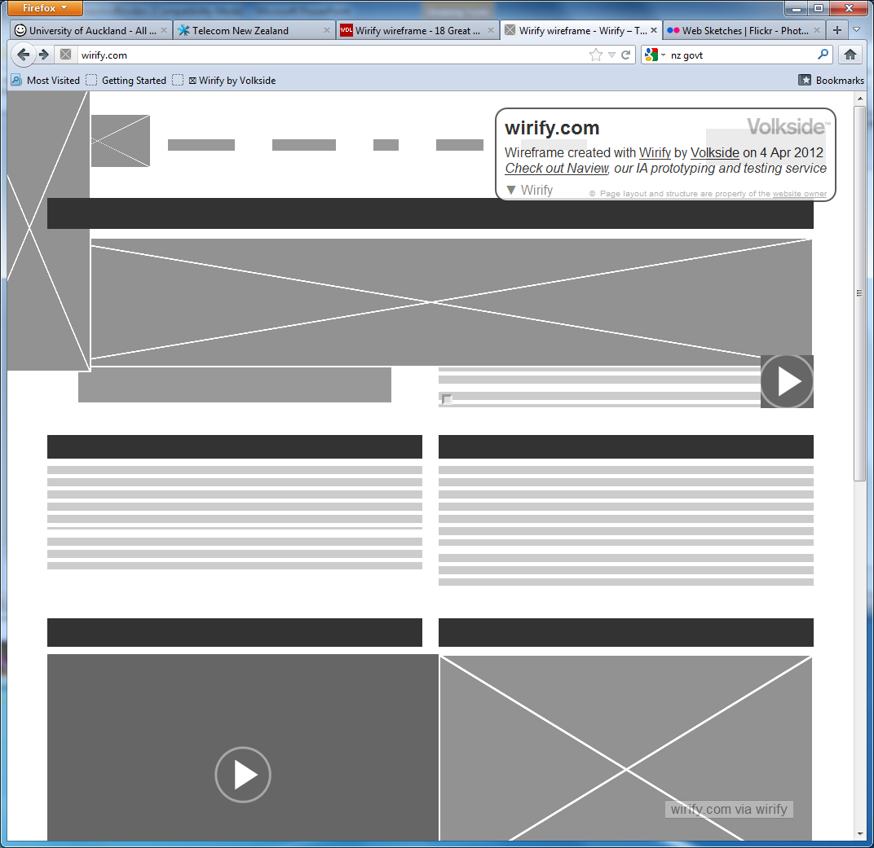
Extracting the wireframes
http://wirify.com/
Drag it to your bookmarks
When on a page click the bookmark

Slide 8
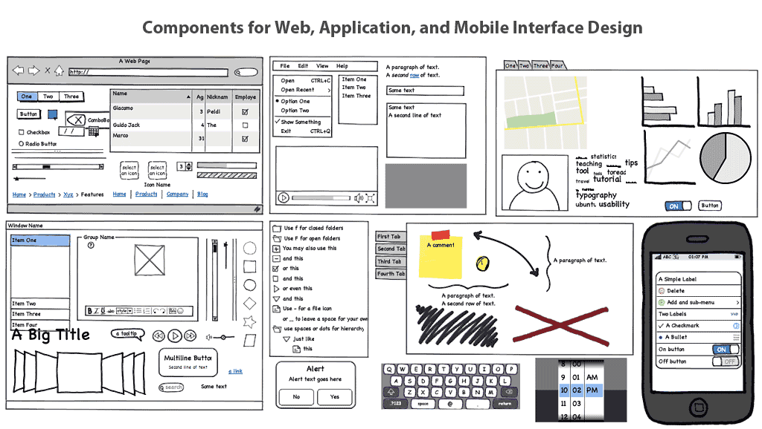
Making Wireframes
Hand-draw them
  (preferable – you can photocopy the main frame
or use Balsamiq
There are lots of other tools around.

Slide 9
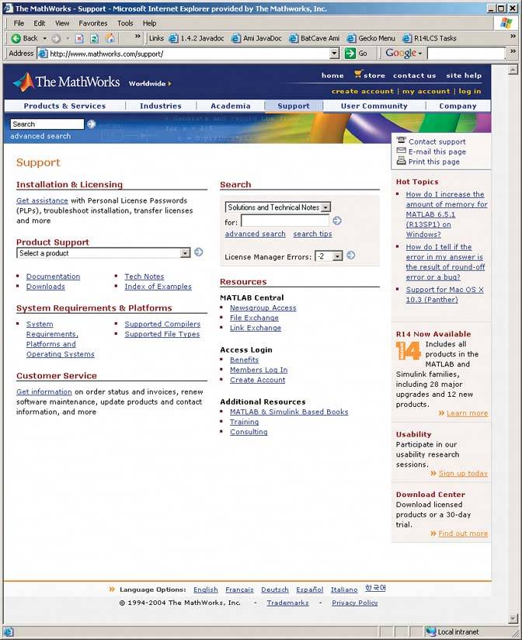
Lines and Borders
Create physical grouping.
Borders offer possibilities for creative styling.

Slide 10
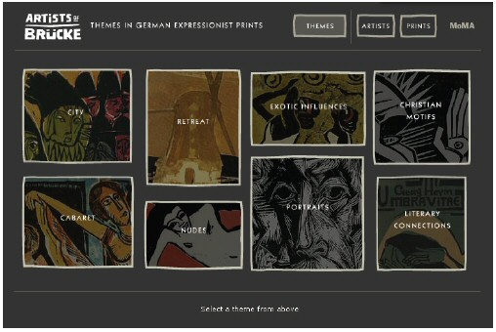
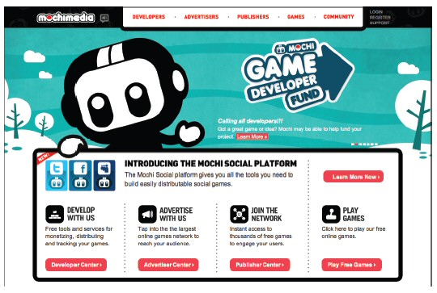
Lines and Borders
Borders and other lines, use the same colour, thickness, and curves as one of the fonts.
Mochimedia uses the logotype’s “fat curves” all over the design. The heavy black border strongly echoes the logo type; so do the icons, the headline, the top menu bar, and the cartoon character itself.

Slide 11
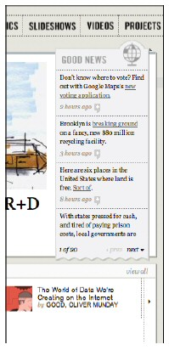
Lines and Borders
Many sites use very thin borders and separator lines that reflect the visual qualities of a body font.

Slide 12
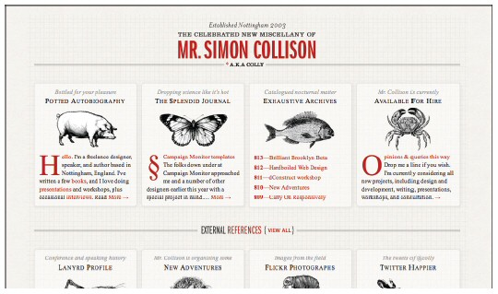
Lines and Borders
The website below shows hairlines used in many places: as a faint grid in the background, as horizontal rules, and as very lightweight borders around the boxes.
The hairlines work with the background texture and excellent typography to create a very rich look.

Slide 13
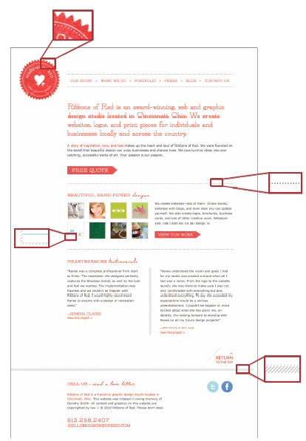
Lines and Borders
Likewise, hairlines are used in several ways in the design studio site
Note their usage in the logo, in the dotted separator lines, and in the diagonal texture used around the thumbnails and at the bottom of the page.

Slide 14
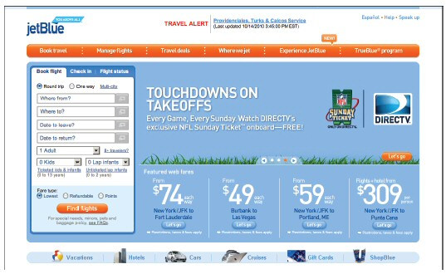
Corner treatments
Instead of using ordinary right angles, you can also use diagonals, curves, or cutouts for some of the interface's box corners.
  Make these corner treatments consistent across the interface!
The repetition of visual motifs helps unify a design. When you devise a single "corner" motif and use it consistently in many places, it gives a distinctive look to the whole design. It's certainly less boring than ordinary right-angled corners.

Slide 15
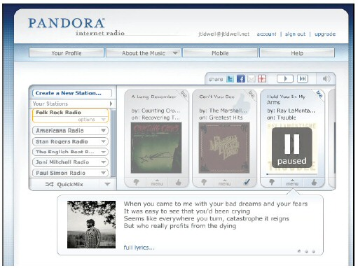
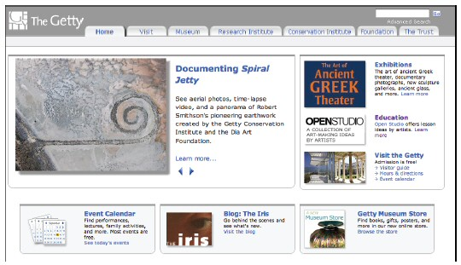
Corner treatments
Pattern repeats the curved corners all over the site:
menu bars,
the main content box,
tabs,
and buttons
The Getty Museum’s site uses
- bars across the top of boxes,
- curves on the bottom corners.
(The tabs also use curved corners, which is common.)

Slide 16
Half time entertainment
This one is a bit long…. But how could we not have it in a lecture about LINES and borders
http://youtu.be/BKorP55Aqvg

Slide 17
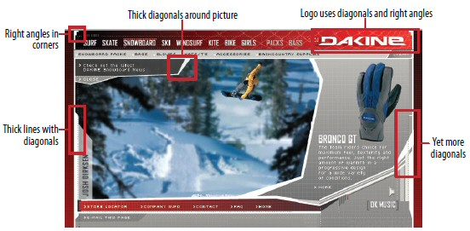
Angles
A page composed of straight up-and-down lines and right angles generally looks calmer and more still than diagonal lines and non-rectangular shapes.
Likewise, a page with many different angles has more apparent motion than a page with a single repeated angle.

Slide 18
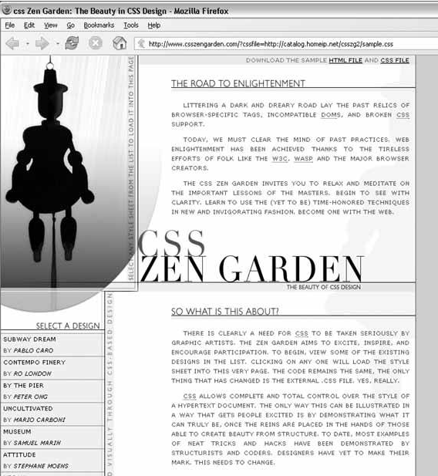
Curves
Curves also can add motion and liveliness, but not always.
A design made with a lot of circles and circular arcs can be calming and restful.
  But a curve swooping through a page sets the whole design in motion, and a few carefully chosen curves in an otherwise rectangular design add sophistication and interest.

Slide 19
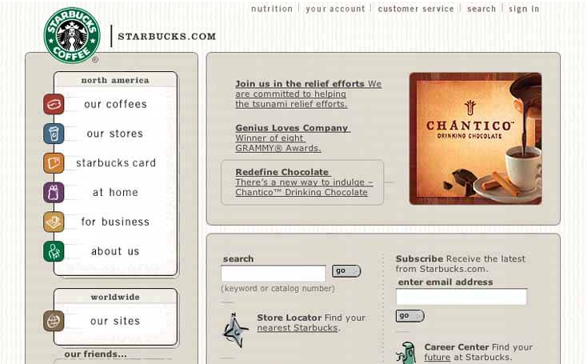
Curves
The Starbucks web site above takes advantage of its circular logo by echoing that curve in rectangle corners all over the page in panel borders, icons, and even the "go" buttons. The overall effect is restful and unified.

Slide 20
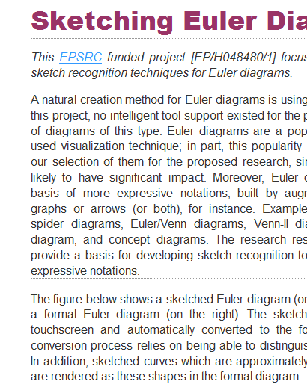
Doing it wrong
Adding lines between connected bits of information disrupts the visual flow
Grouping incorrectly is guaranteed to confuse your users!
????????

Slide 21
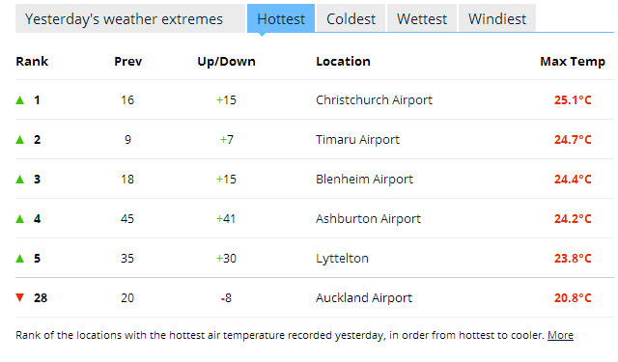
Tables
Tabular data is everywhere and naturally the columns and rows must be visually separated
taking this table as an example what are all the decisions that must be made?

Slide 22
Table Data
All cells in a column should be of the same magnitude
Alignment is critical too
  This
  Or this
Temperature | Time
21 | 12
3 | 1:30
14.46 | 14:17
-8 | 3pm
6 | 9:30am
-1.231 | 17
Temperature | Time
21 | 12:00
3 | 1:30
14 | 14:17
-8 | 15:00
6 | 9:30
-1 | 17:00

Slide 23
Heading and Totals
Temp | Time
21 | 12:00
3 | 1:30
14 | 14:17
-8 | 15:00
6 | 9:30
-1 | 17:00
Should be separate
  But not too dominant
Temp | Time
21 | 12:00
3 | 1:30
14 | 14:17
-8 | 15:00
6 | 9:30
-1 | 17:00
Temp | Time
21 | 12:00
3 | 1:30
14 | 14:17
-8 | 15:00
6 | 9:30
-1 | 17:00
Temp | Time
21 | 12:00
3 | 1:30
14 | 14:17
-8 | 15:00
6 | 9:30
-1 | 17:00

Slide 24
Columns and Rows
Temp | Time
21 | 12:00
3 | 1:30
14 | 14:17
-8 | 15:00
6 | 9:30
-1 | 17:00
What makes the data easier to see?
Is extra encoding sensible?
Temp | Time
21 | 12:00
3 | 1:30
14 | 14:17
-8 | 15:00
6 | 9:30
-1 | 17:00
Temp | Time
21 | 12:00
3 | 1:30
14 | 14:17
-8 | 15:00
6 | 9:30
-1 | 17:00
Temp | Time
21 | 12:00
3 | 1:30
14 | 14:17
-8 | 15:00
6 | 9:30
-1 | 17:00

Slide 25
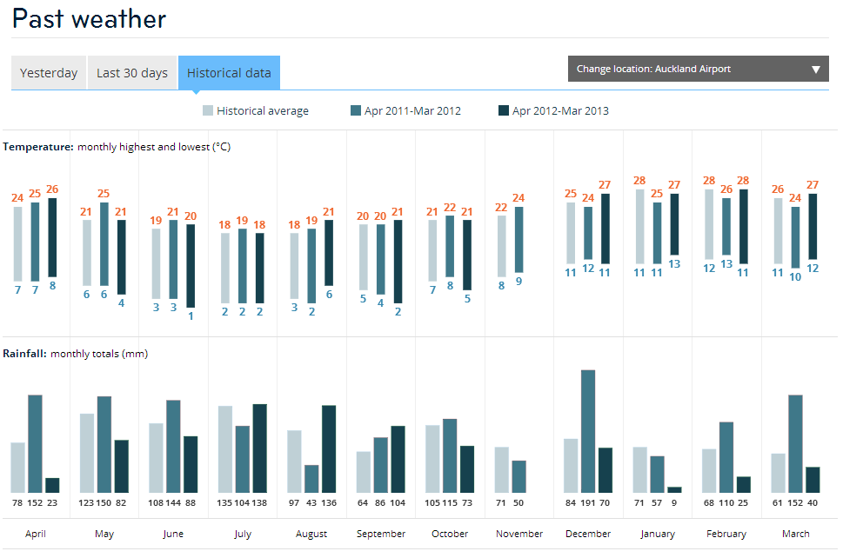
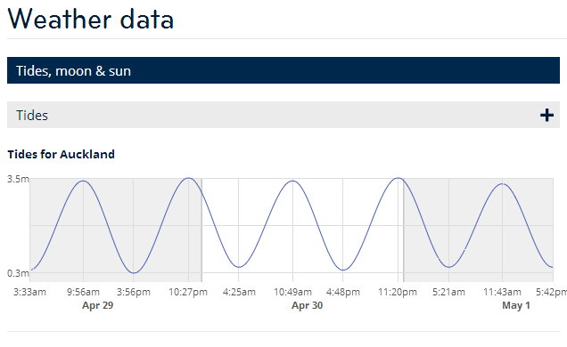
And then there is graphs!

Slide 26
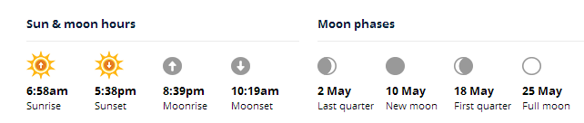
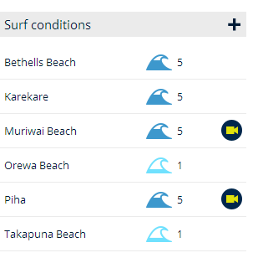
And other information visualization
All from
  http://www.metservice.com/towns-cities/auckland/auckland-central
  Which is pretty cool!

Slide 27
More about this
Stephen Few, Show me the numbers: designing tables and graphs to enlighten 2nd Edition, Analytics Press, 2012
  Chapter 8 is available on the Cecil course webpage.

Slide 28
CSS3 Borders
CSS3 has extended the border options
  http://www.w3schools.com/cssref/playit.asp?filename=playcss_border-style&preval=none
Other elements have borders too
  Tables
  Boxes
  Columns
  http://www.w3schools.com/cssref/playit.asp?filename=playcss_column-rule-style

Slide 29
Summary
What is wire framing and why do you do it?
  Overall design of site/system
  Consistency
Why do you use lines and borders?
  Lines and borders are a powerful aesthetic element
  They can group and segment content
  They can calm or energize a visualization
What are some of style choices?
  The style of the lines and corners should be congruent with the rest of the design
    All sharp and ‘hard’
    All round and ‘soft’
    Can use lines, background contrast or whitespace
Apply this in your assignment

Slide 30
References
http://www.graphics.com/modules.php?name=Sections&op=viewarticle&artid=923
Data Visualization for Human Perception, Stephen Few http://www.interaction-design.org/encyclopedia/data_visualization_for_human_perception.html
Prepared by Safurah Abdul Jalil

