Slide 1
User Interface Aesthetics
COMPSCI 345 / SOFTENG 350
Prepared by Safurah Abdul Jalil & Beryl Plimmer 2011

Slide 2
Learning outcomes
What is aesthetics?
What are the principles of aesthetics?
Why is aesthetics important to HCI?
Do people agree on aesthetically pleasing?

Slide 3
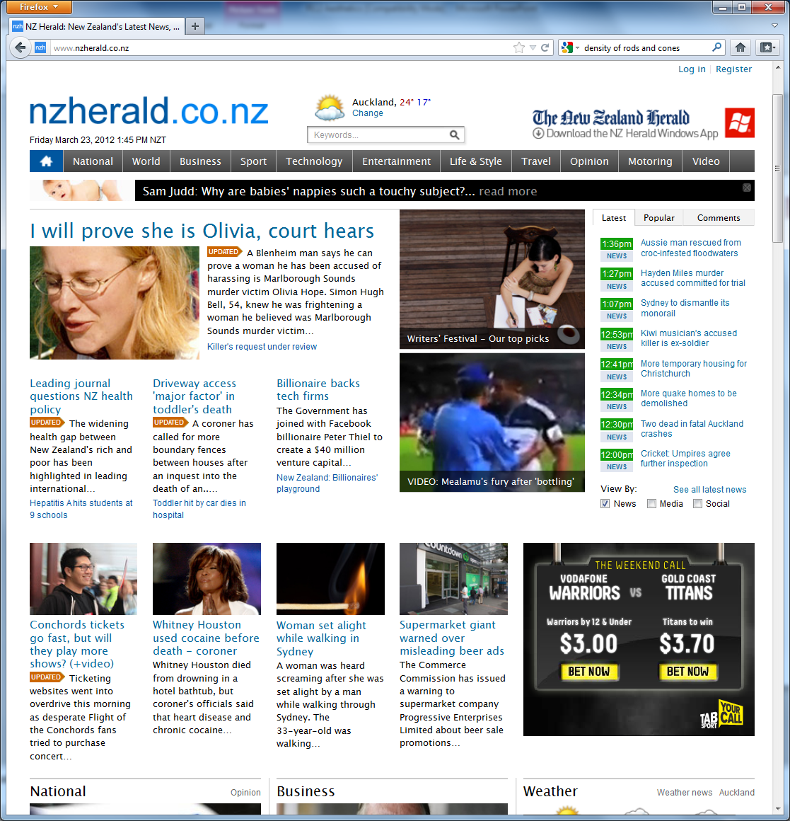
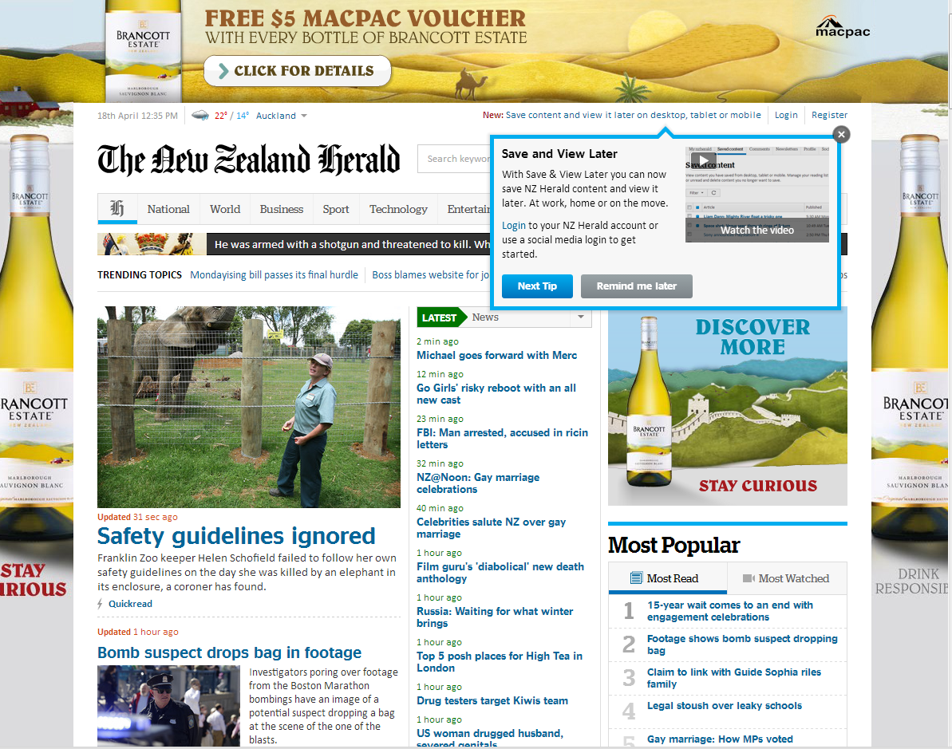
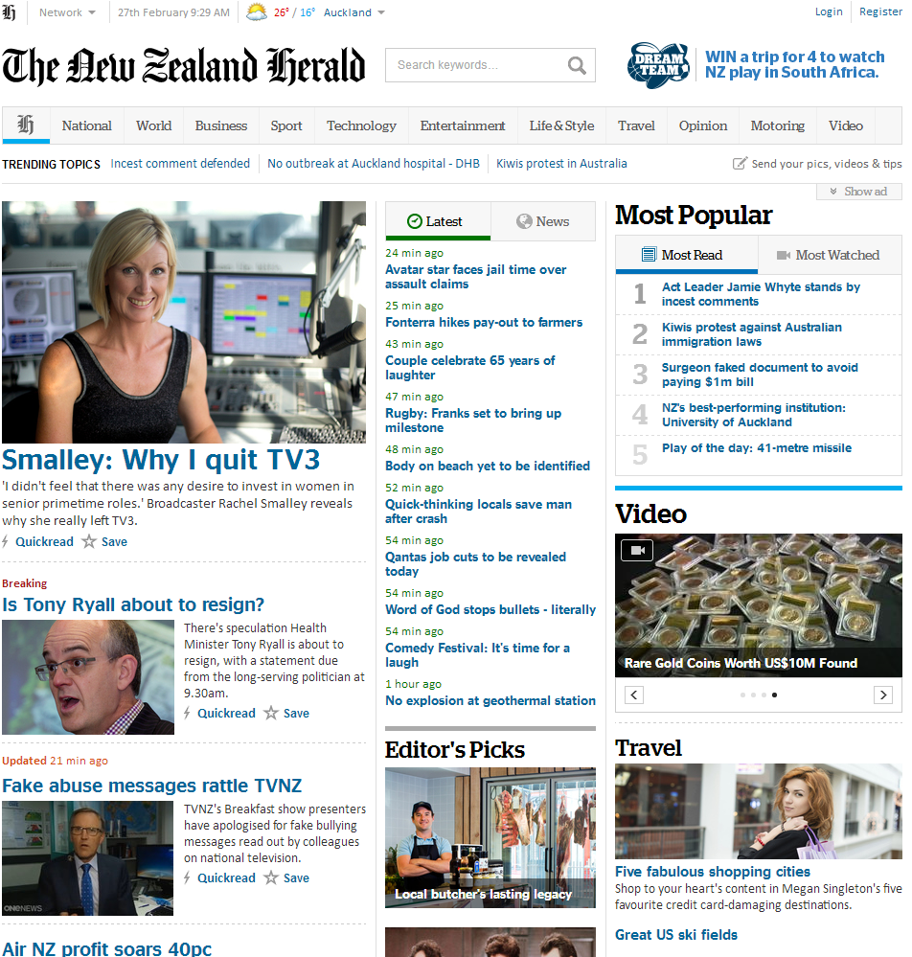
2012
2013
2014

Slide 4
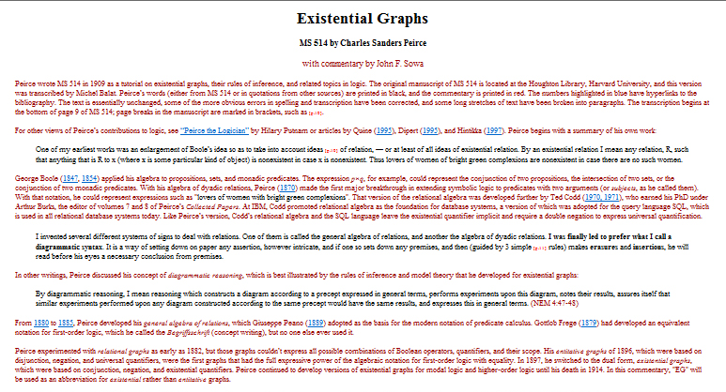

Slide 5


Slide 6
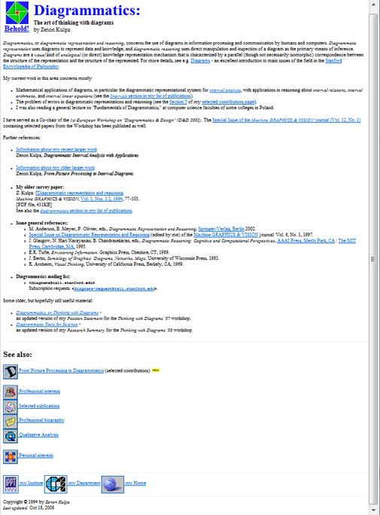

Slide 7
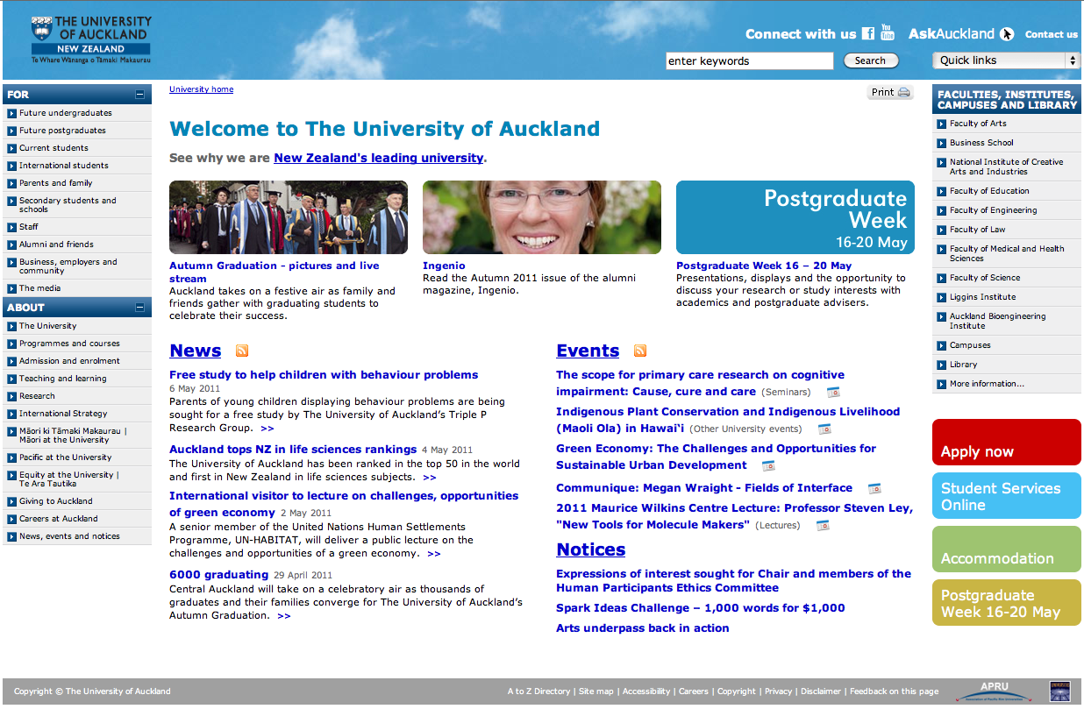

Slide 8
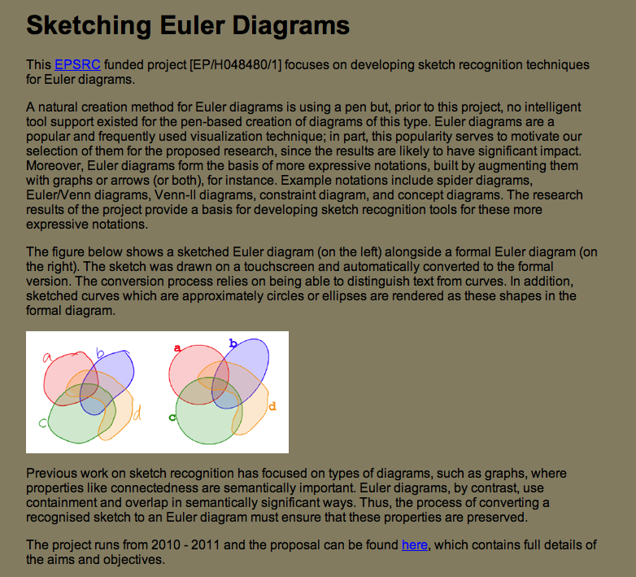

Slide 9
Rank these, most to least attractive

Slide 10
“What is beautiful is usable”
  Tractinsky, et al. (2000)
The term ‘‘aesthetics’’ has been studied from different viewpoints.
  It was not until the eighteenth century that the word ‘‘aesthetics’’ (from the Greek aisthanesthai—to perceive) was introduced into philosophical terminology
  By the end of that century ‘‘aesthetics’’ was no longer merely a technical term in philosophy; it became an integral part of the general language.
  Broadly speaking, aesthetics has been studied by two different investigative methods:
    philosophical approach - on what criteria is a thing consider beautiful – function? Form?
    empirical approach – experimental measuring of what is pleasing – people prefer A to B

Slide 11
“What is beautiful is usable”
  Tractinsky, et al. (2000)
In the field of user interface design, research has shown that visual aesthetics of an interface affects user’s perception on the system’s.
An aesthetically pleasing site is perceived as
  More usable
  More trustworthy
  More error tolerant
In a world of online banking, retail, etc, etc. this is hugely important.
Its also important if your product is software. Beautiful software products have an immediate advantage over their rivals.

Slide 12
Half time entertainment
Don Norman is on of the founders of Usability. He has always had a reputation for function over form…
https://www.youtube.com/watch?v=RlQEoJaLQRA

Slide 13
What guides a design?
Principles
Principles of design are concepts used to organize or arrange the components in a design
We are going to review 3 principles:
  Balance
  Emphasis
  Unity

Slide 14
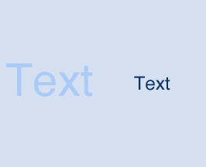
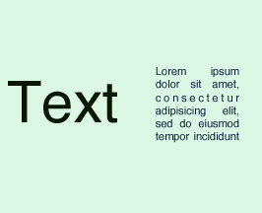
Principles
Balance
The distribution of the optical weight in an interface
  Perception that some objects appear heavier than others, e.g.:
  Larger objects.
  Cluster of small objects
  Objects with strong, intense colors.
The balance in screen design is achieved by providing an equal ‘weight’ of screen elements, left and right, top and bottom.

Slide 15
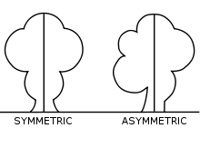
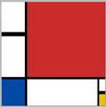
Principles
Balance
There are two common systems for achieving balance:
Symmetry - a mirror image
  Symmetry can occur in any orientation as long as the elements are the same on either side of the central axis.
  Also called formal balance because a form (formula) is used
Asymmetry - without symmetry
  Also known as informal balance.
  The term, however, is usually used to describe a kind of balance that does not rely on symmetry.
  There are no rules or limits with asymmetrical balance. It can be achieved by careful placement of objects and the use of other organizational devices (like figure/ground in Gestalt principles).
Mondrian achieves a subtle asymmetrical balance in his compositions.

Slide 16
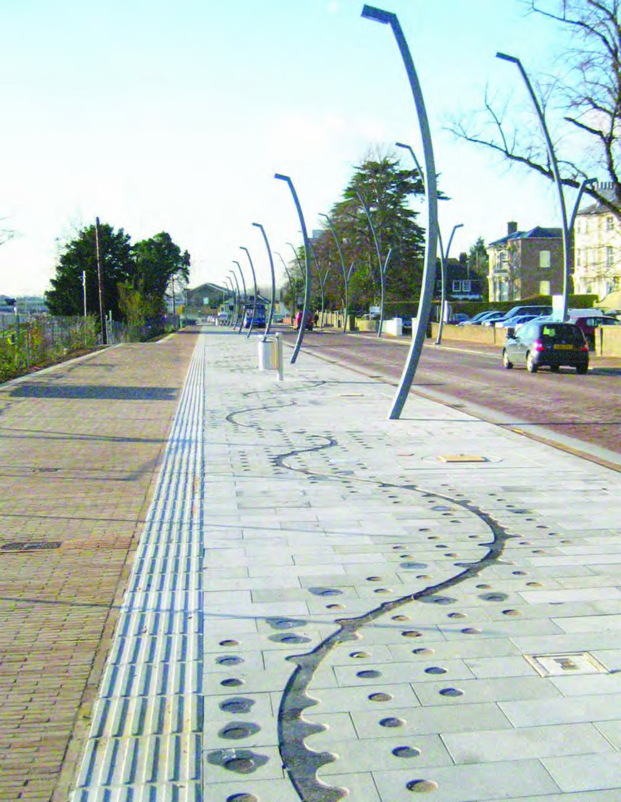
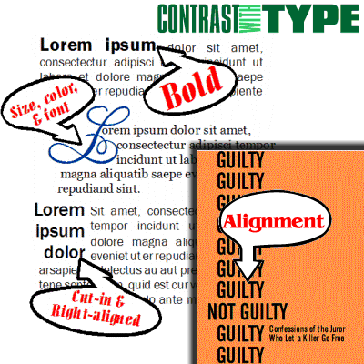
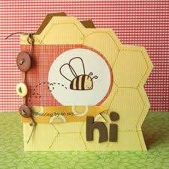
Principles
Emphasis
Dominance is to control the attention of someone viewing the visual (make objects easy or difficult to notice).
There are three major methods for controlling emphasis in a visual image:
  Contrast
  Placement
    Central vision
  Isolation
    Search for detail

Slide 17
Principles
Unity
The relationship between the individual parts and the whole of a layout.
  Aspects that are to tie the composition together, to give it a sense of wholeness, or to break it apart and give it a sense of variety.
Stems from some of the Gestalt theories of visual perception (psychology),
  specifically those dealing with how the human brain organizes visual information into categories, or groups.
Careful placements of components
  connect by one grouping tendency (similarity of color, for example)
  disconnect by others (distance, for example, or differences of shape, size or direction)
Understanding gestalt concepts can help to create unity and variety.

Slide 18
What is it that is guided?
Components
Foreground
  Text
  Colours & images
  Lines & borders
  Forms & Controls
Background

Slide 19
Summary
Principles
  Balance
  Emphasis
  Unity
Components
  Foreground
    Text
    Colours & images
    Layout, lines & borders
    Forms & Controls
  Background

Slide 20
References
Visual Aesthetics in human-computer interaction and interaction design by Noam Tractinsky. http://216.92.33.154/encyclopedia/visual_aesthetics.html
Course notes for a 2D design course http://daphne.palomar.edu/design/Default.htm
Art, Design and Gestalt Theory by Roy R. Behrens http://www.leonardo.info/isast/articles/behrens.html
The Principles of Design magazine article http://www.digital-web.com/articles/principles_of_design/
Prepared by Safurah Abdul Jalil & Beryl Plimmer 2011

