Slide 1
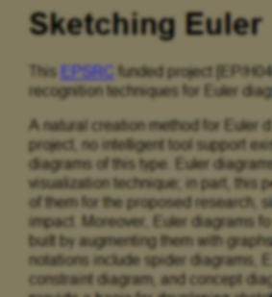

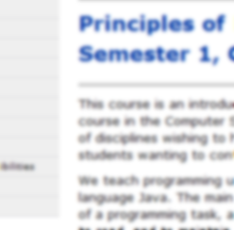

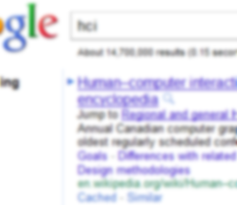
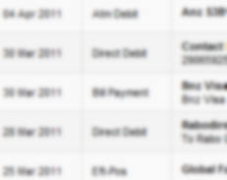
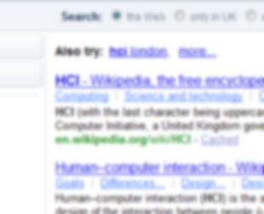
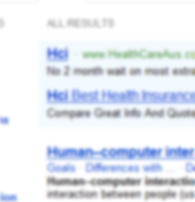

Slide 2
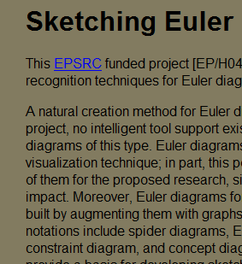
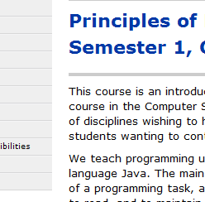

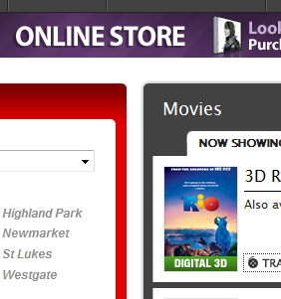
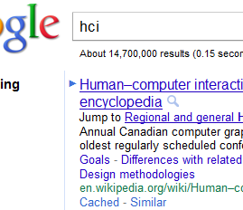
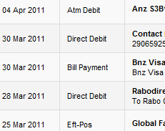
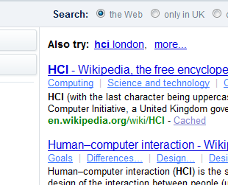
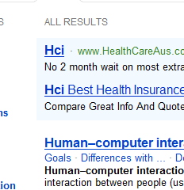

Slide 3
How do we realize design?
What should we consider?
  Technical
  Visual
  Interaction
  Search
  Context of use
    Information
    Interacting/ transacting

Slide 4
Realizing the visual interface
  Human visual systems
  Visual aesthetics
  Grouping
  Lines Borders & Tables
  Text
  Colour and Images
  Forms and Controls

Slide 5
The visual interface
Human Visual Perception

Slide 6
Learning outcomes
What are the two stages of the visual system?
How do luminance and colour effect visual perception?
What is the difference between central and peripheral vision?
How do we read?

Slide 7
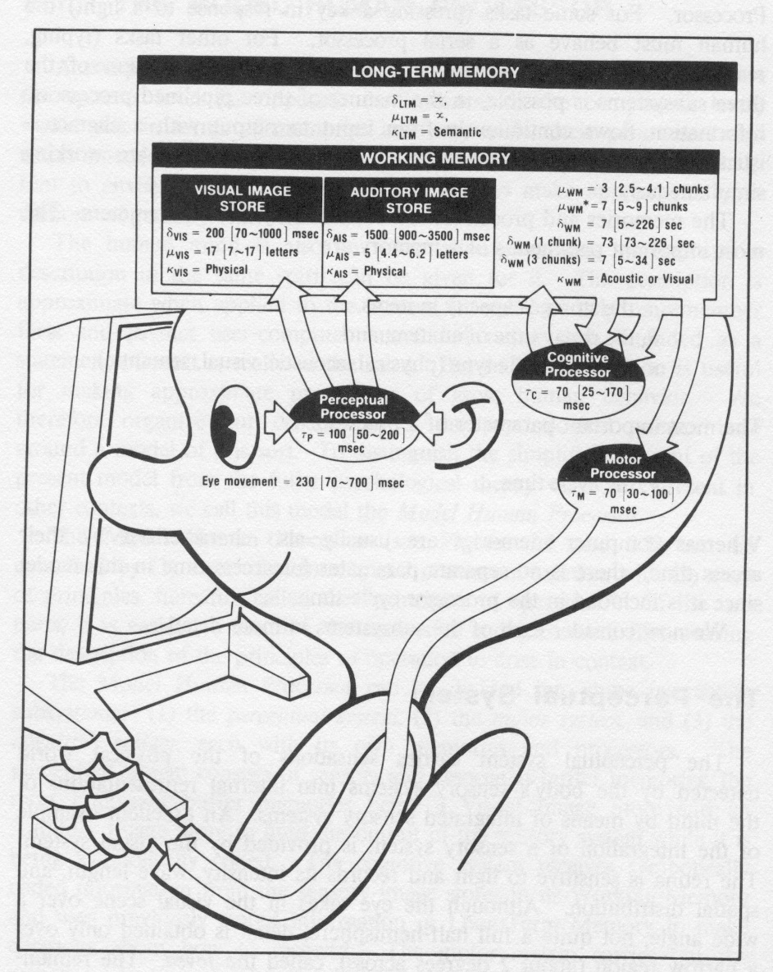
The human processor
Input
  senses
Process
  Cognition
    Knowledge
    Skills
    Reasoning
Storage
  Memory
Output
  Actions
  Speech

Slide 8
Senses
Computer devices
Input output
Human
  Vision
  Hearing
  Smell
  Taste
  Touch
  Kinaesthetic / proprioception

Slide 9
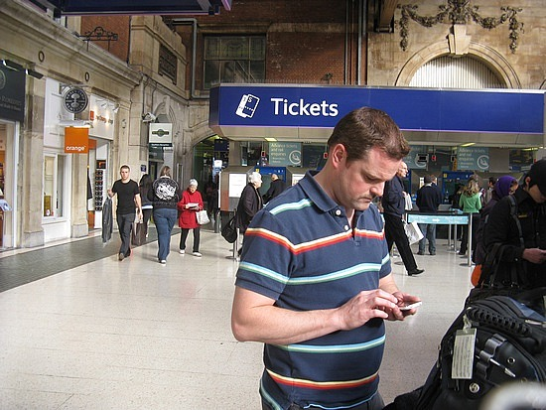




Current computer systems
Mostly output is to a visual display.
  And the display is also the input medium on phones etc!
Exceptions
  Sound
  Vibrate

Slide 10
Vision
Two stages in vision
• physical reception of stimulus
• processing and interpretation of stimulus

Slide 11

The Eye - physical reception
mechanism for receiving light and transforming it into electrical energy
light
  Reflects from objects (e.g. paper)
  Or is produced from a light source (e.g. a display)
images are focused upside-down on retina
retina contains rods for low light vision and cones for colour vision
ganglion cells (brain!) detect pattern and movement
Interesting web site
http://www.hhmi.org/senses

Slide 12

Interpreting the signal (cont)
Luminance (Brightness)
  subjective reaction to levels of light
  affected by luminance of object
  visual acuity increases with luminance
  as does flicker
Colour
  made up of hue, intensity, saturation
  cones sensitive to colour wavelengths
  blue acuity is lowest
  8% males and 1% females colour blind are severely colour blind

Slide 13
Luminance (Brightness)
Rods provide low-light monotone (grey scale) vision. Rods are saturated in bright light and contribute little or nothing to what you see.
However the principles of brightness and contrast are equally important with colour vision.

Slide 14
Half Time Entertainment
https://www.youtube.com/watch?v=DCu1G2rxj5c
There are a few naughty words in this clip so if you are easily offended don’t watch.

Slide 15
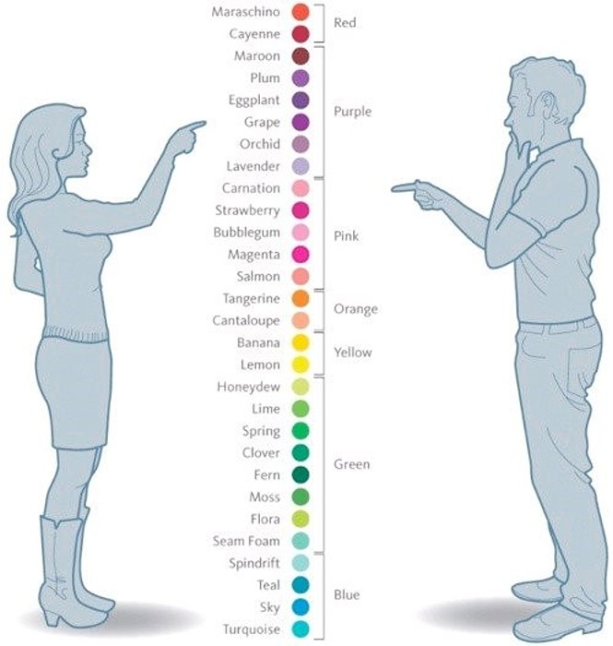
Colour and gender
Women see more colours than men (on average)
Perhaps 80% of men are colour blind .. depending on how you measure it. ☺
There is a difference between seeing the colours on a chart and seeing them in isolation

Slide 16
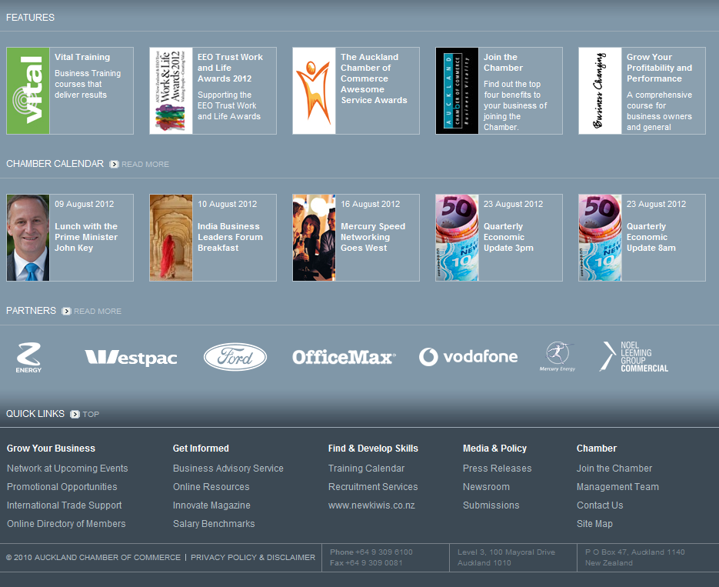
Oops

Slide 17
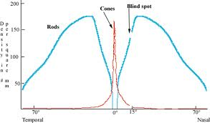
Central versus peripheral vision
Central
Peripheral
More cone cells
Better detail and focus
Less cells in general and more rod cells
Good movement detection

Slide 18
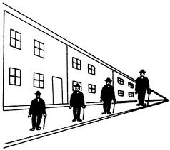
Interpreting the signal
Size and depth
  visual angle indicates how much of view object occupies
  (relates to size and distance from eye)
  visual acuity is ability to
  perceive detail (limited)
  familiar objects perceived as
  constant size in spite of changes in
  visual angle when far away)
  cues like overlapping help
  perception of size and depth
What does this mean for
items on the screen periphery?

Slide 19
Interpreting the signal (cont)
The visual system compensates (to some degree) for:
  movement
  changes in luminance.
Context is used to resolve ambiguity
Optical illusions sometimes occur due to over compensation

Slide 20

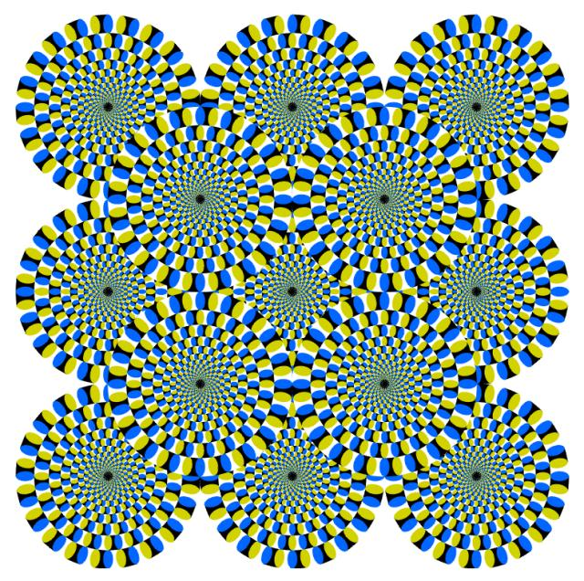
Optical Illusions
http://michaelbach.de/ot/

Slide 21
Reading
Several stages:
  visual pattern perceived
  decoded using internal representation of language
  interpreted using knowledge of syntax, semantics, pragmatics
Reading involves saccades and fixations
Perception occurs during fixations
Word shape is very important to recognition
  There are two main theories about how we read, one from psychology and one from typography… suffice to say, that either way the same things are important

Slide 22
Word shapes

Slide 23
When you are surfing the web this week
If you have trouble finding something you know must be on a page
Look to see why that is
  Is it on an edge?
  Is the colour wrong?
  Is the font too small?
Put some examples up on the class forum – link and your comment as to what was good/bad about the visual layout
We will come back to the details for design over the next few lectures.

Slide 24
What if ….
Your visual attention is need for another activity
  Driving & cell phone / gpa navigation….
Are colour blind?
Needed reading glasses?
Have really poor eye sight that cannot be corrected by glasses?
You are blind?

Slide 25
Learning outcomes
What are the two stages of the visual system?
  ..
  ..
How do luminance and colour effect visual perception?
  …
What is the difference between central and peripheral vision?
  ..
How does our brain interpret the image?
  …
How do we read?
  ..

