Slide 1
Lecture 10
Design Principles #1
Design principles
Comprehensibility
Learnability
Effectiveness/usefulness
Efficiency/usability
Heim, Chapters 6.1-6.5

Slide 2
Learning Objectives
To be able to apply design principles in the context of user interface design tasks
To be able to characterise key design principles for effectiveness and efficiency
To be able to conceptualise design principles in terms of an interaction framework

Slide 3
Principles of Interaction Design
How do we create elegant solutions to complex interaction problems?
  Don’t let the technical variables get in the way of coming up with something useful, usable and pleasing
How do interaction designers succeed at creating great designs that are powerful and aesthetically appealing?
‘Insanely great’ – Steve Jobs’ description of the Macintosh

Slide 4
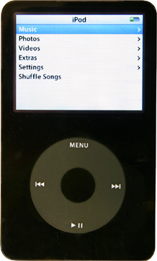
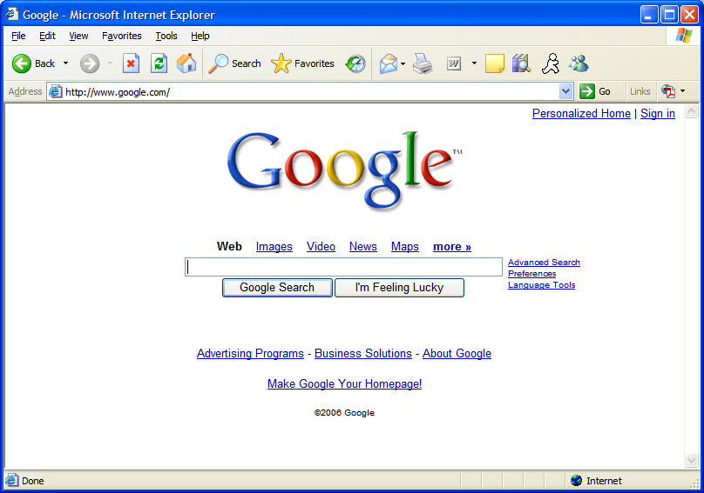
Principles of Interaction Design
Clear, minimal, to-the-point and insanely successful!

Slide 5
Principles of Interaction Design
Design principles can be used to guide design decisions
Design principles do not prescribe specific outcomes; they function within the context of a particular design project.
Design principles guide interaction designers and help them make decisions that are based on established criteria

Slide 6
Gulfs and Principles
Design principle can be used to determine if there are gulfs of execution or evaluation
Gulfs of execution relate to the effectiveness principles
Gulfs of evaluation relate to the efficiency principles

Slide 7
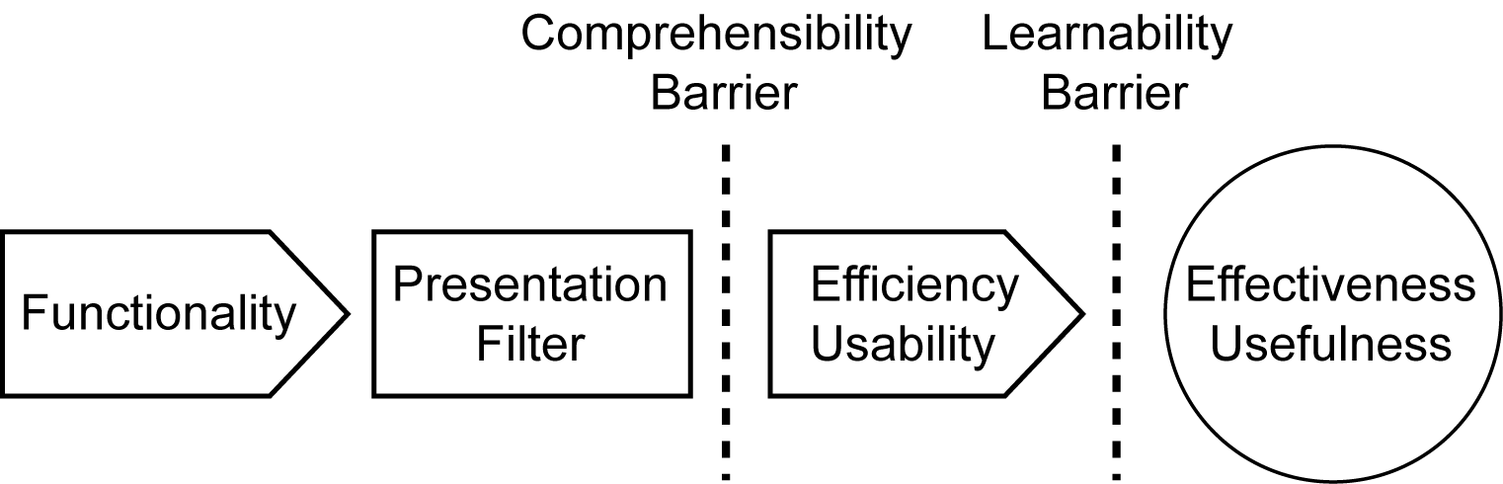
Framework for Design Principles
Provides a framework for thinking about design principles in terms of interaction

Slide 8
Framework for Design Principles
The framework has the following components:
Usability Goals
  There are two main usability goals in the framework; comprehensibility and learnability.
Design Principle Categories
  The framework also divides the design principles into two main groups; efficiency principles and effectiveness principles.
Format to Describe Design Principles
  The framework uses the format “serves the principle of … which promotes …” to describe the different principles.
  Familiarity serves the principle of memorability, which promotes usability.

Slide 9
Framework for Design Principles
Functionality - The system must have adequate functionality for a particular task.
Presentation Filter - The functionality must be made accessible through the presentation filter (interface).
  The user has to be able to access the functionality (that’s what the ‘user interface’ is for!)

Slide 10
Framework for Design Principles
Comprehensibility Barrier - If the presentation is comprehensible, the comprehensibility barrier will be superseded. This depends on the degree of efficiency/usability in the interface design.
  The user needs to understand how they access the functionality
Learnability Barrier – If the interface is comprehensible it will be learnable, there is a direct relationship.
  Effective use generally requires that the way of working through the interface become natural to the user (that they ‘learn’ it)
Effectiveness/Usefulness - If the user can learn the interface s/he can take advantage of the functionality and the interface will, therefore, be useful.

Slide 11
Comprehensibilty
An interface design that is easy to comprehend will be efficient and effective
If a user does not understand the interface it will be useless
A design’s comprehensibility is highly dependent on the way in which the interface communicates its functionality to the user

Slide 12
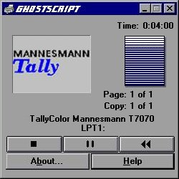
Interface Hall of Shame
VCR metaphor for a print dialog – what does rewind do?!
Tally printer dialog

Slide 13
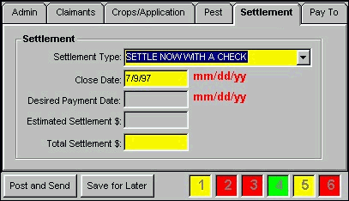
Interface Hall of Shame
Stoplight can be a good metaphor
In this dialog, however, it’s indicating whether all, some or none of the required information has been entered
Problems:
Could do with a single colour of flag (e.g. for ‘incomplete’)
The 1-6 on the bottom row is an indirect reference to the labelled tabs, requiring the user to map
Stoplight metaphor

Slide 14
Learnabilty
An interface with high usability will be easier to learn
The learnability of a design is based on comprehensibility: if you can’t understand it, you can’t learn it

Slide 15
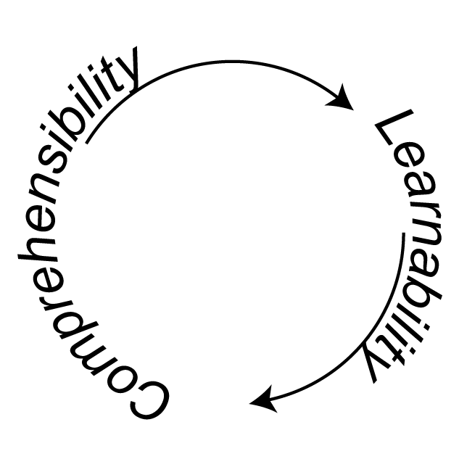
Comprehensibility Learnabilty
Learnability and comprehensibility are recursive: we start with comprehensibility which affects learnability, which will in turn increase comprehensibility.
Comprehensibility/Learnability Feedback Loop

Slide 16
Principles of Interaction Design
Effectiveness/Usefulness
  Utility
  Safety
  Flexibility
  Stability
Efficiency/Usability
  Simplicity
  Memorability
  Predictability
  Visibility

Slide 17
Half time entertainment
https://www.youtube.com/watch?v=ouP9xNujkNo

Slide 18
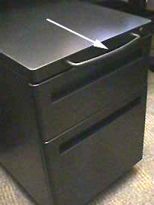
Design Principle Categories
Effectiveness/Usefulness
Effectiveness describes the usefulness of a design
The effectiveness goal stipulates that a design must fulfill the user’s needs by affording the required functionality

Slide 19
Effectiveness/Usefulness
Utility - The principle of utility relates to what the user can do with the system.
  And how that relates to the user’s goals in the real world
Safety - If a design has a high degree of safety, it will prove more useful than a design that involves a high degree of risk.
  Recovery - can be implemented in interaction designs by incorporating appropriate undo functionality and robust error recovery routines.
A computer shall not harm your work or,
through inaction, allow your work to come to harm.
(Raskin, 2000 [making fun of Asimov’s laws of robotics])
Can be a real pain to implement, but immensely useful

Slide 20
Effectiveness/Usefulness
Flexibility - A tool that is flexible can be used in multiple environments and may address diverse needs (e.g. a spreadsheet app)
  Customization - A tool will have greater flexibility if people are able to customize the interface according to their personal preferences
Stability - A stable system is a robust system.
  A system that functions consistently well will be more useful than a system that crashes frequently

Slide 21
Efficiency/Usability
Efficiency describes the usability of a design
The efficiency goal stipulates that a design should enable a user to accomplish tasks in the easiest and quickest way possible without having to do overly complex or extraneous procedures.
A computer shall not waste your time or require you to do more work than is strictly necessary. (Raskin, 2000)

Slide 22
Efficiency/Usability
Simplicity - If things are simple they will be easy to understand and, therefore, easy to learn and remember.
  Ockham’s Razor - Pluralitas non est ponenda sine necessitate - pluralities should not be posited without necessity (‘simplest is best’)
  80/20 Rule - The 80/20 rule implies that 80% of an application’s usage involves 20% of its functionality
  Satisficing - Combines the conflicting needs of finding the optimal solution that satisfies all the requirements and the need to settle on a solution that will be sufficient to proceed with the design

Slide 23
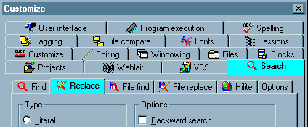
Interface Hall of Shame
MultiEdit tabs
Avoid multiple rows of tabs
  And the icons aren’t helping here
  And the tabs are interacting in some complex way to allow search and replace to both be highlighted

Slide 24
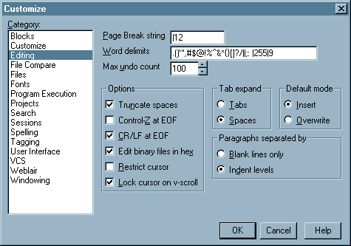
Improved
Did it really need so much functionality in the one dialog?
If so, here we use the list metaphor (and thus natural alphabetical order)

Slide 25
Simplicity!
Well, it’s changed since this screen cap, but they continue to play the 80/20 rule – if you want one of their many less popular functions, then you go another step

Slide 26
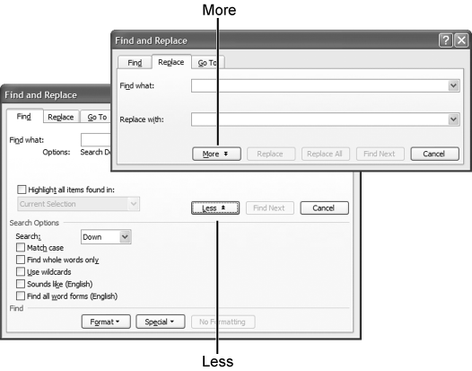
Efficiency/Usability
Simplicity
  Progressive Disclosure - Show the user only what is necessary

Slide 27
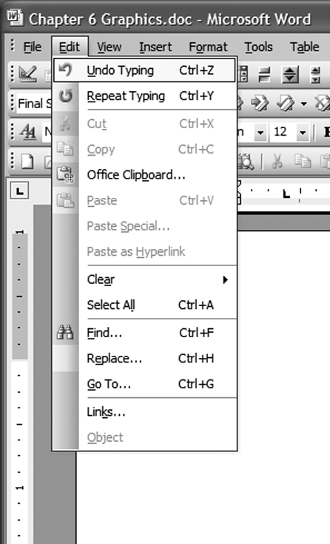
Efficiency/Usability
Simplicity
  Constraints - Involves limiting the actions that can be performed in a particular design
    Controls the design’s simplicity
    Physical
      Paths - constrain movement to a designated location and direction (e.g. scrollbar)
      Axes - constrain the user’s movement to rotation around an axis
      Barriers -provide spatial constraints that can confine the user’s movement to the appropriate areas of the interface

Slide 28








Efficiency/Usability
Simplicity
  Constraints
    Psychological – limit the way the user perceives the components
      Conventions - exploit learned behavior to influence a user’s actions
      Mapping - can influence the way in which people perceive relationships between controls and effects
      Symbols - can influence the way in which we interact with an interface by defining meaning and constraining our possible interpretations of interface elements

Slide 29
Efficiency/Usability
Memorability - Interfaces that have high memorability will be easier to learn and use
  Many different parameters affect memorability:
    Location
    Logical Grouping
    Conventions
    Redundancy

Slide 30



Efficiency/Usability
Predictability - Predictability involves a person’s expectations and his ability to determine the results of his actions ahead of time.
  Consistency (when appropriate)
    Consistency reinforces our associations and, therefore, increases our ability to remember and predict outcomes and processes.
    Consistency is great, but only offer options that fit the task at hand
      Greyed out menu items are a compromise to keep the menu consistent, while also having the options minimized to those that are appropriate in context

Slide 31
Efficiency/Usability
Predictability
  Generalizabilty: can help us use the knowledge we gathered from previous experience and apply it to similar situations
  Conventions: allows us to use our intuition
  Familiarity: familiar menu names and options help users locate objects and functions more easily
  Location, Location, Location: Not all areas on the screen are created equal
    Top-left is the most prime real estate; bottom and right for closure; many location conventions exist

Slide 32
Efficiency/Usability
Predictability
  Modes: Modes create instability in mental models because they change the way objects function
Simplest example of a mode: Caps Lock – causes input to be interpreted differently. With few exceptions, modes are considered bad for usability (and, alas, are traditionally easy to program)

Slide 33
Efficiency/Usability
Visibility - The principle of visibility involves making the user aware of the system’s components and processes, including all possible functionality and feedback from user actions.
Show everything at once, and the result is chaos.
Don’t show everything, and then stuff gets lost.
(Norman, 1998, 74)

Slide 34
Efficiency/Usability
The principles of progressive disclosure and simplicity should be used in
conjunction with the principle of visibility to avoid overload
Visibility
  Overload: Following the principle of visibility without also applying progressive disclosure can lead to visual overload
  Feedback: Direct Manipulation interfaces provide immediate visual feedback about user actions. It is the task of the interaction designer to decide what form that feedback takes

Slide 35
Efficiency/Usability
Visibility
  Recognition/Recall: The principle of visibility is based on the fact that we are better at recognition than we are at recall
    We’ll explore cognitive reasons later in the semester, but basically it’s easy to work with what’s before your eyes as compared to dredging your memory
  Orientation: People need to be able to orient themselves, especially in complex information spaces
    With web sites – consistent and hierarchical page titles and menu structure, as well as footprints (changing colour to indicate traversed area)

Slide 36
To be continued
Next lecture we’ll talk about human perception – particularly visual perception.
We will come back to this chapter of Heim in week 6 and look at more design principles, with a focus on proportion and screen complexity

