Slide 1
Health Informatics and HCI
Jim Warren
Professor of Health Informatics

Slide 2
Learning Objectives
To gain awareness of IT applications in health
To be able to identify common HCI problems and approaches for health IT systems
  Maybe you’ll use this directly
    Health is a big sector where IT use is expanding rapidly, and Orion Health is one of NZ’s biggest IT employers
  Maybe you’ll transfer these lessons to another sector

Slide 3
Outline
What is Health Informatics?
Some HCI-focused projects I’ve done
Some core HCI lessons in health including issues around
  Research ethics
  Appropriate information display
  Evaluation

Slide 4
‘Health Informatics’ defined
One of the journals in the field is called Methods of Information in Medicine
Anything about how to process and distribute information to support health and healthcare
  Clinical decision support systems (CDSS)
  Electronic medical records
  Consumer Health Informatics (e.g. use of Internet)
  Medical imaging (CT, MRI, etc.)
  Also, standards, and strategy and policy…

Slide 5
An HCI study I did: PREDICT usability
PREDICT is a CDSS that computes probability of a patient having a cardiovascular event (e.g. heart attack, stroke) in the next 5 years (CVR₅)
  Can play ‘what if’ should patient change risk factors (lower blood pressure, quit smoking)
  Has about 1000 rules to compute recommended actions to manage down CVR
Has been used in about 300,000 consults, mostly in general practice

Slide 6
Usability (and safety)
Some say PREDICT usability could be better; what kind of problems might be present?
  Data entry burden is high
  Data validation is awkward
  Uptake of data from the Practice Management System (PMS) database is incomplete
    i.e. doctor or nurse might need to re-enter data they’ve already entered into their primary system
  Recommendations are too numerous
Well, so let’s study PREDICT in use and see

Slide 7
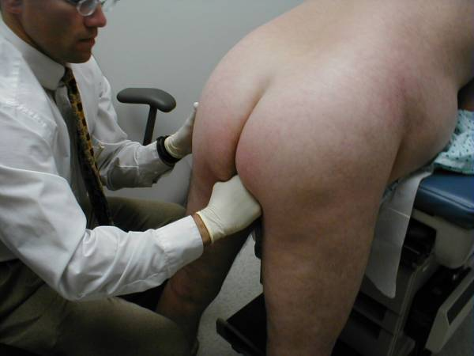
Challenge: Consent, Recruitment and the Problem with Video
Video recording and General Practice can be a little difficult to mix
Most decision support tools are only used on a proportion of patients
  i.e., only want to recruit and to invoke equipment sporadically
Censored!

Slide 8
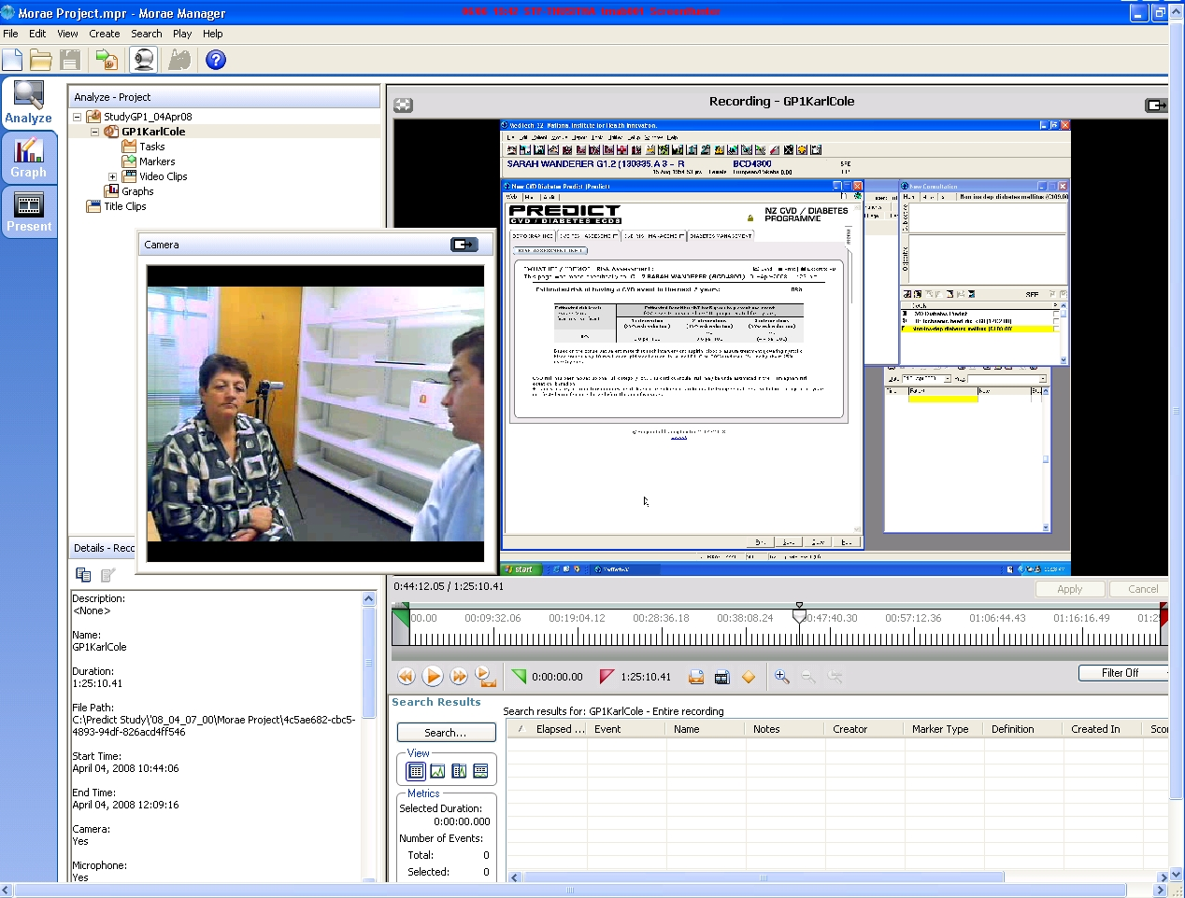

Slide 9
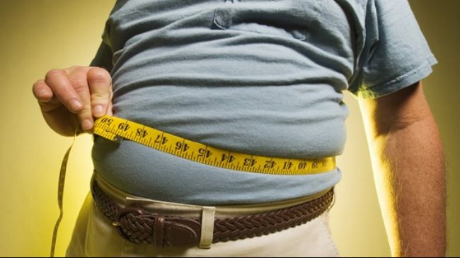
Challenge: Realistic Test Cases and Software Environment
Sounds easy enough to put a ‘realistic’ patient into a PMS
But when does their record begin?
  Our scenario began with a sick certificate for flu the previous week (now GP wanted to assess CVD risk)
  But we need to set up complete history, including that visit a week ago
Time moves on!
  ‘A week ago’ keeps moving
  Actually very hard to synthesize
  patients
    Physicians very sensitive to infeasible
    clinical data!
    Ethics issues in re-using past real
    case data
  And to keep them current
    PMS designed to enter data as you go – not to fake a past!

Slide 10
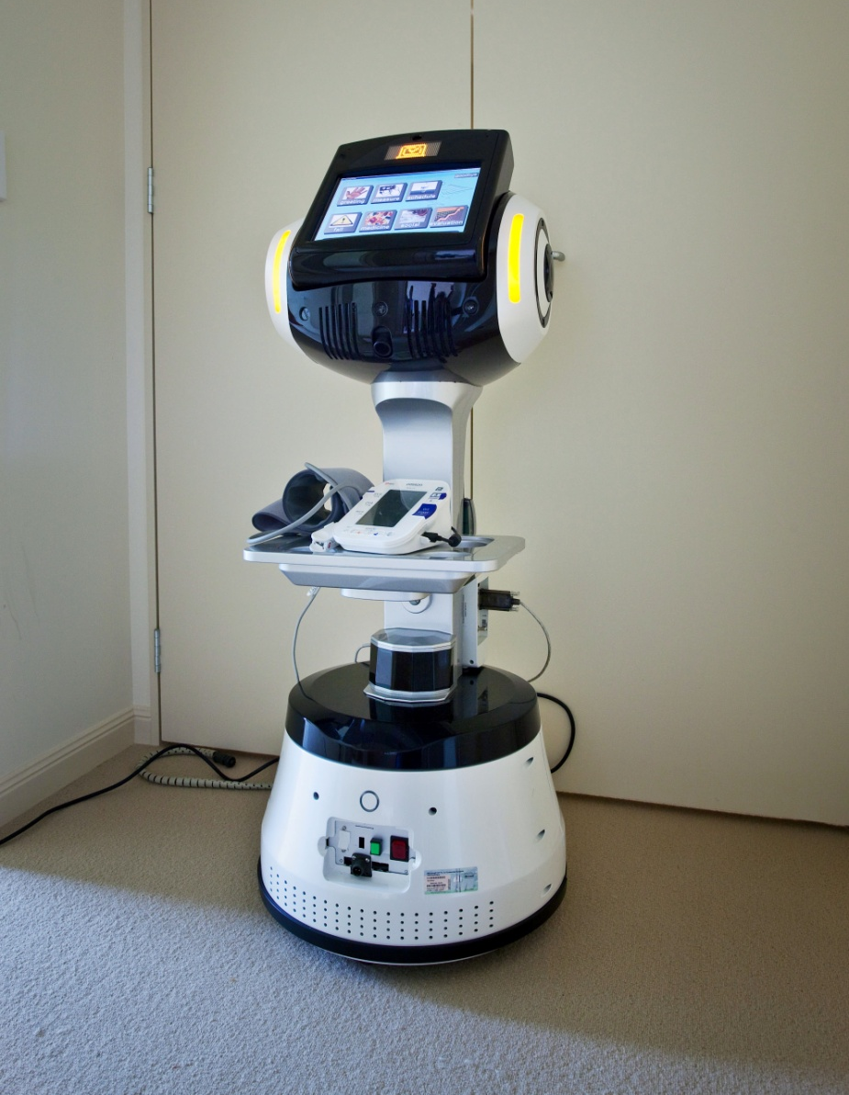
Another study: Robotic elder care
‘Cafero’ waiter robot with clinical monitoring tools on the tray
Linux based navigation system on bottom
Windows touchscreen and voice interface up top
(Project with A/Prof Bruce MacDonald in ECE)

Slide 11
Application / Study
Elder care
  Testing in a residential care facility (supported living: periodic caregiver visits, nurse on call)
  Promoting quality use of medicine
    Adherence to taking it (or knowing why not)
    Physiological monitoring of effectiveness (and for safety)
    Asking about side-effects
    Providing education (and entertainment)
Tested with morning medications of 12 residents

Slide 13
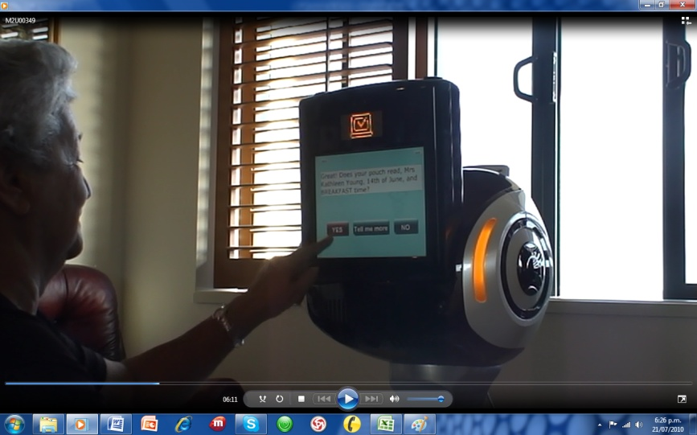
Measures / findings
Video recorded
Interviewed
  Structured,
  open-ended
Needed to tilt
head lower!
Patients like it and can use it well enough unless having significant dementia or macular degeneration
Want features to video call and alert family

Slide 14
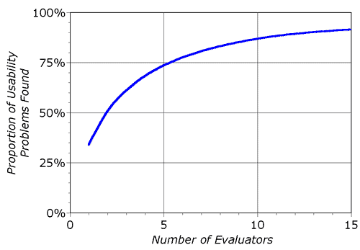
Lesson 1: Remember Nielsen
A common problem will appear after a few sessions
For systems in production use, you can just ask a couple real users and they’ll tell you about all the worst problems (“saturation”)
Based here on 34% probability of one independent use evaluator finding the problem

Slide 15
Lesson 2: Show name, the right name (aka, don’t kill the patient: type 1)
Patient full name, age/dob, and gender
Ideally, patient photo
Navigation controls
Sub-window (often in HTML) with clinical details
  Don’t let the subwindow navigate to a different patient without refreshing the main window
  Don’t let the main window navigate to a different patient without refreshing the subwindow

Slide 16
Lesson 3: Show all the data
(aka, don’t kill the patient: type 2)
Must always avoid truncating a field
Must do best to make navigation easy and presence of more data apparent
Most medical data is indefinite upper bound repeating groups (e.g., problems, medications)
  No obvious answer; tabs are used a lot
  Allow comments fields on every visual ‘chunk’ of patient data (hmm… if only you knew how the data might get transmitted and reformatted!)
Amoxicillin should be given
under no circumstances due to severe allergic reaction

Slide 17
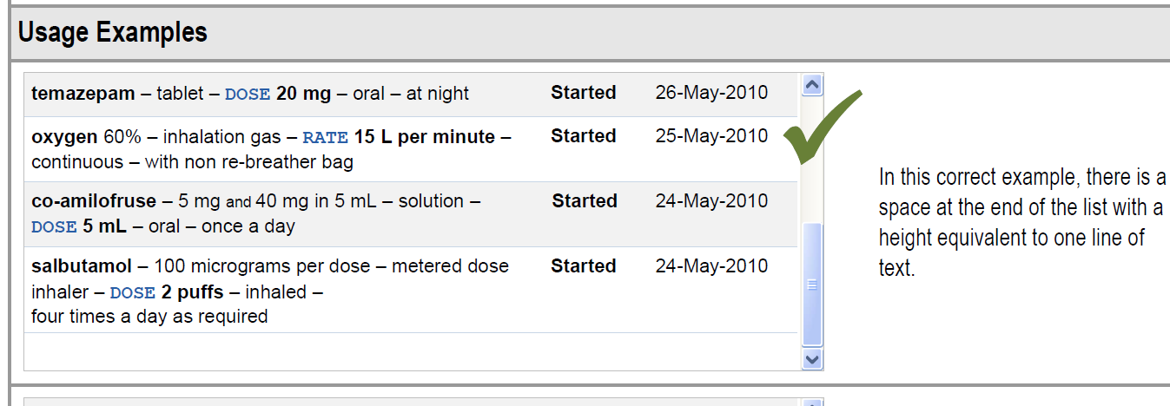
Lesson 4: Microsoft CUI
(‘standards and successful templates’)
API and style guide based on extensive study of common clinical HCI problems
  CUI = common user interface

Slide 18
Lesson 5: research ethics
There’s not much you’ll do research-wise in this area without needing formal human research ethics approval (called IRB – institutional review board – in the US)
  Takes time; doesn’t always go smoothly
  Acknowledge risks (confidentiality, safety): they’re always there
  Indicate benefits and safeguards
Need clinical collaborators

Slide 19
Lesson 6: consider a wide range of criteria for evaluation
HCI success is never one-dimensional
  Efficiency, error rate, subjective user satisfaction
  All the more so in health
  Serious deficiency in any area will be unacceptable
    Clinical users can work around system, or have many levels of appeal if forced to use something
Simple qualitative feedback from users will quickly yield important information
  That’s basically Lesson 1 (Nielsen’s curve)
  The software can always be made better for the current context of use
Quantitative measures provide a ‘warrant’ to sustain the innovation
  Show the good that’s being done (well, or not!) to make case for further roll-out and perfective maintenance

Slide 20
Criteria pool (1 of 2)
Criteria Domain |  | Criteria Type |  | Examples / Comments
Genre: Impact
Work and Communication Patterns | Efficiency |  | Time-and-motion measurements, logging of screen access times, transactional log cycle times (e.g. received-to-actioned latency), direct expenditure (cost), self report of task time, impression of efficiency
 | Coherence |  | Interruptions, multi-tasking (observed or self-reported)
Organisational Culture | Positivity |  | Reporting feeling positive / motivated, sick leave rates, turnover
 | Safety (culture of) |  | Reported feeling that system is safe, specific safety promoting practices (e.g. incident reporting and review) – also see Safety and Quality domain below
 | Effectiveness and Quality (culture of) |  | Self report that efforts are effective / that quality matters, quality improvement activity
 | Social networks |  | Levels of inter-professional communication, inter-professional respect and empathy
 | Patient centeredness |  | Patient engagement, adherence, confidence, knowledge
Safety and Quality | Safety |  | Incident rates and timeliness of review, description of potential sources of error, data inaccuracy (wrong patient details, incorrect / missing / duplicate clinical data)
 | Quality |  | See Organisational Culture above and Clinical Effectiveness below
Clinical Effectiveness | Outcome |  | Mortality, morbidity, readmission, length of stay, patient functional status, quality of life / health status (e.g. SF-36)
 | Indicator |  | HbA1c, blood pressure, etc.
 | Process measure |  | Guideline adherence – also domains above

Slide 21
Criteria pool (2 of 2)
Criteria Domain | Criteria Type | Examples / Comments
Genre: Product
IT System Integrity | Stability | Uptime, errors (logged or self-report), disaster recovery features, maintenance effort
 | Data quality | See Safety above
 | Data security | IT expert opinion, standards compliance, evidence of breaches
 | Standards compliance | International / national compliance, demonstrated interoperability
 | Scalability | Response time, maintainability / tailorability / extensibility, IT expert opinion
Usability | Uptake / Use | Rate and extent of uptake, persistence of use of alternatives / workarounds (as measured from transactional systems, or self-report)
 | Efficiency | As per Impact genre above
 | Accuracy | Data entry / interpretation error rates – as per Safety above
 | Learnability | Extent of feature use, help desk requests, rate of uptake
 | Satisfaction | Overall happiness with solution (e.g. desire to continue using it)
Vendor factors |  | Cost competitiveness of licensing / services, vendor support / commitment
Genre: Process
Project Management |  | On time, on budget, with proposed features / benefits
Participant experience |  | Disruption (self-report or using intermediate measures from the Impact genre), angst, meeting expectations, feeling included
Leadership |  | Identification of leaders, ability to have bridged difficult transitions, role in maintaining quality of participant experience

Slide 22
Conclusion
Health IT presents exciting HCI challenges
  Both practical and for research
Key lessons include
  Get feedback from users: you’ll quickly uncover the major problems
  Keep the patient identity synchronized to the displayed data
  Make sure user can see if there’s more data
  Take advantage of successful standards, templates and APIs
  Operate within a formal human research ethics framework where necessary and with clinical collaborators
  Consider a wide range of evaluation criteria and make both qualitative and quantitative measures, including subjective measures
Please let me know (jim@cs.auckland.ac.nz) if you might be interested in a Health Informatics research topic for honours

