Slide 1
COMPSCI 345 / SOFTENG 350
Exam Review 2013
Assoc Prof Beryl Plimmer
Prof Jim Warren

Slide 2
Exam Format
20 x 1 mark ‘fill in the gap’ questions (5 from Jim, 15 from Beryl)
30 marks longer answer questions from Jim
60 marks longer answer questions from Beryl
Bring a few pens and a ruler, you may have to do some design work.

Slide 3
Exam review
Review the learning objectives
Look for key terminology and definitions
Remember what was applied in assignments and tutorials
Look for techniques that could form the basis for the high-point exam questions!

Slide 4
Jim’s section

Slide 5
Nielsen’s Heuristics
L2
Visibility of System Status
Match between System and the Real World
User Control and Freedom
Consistency and Standards
Error Prevention
Recognition Rather Than Recall
Flexibility and Efficiency of Use
Aesthetic and Minimalist Design
Help Users to Recognise, Diagnose, and Recover from Errors
Help and Documentation

Slide 6

Fitts’ Law
L2
Fitts’ Law is the classic performance measure.
Time to target depends on target width (W) and distance to move pointer (D) (see tutorial exercise)
It is a very valuable measure for designing
Control size and location
Its also fun to play with!
2
1
3

Slide 7
L4: Usability testing – planning & reporting
Be able to develop usability testing plans
Be able to write usability test reports
Understand the nature of human research ethics requirements when conducting studies on humans

Slide 8
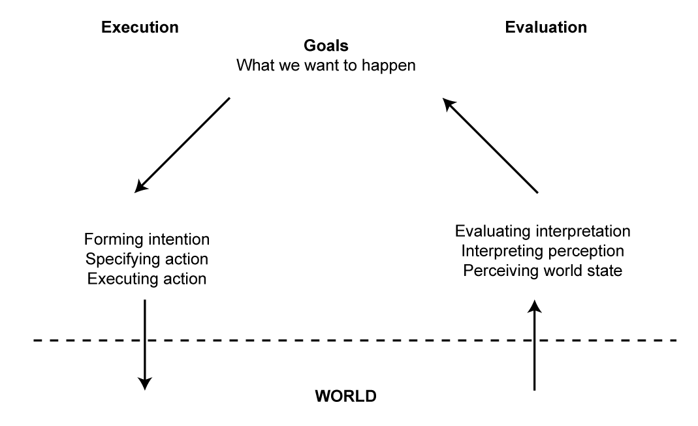
Execution/Evaluation Action Cycle (EEC)
L5
Seven Stages of Action

Slide 9
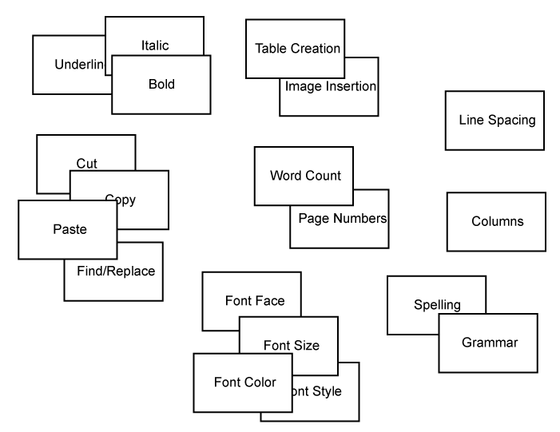
Conceptual Design – Card Sort
L6
Result of a card sort

Slide 10
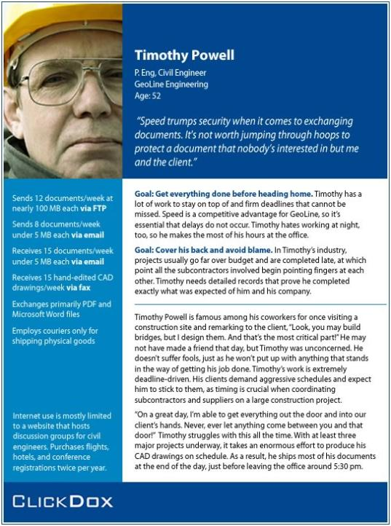
Persona example
L6
© http://chopsticker.com/
Notes:
Relate to the civil engineering database from earlier lectures

Slide 11
Scenario example
L6
Accessing Design Files from a remote server
PACT Analysis
People: Design engineer on a project
Activities: Using the DMS (document management system) to identify released document set for a design part
Context: Remote site work environment, independently managed work activity
Technology: Mobile interface to previous PC-based DMS
Scenario
Engineer is on site discussing construction of ‘Bridge D’ ‘Deck’ with contractors. Doesn’t believe that they have all the documentation and needs to check their set of documents against the master set. Uses mobile device to access DMS and authenticates with the system. Selects project ‘Bridge D’ and design part ‘Deck’. Requests the set of released documents to be identified. Works through the identified set of documents checking document codes, release date, and versions with the contractor. Identifies no anomalies with the contractor’s set and completes programme task.

Slide 12
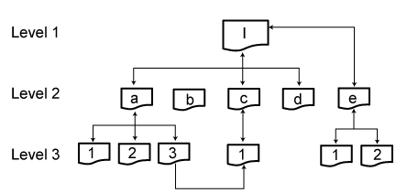
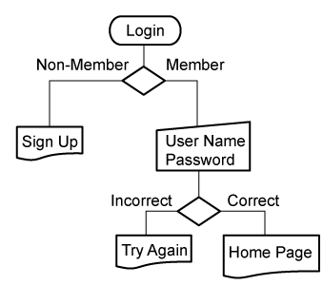
Conceptual Design – Scenarios, Flowcharts, and Cognitive Walkthroughs
L5
Flowcharts can be:
Simple network diagrams that identify the pages of a Web site and the navigational links between them
Sophisticated diagrams that capture conditional junctures and computational processes

Slide 13
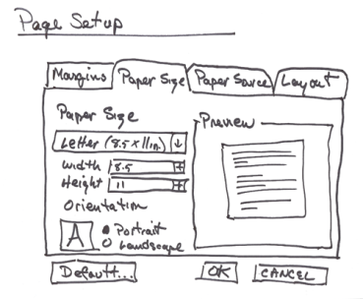
Physical Design - Low-fidelity prototypes
L7
The three main criteria for low-fidelity prototypes:
Easy and inexpensive to make.
Flexible enough to be constantly changed and rearranged.
Complete enough to yield useful feedback about specific design questions.

Slide 14
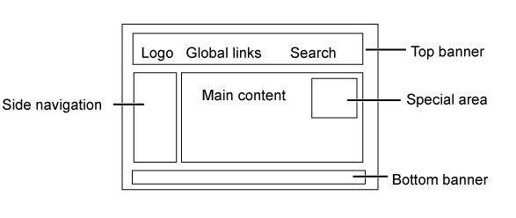
Physical Design Cont. - Wireframes
L8
Wireframes help to create template layouts that can be used to impose a consistent structure throughout the interface

Slide 15
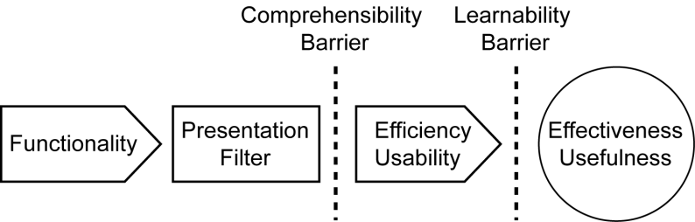
Framework for Design Principles
L9
Provides a framework for thinking about design principles in terms of interaction

Slide 16
Principles of Interaction Design
L0
Effectiveness/Usefulness
Utility
Safety
Flexibility
Stability
Efficiency/Usability
Simplicity
Memorability
Predictability
Visibility

Slide 17
Other Principles of Perception - Screen Complexity
L10
More practical (approximate) way to calculate the measure of complexity for a particular screen, do the following:
Count the number of elements
Count the number of columns (horizontal alignment points)
Count the number of rows (vertical alignment points)
Sum up these three counts for a complexity score

Slide 18
Optimal Usability guest lecture
To see how the concepts and techniques from our lectures are applied by a leading usability service organisation

Slide 19
L12: Discovery
To develop a set of skills for systematic analysis of a problem domain to discover HCI issues and requirements
To understand perspectives on data collection including types of stakeholders
To be able to collect data by interviews, focus groups and questionnaires

Slide 20
Orion Health guest lecture
To appreciate the emphasis on user experience design by one of our top employers of new computing graduates

Slide 21
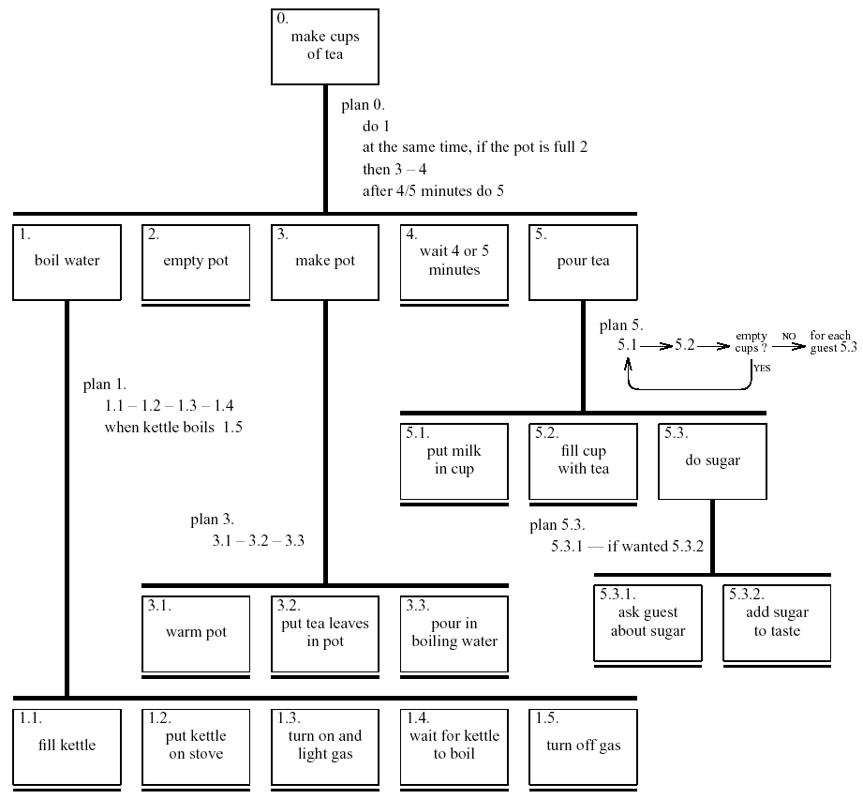
Refined HTA for making tea
L14

Slide 22
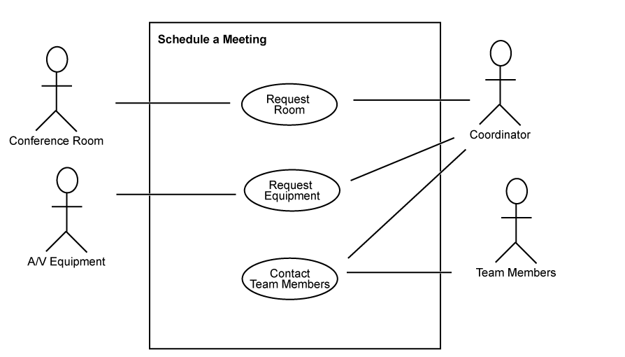
Interpretation – Use Cases
L14
Notice we use a stickman symbol for the equipment!
Use case diagram of “schedule a meeting” process.

Slide 23
Lesson 2: Show name, the right name (aka, don’t kill the patient: type 1)
From Jim’s lecture of Health and HCI
Patient full name, age/dob, and gender
Ideally, patient photo
Navigation controls
Sub-window (often in HTML) with clinical details
Don’t let the subwindow navigate to a different patient without refreshing the main window
Don’t let the main window navigate to a different patient without refreshing the subwindow

Slide 24
Beryl’s Section
Major Themes
Visual Interface
Other Interaction modalities
Human sensory/motor system
HCI Research

Slide 25
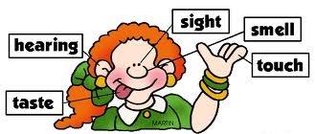
Human Sensory/Motor systems
Running through this part of the course were high level ideas of human
Memory and processing
Sight
Hearing
Smell
Touch and kinaesthetic

Slide 26
Visual Interface
Principles of visual aesthetics
Understand and describe the basics of visual interface design
Be able to critique and interface in a methodical manner
Be able to design an interface in a methodical manner

Slide 27

Visual Interface
Text and Fonts
Colours and Images
Grouping
Lines and borders
Forms and controls

Slide 28
Other Modalities
Sound – input and output
Pens and other tangibles
Touch and Haptics
Smell
Brain Computer Interaction

Slide 29
HCI Research
Pen and Tangible
Eye tracking and eye gaze
UI customization

Slide 30
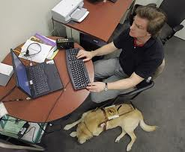
Guest lecture
Accessibility for visually impaired

Slide 31
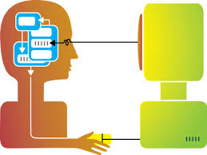
Thank you
And good luck!

