Slide 1
User centered design in Health
Adam Sawyer, Orion Health

Slide 2
The limitations of the physical world

Slide 3
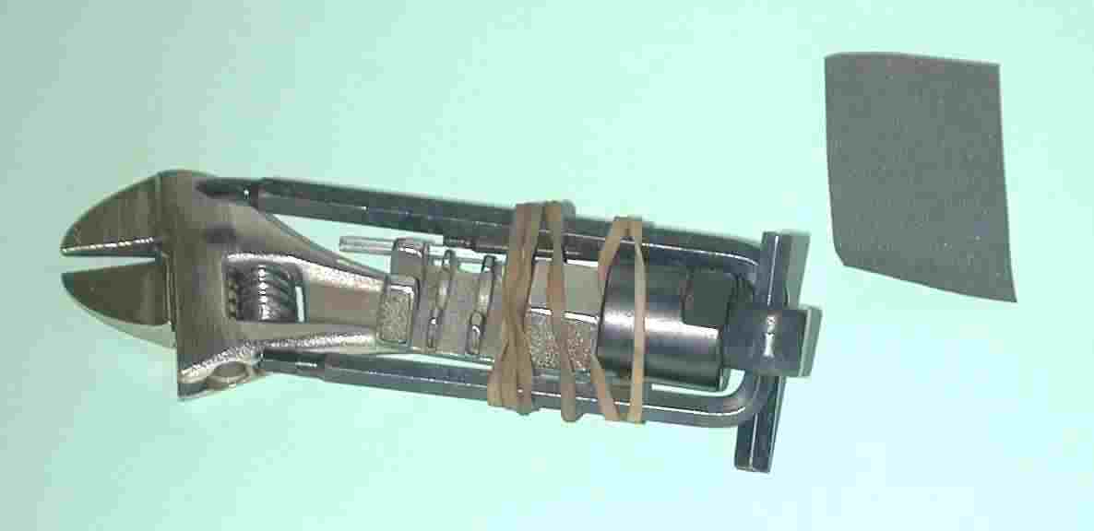
Ugly? Perfection?

Slide 4
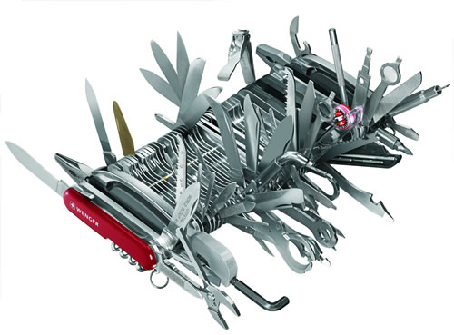
Is this feature packed baby really better?

Slide 5
The limitations of the electronic world

Slide 6
0

Slide 7
0

Slide 8
0

Slide 9
Which leads to a question
In an industry that has so few barriers, so much scope – why do we have so few interaction designers? Why do so few companies employ it, and those that do, clearly show the point of difference?
Lots of other industries have discovered design as a solution
  Do engine builders design cars?
  Do builders design houses

Slide 10
Design
Design gives us beautiful buildings, stunning tools, elegant typography and aesthetic beautiful to use furniture.
So what happens when an electronic device is designed beautifully?

Slide 11
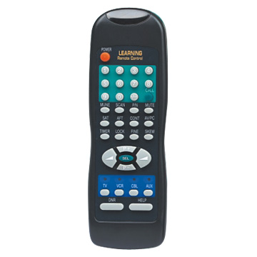
Beautiful isn’t it?

Slide 12
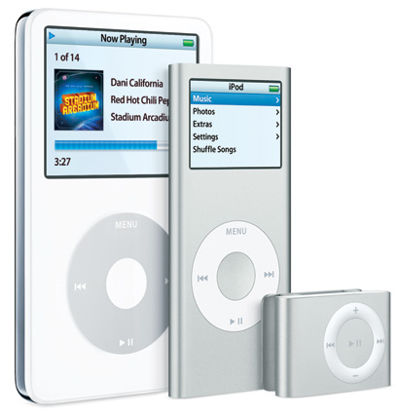
Are we getting closer?

Slide 13
Today
Intro to Orion and Adam done
What is design - done
What are the challenges of design? How do software companies traditionally design?
What do software companies do?
What’s it like to be international?
What makes an interaction designer

Slide 14
Orion Health
www.orionhealth.com
A company of nearly 300 people, based in Auckland, with offices in USA, Canada, Australia, UK and Spain.
We make software that allows clinicians to access information which means patients get treated better
Wholly New Zealand owned, fabulous place to work

Slide 15
Adam Sawyer
Started life as a geomorphologist (I know about rocks in rivers, you can ask me later) in the UK
Went into Health IT management in Auckland
Moved onto Health software design
…..

Slide 16
Intro to Orion and Adam
What is design
What are the challenges of design? How do software companies traditionally design?
What do software companies do?
What’s it like to be international?
What makes an interaction designer

Slide 17
Some design reading
Cooper – About Face, Inmates are running the Asylum
Donald Norman – the design of everyday things
Bruce Tognazzini – first principals of interaction design

Slide 18
What is design?
In this context lets talk interaction design of a software application in a complex environment consisting of people, places, space, information
How a user feels, how he works, how this interface affects his day

Slide 19
It is…..
Systematic
Dynamic
Scientific
Creative
Involving
Communicative

Slide 20
It isn’t…..
A guess

Slide 21

Why strive for good design?
It is purposeful and helps people to achieve goals
It makes people feel competent and..
It stops users feeling dumb..
It is elegant and the simplest complete solution
It makes products great to use

Slide 22
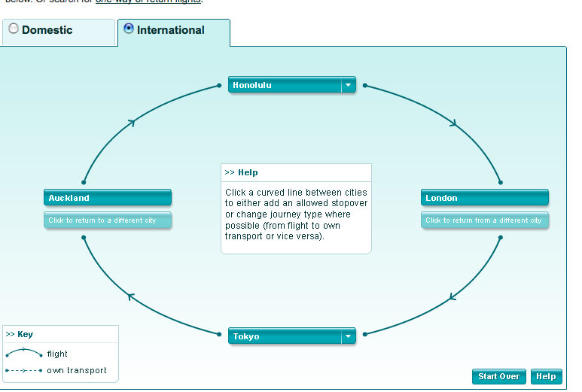
Air NZ international multistop

Slide 23
The benefits of a design process
Creates rigour
Creates auditable outcomes
Creates great artifacts
Actually solves the problem at hand, not some theoretical one in the developers/salespersons mind. The CEOs favourite widget……

Slide 24
The 6 Cooper steps to good design
Clarify business requirements and conduct user research
Modeling users as personas
Requirements of personas
Create the design framework and boundaries
Refine design and leave artifacts for developers
Contribute to development process
Notes:
These are directly linked to the cooper manuals – please feel free to view these on my desk

Slide 25
1. Clarify business requirements and conduct user research
Users are generally unable to tell you what they require, customers even less
Requirements need to be defined based on business goals
Neither business stakeholders nor developers are capable of elucidating this
An end-to-end designer is tasked with capturing this information

Slide 26

Research.
Research has its emphasis on qualitative
Based on interviews and time with users in their environment
Specifically not self-referential nor leading

Slide 27
2. Modeling
Identify usage patterns of researched users
Analyse workflows
Assess work environment and technical factors
Create personas (archetypal users representing the needs of many) and identify and write down their goals
Review with stakeholders

Slide 28
3. Requirements definition
Identify risks
Construct scenarios
Create lists of functional needs
Review with stakeholders
Make trade off decisions on major requirements

Slide 29
Tools
User Story
When I create/read an alert I want to capture/see meaningful information about the alert, so myself and other users can assess its significance.
Scenario
Day 2
The operation to correct Clive's leg proceeds as planned and there are no complications. Just before the operation, the anaesthetist, Dr Slumberpond reads Clive's clinical record and it is highlighted on the screen that a clinical alert exists for Clive. Dr Slumberpond, therefore checks these to ensure that the drugs she is going to give Clive won't cause an adverse event.

Slide 30
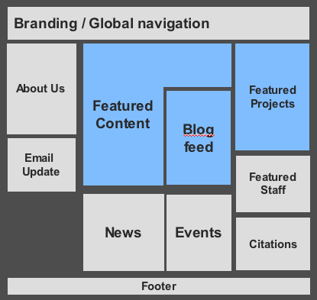
4. Create the design framework
Define the data objects
Define the functional elements
Sketch and iterate elements
Develop visual style
Review with stakeholders
Style guide
A guide to ensure clarity of communication, demonstrating visual and user style of product

Slide 31
5. Refine and iterate the design
Iterate through more detailed scenarios
Work closely with development to ensure feasibility
Illustrate every detail, pixel and control on screen
Develop a visual style guide
Conduct usability testing
Create form and behavior specification
Document, communicate, Illustrate

Slide 32
6. Development support
Design consultation on issues as they arise
Maintain quality throughout
Assure development trade offs are appropriate and negotiate with stakeholders

Slide 33
Design and Development effort
Not Waterfall, Not Agile, and not prescriptive of a development methodology
Development
Design
Effort
Time

Slide 34
Intro to Orion and Adam
What is design
What are the challenges of design? How do software companies traditionally design?
What do software companies do?
What’s it like to be international?
What makes an interaction designer

Slide 35
The challenges of design in the real world
Time vs Quality: Companies naturally need cashflow to survive, and sector is faster moving than say, furniture making….
Access to subjects: How to access our users without being a provider?
Finding specialist designers: skilled designers with BA skills, creative thinking skills that can be applied to the user interface are very rare

Slide 36
Intro to Orion and Adam
What is design
What are the challenges of design? How do software companies traditionally design?
What do software companies do?
What’s it like to be international?
What makes an interaction designer

Slide 37
What do software companies do?
OrionHealth lives by its values – we want to make a difference to the lives of the clinicians and patients
Support teams, 24:7, Marketing, Sales, Consulting, Professional onsite installation, web development, java development, design, testing, integration, finance, …..even IT!
Ongoing products as well as bespoke development.

Slide 38
Intro to Orion and Adam
What is design
What are the challenges of design? How do software companies traditionally design?
What do software companies do?
What’s it like to be international?
What makes an interaction designer

Slide 39
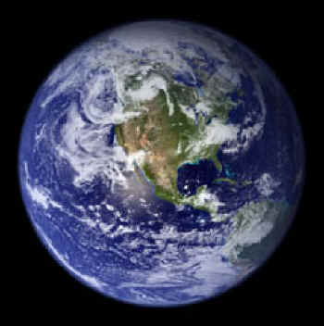
An international company
An International company is an one exciting to work in, meeting new professionals, opening new markets
Health is a sector that brings the best from staff, the challenge is making our teams empathetic to our end users
How do you run medical
software in the Spanish islands?

Slide 40
Intro to Orion and Adam
What is design
What are the challenges of design? How do software companies traditionally design?
What do software companies do?
What’s it like to be international?
What makes an interaction designer

Slide 41
What makes an interaction designer
Insightful – can you look beyond the actual to find the goal?
Listener –can you listen to the hidden cues?
Creative – can you invent? Can you create a solution from a parallel industry?
Technical…….?
Organised – Must be able to follow process and be iterative through this
Systematic – its just too easy to skip to the design and build part

Slide 42
Adam.Sawyer@orionhealth.com
If this is you…..
Questions

