Slide 1

A Multi-modal Alert System for Anaesthesia Diagnosis
Part IV Project – Software Engineering
Tyler & Ken
Dr. Michael Harrison – Faculty of Medical & Health
Dr. Beryl Plimmer – Department of Computer Science

Slide 2

Background
A use of medicine to prevent the feeling of pain or another sensation during the operation
Few fatal errors occur during Anaesthesia administration
80% are preventable human mistakes
Needs of Computerised Diagnosis

Slide 3
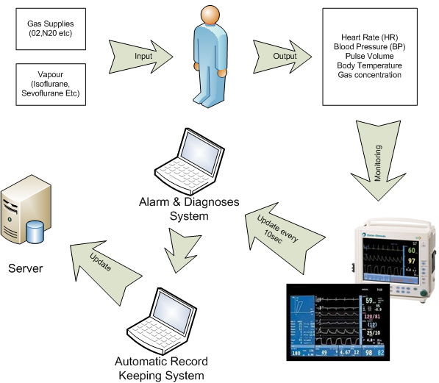
How it works

Slide 4

Current Issues
Increasing number of monitors in operating room
Low identification rate / High false alarm rate
Discrepancies between clinical and perceived urgencies
Ineffective Display

Slide 5
Gathering User Requirements
Research previous works
One-to-One interviews with Anaesthesiologists
Field Trips
Consultation with an area expert

Slide 6
Findings – 1/2
15” Touch Screen
Design to run in Windows based OS
Low occurrence rate
Management Protocol required

Slide 7
Findings – 2/2
User-centred Visualisation
Auditory Alarms
Physiological data through S5 Anaesthesia monitor
Categorised into 6 different Anaesthesia Status

Slide 8
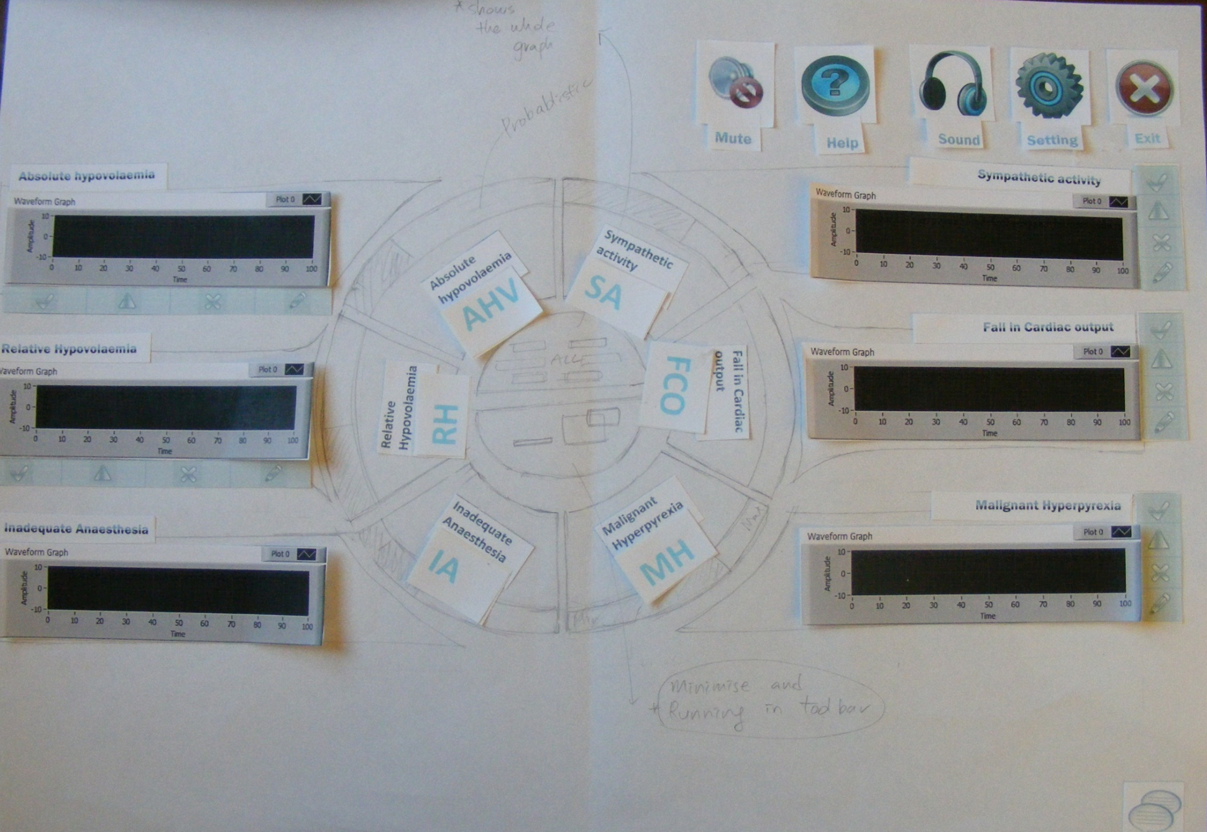
Lo-Fi Prototypes – 1/2

Slide 9
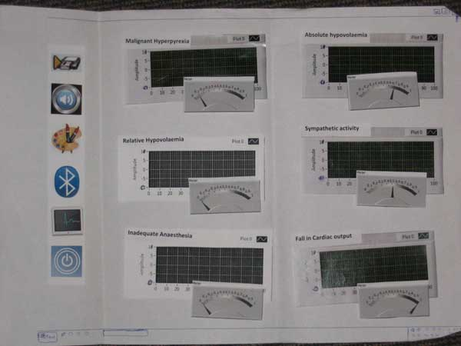
Lo-Fi Prototypes – 2/2

Slide 10
Suggested Solutions
Use of Multi-modal alarms with Speech
Bluetooth technology
Display with User-Centred UI

Slide 11
Development Tool
Required to use LabVIEW 8.5
Graphical programming for measurement and automation
For easy transition of project

Slide 12
Key Implementations
Visualising low fidelity prototypes
Text-to-Speech in LabVIEW 8.5
Plotting graph with real-time (time series)

Slide 13
Conclusions
Clear and Easy Multi-Modal alarms
High Identification Rate without further learning progress
No interference to others (surgeons / patients)
Improved user control setting

Slide 14
The End

