Slide 1
Two touch Origami Simulator
Lachlan Stuart
Samuel Hsiao-Heng Chang
Dr. Beryl Plimmer

Slide 2
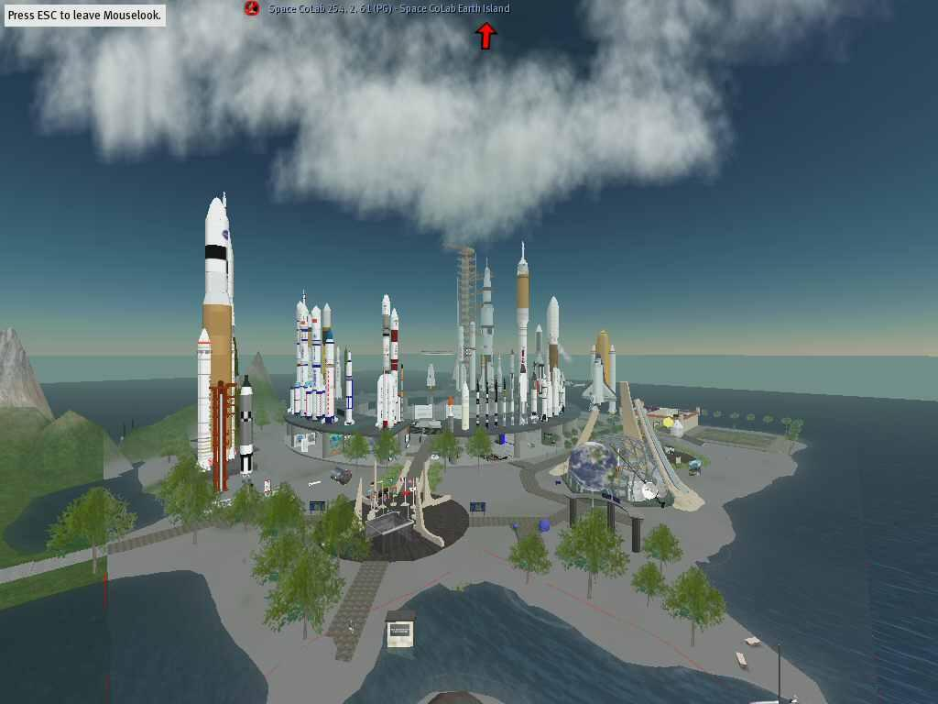
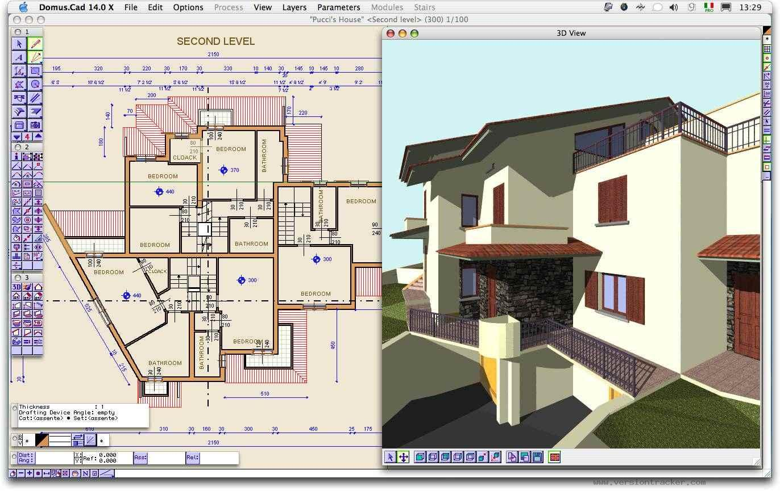
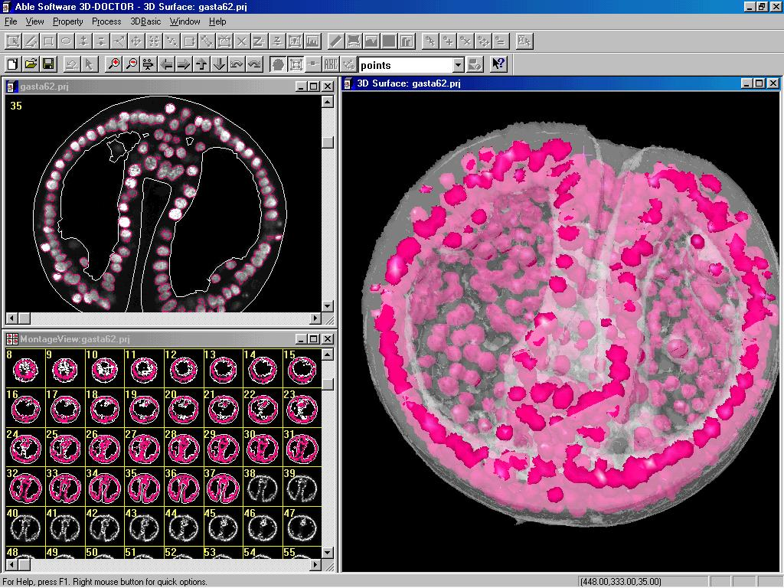
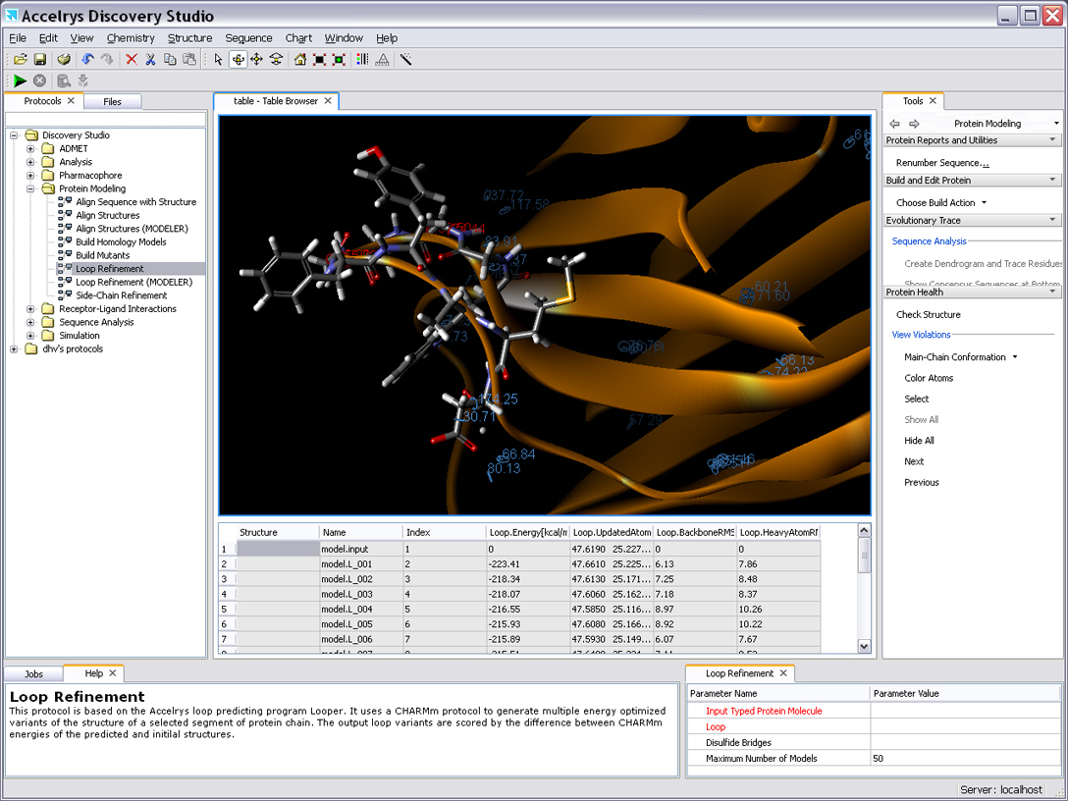
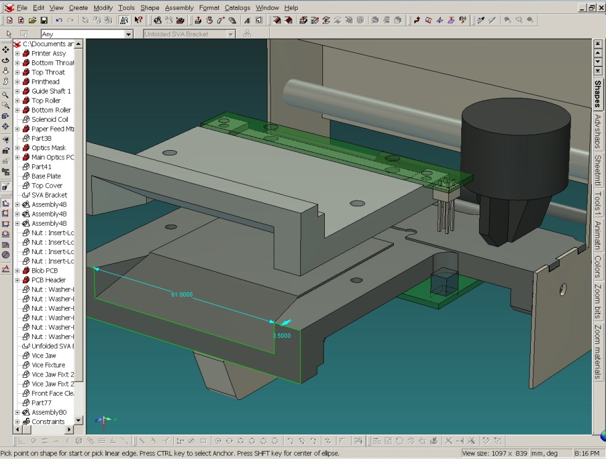
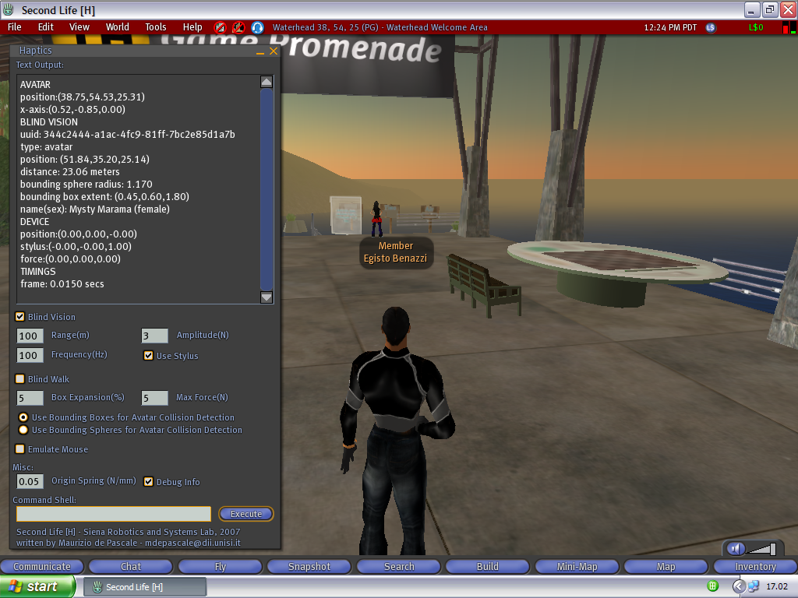
Importance of 3D modeling

Slide 3
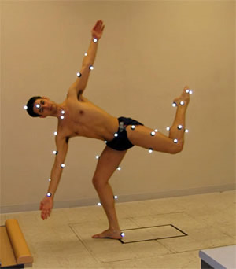
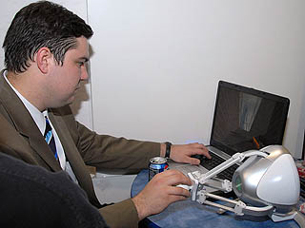
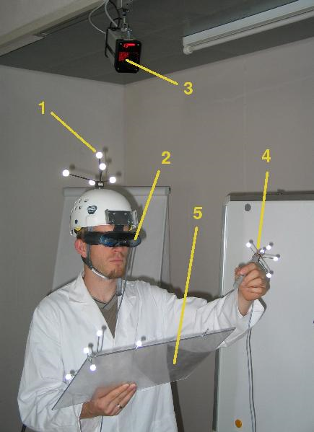
3D control?
Real world
Bimanual
Mouse and keyboard?
Unintuitive
One point
Special device?
Expensive
Still not very intuitive

Slide 4
Multi-touch?
Success in 2D
Bimanual
Point and select
Cheap

Slide 5
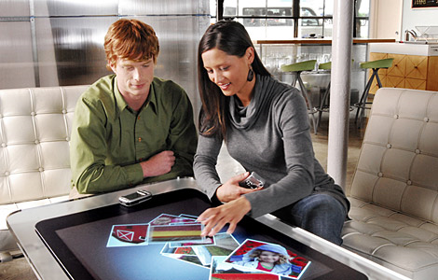
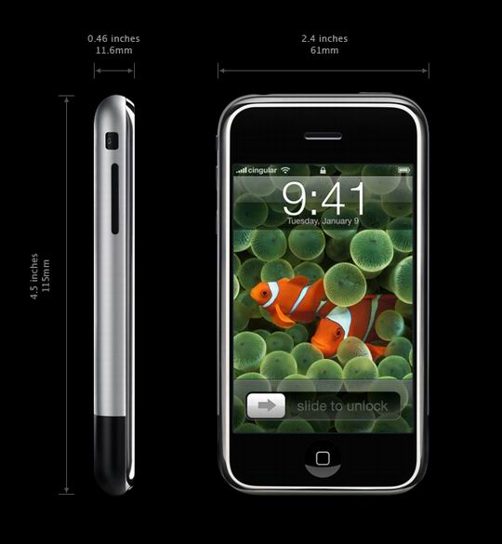
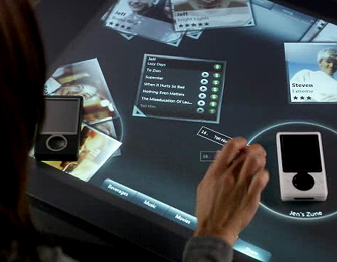
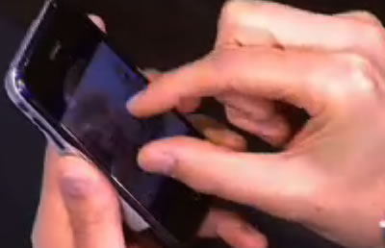
Multi-touch
M$ Surface
Apple iPhone

Slide 6
Multi-touch + 3D?
Manipulate 3D object with 2D interface
Focused on 2D environment
No “interactive” research found
Opportunity

Slide 7
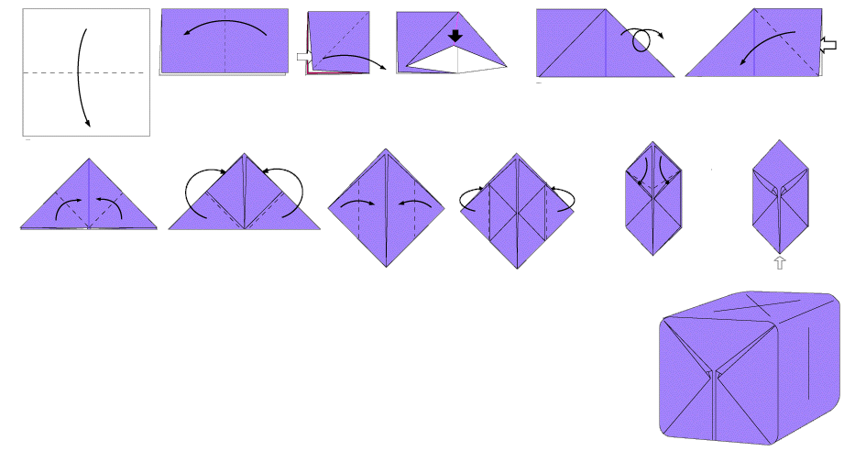
Target model
Origami
Common
Simple
Model
Complex
Interaction

Slide 8
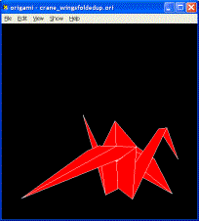
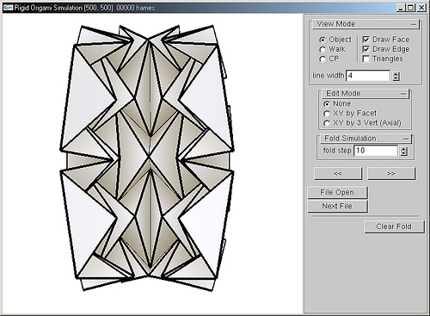
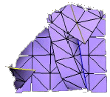
Origami simulators
Ways to create origami digitally
Limitation
Unintuitive interaction
Keyboard/Mouse
Non real time
Aesthetic requirement

Slide 9
Goal
User experience
Intuitive
Fun
Real interaction
Multi-touch technology
Physics engine

Slide 10
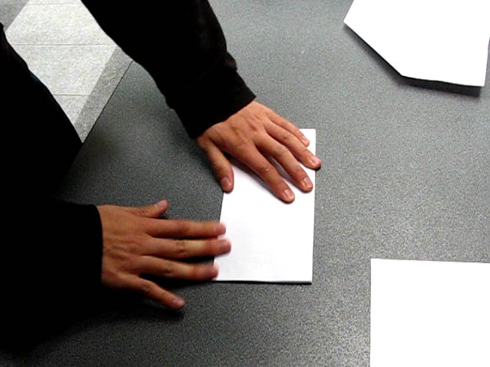
Multi-touch
No previous research
No tradition to follow
Real life origami
Techniques
User centered design
Experiments

Slide 11
Multi-touch
Folding gestures
Point to point
Line to line
Point to line
Tucking
Dragging gesture
Environment gesture
System gesture

Slide 12
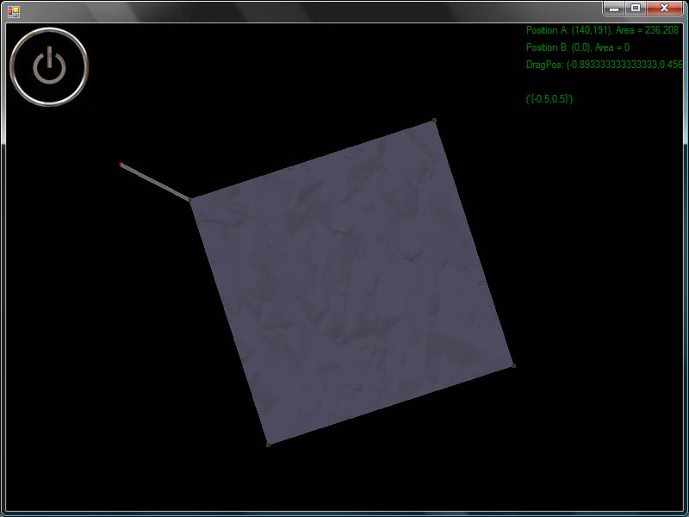
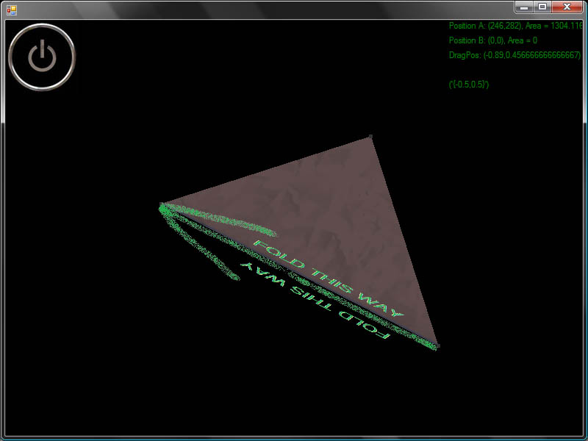
Interaction

Slide 13
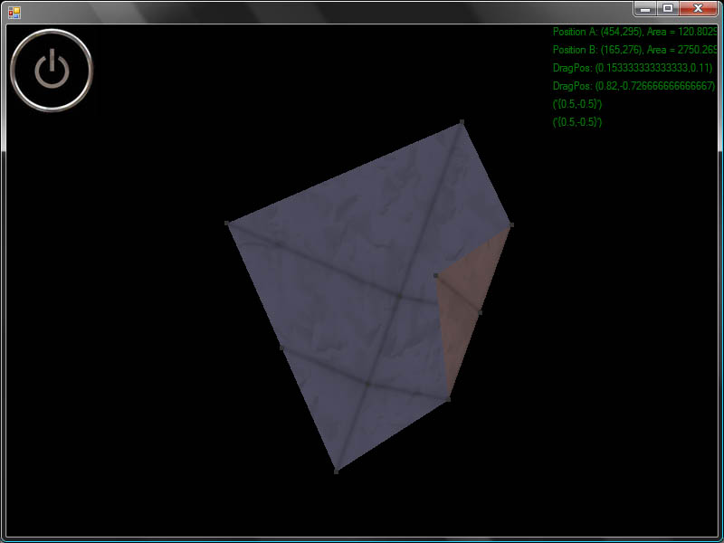
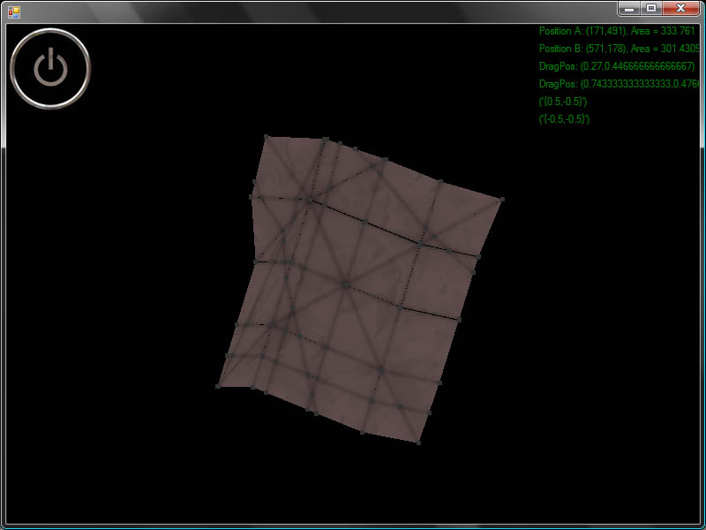
Interaction

Slide 14
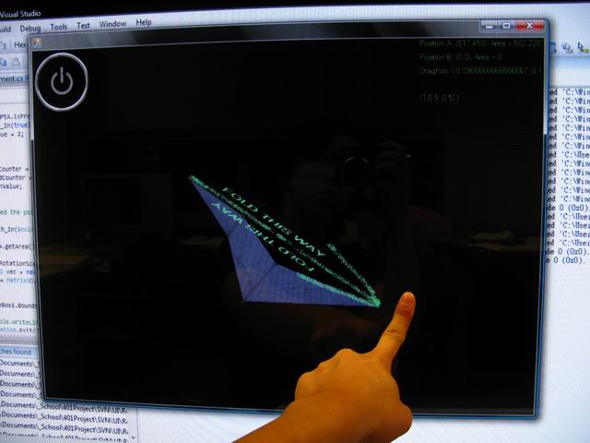
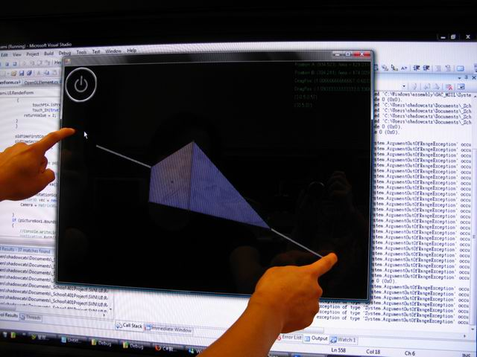
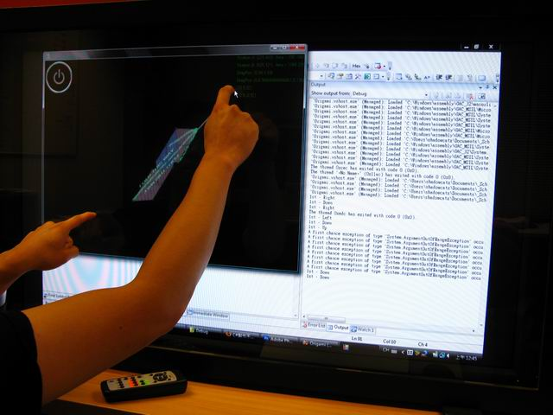
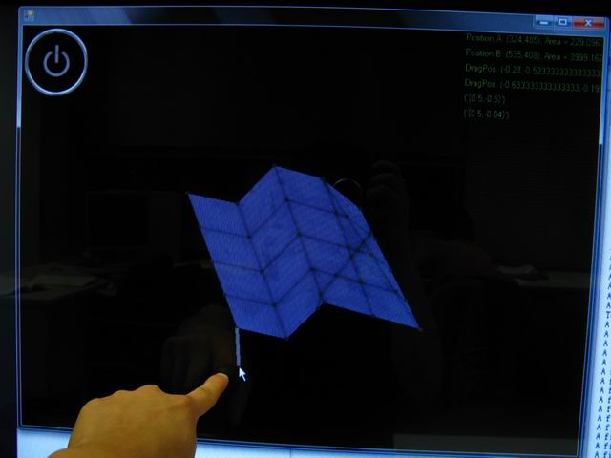
Interaction

Slide 15
Participants wanted
Usability study
40” multi-touch
Fun simulator

Slide 16
Questions?
Thanks for your concentration

