Slide 1
CompSci 230
Software Design and Construction
Software Quality 2015S1
Revision

Slide 2
Lecture plan
Week 1: No class - Anzac Day
What is software quality?
Some key developer practices (version control, testing).
Week 2: Black box testing.
White-box testing.
Myers' testing principles.
Week 3: Traditional approach to testing (Waterfall).
Agile approach to testing (XP).
Famous failures.

Slide 3
Questions
What do we mean by ‘software quality’?
How can we achieve ‘software quality’?

Slide 4
What is software quality?
Some ideas:
  Fitness for use
    How well does the product perform its intended functions?
    Varies according to user group (concept of ‘grade’)
      In a car, I want fuel-efficiency and safety
      You may prefer a car that looks good and has powerful acceleration
    For software, a user may care about, for example, security, usability, reliability, etc.

Slide 5
What is software quality?
So the answer to ‘what is software quality?’ is ‘it depends’
Some products to consider
  Control software for a patient monitoring system
    reliability? accuracy?
  Game to support children learning maths
    usability? child-age appropriate?
  Mobile app
    resource usage? usability? developer can easily modify to upgrade frequently?

Slide 6
Quality models
A number of quality models have been developed that describe the quality characteristics to be considered when developing a quality product.
As a developer, you should understand which of these apply to the product you are developing.

Slide 7
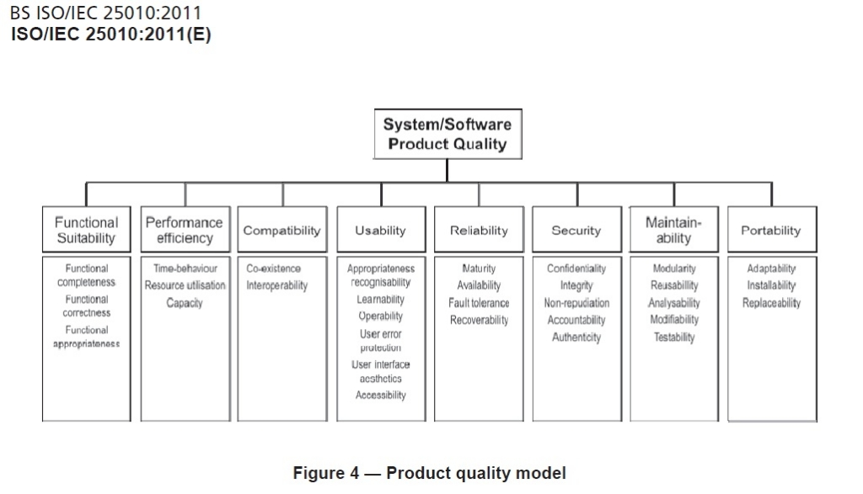
Quality models
ISO/IEC 25010 – System and software quality models

Slide 8
Historical perspective
First look at where many of the software quality ideas come from.
Origins are in manufacturing.
Brief historical look at manufacturing:
  US
  Japan

Slide 9
Historical perspective
Brief historical look at manufacturing:
  adapted from Juran 1981

Slide 10
Quality themes
Deming:
  Quality is conformance to specification
    Get the specs right and build according to them. Basis of the ‘waterfall’ approach to software development.
  You cannot inspect quality into a product – it must be built in from the start
    Inspecting (testing) finds what is wrong with the product, which then has to be reworked. Too late. For developer, it’s your job to make sure what is passed on to testing team or another developer is of high quality.
  Most problems are a result of the system (process) – don’t blame the workers, it’s a management problem
    Consider: team of 5 developers, 4 experienced and 1 new. The new one is in charge of keeping the specification wiki up to date. Hmmm…

Slide 11
Quality themes
Juran:
  Quality is fitness for use (issues of ‘grade’)
    Seen in agile approaches to software development i.e. work closely with the client to make sure you deliver what (s)he really wants.
    Developer must understand required quality characteristics.
  Workers must be empowered by support of top management
    Basis of TQM initiatives.
    HUGE problem in many (most?) software development initiatives.
  http://www.toyota.co.jp/ev/vision/production_system

Slide 12
Quality themes
Pareto:
  Only a few factors are responsible for most of the problems
  If you want to improve your software process, identify the small number of areas that will make the biggest difference.
Toyota:
  Eliminate waste (inventory, processing steps)
  Basis of the lean approach to software development.
  http://www.toyota.co.jp/ev/vision/production_system

Slide 13
Quality themes and SE
Underlying belief is : Good process -> quality product
  This idea is behind all the (heated) discussions about software process. For example, should an organisation implement a waterfall approach? XP? Perhaps Lean Software Development is the way to go?
  Each of these approaches implements some of the ideas from above.
  Current thinking is that practices must be adapted to the particular circumstances of the project.

Slide 14
Key developer practices
Two key developer practices that support quality outcomes are:
  version control
  testing

Slide 15
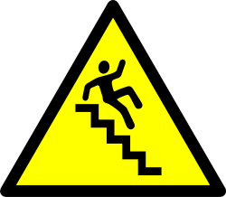

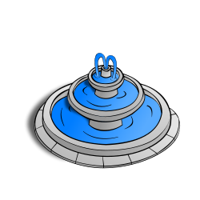
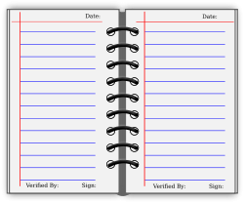


Version Control
Best Practices
Complete one change at a time and commit it
  If you committing several changes together
  you cannot undo/redo them individually
  If you don’t commit and your hard disk crashes…
Don’t break the build
  Test your changes before committing
Commit only the source files (e.g. not .class files)
Use the log by writing a summary for each commit
  What has been changed and why
Communicate with the other developers
  See who else is working on a part before changing it
  Discuss and agree on a design
  Follow the project guidelines & specifications
Dear diary

Slide 16
Testing
Black box
  Design tests from the specifications only (no knowledge of code structure)
    Tester must understand the user perspective
    Independent tester? Or developer with domain knowledge?
  Techniques
    Equivalence partitioning (split the input into partitions, where values in each partition can be viewed as being ‘similar’ )
    Boundary value analysis (for each partition, choose values at the boundaries over those in the middle of the partition)

Slide 17
Testing
Black box
Thoughts
Perhaps if the software-under-test is an application, someone who understands the users viewpoint will be more effective?
Is this technique really appropriate for within-development? What if the software-under-test is an API? Who is the user?
In a way, Black box testing can be viewed as testing interfaces – between human user and application, system interfaces, development modules, …
Can we use only for functionality? Or can we use to test other quality characteristics (efficiency, reliability, …)?

Slide 18
Testing
White box
  Design tests from a knowledge of code structure
    Tester must be familiar with programming language
    Developer ? (BEFORE submitting code)
  Logic path techniques (in order of strength)
    Statement coverage
    Decision coverage
    Decision/condition coverage

Slide 19
Testing
White box
Thoughts
Developer unwillingness to find defects in his or her own work (Myers’ psychology of testing).
What if the code is wrong in the first place (developer didn’t understand the specification)? Tests will pass when carried out by developer, but QA may later reject code when testing from the specs.
It might be difficult to find inputs that will force a test to take a specific path. Even more difficult to be sure every path is taken (recognising ‘dead code’ is surprisingly difficult in a procedural programming language such as Java or C).
Aim to exercise the most likely usage paths? Is the developer the best person to know this? Is this where Black box testing comes in?

Slide 20
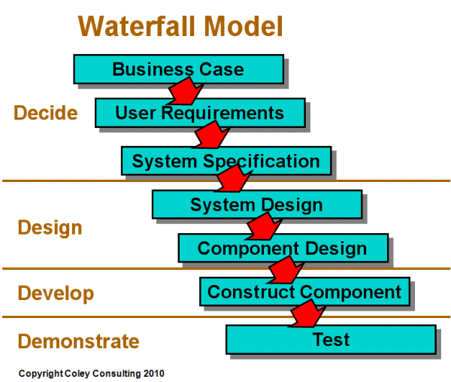
Waterfall model
Staged model. Each stage :
  implemented by different people with different skill sets
  must be completed and ‘signed off’ before the next begins
  verified against the previous stage before sign-off
http://www.coleyconsulting.co.uk/from-waterfall-to-v-model.htm

Slide 21
Waterfall model - verification
  At each stage, what is needed to verify that the product is being built according to what is stated in the previous stage (Are we building the product right)?
  Documents – requirements specs, design specs, code, test cases
    Stringent specification includes quality requirements
  Process – reviews, walkthroughs, inspections
http://softwaretestingfundamentals.com/verification-vs-validation/

Slide 22
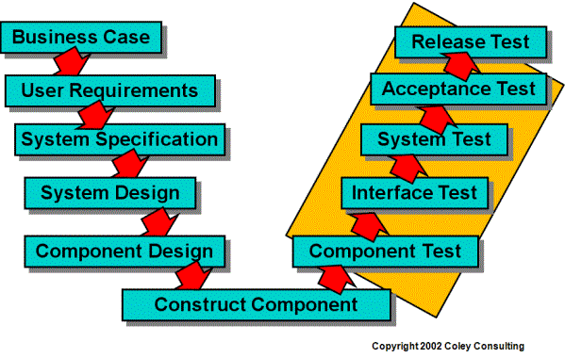
V-model for testing
Staged model testing : Each stage
  has a corresponding kind of test
AKA Integration test
AKA Unit test
http://www.coleyconsulting.co.uk/from-waterfall-to-v-model.htm

Slide 23
V-model for testing
System, acceptance and release tests aim to validate that the software does what the customer wants it to do (Did we build the right product?)
System test
  Does the software deliver to the specification? Test team.
Acceptance test
  Does the software deliver what the customer wanted? Customer.
Release test
  Does the software work in the existing business environment? Operations team.
http://softwaretestingfundamentals.com/verification-vs-validation/

Slide 24
Testing quality characteristics
Testing relating to quality characteristics:
  Load testing – apply maximum loads to test maximum capacity.
  Stress testing – find breaking point by applying over the maximum load.
  Usability testing – measure how quickly users
    learn to use the system
    complete specific tasks
    etc.
  Reliability testing
  Portability testing
  etc.

Slide 25
Other testing
Other kinds of testing :
  Smoke testing. During integration, before the product is handed over to the test team, a superficial check is made by the build person that the product’s basic features do what they are supposed to. Purpose is, of course, to not waste the test team’s time.
  Regression testing. Applied when changes to the product are needed (to fix bugs or add functionality) to make sure nothing is broken. Applied at unit, integration and system test levels,

Slide 26
Waterfall summary
Waterfall is a staged approach based on a manufacturing paradigm.
Created to address problems in large, complex development efforts.
Communication is largely via documentation.
Serious issues relating to documentation, communication and delivering what the customer really wanted.

Slide 27
Agile alliance
Many practitioners explored ways to mitigate issues
  Many (most?) projects actually implemented an iterative and incremental approach.
    1970s: Harlan Mills - upfront specification, deliver in many increments.
      adapt designs as a result of customer feedback.
    1976: Tom Gilb formally introduced ideas of ‘evolutionary project management’.
      no upfront specification, rather discover requirements in an iterative way.
In 2001, a number of separate groups working on ‘agile’ approaches to software development formed the Agile Alliance.
http://www.craiglarman.com/wiki/downloads/misc/history-of-iterative-larman-and-basili-ieee-computer.pdf
http://www.agilealliance.org/

Slide 28
XP testing
XP is one popular agile methodology
  Unit testing - create the unit (module) and acceptance tests before coding - Extreme Testing (XT).”
    ? Isn’t a more common name “Test Driven Development” (TDD) ?
    ? Did Kent Beck really invent the idea ?
    ? Was TDD originally part of XP ?
  Acceptance testing – carried out at the end of each iteration by the customer - Extreme Acceptance Testing (XAT).”
    ? What if there’s more than one customer?
    ? What if the stakeholders disagree about requirements?

Slide 29
Myers’s Summative Evaluation of XP
“Although glamorous, XP is not for every project or every organization.”
“Proponents of XP [claim] that the chances of successful application development increase dramatically”
“Detractors say that because XP is a process, you must do all or nothing. If you skip a practice, then … your program quality may suffer.”
“[D]etractors claim that the cost of changing a program in the future to add more features is more than the cost of initially anticipating and coding the requirement.”
“[S]ome programmers find working in pairs very cumbersome and invasive, therefore they do not embrace the XP methodology.”

Slide 30
Where are we now?
Many development methodologies have been proposed
  Each tends to gather a number of zealots who:
    advocate application of the methodology under all circumstances
    spend significant time ‘proving’ the methodology works under all circumstances.
  Architects originally stated that all practices must be carried out:
    each supports the others
    if you omit some, there will be gaps in the process
The current wisdom is that no one approach is guaranteed to be effective in all cases
  Each organisation must tailor a development process suitable for its specific contexts
  ‘Agile’ has morphed to mean ‘flexible’
When the next ‘silver bullet’ arrives (as it surely will), you should ask ‘what is the evidence?’

