Slide 1
CompSci 230 Software Design and Construction
Software Quality 2015S1
Traditional approach to testing (Waterfall)

Slide 2
Lecture plan
Week 1: No class - Anzac Day
What is software quality?
Some key developer practices (version control, testing).
Week 2: Black box testing.
White-box testing.
Myers' testing principles.
Week 3: Traditional approach to testing (Waterfall).
Agile approach to testing (XP).
Famous failures.

Slide 3
Learning goals
Have a working understanding of :
the waterfall model for software development
testing in the waterfall model
iterative, incremental and evolutionary development
Discuss:
limitations of the waterfall model
agile alliance and manifesto

Slide 4
Brief history of waterfall
1960s : programming is an ‘art’
practitioners receive no formal training
serious concerns about quality as projects became larger
1968 : conference organised by the NATO Science Committee
discussed issues with ‘software manufacture’
coined the term ‘software engineering’
introduced standard development model (waterfall) based on staged manufacturing process
Note : many ‘current’ issues discussed (need to iterate, obtain feedback from customer, reuse, product architecture) BUT appears to have been little attempt to reframe software development as anything other than a manufacturing process.

Slide 5
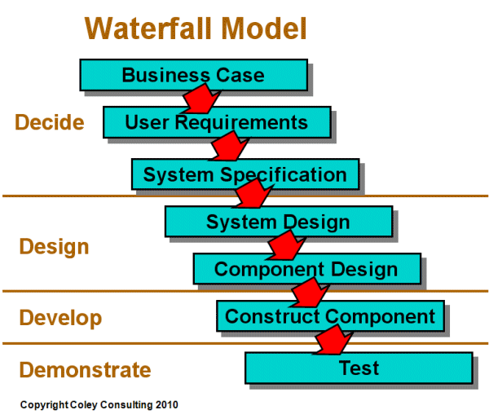
Waterfall model
Staged model. Each stage :
implemented by different people with different skill sets
must be completed and ‘signed off’ before the next begins
verified against the previous stage before sign-off
http://www.coleyconsulting.co.uk/from-waterfall-to-v-model.htm

Slide 6
Waterfall model - verification
At each stage, what is needed to verify that the product is being built according to what is stated in the previous stage (Are we building the product right)?
Documents – requirements specs, design specs, code, test cases
Process – reviews, walkthroughs, inspections
http://softwaretestingfundamentals.com/verification-vs-validation/

Slide 7
Waterfall model - documents
Documents play a critical role in the verification process.
Document standards :
IEEE Recommended Practice for Software Requirements Specifications (SRS)
etc.
IEEE Std 830-1998 - IEEE Recommended Practice for Software Requirements Specifications
/

Slide 8
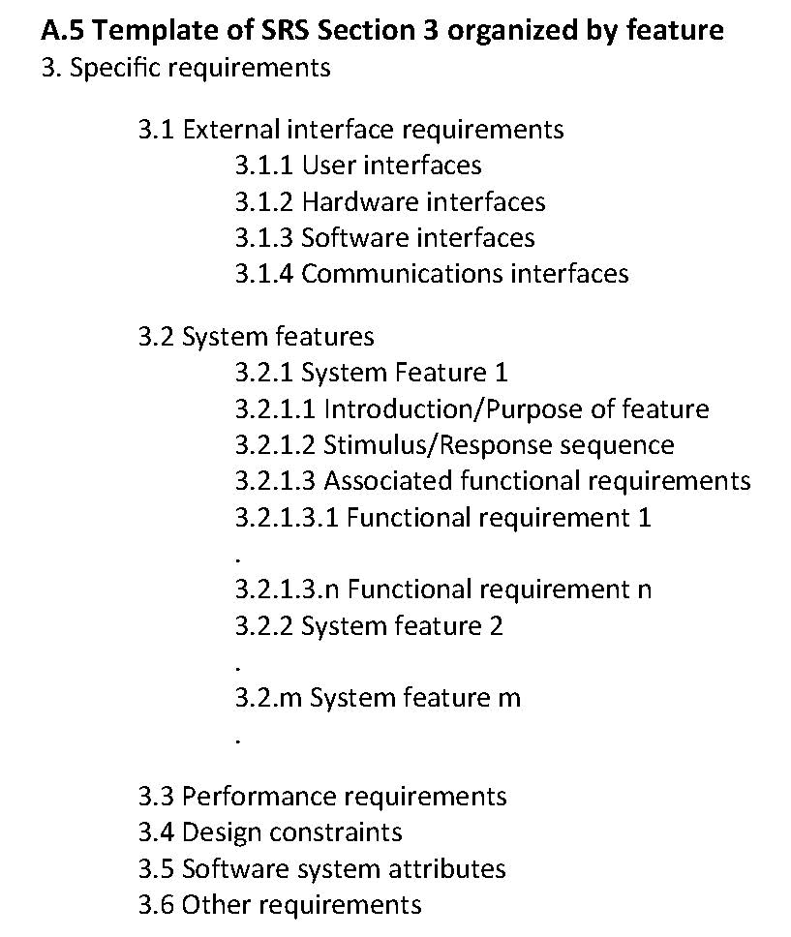
Waterfall model - requirements
A template from the IEEE SRS.
Note that, in addition to the features, you must consider external product interfaces and non-functional requirements.
IEEE Std 830-1998 - IEEE Recommended Practice for Software Requirements Specifications
/

Slide 9
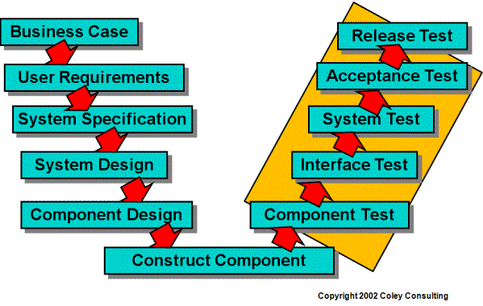
V-model for testing
Staged model testing : Each stage
has a corresponding kind of test
AKA Integration test
AKA Unit test
http://www.coleyconsulting.co.uk/from-waterfall-to-v-model.htm

Slide 10
V-model for testing
Component (unit) test
Does the component implement the design?
Performed by
developer OR
independent tester
Issues
Cannot catch every bug in a component. Impossible to test
every combination of inputs (black box)
every execution path (white box)

Slide 11
V-model for testing
Interface (integration) test
Do the components work with each other?
Performed by
developer OR
independent build person
Issues
Many integration issues for large application
interfaces
misunderstanding about functionality

Slide 12
V-model for testing
System test
Does the software deliver to the specification (functional and non-functional requirements)?
Performed by
specialised test team
Issues
Can be difficult to replicate user’s (production) environment

Slide 13
V-model for testing
Acceptance test
Does the software deliver what the customer wanted?
Performed by
specialised QA team and/or
customer (alpha releases)
Issues
Can be difficult to replicate user’s environment
use low spec machines to test e.g. latency issues

Slide 14
V-model for testing
Release test
Does the software work in the existing business environment?
Performed by
operations team and/or
customer (beta releases)
Issues
Customers can be busy and don’t want to be interrupted
If beta testing, need committed users

Slide 15
V-model for testing
System, acceptance and release tests aim to validate that the software does what the customer wants it to do (Did we build the right product?)
System test
Does the software deliver to the specification? Test team.
Acceptance test
Does the software deliver what the customer wanted? Customer.
Release test
Does the software work in the existing business environment? Operations team.
http://softwaretestingfundamentals.com/verification-vs-validation/

Slide 16
Quality characteristics
Testing relating to quality characteristics:
Load testing – apply maximum loads to test maximum capacity.
Stress testing – find breaking point by applying over the maximum load.
Usability testing – measure how quickly users
learn to use the system
complete specific tasks
etc.
Reliability testing
Portability testing
etc.

Slide 17
Other testing
Other kinds of testing :
Smoke testing. During integration, before the product is handed over to the test team, a superficial check is made by the build person that the product’s basic features do what they are supposed to. Purpose is, of course, to not waste the test team’s time.
Regression testing. Applied when changes to the product are needed (to fix bugs or add functionality) to make sure nothing is broken. Applied at unit, integration and system test levels,

Slide 18
Waterfall - issues
Practitioners uncovered some serious issues when implementing a waterfall approach :
During projects lasting several years, clients often changed their minds about what was required. The wrong product was delivered.
changes in environment
introduction of new technologies
The need for extensive documentation resulted in documents not being kept up-to-date.
e.g. during design phase, mistake in requirements document is discovered – fixed in design doc but not in requirements doc.
No communication between practitioners from different phases meant that tacit knowledge wasn’t shared. Coders often didn’t really grasp what was wanted.

Slide 19
Waterfall summary
Waterfall is a staged approach based on a manufacturing paradigm.
Created to address problems in large, complex development efforts.
Communication is largely via documentation.
Serious issues relating to documentation, communication and delivering what the customer really wanted.

Slide 20
Agile alliance
Many practitioners explored ways to mitigate issues
Many (most?) projects actually implemented an iterative and incremental approach.
1970s: Harlan Mills - upfront specification, deliver in many increments.
adapt designs as a result of customer feedback.
1976: Tom Gilb formally introduced ideas of ‘evolutionary project management’.
no upfront specification, rather discover requirements in an iterative way.
In 2001, a number of separate groups working on ‘agile’ approaches to software development formed the Agile Alliance.
http://www.craiglarman.com/wiki/downloads/misc/history-of-iterative-larman-and-basili-ieee-computer.pdf
http://www.agilealliance.org/

Slide 21
Agile alliance
Mission
“We support those who explore and apply Agile principles and practices to make the software industry productive, humane and sustainable.”
Manifesto
“We are uncovering better ways of developing software by doing it and helping others do it. Through this work we have come to value:
Individuals and interactions over processes and tools
Working software over comprehensive documentation
Customer collaboration over contract negotiation
Responding to change over following a plan.
That is, while there is value in the items on the right, we value the items on the left more.”
http://www.craiglarman.com/wiki/downloads/misc/history-of-iterative-larman-and-basili-ieee-computer.pdf
http://www.agilealliance.org/

Slide 22
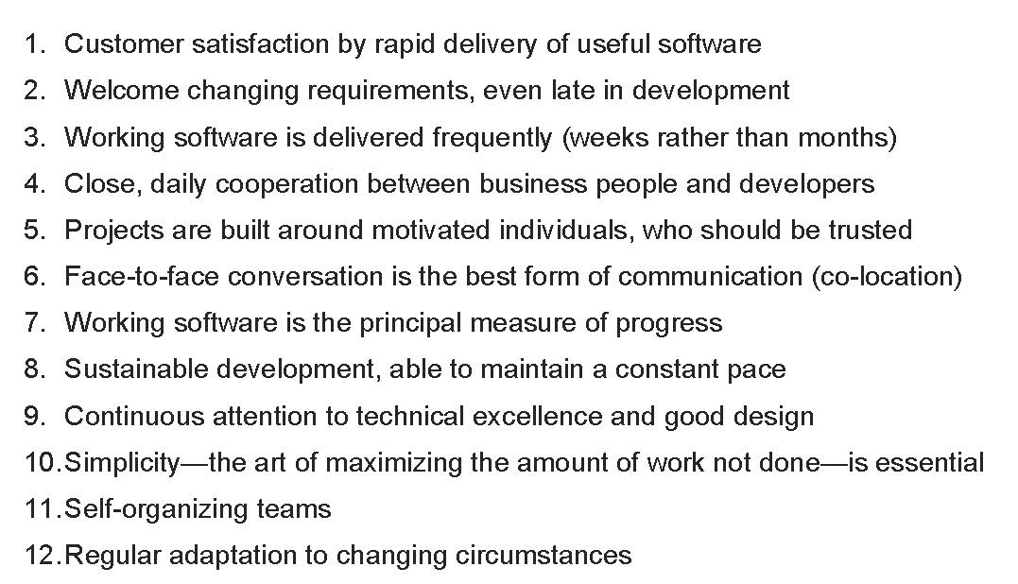
Agile alliance
Principles:
http://www.agilealliance.org/

Slide 23
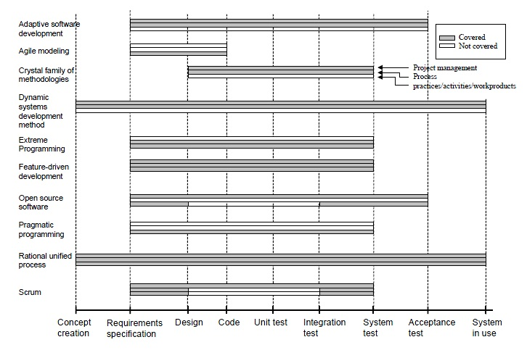
Agile methods
http://en.wikipedia.org/wiki/Agile_software_development

Slide 24
Agile approach
Agile approach is based on a software-as-a-service paradigm.
Communication is largely face-to-face.
Software is delivered frequently to customers.
The agile methods are quite different from one another but have the Principles in common.
Next session, we will study one agile method, eXtreme Programming (XP), in greater detail.

