Slide 1
CompSci 230
Software Design and Construction
Software Quality 2015S1
What is software quality?

Slide 2
Introduction to your lecturer
Diana Kirk
  1987-1994: C programmer - Minder Systems and ECONZ
  1994-1998: Shareholder-Director - Foley International
  1998-2003: Software Quality Manager – Dialogic, later Intel NZ
  2003-2006: PhD Computer Science, The University of Auckland
  2006-2008: Post-doc – Research Fellow at Griffith University
  2008-2010: Consultant (software process and practice)
  2008- : Contract research and teaching positions (UoA, AUT, Unitec, Massey)

Slide 3
Lecture plan
Week 1: No class - Anzac Day
What is software quality?
Some key developer practices (version control, testing).
Week 2: Black box testing.
White-box testing.
Myers' testing principles.
Week 3: Traditional approach to testing (Waterfall).
Agile approach to testing (XP).
Famous failures.

Slide 4
Readings
Myers, Glenford. The Art of Software Testing, 3rd edition, Wiley, 2012.
  This is an e-book, on an unlimited-user viewing licence in our library. This means that 3 people can access at any one time.
  The number of pages you can download at any one time is limited.
  You may have to be on-campus to read this online.
  Vogel, Lars. JUnit – Tutorial, version 2.5, sections 1, 3, 4 and 5.
    Please do this before Friday.
Supplementary reading :
  If you’re using Eclipse, you should complete Vogel’s tutorial (Sections 3.4 through 6) before attempting Assignment 3.
  If you’re using DrJava, read Chapter 8 (Testing Using Junit) in the DrJava User Documentation.

Slide 5
Learning goals
Demonstrate a theoretical understanding of software quality
  Quality models and characteristics
  Quality themes, origins and application to software processes
Demonstrate an understanding of testing
  theoretical (black box, white box, unit test, component test, system test, acceptance test, …)
  practical (competently perform some testing tasks using JUnit)
Demonstrate a basic understanding of how traditional and agile methodologies approach software testing
Develop an understanding of version control
  theoretical (best practices)
  practical (tutorial and assignment)

Slide 6
Learning goals for today
Understand what we mean by software quality.
Relevance of
  quality models
  process

Slide 7
Questions
What do we mean by ‘software quality’?
How can we achieve ‘software quality’?

Slide 8
What is software quality?
Some ideas:
  Does it do what the specification states?
    The idea of ‘conformance to specification’ was introduced in the field of manufacturing (widgets must be 4mm +- .1mm)
    Directly measurable (establish by inspecting or testing) BUT
    User may expect this as a minimum and view a quality product as one that offers more
      e.g. word processor may have all expected functions but may be difficult to use

Slide 9
What is software quality?
Some ideas:
  Fitness for use
    How well does the product perform its intended functions?
    Varies according to user group (concept of ‘grade’)
      In a car, I want fuel-efficiency and safety
      You may prefer a car that looks good and has powerful acceleration
    For software, a user may care about, for example, security, usability, reliability, etc.

Slide 10
What is software quality?
So the answer to ‘what is software quality?’ is ‘it depends’
Some products to consider
  Control software for a patient monitoring system
    reliability? accuracy?
  Game to support children learning maths
    usability? child-age appropriate?
  Mobile app
    resource usage? usability? developer can easily modify to upgrade frequently?

Slide 11
Quality models
A number of quality models have been developed that describe the quality characteristics to be considered when developing a quality product.
As a developer, you should understand which of these apply to the product you are developing.

Slide 12
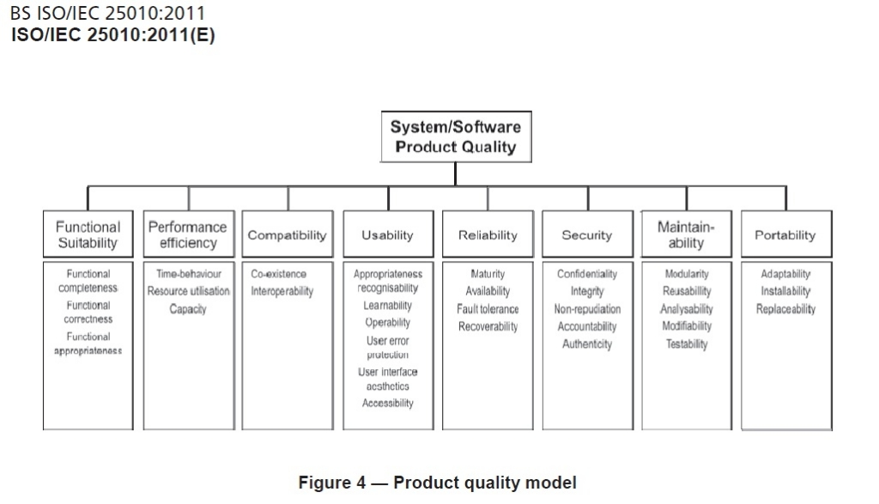
Quality models
ISO/IEC 25010 – System and software quality models

Slide 13
Questions
What do we mean by ‘software quality’?
How can we achieve ‘software quality’?

Slide 14
Historical perspective
First look at where many of the software quality ideas come from.
Origins are in manufacturing.
Brief historical look at manufacturing:
  US
  Japan

Slide 15
Historical perspective US
Brief historical look at manufacturing: (US)
  13th century: craftsman guilds
  mid-18th century: factory system emphasising product inspection (conformance to specification)
  World War 11: quality becomes critical (bullets) - Shewart’s statistical process control techniques applied
  1950s: post-war economic growth - abandon quality learnings (assumption: quality == $$)
  1970s: US industrial sectors broadsided by competition from Japan
  Late 1900s: Quality systems based on Japanese practices - TQM, CMM, Six-Sigma, Zero Defects, Lean manufacturing

Slide 16
Historical perspective Japan
Brief historical look at manufacturing: (Japan)
  1920-1930s: under-developed industrial technology (scrap high, reliability low)
  late 1940s:
    war with US destroys Japanese production capacity
    Sarasohn (US) posted to Japan to support Japanese communications industry
    Deming and Juran brought from US to train Japanese managers
  1950 - ??? Japanese embrace and expand quality ideas and make quality production profitable

Slide 17
Historical perspective
Brief historical look at manufacturing:
  adapted from Juran 1981

Slide 18
Quality themes
What were some of the quality ideas that produced such success?
There were many – I will present those most relevant for our investigation into software quality.

Slide 19
Quality themes
Deming:
  Quality is conformance to specification
    Get the specs right and build according to them. Basis of the ‘waterfall’ approach to software development.
  You cannot inspect quality into a product – it must be built in from the start
    Inspecting (testing) finds what is wrong with the product, which then has to be reworked. Too late. For developer, it’s your job to make sure what is passed on to testing team or another developer is of high quality.
  Most problems are a result of the system (process) – don’t blame the workers, it’s a management problem
    Consider: team of 5 developers, 4 experienced and 1 new. The new one is in charge of keeping the specification wiki up to date. Hmmm…

Slide 20
Quality themes
Juran:
  Quality is fitness for use (issues of ‘grade’)
    Seen in agile approaches to software development i.e. work closely with the client to make sure you deliver what (s)he really wants.
    Developer must understand required quality characteristics.
  Workers must be empowered by support of top management
    Basis of TQM initiatives.
    HUGE problem in many (most?) software development initiatives.
  http://www.toyota.co.jp/ev/vision/production_system

Slide 21
Quality themes
Pareto:
  Only a few factors are responsible for most of the problems
  If you want to improve your software process, identify the small number of areas that will make the biggest difference.
Toyota:
  Eliminate waste (inventory, processing steps)
  Basis of the lean approach to software development.
  http://www.toyota.co.jp/ev/vision/production_system

Slide 22
Quality themes
Western initiatives resulting from Japanese successes, all applied to software:
  TQM (Total Quality Management):
    Management approach involving customer focus and system-wide continuous improvement based on measurement
  Six Sigma:
    Management strategy aimed at reducing process variability i.e. removing ‘common causes’
  Lean:
    Reduce waste
  ISO 9000 series (Quality systems):
http://www.isixsigma.com/library/content/c021230a.asp
http://europe.isixsigma.com/library/content/c051214b.asp

Slide 23
Quality themes and SE
Waterfall
  quality is conformance to specification
  inspections and reviews to avoid defect injection (can’t test quality in)
  phase ‘gates’ (test outputs from each stage before passing to next)
XP
  shared vision
  iterations for customer feedback (quality is ‘fitness-for-use’)
  pair programming and test-first to avoid defect injection
  empower employees
Lean software development
  reduce waste

Slide 24
Quality themes and SE
Underlying belief is : Good process -> quality product
  This idea is behind all the (heated) discussions about software process. For example, should an organisation implement a waterfall approach? XP? Perhaps Lean Software Development is the way to go?
  Each of these approaches implements some of the ideas from above.
  Current thinking is that practices must be adapted to the particular circumstances of the project.

Slide 25
Quality themes and SE
Good process -> quality product
  In this course, our focus is software development. There are some basic practices advocated by all methodologies that are relevant within development and crucial for a quality outcome. These should be understood and implemented by the developer.
    Managing changes to the codebase (version control)
    Ensuring you deliver high quality code (unit testing)
  We will talk about these over the next few sessions.

