Slide 1
CompSci 230
Software Construction
Swing and MVC S1 2015

Slide 2
Learning Goals
You will learn an architectural design pattern: the MVC
  You will start to understand why high-level design is important
You will learn how Swing implements MVC
  You will start to understand why architecture is an art, not a science.

Slide 3
Swing
“The overall goal for the Swing project was:
  To build a set of extensible GUI components to enable developers to more rapidly develop powerful Java front ends for commercial applications.
“To this end, the Swing team established a set of design goals early in the project that drove the resulting architecture. These guidelines mandated that Swing would:
Be implemented entirely in Java to promote cross-platform consistency and easier maintenance.
Provide a single API capable of supporting multiple look-and-feels so that developers and end-users would not be locked into a single look-and-feel.
Enable the power of model-driven programming without requiring it in the highest-level API.
Adhere to JavaBeansTM design principles to ensure that components behave well in IDEs and builder tools.
Provide compatibility with AWT APIs where there is overlapping, to leverage the AWT knowledge base and ease porting.”
[Amy Fowler, “A Swing Architecture Overview”, Sun Microsystems, 2002. A corrupted version is available at http://www.oracle.com/technetwork/java/architecture-142923.html, April 2015. Archival version: http://web.archive.org/web/20020809043740/http://java.sun.com/products/jfc/tsc/articles/architecture/index.html. ]

Slide 4
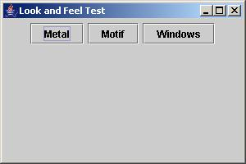

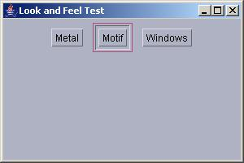
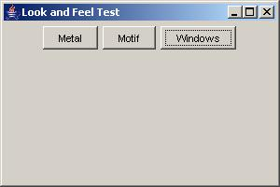
Pluggable look and feel
With a Swing application, it is possible to change the look-and-feel at run-time.
What technique do you think has been used in implementing this feature?
JButton
setUI( delegate : ButtonUI ) : void
<< interface >>
ButtonUI
paint( g : Graphics ) : void
Implemented by one class for each different look-and-feel, e.g. Windows, Metal, Motif.

Slide 5
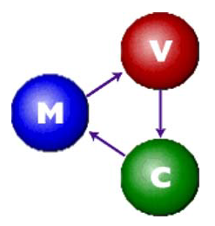
Swing’s Model-based Architecture
“Swing architecture is rooted in the model-view-controller (MVC) design that dates back to SmallTalk.
“MVC architecture calls for a visual application to be broken up into three separate parts:
  A model that represents the data for the application
  The view that is the visual representation of that data
  A controller that takes user input on the view and translates that to changes in the model.”
[Amy Fowler, ibid.]

Slide 6
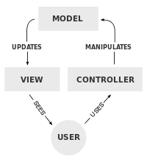
MVC: According to Wikipedia
A controller can send commands to the model to update the model's state (e.g., editing a document).
  It can also send commands to its associated view to change the view's presentation of the model (e.g., by scrolling through a document).
A model notifies its associated views and controllers when there has been a change in its state.
  This notification allows the views to produce updated output, and the controllers to change the available set of commands.
  In some cases an MVC implementation may instead be 'passive' and other components must poll the model for updates rather than being notified.
A view requests information from the model that it uses to generate an output representation to the user.
[http://en.wikipedia.org/wiki/Model%E2%80%93view%E2%80%93controller]

Slide 7
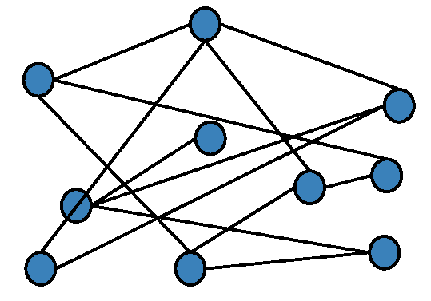
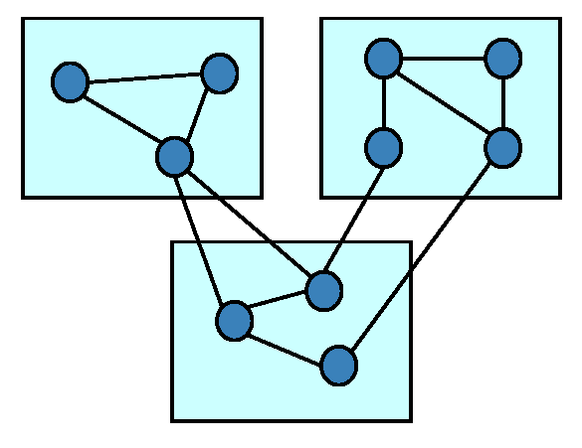
Spaghetti Code vs Modular Design
Spaghetti Code
  Haphazard connections, probably grown over time
  No visible cohesive groups
  High coupling: high interaction between random parts
  Understand it: all or nothing
Modular System
  High cohesion within modules
  Low coupling between modules
  Modules can be understood separately
  Interaction between modules is easily-understood and thoroughly specified
Both examples have 10 modules and 13 connections!

Slide 8
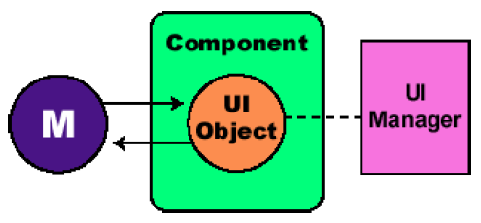
Architectural Design History of Swing
[Fowler, ibid.]
“The first Swing prototype followed a traditional MVC separation in which each component
  had a separate model object and
  delegated its look-and-feel implementation to separate view and controller objects.
“I quickly discovered that this split didn’t work well in practical terms
  because the view and controller objects required a tight coupling
  (for example, it was very difficult to write a generic controller that didn’t know specifics about the view).
“So I collapsed these two entities into a single UI (user-interface) object, as shown in this diagram:”

Slide 9
Separable Model Architecture [Fowler, ibid.]
“In the world of Swing, this new quasi-MVC design is sometimes referred to as a separable model architecture.
“Swing’s separable model design treats the model part of a component as a separate element, just as the MVC design does.
  But Swing collapses the view and controller parts of each component into a single UI (user-interface) object.
“… as an application developer, you should think of a component’s view/controller responsibilities as being handled by the generic component class (such as Jbutton, JTree, and so on).
  The component class then delegates the look-and-feel specific aspects of those responsibilities to the UI object that is provided by the currently installed look-and-feel.” [Amy Fowler, ibid.]

Slide 10
GUI-state models, Application-data models
“GUI state models are interfaces that define the visual status of a GUI control, such as
  whether a button is pressed or armed, or
  which items are selected in a list.
“An application-data model is an interface that represents some quantifiable data that has meaning primarily in the context of the application, such as
  the value of a cell in a table or
  the items displayed in a list.
“Of course, with some components, the model categorization falls somewhere between GUI state models and application-data models … This is the case with
  the BoundedRangeModel or
  JProgressBar. ”

Slide 11
Learning Goals: Review
You will learn an architectural design pattern: the MVC
  You will start to understand why high-level design is important
You will learn how Swing implements MVC
  You will start to understand why architecture is an art, not a science.

