Slide 1
CompSci 230 Software Construction
Applets, AWT S1 2015

Slide 2
Learning Goals
You will gain a high-level understanding of two GUI frameworks
Applets
AWT
The details are uninteresting (but necessary if you’re implementing)
Basic GUI terminology:
Component, container, panel, window, frame. Layout manager.
Theory:
Inversion of control
Composite design pattern
Painting and layout are recursive.
Classes may have (or “require”) interfaces, they don’t just implement (or “provide”) them.

Slide 3
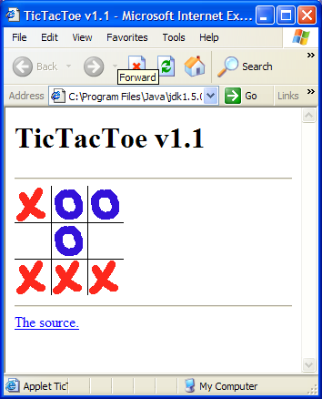
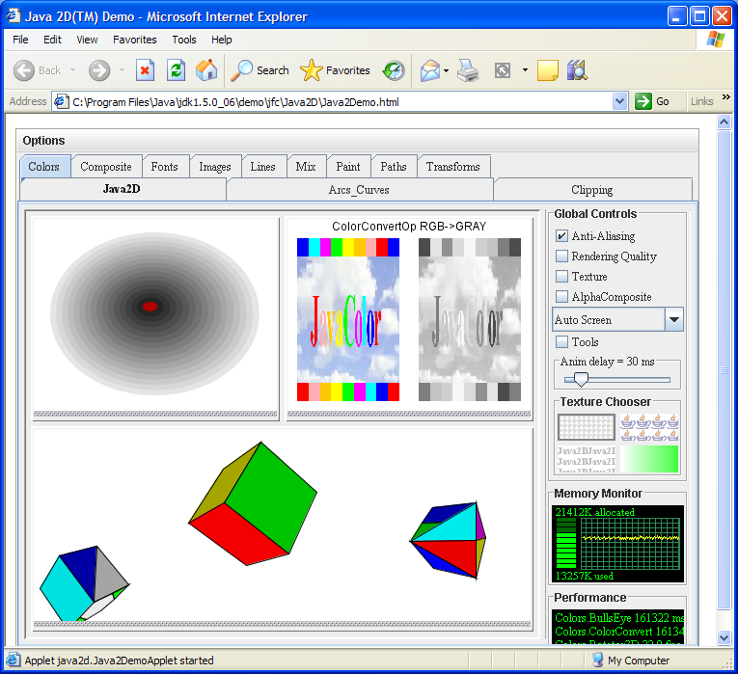
Java applets: a simple GUI framework
Applet
init( )
start( )
paint( )
stop( )
destroy( )
init( )
start( )
destroy( )
paint( )
stop( )
Application code
Applet framework (web browser)
Notes:
Class Applet defines a set of so-called lifecycle methods that are expected to be implemented by sucbclasses.
init( ) – executed when the web browser loads the Applet subclass code. This method is often implemented to acquire resources – threads, sockets etc.
start( ) – executed when the applet should start its execution.
paint( ) – called whenever the applet is to paint itself, e.g. if the web browser’s window once obscured exposed or if the state of the applet (e.g. a person has moved on the tic-tac-toe game) has changed. Typically called multiple times.
stop( ) – called when the user leaves the web page that contains the applet.
destroy( ) – called by the browser on exit. This gives the applet the chance to clean up – e.g. close sockets.

Slide 4
Hello World applet
import javax.swing.JApplet;
import javax.swing.SwingUtilities;
import javax.swing.JLabel;
public class HelloWorld extends JApplet {
//Called when this applet is loaded into the browser.
public void init() {
//Execute a job on the event-dispatching thread; creating this applet's GUI.
try {
SwingUtilities.invokeAndWait(new Runnable() {
public void run() {
JLabel lbl = new JLabel("Hello World");
add(lbl);
}
});
} catch (Exception e) {
System.err.println("createGUI didn't complete successfully");
}
}
}

Slide 5
Java’s AWT framework
Object
Generalisation
A Component is something that can be displayed on a GUI and with which a user can interact.
Component
getSize( ) : int
setSize( width : int, height : int ) : void
setVisible( visible : boolean ) : void
repaint( g : Graphics ) : void
paint( g : Graphics ) : void
addMouseListener( listener : MouseListener ) : void
addKeyListener( listener : KeyListener ) : void
repaint( ) schedules a Component instance for repainting. The AWT framework will subsequently call paint( ) on the Component object.
add( ) is a polymorphic method; it can take as actual argument any kind of Component.
paint( ) is a hook method: developers may customise it.
Button
Checkbox
Choice
Label
List
Scrollbar
Container
setLayout( mgr : LayoutManager ) : void
add( c : Component ) : void
A Container is a special component that can nest other components, be they simple components (e.g. Buttons, Labels) or themselves Containers (e.g. Panels).
TextComponent
Panel
Window
toFront( )
toBack( )
ScrollPanel
TextArea
TextField
A Window is a special Container that can be stacked, and moved to the front/back.
Frame
setTitle( title : String ) : void
setCursor( c : int ) : void
setResizable( resizable : boolean ) : void
setMenuBar( mb : MenuBar ) : void
A Frame is a special Window with a title, menubar, border and cursor.
Specialisation
Notes:
A GUI application is implemented by subclassing Frame – a Frame instance gives an application window. A Frame subclass typically overrides inherited methods as necessary – e.g. paint( ).
Typical methods called, e.g. setTitle, setSize, setVisible, repaint, etc. span the inheritance hierarchy.
Points of interest:
The framework satisfies the is-a test. All subclasses specialise their superclasses. Subclassing for specification and specialisation.
repaint( ) looks like a template method – when called paint( ) is a hook that is called.
Container is a special Component that can contain other Components; an instance of Container may contain other components, be they simple components or themselves containers.
Container’s add( ) method is polymorphic – it can accept any kind of component (e.g. Button, Label, Panel, etc.).
The class hierarchy as a whole represents a reusable resource. Nothing here is application-specific.

Slide 6
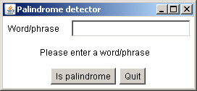
Panel
TextField
Component
Frame
Label
Label
Button
Panel
Container
add( c : Component ) : void
Button
Panel
Frame instance
class Container extends Component {
private List<Component> children;
…
public void add( Component c ) {
children.add( c );
}
}
Panel
instance
Panel
instance
Panel
instance
Label
instance
TextField
instance
Label
instance
Button
instance
Button
instance

Slide 7
Traversing the nested structure
class Container extends Component {
private List<Component> children;
…
public void add( Component c ) {
children.add( c );
}
public void paint( Graphics g ) {
for( Component c : children )
c.paint( );
}
}
1: paint( )
Frame instance
2: paint( )
7
Panel
instance
5
Panel
instance
Panel
instance
9
3: paint( )
4: paint( )
6
8
Label
instance
TextField
instance
Label
instance
Button
instance
Button
instance

Slide 8
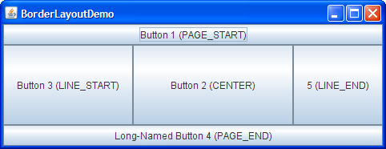
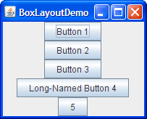
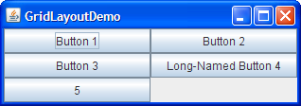
Layout management
Why is this design for layout management so effective?
Component
Container
setLayout( mgr : LayoutManager ) : void
doLayout( )
add( c : Component ) : void
<< interface >>
LayoutManager
layoutContainer( c : Container )
minimumLayoutSize( c : Container ) : Dimension
preferredLayoutSize( c : Container ) : Dimension
BorderLayout
BoxLayout
FlowLayout
GridLayout

Slide 9
Layout management
Container
Alternative design: for each special kind of container, implement further subclasses, one for each kind of layout strategy.
Panel
…
Frame
PanelWithBorderLayout
…
PanelWithBoxLayout
FrameWithBorderLayout
…
FrameWithBoxLayout
Composition and interfaces | Inheritance
This solution requires only one class for each special type of container, and one class for each layout strategy. Any kind of container instance can be configured with any kind of strategy object. | Subclass explosion! To support all container (c) and layout strategy (s) combinations, c * s classes would be required.
Composition offers run-time flexibility. A Frame can change how it lays out its children simply by swapping its current layout strategy (e.g. BorderLayout) for another (e.g. GridLayout). | Overly rigid structure. Once a PanelWithBorderLayout object, for example, has been created, the panel will always be laid out according to the border strategy.

Slide 10
Provided and Required Interfaces
Component
Container
setLayout( mgr : LayoutManager ) : void
doLayout( )
add( c : Component ) : void
<< interface >>
LayoutManager
layoutContainer( c : Container )
minimumLayoutSize( c : Container ) : Dimension
preferredLayoutSize( c : Container ) : Dimension
BorderLayout
BoxLayout
FlowLayout
GridLayout
A Container requires a LayoutManager
A BorderLayout provides a LayoutManager

Slide 11
Layout management
public class Container extends Component {
…
private List< Component > children;
private LayoutManager layoutManager;
public void setLayout( LayoutManager lm ) {
layoutManager = lm;
}
public void doLayout( ) {
layoutManager.layout( this );
}
}
LayoutManager
instance
2: layoutContainer( this )
1: doLayout( )
Frame instance
Panel
instance
Panel
instance
Panel
instance
Label
instance
TextField
instance
Label
instance
Button
instance
Button
instance

Slide 12
Layout Managers
BorderLayout:
This scheme defines five areas for the component.
All extra space is placed in the center area.
FlowLayout:
Simplest, just one row
BoxLayout, GridLayout, …

Slide 13
Learning Goals: Review
You will gain a high-level understanding of two GUI frameworks
Applets
AWT
The details are uninteresting (but necessary if you’re implementing)
Basic GUI terminology:
Component, container, panel, window, frame. Layout manager.
Theory:
Inversion of control
Composite design pattern
Painting and layout are recursive.
Classes may have (or “require”) interfaces, they don’t just implement (or “provide”) them.

