Slide 1
CompSci 230 Software Construction
Java Implementation: Part 3 S1 2015

Slide 2
Agenda
Topics:
Enum Types
Object: a superclass
Memory allocation
An OO description of Java’s type system
Reading, in The Java Tutorials:
Enum Types and Nested Classes pages, in the Classes and Objects Lesson.
Object as a Superclass page, in the Interface and Inheritance Lesson.

Slide 3
Enum Types
“An enum type is a special data type that enables for [sic] a variable to be a set of predefined constants.
The variable must be equal to one of the values that have been predefined for it.
Common examples include
compass directions (values of NORTH, SOUTH, EAST, and WEST) and
the days of the week.
“Because they are constants, the names of an enum type's fields are in uppercase letters.
“… you define an enum type by using the enum keyword.
For example, you would specify a days-of-the-week enum type as:
“You should use enum types any time you need to represent a fixed set of constants.
That includes natural enum types such as the planets in our solar system and
data sets where you know all possible values at compile time—for example,
the choices on a menu,
command line flags, and so on.”
public enum Day {
SUNDAY, MONDAY, TUESDAY, WEDNESDAY, THURSDAY, FRIDAY, SATURDAY
}

Slide 4
Example of enum usage; switch syntax
public class EnumTest {
Day day;
public EnumTest(Day day) { this.day = day; }
public void tellItLikeItIs() {
switch (day) {
case MONDAY:
System.out.println("Mondays are bad.");
break;
case FRIDAY:
System.out.println("Fridays are better.");
break;
case SATURDAY:
case SUNDAY:
System.out.println("Weekends are best.");
break;
default:
System.out.println("Midweek days are so-so.");
break;
}
}

Slide 5
Remainder of the EnumTest class
public static void main(String[] args) {
EnumTest firstDay = new EnumTest(Day.MONDAY);
firstDay.tellItLikeItIs();
EnumTest thirdDay = new EnumTest(Day.WEDNESDAY);
thirdDay.tellItLikeItIs();
EnumTest fifthDay = new EnumTest(Day.FRIDAY);
fifthDay.tellItLikeItIs();
EnumTest sixthDay = new EnumTest(Day.SATURDAY);
sixthDay.tellItLikeItIs();
EnumTest seventhDay = new EnumTest(Day.SUNDAY);
seventhDay.tellItLikeItIs();
}
}
Mondays are bad.
Midweek days are so-so.
Fridays are better.
Weekends are best.
Weekends are best.
Output:

Slide 6
Importing static members of a class
Importing the static members of an enum may significantly reduce “code clutter”, because you won’t have to fully qualify their names.
However a static import may decrease readability, if the reader has trouble figuring out “which class defined this member.”
package enumtest;
public class EnumTest {
enum Day { // note: this is a “nested inner class”
SUNDAY, MONDAY, TUESDAY, WEDNESDAY, THURSDAY, FRIDAY, SATURDAY
}
public static void main(String[] args) {
(new EnumTest(Day.MONDAY)).tellItLikeItIs();
(new EnumTest(Day.WEDNESDAY)).tellItLikeItIs();
(new EnumTest(Day.FRIDAY)).tellItLikeItIs();
(new EnumTest(Day.SATURDAY)).tellItLikeItIs();
(new EnumTest(Day.SUNDAY)).tellItLikeItIs();
}

Slide 7
Importing static members of a class
Importing the static members of an enum may significantly reduce “code clutter”, because you won’t have to fully-qualify their names.
However a static import may decrease readability, if the reader has trouble figuring out “which class defined this member.”
package enumtest;
import static enumtest.EnumTest.Day.*;
public class EnumTest {
enum Day { // note: this is a “nested inner class”
SUNDAY, MONDAY, TUESDAY, WEDNESDAY, THURSDAY, FRIDAY, SATURDAY
}
public static void main(String[] args) {
(new EnumTest(MONDAY)).tellItLikeItIs();
(new EnumTest(WEDNESDAY)).tellItLikeItIs();
(new EnumTest(FRIDAY)).tellItLikeItIs();
(new EnumTest(SATURDAY)).tellItLikeItIs();
(new EnumTest(SUNDAY)).tellItLikeItIs();
}

Slide 8
Switch: semantics
public void tellItLikeItIs() {
switch (day) {
case MONDAY: // Each case is labelled by one (or more) values
// in the range of the switch variable (or expression)
System.out.println("Mondays are bad.");
break;
case FRIDAY: // We don’t have to write Day.FRIDAY, because each case
// label is a value of the same type as the switch expression.
System.out.println("Fridays are better.");
break; // Case statements “flow-through” if there’s no break!
case SATURDAY: // Note the “flow-through” for this case
case SUNDAY:
System.out.println("Weekends are best.");
break;
default: // You’ll get a runtime error if there’s no matching case
// but default matches any value of the switch expression
System.out.println("Midweek days are so-so.");
break;
} } } // https://docs.oracle.com/javase/tutorial/java/nutsandbolts/switch.html

Slide 9
Object – this is what your classes extend!
When you define a class in Java without specifying what class you’re extending, you’re actually extending the Object class.
The Object as a Superclass lesson briefly discusses six of the methods which your classes inherit from Object.
protected Object clone() throws CloneNotSupportedException
Creates and returns a copy of this object.
public boolean equals(Object obj)
Indicates whether some other object is “equal to” this one.
protected void finalize() throws Throwable
Called by the garbage collector on an object when garbage collection determines that there are no more references to the object
public final Class getClass()
Returns the runtime class of an object.
public int hashCode()
Returns a hash code value for the object.
public String toString()
Returns a string representation of the object.

Slide 10
Overriding toString()
“You should always consider overriding the toString() method in your classes.
“The Object’s toString() method returns a String representation of the object, which is very useful for debugging.
The String representation for an object depends entirely on the object, which is why you need to override toString() in your classes.”
http://docs.oracle.com/javase/tutorial/java/IandI/objectclass.html

Slide 11
Overriding equals()
The equals() method compares two objects for equality and returns true if they are equal.
The equals() method provided in the Object class uses the identity operator (==) to determine whether two objects are equal.
For primitive data types, this gives the correct result.
For objects, however, it does not.
The equals() method provided by Object tests whether the object references are equal—that is, if the objects compared are the exact same object.
To test whether two objects are equal in the sense of equivalency (containing the same information), you must override the equals() method.

Slide 12
Example: overriding equals()
public class Book {
String Title;
String Author;
String Publisher;
String Year;
String ISBN;
...
public boolean equals(Object obj) {
if (obj instanceof Book)
return ISBN.equals(((Book) obj).getISBN());
else
return false;
}
}
...
}

Slide 13
Example: overriding equals()
public class Book {
String Title;
String Author;
String Publisher;
String Year;
String ISBN;
...
@Override // This annotation suppresses error messages from the
// Java compiler, and it improves readability.
public boolean equals(Object obj) { // Note: the same signature
// as Object.equals(), but with a different implementation
if (obj instanceof Book)
return ISBN.equals(((Book) obj).getISBN());
else
return false;
}
}
...

Slide 14
Example: testing an overridden equals()
public static void main(String[] args){
Book firstBook = new Book("0201914670");
Book secondBook = new Book("0201914670");
if (firstBook.equals(secondBook)) {
System.out.println("equivalent objects");
} else {
System.out.println("non-equivalent objects");
}
if (firstBook == secondBook){
System.out.println("two references to the same object");
} else {
System.out.println("references to different objects");
}
}
}

Slide 15
Memory Allocation
int i = 20;
Ball b1
= new Ball( 10, i, Color.RED );
Object o1 = b1;
Recall: we use a reference variable to refer to instances of a class.
The value in a reference variable is, essentially, a pointer to an object.
A special value (null) indicates that there is no object corresponding to this reference.
The runtime system (the JVM) interprets a reference value as an index into a heap.
The new operator allocates sufficient memory on the heap to store all of the fields of an object of the requested type.
Formally: the range of allowable values for a reference variable is its reference type.
The reference type of o1 is Object. This means it can point to any instance of Object, or to any instance of any subclass of Object.
Java also has primitive variables.
These have a primitive type, such as int.
They don’t refer to objects.
In Java, a reference type is a static type, and a primitive type is also a static type.
Static types are determined by a static analysis of the program text.
A reference variable has a dynamic type, which is determined at runtime by the type of the object it is referring to.
static types
:StackFrame
i :int = 20 b1 :Ball = 0xfe100140 o1 :Object = 0xfe100140
refersTo
dynamic type
0xfe100140 :Ball
-class :Class = Ball xPos :int = 10 yPos :int = 20 Color :Java.awt.Color = RED

Slide 16
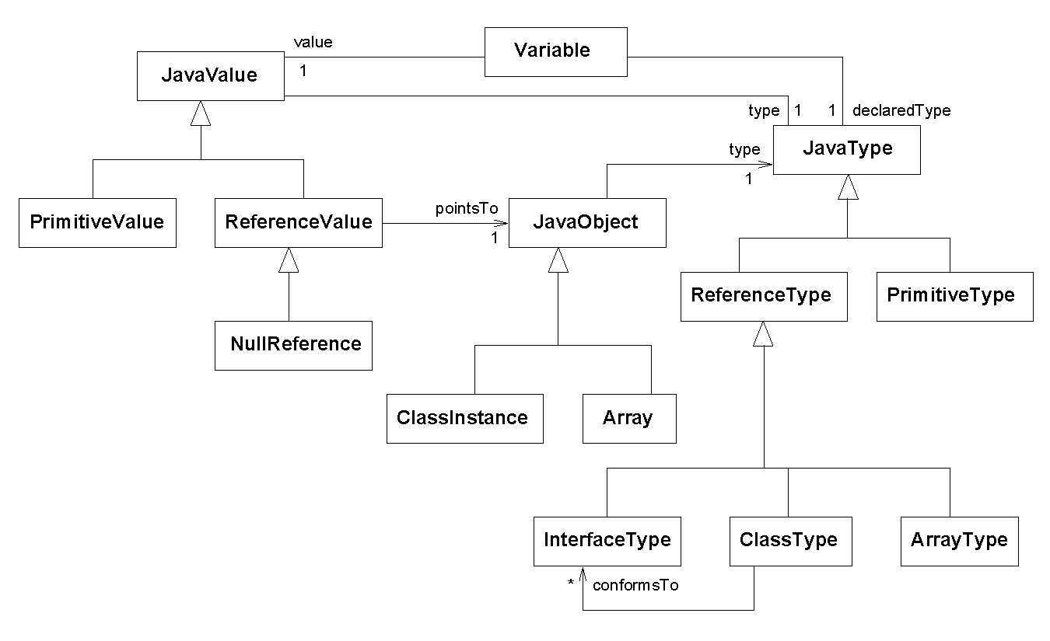
A model of Java’s type system (for reference)
Source: Kollman, R. and Gogolla, M., “Capturing Dynamic Program Behaviour with UML Collaboration Diagrams”, Proc. CSMR, 2001.

Slide 17
Review
Topics in this set of slides:
Enum types
Object.toString(), Object.equals()
Memory allocation
An overview of Java’s type system
End of Theme A: The OO Programming Paradigm
We took a top-down approach: use-case analysis → class design → implementation.
You learned the fundamentals of OO design theory
You are starting to understand type systems
You have a basic understanding of Java development (JDK, Eclipse) and Java runtime (JRE).
You understand the difference between the static type of a reference variable (defined by its declaration) and its dynamic type (defined by its current value)
You have a basic proficiency in program analysis, OOD, and Java implementation
You are able to “learn more”, if necessary, by reading, thinking, and experimenting.

