Slide 1
CompSci 230 Software Construction
Java Implementation: Part 1 S1 2015

Slide 2
Agenda
Topics:
Interfaces in Java
Reference data types
Abstract classes in Java
Java syntax: five important keywords
Reading
In The Java Tutorials:
What is an Interface?, in the Object-Oriented Programming Concepts Lesson
The Interfaces and Inheritance Lesson

Slide 3
Learning objectives: Java Implementation
Students will be competent at implementing OO designs in Java
Interfaces, reference data types, abstract classes, intro to generics
Visibility, packages, static & dynamic typing, conversion & casting
The lectures will give you the basic “theory”, but they won’t give you a “working understanding” – you have to do the hard-yards of putting these ideas into practice.
You won’t even understand the theory, if you listen passively to lectures. I’ll try to help you “learn how to learn” from the Java tutorials.
You’ll get many chances to develop your understanding in your lab assignments for this course.

Slide 4
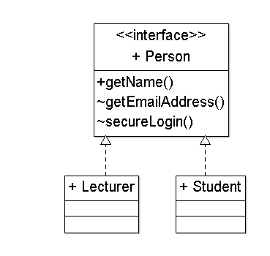
Interfaces, in UML
Interfaces specify behaviour (a public contract), without data or implementation.
Interfaces are drawn like classes, but without attributes, and with the keyword <<Interface>>
A dotted open-triangle arrow, from a class to an interface, means that “the class implements this interface”.
We also say that “the class fulfils the contract specified by this interface”, or that it “realizes the interface.”
Note that interfaces define methods but not attributes.
A password allows a secureLogin().

Slide 5
Interfaces in Java 7
An Interface is like a Class, with no bodies in the methods. It may define constants (public static final) but no runtime variables.
Usually, an Interface is public.
An interface provides a standard way to access a class which could be implemented in many different ways.
The Java Tutorials:
“There are a number of situations in software engineering when it is important for disparate groups of programmers to agree to a ‘contract’ that spells out how their software interacts.”
“Each group should be able to write their code without any knowledge of how the other group's code is written.”
“Generally speaking, interfaces are such contracts.”

Slide 6
Interfaces in Java 8
In Java 8, an interface may contain
default implementations of instance methods, and
implementations of static methods.
In any OO language, an interface
cannot be instantiated, and
defines a “contract” which any realization of the interface must fulfil.
Java is a strongly-typed language.
Java compilers can enforce contracts, by refusing to compile classes whose implementations might “partially realize” an interface.
Java is a tightly-specified language.
If a compiler allows instantiations of incompletely-implemented interfaces, then it is not a Java compiler.

Slide 7
Implementations as contracts
A class which realizes an interface must provide an implementation of every method defined within the interface
A class may implement some additional methods (but these extra methods aren’t accessible through this interface)
Beware: adding another method to an existing Interface will “break” every current implementation of this Interface!
A class can implement many interfaces.
An Interface can extend other Interfaces.
Extension is the preferred way to add new methods to an Interface.
(Do you understand why?)
In Java, classes are less extendible than interfaces, because a Class can extend at most one other Class (“single inheritance”).
class MountainBike extends Bicycle { … }

Slide 8
Interfaces in Java 8
In Java 8, an interface may contain
default implementations of instance methods, and
implementations of static methods.
In any OO language, an interface
cannot be instantiated, and
defines a “contract” which any realization of the interface must fulfil.
In Java, a realization is denoted by the keyword implements.

Slide 9
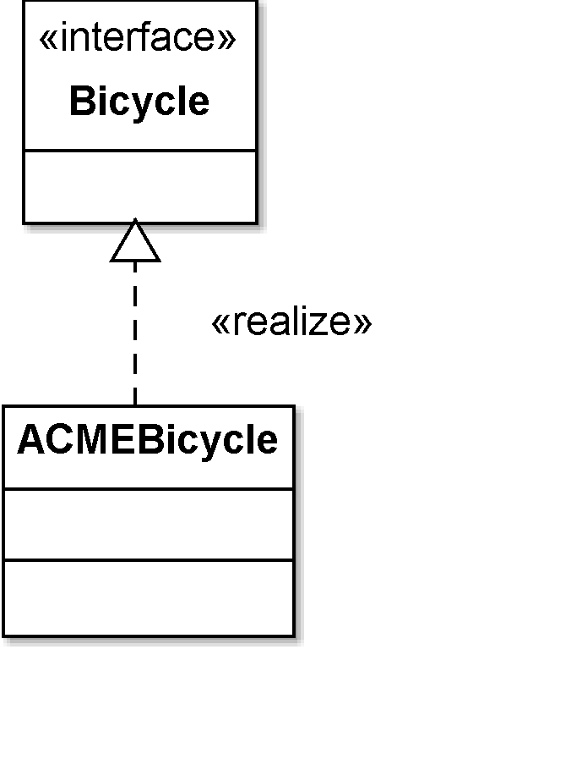
Example 1
public interface Bicycle {
void changeCadence(int newValue);
void changeGear(int newValue);
void speedUp(int increment);
void applyBrakes(int decrement);
}
class ACMEBicycle implements Bicycle {
int cadence = 0;
void changeCadence(int newValue) {
cadence = newValue;
}
\\ note: an implementation may be incorrect!
void changeGear(int newValue) {}
void speedUp(int increment) {}
void applyBrakes(int decrement) {}
}
\\ an implementation may have variables

Slide 10
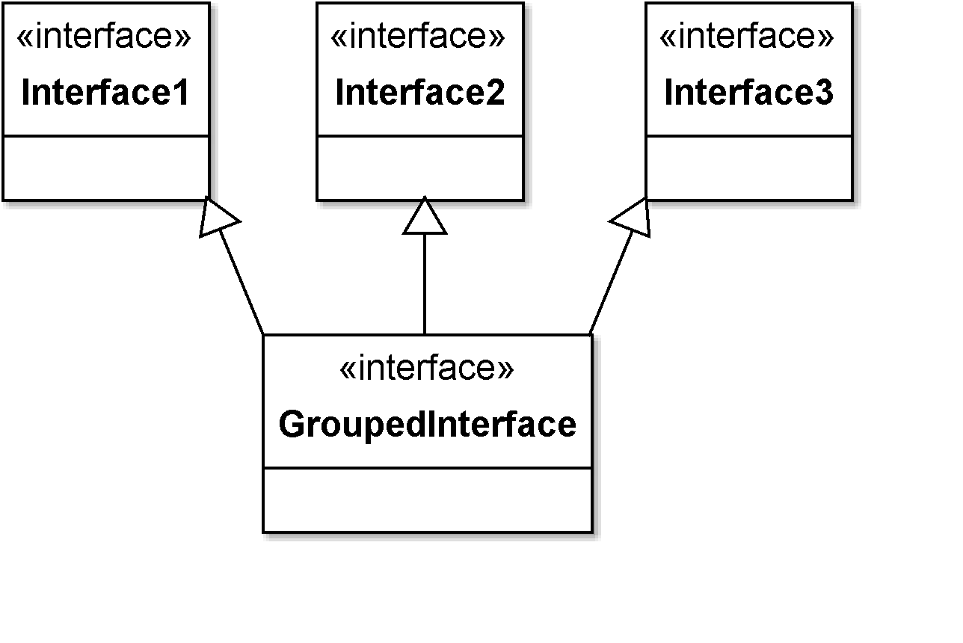
Example 2
public interface GroupedInterface extends
Interface1, Interface2, Interface3 {
// constant declarations
// base of natural logarithms
double E = 2.718282;
// method signatures
void doSomething( int i, double x );
int doSomethingElse( String s );
}

Slide 11
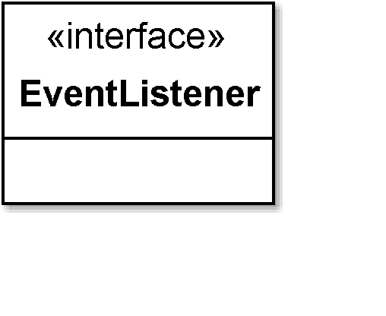
Example 3
public interface EventListener {
// No constants
// No method signatures!
}
“A tagging interface that all event listener interfaces must extend.” [http://docs.oracle.com/javase/6/docs/api/java/util/EventListener.html]
Why?
At first glance, this is worse than useless! One more name for the Java programmer to remember…
This interface allows programmers, and the Java compiler, to distinguish event-listeners from all other types of classes and interfaces.
Event-listeners are important, and they behave quite differently to a regular class. (Later, you’ll learn about inversion of control…)

Slide 12
MouseListener in java.awt.event
public interface MouseListener extends EventListener
The listener interface for receiving “interesting” mouse events (press, release, click, enter, and exit) on a component. (To track mouse moves and mouse drags, use the MouseMotionListener.)
All Known Subinterfaces:
MouseInputListener
All Known Implementing Classes:
AWTEventMulticaster, BasicButtonListener, BasicComboPopup.InvocationMouseHandler, BasicComboPopup.ListMouseHandler, BasicDesktopIconUI.MouseInputHandler, …
public interface MouseListener
extends EventListener {
mouseClicked( MouseEvent e );
mouseEntered( MouseEvent e );
mouseExited( MouseEvent e );
mousePressed( MouseEvent e );
mouseReleased( MouseEvent e );
}
public interface MouseMotionListener extends EventListener {
mouseDragged( MouseEvent e );
mouseMoved( MouseEvent e );
}
public interface MouseInputListener
extends MouseListener, MouseMotionListener {
// this interface has 7 method signatures, can you list them?
}

Slide 13
Using an Interface as a Type
“When you define a new interface, you are defining a new reference data type.
“You can use interface names anywhere you can use any other data type name.
“If you define a reference variable whose type is an interface, any object you assign to it must be an instance of a class that implements the interface.” [http://docs.oracle.com/javase/tutorial/java/IandI/interfaceAsType.html]
Example on the next slide:
A method for finding the largest object in a pair of objects, for any objects that are instantiated from a class that implements Relatable.
public interface Relatable {
public int isLargerThan( Relatable other );
}

Slide 14
Using an Interface as a Type
public Object findMax(Object object1, Object object2) {
Relatable obj1 = (Relatable)object1;
Relatable obj2 = (Relatable)object2;
if( (obj1).isLargerThan(obj2) > 0 )
return object1;
else
return object2;
}
If comparisons are important in your application, then you’ll be able to write very elegant code!
You can write z.findMax(x, y), if x and y are instances of any class which extends Relatable.

Slide 15
Using an Interface as a Type: Mismatches
public Object findMax( Object object1, Object object2 ) {
Relatable obj1 = (Relatable)object1;
Relatable obj2 = (Relatable)object2;
if( (obj1).isLargerThan(obj2) > 0 )
return object1;
else return object2;
}
We’d get errors at compile-time (or at runtime) if
(object1).isLargerThan(object2) were in the body of this method, if
we invoked it as z.findMax(x,y), for any instance x of a class that doesn’t extend Relatable, or if
we invoked it as x.findLargest(y,z), if y.isLargerThan() does not accept z as a parameter.
Typing is complex… we’ll keep looking at it, in different ways…

Slide 16
Typing Rules
The typing rules for interfaces are similar to those for classes.
A reference variable of interface type T can refer to an instance of any class that implements interface T or a sub-interface of T.
Through a reference variable of interface type T, methods defined by T and its super interfaces can be called.
«realize»
interface I1 {
public void m1();
public void m2();
}
class c1 implements I1 {
public void m1() {}
public void m2() {}
}
interface I2 extends I1 {
public void m3();
}
C1 a = new C1(); \\ a is a reference variable of type C1
C1 b = new C1();
I1 p = a; \\ p is a reference variable of type I1
p.m1();
C2 c = new C2();
I2 q = c; \\ q is a reference variable of type I2
q.m1();
q.m2();
«realize»
class c2 implements I2 {
public void m1() {}
public void m2() {}
public void m3() {}
}

Slide 17
instanceof
You can use the instanceof operator to test an object to see if it implements an interface, before you invoke a method in this interface.
This might improve readability and correctness.
This might be a hack.
Where possible, you should extend classes and interfaces to obtain polymorphic behaviour, rather than making a runtime check.
if( b instanceof Bounceable ) {
b.hitWall( "Wall A" );
} else { \\ abort, with an error message to the console
throw new AssertionError( b );
}
Date somedate = new Date();
\\ throw an exception if somedate is not Relatable. assert( Date instanceof Relatable );
\\ See http://docs.oracle.com/javase/1.4.2/docs/guide/lang/assert.html

Slide 18
Abstract Classes
Sometimes, it’s appropriate to partly-implement a class or interface.
Abstract classes allow code to be reused in similar implementations.
Abstract classes may include some abstract methods.
If there are no abstract methods, then the class is usually (but not always) implemented fully enough to be used by an application.
Sometimes it’s helpful to have multiple implementations that differ only in their type, but this is quite an advanced concept in design.
public abstract class MyGraphicObject {
// declare fields – these may be non-static
private int x, y;
// declare non-abstract methods
// (none)
// declare methods which must be implemented later
abstract void draw();
}

Slide 19
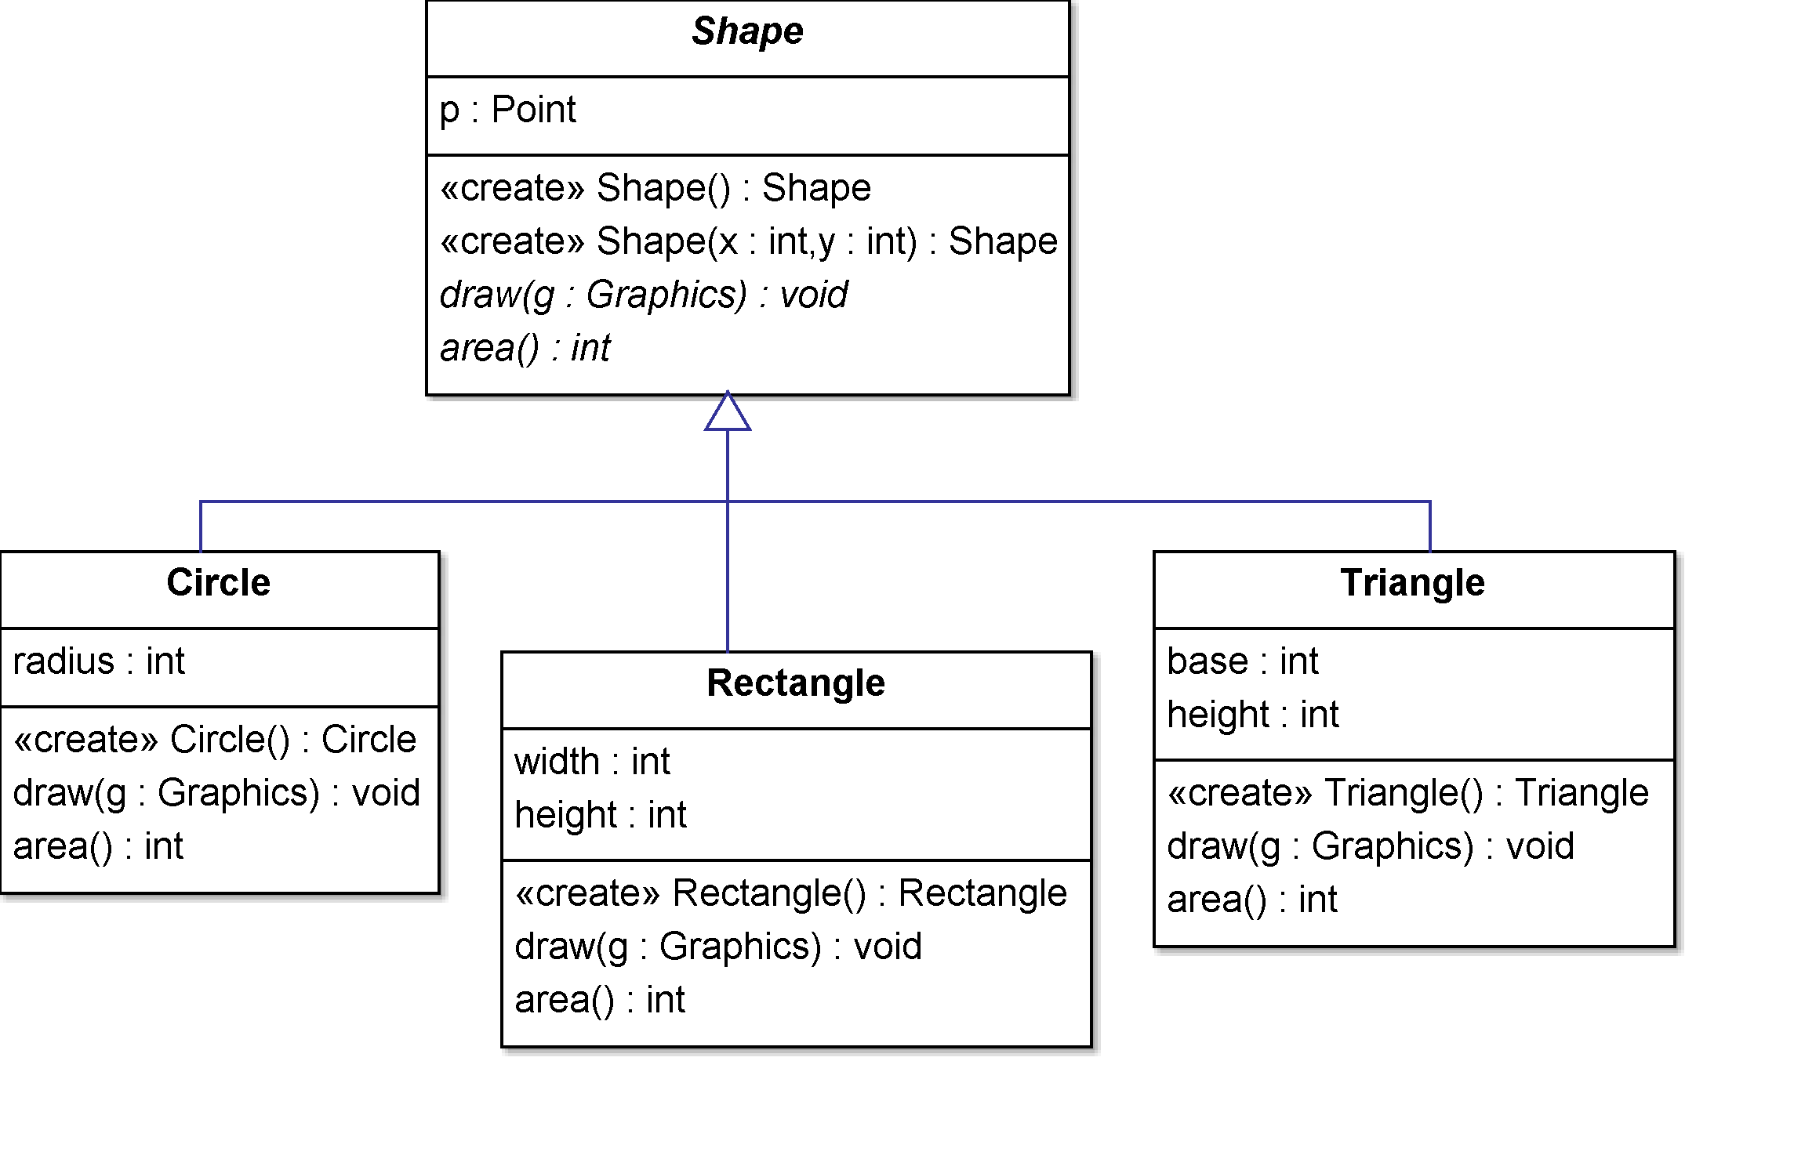
Example
abstract class Shape {
Point p;
Shape(){ this(0, 0); }
Shape(x, y){ p = new Point(x, y); }
public abstract void draw(Graphics g);
public abstract int area();
}
An abstract method is defined with a signature but no implementation.
Abstract methods
Concrete subclasses must implement all abstract methods.
public class Rectangle extends Shape {
private int width, height;
public int area() {
return (width * height);
}
...
public class Circle extends Shape {
private int radius;
public int area() {
return (int) (Math.PI * radius * radius);
}
...
public class Triangle extends Shape {
private int base, height;
public int area() {
return (base * height) / 2;
}
...

Slide 20
Super!
If your method overrides one of its superclass's methods, you can invoke the overridden method through the use of the keyword super.
You can also use super to refer to a hidden field (although hiding fields is discouraged).
Example below.
Can you determine what will be printed to System.out when main() is executed?
public class Superclass {
public void printMethod() {
System.out.println("Printed in Superclass.");
} }
public class Subclass extends Superclass {
public void printMethod() { // overrides super.printMethod
super.printMethod();
System.out.println("Printed in Subclass");
} }
public static void main(String[] args) {
Subclass s = new Subclass();
s.printMethod();
} }
Printed in Superclass.
Printed in Subclass

Slide 21
Hiding vs overriding
If a subclass defines a static method with the same signature as a static method in the superclass, then
the method in the subclass hides the one in the superclass.
The distinction between hiding a static method and overriding an instance method has important implications:
The version of the overridden instance method that gets invoked is the one in the subclass.
The version of the hidden static method that gets invoked depends on whether it is invoked from the superclass or the subclass.
Hmmm… this could be confusing! So … I don’t encourage you to hide methods.
Overriding methods is an important part of OO design.

Slide 22
this
Within an instance method or a constructor, this is a reference to the current object —
the object whose method or constructor is being called.
You can refer to any member of the current object
from within an instance method or a constructor
by using this.
The most common reason for using the this keyword is
because a field is shadowed by a method or constructor parameter.

Slide 23
Is shadowing a good idea?
A parameter can have the same name as one of the class's fields.
If this is the case, the parameter is said to shadow the field.
Shadowing fields can make your code difficult to read and is conventionally used
only within constructors and methods that set a particular field.
For example, consider the following Circle class …
Source: http://docs.oracle.com/javase/tutorial/java/javaOO/arguments.html

Slide 24
Example: using this.x
public class Point {
public int x = 0;
public int y = 0;
public Point(int a, int b) {
x = a;
y = b;
}
}
Equivalently:
public class Point {
public int x = 0;
public int y = 0;
public Point(int x, int y) {
this.x = x; // this.x refers to the shadowed instance variable
this.y = y;
}
}

Slide 25
Using this()
From within a constructor, you can also use the this keyword to
call another constructor in the same class.
Doing so is called an explicit constructor invocation.
[https://docs.oracle.com/javase/tutorial/java/javaOO/thiskey.html]
(Let’s look at an example of this in Eclipse.)
(I also want to show you how to import a JARfile.)

Slide 26
Final
The final keyword can be applied to prevent the extension (over-riding) of a field, argument, method, or class.
Final field: constant
Final argument: cannot change the data within the called method
Final method: cannot override method in subclasses
Final class: cannot be subclassed (all of its methods are implicitly final as well)
class ChessAlgorithm {
. . .
final void nextMove(
ChessPiece pieceMoved, BoardLocation newLocation ) {
\\ body of nextMove – can’t be overriden
}
}

Slide 27
Review
Interfaces in Java
Types in Java
Abstract classes in Java
Six important keywords:
interface
implements
abstract
super
this
final

