Slide 1
CompSci 230
Software Construction
Lecture Slides #4: Use Cases S1 2015

Slide 2
Agenda & Reading
Topics:
  Review (or learn for the first time)
    What are the major steps in an Object-Oriented Design process?
  Introduction to Use Case modelling
    What? A process of determining what the stakeholders require – by decomposing their requirements into tasks (or “use cases”) for each class of stakeholders.
    How? Stakeholder Identification, Requirements Elicitation, Use Case Diagrams
    Why learn this? Use cases are widely used in the industry, because they seem to work pretty well, they aren’t very expensive to develop, and they are at a good level of detail for end-users.
    Major alternatives (not taught in this course): user stories (for agile development), formal specifications (for safety-critical software).
Reading:
  D. G. Firesmith, “Use Cases: the Pros and Cons”, in The Wisdom of the Gurus, SIGS Reference Library,1996. Available: http://www.ksc.com/article7.htm.
To learn more (optional reading):
  A. Ramirez, “Requirements Capture”, in ArgoUML User Manual, v0.34, 2011.
  Object Management Group, “Use Cases”, in OMG Unified Modeling Language (OMG UML) Superstructure, v 2.4.1, 6 August 2011.

Slide 3
Software Design (review)
Communication:
  identify stakeholders, find out what they want and need.
Planning:
  list tasks, identify risks, obtain resources, define milestones, estimate schedule.
Modeling:
  develop structure diagrams and use cases, maybe some other UML artifacts.
Construction:
  implement the software, with assured quality.
Deployment:
  deliver the software, then get feedback for possible revision.
To learn more:
  R. Pressman, Software Engineering: A Practitioner’s Approach, 7th Ed., 2010, pp. 14-15.

Slide 4
Stakeholder Identification
Identify a variety of stakeholders, by asking yourself:
  Who is likely to be affected by, or to have an effect on, this system?
Classify the stakeholders you know about.
  Anyone who will directly use the system is a stakeholder.
  Anyone who will be indirectly affected (in a major way) is a stakeholder.
    Anyone who pays for, or otherwise controls. the design of the system is a stakeholder.
    Advertisers are important stakeholders for Google’s online search service.
  Governments are stakeholders, if their laws constrain the design of a system (e.g. because citizens could be greatly harmed by the system).
  Note: use cases depict the requirements of direct stakeholders (users), but you’ll have to use another method (e.g. natural language) to describe the requirements of indirect and external stakeholders.
Reflect on your classification – have you missed an important class?

Slide 5
Use Case Analysis
To start developing use cases, ask yourself:
  What useful tasks could be performed by my system, upon request by a user?
  You probably won’t “get it right” at first. (It’ll never be perfect, but could be improved…)
To validate your current set of use cases, talk to stakeholders!
  Ask them “Would you use a system, if it would help you do …?”
  If they start telling you how they want the system to handle a use-case, then you have validated this use-case.
    You should record their detailed requirements, in natural language, as notes which accompany your use case.
    If their detailed requirements are infeasible or contradictory, you should take careful note of this!
  If they tell you about some other task they’d like the system to help them with, you should document this as a possible use-case.
    Your system can’t do everything!
    Whenever you discover that you can’t deliver on all use cases within your current resources, you should communicate with your stakeholders to negotiate a feasible set.

Slide 6
An Example: Video System
John’s Video Store is an Information System which supports the following business functions:
  Recording information about videos the store owns
    This database is searchable by staff and all customers
  Information about which customer is renting which videos
    Access by staff, and also by customers who is asking about themselves.
  Staff are able to record video rentals and returns by customers.
    John doesn’t trust his customers to make these entries in their own records!
  Staff can maintain customer, video and staff information.
    Privacy requirements: customers cannot access information about other customers, personal information about customers must be accurate and relevant to John’s Video Store, …
  Managers of the store can generate various reports.

Slide 7
Who are the stakeholders?
John’s Video Store is an Information System which supports the following business functions:
  Recording information about videos the store owns
    This database is searchable by staff and all customers
  Information about which customer is renting which videos
    Access by staff, and also by customers who is asking about themselves.
  Staff are able to record video rentals and returns by customers.
    John doesn’t trust his customers to make these entries in their own records!
  Staff can maintain customer, video and staff information.
    Privacy requirements: customers cannot access information about other customers, personal information about customers must be accurate and relevant to John’s Video Store, …
  Managers of the store can generate various reports.

Slide 8
What are the tasks?
John’s Video Store is an Information System which supports the following business functions:
  Recording information about videos the store owns
    This database is searchable by staff and all customers
  Information about which customer is renting which videos
    Access by staff, and also by customers who is asking about themselves.
  Staff are able to record video rentals and returns by customers.
    John doesn’t trust his customers to make these entries in their own records!
  Staff can maintain customer, video and staff information.
    Privacy requirements: customers cannot access information about other customers, personal information about customers must be accurate and relevant to John’s Video Store, …
  Managers of the store can generate various reports.

Slide 9
Requirements Documentation
Use case descriptions
  A brief statement of what happens during each use case.
  The previous slide is a good start on this, but it’s not well-organised.
Use case diagrams show
  Stick-figure actors, interacting with the system (a box).
    Choose easily-understood names for your classes of stakeholders!
    John’s Video Store might have three actors: Customer, Staff, and Manager.
    (Hmmm… is John an actor? Does he have a special use-case which is so important that we must add it to our diagram? Hold this question…)
  Ovals (“use cases”) within the box, with easily-understood names, e.g. “Rent a video”.
  Lines (“associations”) between actors and ovals.
  Optionally: arrowheads, extension cases, included cases, subsystems.

Slide 10
Example: John’s Video Store
John’s Video Store
Rent/Return Videos
Staff
«include»
Customer
Search for Videos
Maintain Customers
«include»
Maintain Videos
Manager
Generate Reports
  “Include is a DirectedRelationship between two use cases, implying that the behavior of the included use case is inserted into the behavior of the including use case. …
  “An include relationship between use cases is shown by a dashed arrow with an open arrowhead from the base use case to the included use case. The arrow is labeled with the keyword «include».” [OMG UML v2.4.1, §16.3.5]
John

Slide 11
John’s Video Store, with HR module
John’s Video Store
Rent/Return Videos
Staff
«include»
Search for Videos
Customer
Maintain Customers
«include»
Maintain Videos
Manager
Generate Reports
Maintain Staff List
Maintain Manager List
John

Slide 12
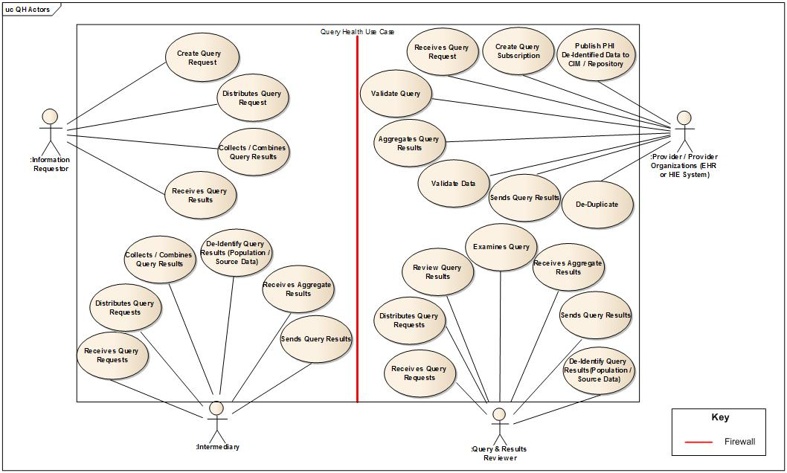
Example: Query Health Use Case
Finalized: 2011-11-16
http://wiki.siframework.org/Query+Health+-+Consensus+Approved+Use+Case

Slide 13
Video System – Designing the Classes
In this system, information stored includes:
  Videos - unique ID; title; category (children's, drama, comedy, etc); cost per night to rent; number of copies video store has available; rating
  Staff - unique ID; name; password; position
  Customers - unique ID; name; password; address; phone #
  Rentals - date rented, customer who rent the video and whether video returned
Functions this system provides include:
  Staff can add, update, delete and find videos
  Staff can add, update, delete and find people.
  Staff can rent out videos to customer and indicate videos have been returned.
  Various reporting functions e.g. number of videos rented this month are provided for managers.

Slide 14
Use Case Descriptions
Use case descriptions should be detailed enough that system analysts can
  design the classes (by grouping attributes and decomposing functions), and
  determine the non-functional requirements:
    “what the system should be” (or always be doing), as distinguished from “what the system should do, upon request”;
    “what the system shouldn’t do” (security requirements);
    usability, auditability, performance, efficiency, capacity, scalability, extensibility, availability, reliability, integrity, recovery, compatibility, portability, maintainability, transparency, legal conformance, …

Slide 15
Semi-formal Use Cases
In some development environments (e.g. in the IBM Rational Unified Process), use cases are semi-formal documents with a required structure e.g.
  Title: the “goal the use case is trying to satisfy” [Fowler, 2004]
  Main Success Scenario: a numbered list of steps
  Step: “a simple statement of the interaction between the actor and a system” [Fowler, 2004]
  Extensions: separately numbered lists, one per extension
  To learn more, see the Wikipedia article on “Use Case”. (But don’t worry about extensions. The focus in CompSci 230 is on the basics!)
Example: a semi-formal use case for SearchForVideos
  1. Used by Staff via an application to query for videos by title.
  2. Event Flow:
    2.1 Repeat Until Exit Program
      2.1.1 Staff types in part of title in text field,
      2.1.2 Staff clicks “Search” button and a list of matching videos are returned showing ID and title. If no videos found, goto step 2.2. If error, goto step 2.3.
      2.1.3. Staff types in a ID. More information is displayed about the video e.g. rating, price to rent, etc
      2.1.4 Exit Program
    2.2 No videos found - error message displayed. Goto 2.1.1
    2.3 Database Error – error message displayed. Goto 2.1.1
  3. Related Actors and Use Cases: Staff may perform this search for a Customer. No inclusions.
  Included in Rent/Return Videos and Maintain Videos.
  4. Special conditions: NONE
John’s Video Store
JVS system
Search for Videos
Staff
Customer

Slide 16
How to draw UML class diagrams?
Sketch by hand
Use a general-purpose graphics editor
Use ArgoUML, or some other specialised graphics editor
Ideally, your UML tool is integrated with your IDE.
  Forward engineering: document your requirements with use cases, develop your design with class diagrams, then start coding.
  Reverse engineering: inspect the code to discover its class structure and use cases.
    ArgoUML does a good job of reverse-engineering class diagrams.
    ArgoUML is clueless about reverse-engineering use cases. (Do you understand why this form of reverse-engineering is very difficult?)

Slide 17
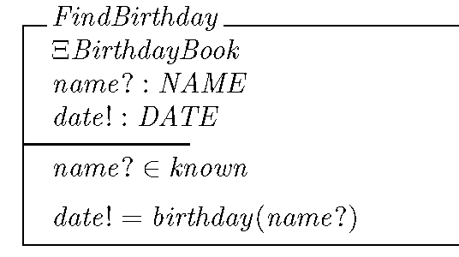
Alternatives to use cases
Story, in agile development:
  a one-sentence description of a feature which could be implemented quickly (i.e. tomorrow, or by the end of this week).
Formal specification, in safety-critical development:
  a precise statement, in a formal language, of
    the post-conditions which will hold after a system action is completed,
    given some pre-conditions (which are also formally specified),
  with some accompanying, explicit, and validated assumptions about the system and its environment.
“As a member of John’s staff, I want to search for my customers by their first name, last name, or by their first and last name.”

Slide 18
Review
Use cases are functional descriptions of what the system should do for its users.
  Use case diagrams depict Actors, the system, and the tasks performed by the system that are important to the Actors.
  If use case descriptions are sufficiently detailed, then they are very helpful in OO design.
  Use case diagrams are orthogonal to OO design, except in their identification of Actors (= classes of users).
Use cases are commonly used in commercial software development, but there are some important alternatives.
Learning goals for this unit:
  If you’re aiming for an A in this class, you should be able to discuss the strengths & weaknesses of use case analysis as a methodology for requirements capture.
  If you’re aiming for a B or better, you should be able to do a good job of drawing up a set of use cases from an informal description.
  If you’re aiming for a C or better, you should be able to do a good job of interpreting the information presented in a use-case diagram or description. (Practice in Quiz 1.)

