Slide 1
CompSci 230
Software Construction
Lecture Slides #3: Introduction to OOD S1 2015
Version 1.1 of 2015-03-12: added return to code on slides 10, 13

Slide 2
Agenda
Topics:
  Software Design (vs. hacking)
  Object-Oriented Design (vs. other approaches to SW design)
  Classes & Objects
  Introduction to UML class diagrams
    Object diagrams may be helpful for visualizing instantiations
  Variables & Methods

Slide 3
Software Design
Communication:
  identify stakeholders, find out what they want and need.
Planning:
  list tasks, identify risks, obtain resources, define milestones, estimate schedule.
Modeling
  develop structure diagrams and use cases, maybe some other UML artifacts.
  Different approaches: OO, procedural, data.
Construction:
  implement the software, with assured quality.
Deployment:
  deliver the software, then get feedback for possible revision.
To learn more:
  R. Pressman, Software Engineering: A Practitioner’s Approach, 7th Ed., 2010, pp. 14-15.

Slide 4
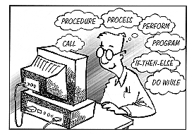
What is Object-Oriented Design?
In OO design, a system is a
  collection of interacting objects.
  Each object should have simple attributes and behaviours.
  Each object should have simple relations to other objects.
In procedural design, a system is a
  collection of basic blocks.
  Each basic block should have a simple effect on local and global variables.
  Basic blocks are linked by control-flow arcs: if/then/else, call/return, while/loop, for/loop, case, goto, …
In data architecture, a system is a
  collection of data structures, with access and update methods.
  Each data structure should have simple relations to other data structures.
Program
object 2
object 1
object 3
object 4

Slide 5
What is an Object?
A building block for OO development
  Like objects in the world around us
  Objects have state and behaviour
Examples:
  Dog
    State/field/attribute: name, colour, isHungry, …
    Behaviour: bark(), fetch(), eat(), …
  Bicycle
    State: gear, cadence, colour, …
    Behaviour: brake(), turn(), changeGear(), …
  VCR
    State: brand, colour, isOn …
    Behaviour: play(), stop(), rewind(), turnOn(), …

Slide 6



Classes & Objects
Class
  A set of objects with shared behaviour and individual state
  Individual state:
    Data is stored with each instance, as an instance variable.
  Shared behaviour:
    Code is stored with the class object, as a method.
  Shared state may be stored with the class object, as a class variable.
Object
  Objects are created from classes at runtime by instantiation
    usually with New.
  There may be zero, one, or many objects (instances) of a class.
  Instantiated objects are garbage-collected if no other
  user-defined object can reference them.

Slide 7
Imagine a world of communicating objects
Object
  An object remembers things (i.e. it has a memory): its state.
  An object responds to messages it gets from other objects.
    It performs the method with the given parameters, then sends a response.
    An object that receives a strange message may throw an exception. Be careful!
  An object’s method may “ask for help” from other objects.
    It sends a message to an object, and waits for a response.
    A method may send a message to itself! This is called recursion. Be careful.
Messages between objects
  Usually: method calls and method returns, sometimes exceptions.

Slide 8
Information Hiding
The implementation details of a method should be of no concern to the sender of the message.
  If a JavaKid tells a JavaDog to fetch(), the dog might run across a busy street during its fetch().
  Parameterised methods allow the senders to have more control over object behaviour. For example, a JavaDog might have a parameterised fetch() method:
  ball = dog.fetch(SAFELY);
Note: in these lecture slides, the word “should” indicates an element of style.
  You should write Java code that is understandable to other Java programmers.

Slide 9
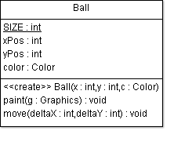
Example 1: Ball
Attributes
  Represent the internal state of an instance of this class.
Constructor
  Creates the object
Methods
  Implement the processing performed by or to an object, often updating its state.
  If there are read and write methods for an attribute x, these should be called getX() and setX().
    You should learn Java’s conventions for capitalisation and naming.
Example: Ball.java
public class Ball
{
public final static int SIZE = 20;
private int xPos;
private int yPos;
private Color color;
public Ball(int x, int y, Color c) {
xPos = x;
yPos = y;
color = c;
}
public void move(int deltaX, int deltaY) {
xPos += deltaX;
yPos += deltaY;
}
public void paint(Graphics g) {
g.setColor(color);
g.fillOval(xPos,yPos,SIZE,SIZE);
}
}

Slide 10
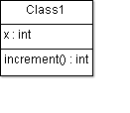
Object Instantiation
When a constructor method is called, a new instance is created.
If a class definition doesn’t include a constructor method, the Java compiler inserts a default constructor with default initialisations.
Ball b = new Ball( 10, 20, Color.Red );
Ball c = new Ball( 0, 10, Color.Blue );
b: Ball
xPos = 10
yPos = 20
Color = Red
c: Ball
xPos = 0
yPos = 10
Color = Blue
public class Class1 {
private int x;
// Note no explicit constructor
public int increment() {
return ++x;
}
}
Class1 d = new Class1();
d: Class1
x = 0
Blecch!
// is this good code?

Slide 11
Message Passing
In a method call, a message is passed to a receiver object.
The receiver’s response to the message is determined by its class.
Ball b = new Ball(10, 20, Color.Red);
b.move(50, 100);
b: Ball
xPos =10
yPos = 20
Color = Red
b: Ball
xPos = 10 60
yPos = 20120
Color = Red
message
receiver
arguments
public class Ball {
...
public void move(int deltaX, int deltaY) {
xPos += deltaX;
yPos += deltaY;
}
}

Slide 12
Instance & Class Variables
Class variables are statically allocated, so they
  are shared by an entire Class of objects.
  The runtime system allocates class variables once per class, regardless of the number of instances created of that class.
  Static storage is allocated when the class is loaded.
  All instances share the same copy of the class variables.
Instance variables are dynamically allocated, so they
  may have different values in each instance of an object.
  When an object is instantiated, the runtime system allocates some memory to this instance – so that it can “remember” the values it stores in instance variables.
Test your understanding:
  List the names of all class variables in Ball.
  List the names of all instance variables in Ball.
: Class
name = “Ball”
size = 10
b1: Ball
xPos=10
yPos = 20
Color = Red
b2: Ball
xPos =10
yPos = 10
Color = Blue

Slide 13
Instance & Class Methods
Instance methods operate on this object's instance variables.
  They also have read & write access to class variables.
  E.g. _______________
Class methods are static.
  Class methods cannot access instance variables.
  Class methods are handled by the “class object” – they can be called even if there are no instances of this class.
  (Example on the next slide.)
public class Class1 {
private int x;
public int increment() {
return ++x; // or x++ ?
}
}

Slide 14
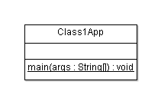
Class1App
public class Class1App {
public static void main( String[] args ) {
Class1 x = new Class1();
System.out.println(
"Without initialisation, ++x = "
+ x.increment()
);
System.out.println(
"After another incrementation, ++x = "
+ x.increment()
);
}
}

Slide 15
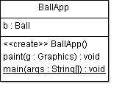
BallApp
import java.awt.*;
import java.awt.event.*;
public class BallApp extends Frame{
Ball b = new Ball( 20, 30, Color.blue );
public BallApp() {
addWindowListener(
new WindowAdapter() {
public void windowClosing(
WindowEvent e
) {
System.exit( 0 );
}
}
);
setSize( 300, 200 );
setVisible( true );
}
public void paint(Graphics g) {
b.paint( g );
}
public static void main(
String[] args
) {
new BallApp();
}
}

Slide 16
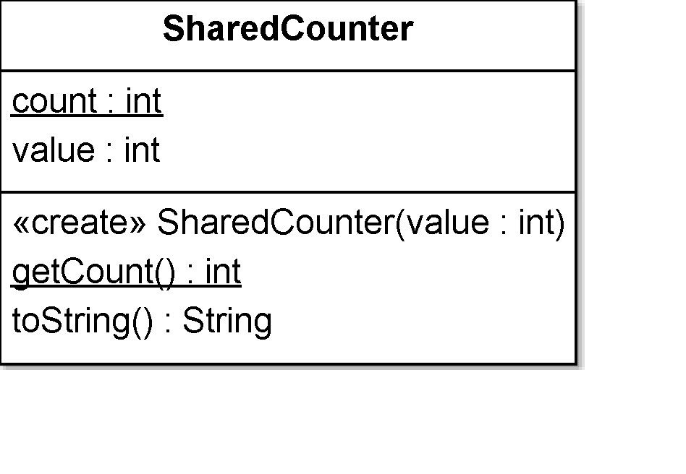
public class SharedCounter {
private static int count;
private int value;
public SharedCounter(int value) {
this.value = value;
count++;
}
public int getValue() {
return value;
}
public static int getCount() {
return count;
}
public String toString() {
return "value=" + value + " count=" + count;
}
}
: Class
name = “SharedCounter”
count = 0 1 2
: Class
name = “SharedCounter”
count = 0 1
: Class
name = “SharedCounter”
count = 0
: Class
name = “SharedCounter” count = 0 1 2 3
c1: SharedCounter
value = 10
c2: SharedCounter
value = 100
public static void main(String[] args) {
SharedCounter c1 = new SharedCounter(10);
SharedCounter c2 = new SharedCounter(100);
SharedCounter c3 = new SharedCounter(200);
System.out.println(c1 + " " + c2 + " " + c3);
}
c3: SharedCounter
value = 200

Slide 17
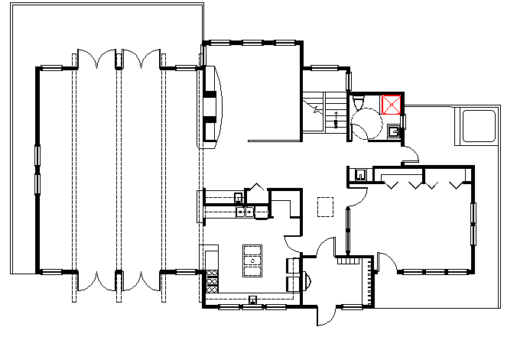
UML
Unified Modeling Language (UML)
  When creating complex OO systems, where do we start?
  When building complex systems, it might be worthwhile to plan things out before you start coding!
    When building a house, we usually have a set of plans.
UML is a language which allows us to graphically model an OO system in a standardised format.
  This helps us (and others!) understand the system.
There are many different UML diagrams, allowing us to model designs from many different viewpoints. Roughly, there are
  Structure diagrams (documenting the architecture), e.g. class diagrams
  Behaviour diagrams (documenting the functionality), e.g. use-case diagrams

Slide 18
Object Diagrams in UML
  In this lecture, I have drawn some object diagrams of instance models (using coloured boxes).
    An object diagram is a graphic representation of an instance model, showing the state of a system after some objects have been instantiated, and after some variables of these objects have been updated.
    Object diagrams are very helpful in tuition, but are not commonly used outside the classroom.
  Please focus on the basics.
    Understand the distinction between static variables and instance variables.
    Develop a working understanding of instantiation – this is a crucial concept!
    Learn how to draw UML-standard class diagrams.
    Honours-level students might want to learn more about object diagrams. I recommend “Modelling instances of classifiers using UML object diagrams”, online Help resource for the IBM Rational Software Modeler, available 4 March 2014.

Slide 19
Tool Support: Eclipse & ArgoUML?
You will need a Java development environment. I strongly recommend Eclipse.
    The de-facto industry standard for Java developers. It’s FOSS: free and open-source software. Its codebase is robust and is under active development. Your tutors will help you learn Eclipse.
  Alternatively, you may use javac and a text editor (e.g. emacs) with Java support
    I reckon every Java developer should know how to run javac from a console, but I won’t attempt to teach this!
You will draw some class diagrams and use-case diagrams. Options:
  ArgoUML
    Supports forward- and reverse-engineering.
      Class diagrams → Java skeletons. Java classes → class diagrams.
    FOSS, works ok but missing some features such as an “undo” button – save your versions carefully!
    No longer under active development: v0.34 is dated 15 December 2011.
    Not on lab image – you’ll have to download and unzip the binary distribution in your echome directory (or on your USB pendrive) then double-click on argouml.jar (this is an “executable jarfile”). See http://argouml-stats.tigris.org/documentation/quickguide-0.32/ch02s02.html.
  Any general-purpose drawing package (e.g. Visio)
    Warning: you’ll have trouble with the fancy arrowheads in UML! Maybe Softwarestencils.com/uml/visio?
  By hand:
    This is your only option during exams and tests
    You’ll have to scan your drawings into your assignments (which are submitted online)

Slide 20
Review
The OO approach is based on modeling the real world using interacting objects.
  OO design is a process of determining what the stakeholders require, designing a set of classes with objects which will meet these requirements, implementing, and delivering.
The statements in a class define what its objects remember and what they can do (the messages they can understand), that is, they define
  Instance variables, class variables, instance methods, and class methods
The hardest concept in this set of lecture slides: instantiation.
  Very important!
A UML class diagram shows the “bare bones” of an OO system design.
  It need not show all classes! (A diagram should not have irrelevant information.)

