Slide 1
Binary Search Trees
Section 6.8

Slide 2
Trees are efficient
Many algorithms can be performed on trees in O(log n) time.
Searching for elements using a binary search can work on a tree if the elements are ordered in the obvious way.
Adding and removing elements is a little trickier.

Slide 3
The Binary Search Tree property
All values in the nodes in the left subtree of a node are less than the value in the node.
All values in the nodes in the right subtree of a node are greater than the value in the node.
http://en.wikipedia.org/wiki/Binary_search_tree

Slide 4
Constructing a BST
We can go through a list of elements adding them in the order they occur.
e.g. 70, 31, 93, 94, 14, 23, 73

Slide 5
70, 31, 93, 94, 14, 23, 73
70

Slide 6
70, 31, 93, 94, 14, 23, 73
70
31

Slide 7
70, 31, 93, 94, 14, 23, 73
70
31
93

Slide 8
70, 31, 93, 94, 14, 23, 73
70
31
93
94

Slide 9
70, 31, 93, 94, 14, 23, 73
70
31
93
14
94

Slide 10
70, 31, 93, 94, 14, 23, 73
70
31
93
14
94
23

Slide 11
70, 31, 93, 94, 14, 23, 73
70
31
93
14
73
94
23

Slide 12
Your turn
Add the elements 17, 5, 25, 2, 11, 35, 9, 16, 29, 38, 7 to a binary search tree

Slide 13
Map ADT and BSTs
If we use a key as the ordering component in our BSTs we can also store a separate value.
We can then use a BST as a Map with functions such as:
put(key, value) - stores value using key
get(key) - returns the value found from key
The text book does this.
Most introductions just use a value - this is what I will use.

Slide 14
Binary Search Tree code
class BST:
"""A Binary Search Tree (BST) class."""
def __init__(self, value, parent=None):
"""Construct a BST.
value -- the value of the root node
parent -- the parent node (of this BST subtree)
"""
self.value = value
self.left = None
self.right = None
self.parent = parent # useful for some operations

Slide 15
Inserting a value
def insert(self, value):
"""Insert value into the BST."""
if value == self.value: # already in the tree
return
elif value < self.value:
if self.left:
self.left.insert(value)
else:
self.left = BST(value, parent=self)
else:
if self.right:
self.right.insert(value)
else:
self.right = BST(value, parent=self)

Slide 16
A Factory Method
def create(a_list):
"""Create a BST from the elements in a_list."""
bst = BST(a_list[0])
for i in range(1, len(a_list)):
bst.insert(a_list[i])
return bst
# A factory method is one which creates and returns
# a new object.
# e.g. this would be called like this
bst = BST.create([70, 31, 93, 94, 14, 23, 73])

Slide 17
Doing something in order
def inorder(self, function):
"""Traverse the BST in order performing function."""
if self.left: self.left.inorder(function)
function(self.value)
if self.right: self.right.inorder(function)
# for example:
bst = BST.create([70, 31, 93, 94, 14, 23, 73])
bst.inorder(print)
# The output is 14 23 31 70 73 93 94

Slide 18
Your turn
Write a __contains__ method which returns True if the BST contains the value, otherwise False.
def __contains__(self, value):

Slide 19
Deleting a value
We need to find the node the value is stored in.
There are three cases
the node has no children
the node has one child
the node has two children

Slide 20
Finding the node
def locate(self, value):
"""Return the node holding value."""
if value == self.value:
return self
elif value < self.value and self.left:
return self.left.locate(value)
elif value > self.value and self.right:
return self.right.locate(value)
else:
return None

Slide 21
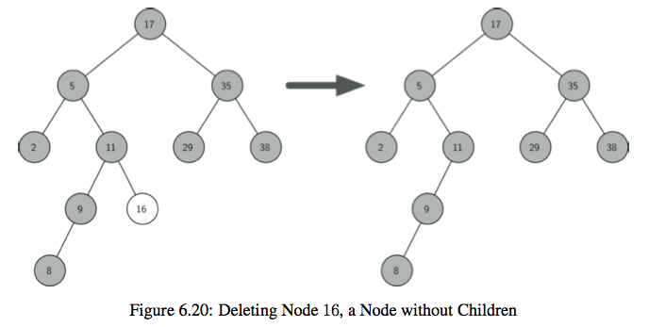
No children

Slide 22
No children
Just delete the node and fix up its parent.

Slide 23
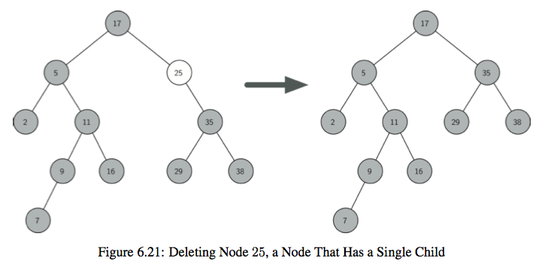
One child

Slide 24
One child
Delete the node and shift its child up to take its place by changing the parent.

Slide 25
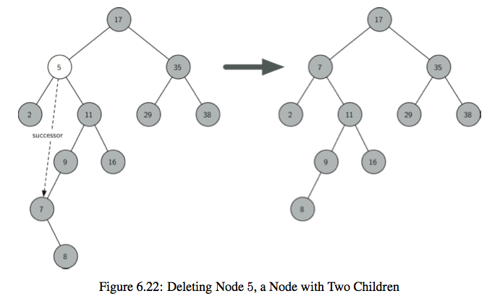
Two children

Slide 26
Two children
Replace the value in the node with its inorder successor.
We also have to delete the inorder successor node.
But this can’t have more than one child.
Why not?

