Slide 1
COMPSCI 107 Computer Science Fundamentals
Lecture 14 - JSON

Slide 2
JavaScript Object Notation
Text-based notation for data interchange
Human readable
Object
Unordered set of name-value pairs
{ name1 : value1, name2 : value2, …, nameN : valueN }
Array
Ordered list of values
[ value1, value2, … valueN ]

Slide 3
Writing JSON using Python
json.dumps( data )
Accepts Python object as an argument
Returns a string containing the information in JSON format
Typically write this string to a file
import json
def write(data, filename):
file = open(filename, 'w')
str_out = json.dumps(data)
file.write(str_out)
file.close()

Slide 4
Reading JSON using Python
json.loads( data )
Accepts string as an argument
The string should be in JSON format
Returns a Python object corresponding to the data
import json
def read(filename):
file = open(filename)
str_in = file.read()
file.close()
data = json.loads(str_in)
return data

Slide 5
Writing JSON using pretty printing
json.dumps( data )
json.dumps( data, indent=4, sort_keys=True )
Formats the output over multiple lines
{'b': ['HELLO', 'WORLD'], 'a': ['hello', 'world']}
{
"a": [
"hello",
"world"
],
"b": [
"HELLO",
"WORLD"
]
}

Slide 6
What about user-defined classes?
Point class
Can create a dictionary to store state information then use json
Can use json to read dictionary and extract the state information
class Point:
def __init__(self, loc_x, loc_y):
self.x = loc_x
self.y = loc_y
def generate_json(p):
out = {'_Point' : True, 'x' : p.x, 'y' : p.y}
return json.dumps(out, sort_keys=True)
def generate_point(txt):
inp = json.loads(txt)
result = Point( inp['x'], inp['y'] )
return result

Slide 7
Program Development
Start by thinking of the different kinds of input and the output
Test Cases
Work on the solution, keeping the test cases in mind
Test your code after each development advance

Slide 8
Debugging
Debugging and tracing code are closely linked skills
To debug your code, you need to know:
what your code *should* produce
what your code *does* produce
why is there is a difference
Use text output to determine data
Test functions at entry and exit points
Test loops at entry and exit points
If data is large or complex, save output to a file
JSON may help

Slide 9
Converting from infix to postfix
A stack can be used in the algorithm to convert infix to postfix
Divide expression into tokens
Operators: +. -, *, /
Operands: single digits
Other tokens: brackets

Slide 10
Algorithm for converting infix to postfix
Create a stack to store operators and a list for the output tokens
Scan the tokens from left to right
If the token is an operand, add it to the output list
If the token is a left parenthesis, push it to the operator stack
If the token is a right parenthesis, pop the operator stack until the left parenthesis is removed. Append each operator to the output list
If the token is an operator, push it onto the operator stack. But first, remove any operators that have higher or equal precedence and append them to the output list
When there are no more tokens, remove operators on the stack and append to the output list

Slide 11
Exercise
Show the operator stack and the output list at every step as the following infix expression is converted to postfix
12 / ( 3 + 4 ) * 2 + 4

Slide 12
Evaluating postfix expressions
Create an empty stack
Scan the list of tokens from left to right
If the token is an operand, push it to the operand stack
If the token is an operator, pop the stack twice
The first element popped is the right operand
The second element popped is the left operand
Apply the operator to the operands and push the result onto the stack
When there are no more tokens, the stack should contain the result.

Slide 13
Exercise
Following the algorithm to evaluate postfix expressions, show the operand stack, and the token being processed (at each step) as the following postfix expression is evaluated:
7 12 8 9 - * 3 / +

Slide 14
Exercise
How does a user know if the circular_queue is full? What should happen when the circular_queue is full? Discuss
class circular_queue:
def __init__(self, capacity):
#creates empty list, count, front, back
def is_empty(self):
def enqueue(self, item):
def dequeue(self):
def size():

Slide 15
ADT Deque
A Double-Ended Queue or Deque (pronounced ‘Deck’)
An ordered collection of items where items are added and removed from either end, either front or back
add_front()
add_rear()
remove_front()
remove_rear()
is_empty()
size()

Slide 16
Exercise
Use a double ended queue to write a function that determines if a string is a palindrome.
A palindrome is a sentence in which the letters appear in the same order forwards and reverse. Punctuation is ignored.
>>> is_palindrome(‘bob’)
True

Slide 17
Bob – Weird Al Yankovic
I, man, am regal - a German am I Never odd or even If I had a hi-fi Madam, I'm Adam Too hot to hoot No lemons, no melon Too bad I hid a boot Lisa Bonet ate no basil Warsaw was raw Was it a car or a cat I saw?
Rise to vote, sir Do geese see god? "Do nine men interpret?" "Nine men," I nod Rats live on no evil star Won't lovers revolt now? Race fast, safe car Pa's a sap Ma is as selfless as I am May a moody baby doom a yam?
Ah, Satan sees Natasha No devil lived on Lonely Tylenol Not a banana baton No "x" in "Nixon" O, stone, be not so O Geronimo, no minor ego "Naomi," I moan "A Toyota's a Toyota" A dog, a panic in a pagoda
Oh no! Don Ho! Nurse, I spy gypsies - run! Senile felines Now I see bees I won UFO tofu We panic in a pew Oozy rat in a sanitary zoo God! A red nugget! A fat egg under a dog! Go hang a salami, I'm a lasagna hog

Slide 18
Exercise
What is the big-O running time for the following function?
def exampleA(n):
s = "PULL FACES"
for i in range(n):
print("I must not ", s)
for j in range(n, 0, -1):
print("I must not ", s)
Notes:
N

Slide 19
Exercise
What is the big-O running time for the following function?
def exampleB(n):
s = "JUMP ON THE BED"
for i in range(n):
for j in range(i):
print("I must not ", s)
Notes:
n2

Slide 20
Exercise
What is the big-O running time for the following function?
def exampleC(n):
s = "WHINGE"
i = 1
while i < n:
for j in range(n):
print("I must not ", s)
i = i * 2
Notes:
N log n

Slide 21
Exercise
What is the big-O running time for the following function?
def exampleD(n):
s = "PROCRASTINATE"
for i in range(n):
for j in range(n, 0, -1):
outD(s, n / 2)
def outD(s, b):
number_of_times = int(b % 10)
for i in range(number_of_times):
print(i, "I must not ", s)
Notes:
N squared

Slide 22
Exercise
What is the big-O running time for the following function?
def exampleF(n):
s = "FORGET MY MOTHER’S BIRTHDAY"
i = n
while i > 0:
outF(s)
i = i // 2
def outF(s):
for i in range(25, 0, -1):
print(i, "I must not ", s)
Notes:
Log(n)

Slide 23
Challenge Question
If a particular quadratic time algorithm uses 300 elementary operations to process an input of size 10, what is the most likely number of elementary operations it will use if given an input of size 1000.
(a) 300 000 000
(b) 3 000 000
(c) 300 000
(d) 30 000
(e) 3 000

Slide 24
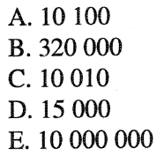
Challenge Question
You know that a given algorithm runs in O(2^{n}) time. If your computer can process input of size 10000 in one year using an implementation of this algorithm, approximately what size input could you solve in one year with a computer 1000 times faster?

Slide 25
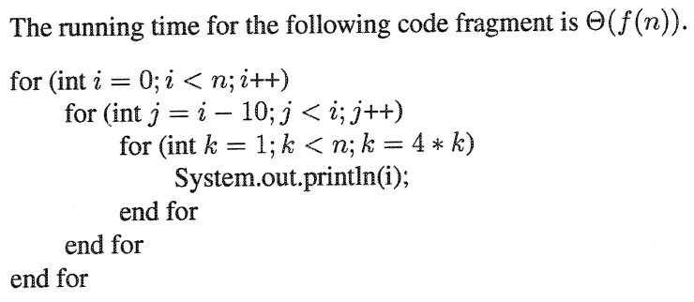
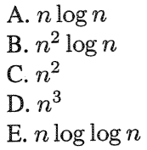
ChallengeQuestion

