Slide 1
COMPSCI 107 Computer Science Fundamentals
Lecture 10 – Algorithm Analysis

Slide 2
Fibonacci numbers
Next number is sum of previous two numbers
1, 1, 2, 3, 5, 8, 13, 21 …
Mathematical definition

Slide 3
Question
Which of the following would you choose?
def fib_a(n):
if n == 0 or n == 1:
return n
if n >= 2:
return fib_a(n - 1) + fib_a(n - 2)
def fib_b(n):
if n == 0 or n == 1:
return n
prev = 1
prev_prev = 0
for i in range(2, n+1):
temp = prev + prev_prev
prev_prev = prev
prev = temp
return prev

Slide 4
Empirical testing
How long will it take for fib_a(100) to execute?
Fibonacci number | Time taken
 | fib_a(n) | fib_b(n)
10 | < 0.001 second | < 0.001 second
20 | < 0.001 second | < 0.001 second
30 | 1 second | < 0.001 second
100 | ??? | < 0.001 second
Notes:
About 1 second for fibonacci 30
10, 000, 000 years

Slide 5
Fibonacci numbers
2
1
20
6,765
3
2
30
832,040
4
3
40
102,334,155
5
5
50
12,586,269,025
6
8
60
1,548,008,755,920
7
13
70
190,392,490,709,135
8
21
80
23,416,728,348,467,685
9
34
90
2,880,067,194,370,816,120
10
55
100
354,224,848,179,261,915,075

Slide 6
Comparing Algorithms
Analyse performance
How much of a given resource do we use?
Space (memory)
Time
We are going to be mainly interested in how long our programs take to run, as time is generally a more precious resource than space.

Slide 7
Analysing time to run an algorithm
Three considerations
How are the algorithms encoded?
What computer will they be running on?
What data will be processed?
Analysis should be independent of specific
Coding,
Computers, or
Data
How do we do it?
Count the number of basic operations and generalise the count

Slide 8
Example
Sum the first 10 element of a list
def count_operations1(items):
sum = 0
index = 0
while index < 10:
sum = sum + items[index]
index += 1
return sum
1 assignment
1 assignment
11 comparisons
10 assignments
10 assignments
1 return
Total: 34

Slide 9
Example
Sum the elements in a list
We express the time as a function of problem size
def count_operations2(items):
sum = 0
index = 0
while index < len(items):
sum = sum + items[index]
index += 1
return sum
1 assignment
1 assignment
N + 1 comparisons
N assignments
N assignments
1 return
Total: 3n + 5

Slide 10
Exercise
For each of the following, how many operations are required (express in terms of N where possible)?
Adding an element to the beginning of a list containing n elements
Printing each element of a list containing n elements,
Adding a single element to a list using the append() function.
Performing a nested loop where the outer loop is executed n times and the inner loop is executed 10 times. For example, printing out the times tables for all integer values between 1 and n

Slide 11
Exercise
Assume that we have 5 different algorithms that are functionally equivalent. The time taken to execute each algorithm is described by the respective functions below. Which algorithm would you choose and why?
(a) T(n) = n³ + 4n + 7
(b) T(n) = 20n + 2
(c) T(n) = 3n² + 2n + 23
(d) T(n) = 1,345,778
(e) T(n) = 3log₂n + 2n

Slide 12
Efficiency – we care most about scalability
For small problem sizes, most code runs extremely fast
When we do care about small problem sizes, we can do detailed analysis and measure empirically
However, running well when the problem is small doesn’t mean the code will run well when the problem gets bigger
Scalability is critically important
Interested in the order of magnitude of the running time
Can analyse in different levels of detail
Crude estimates are good enough

Slide 13
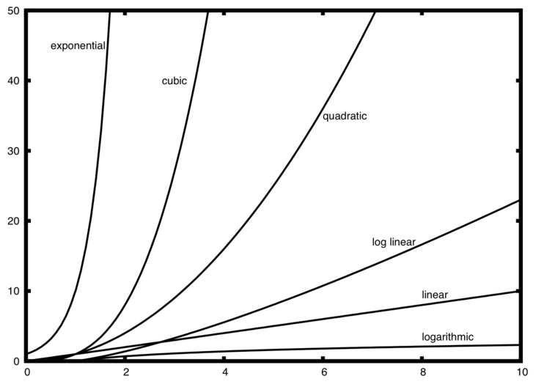
Growth rates of common time-complexity functions
Running time
Problem size

Slide 14
Describing time-complexity
We can describe the running time of an algorithm mathematically
Simply count the number of instructions executed
def peek(a):
#return the first item
return a[0]
def pop(a):
#remove and return the first item
firstItem = a[0]
for i in range(1,len(a)):
a[i-1] = a[i]
return firstItem

Slide 15
Ignore constant factors
Linear time algorithm takes An + B
Where A and B are implementation-specific constants
When n is large, An is a good approximation
Since we know the relationship is linear, we can work out A for a particular implementation if we need it.
For large n, the difference between different order of magnitude is huge – the other factors are insignificant
Therefore, we don’t need fine distinctions, only crude order of magnitude

Slide 16
Big-O
We use Big O notation (capital letter O) to specify the complexity of an algorithm e.g., O(n² ) , O(n³ ) , O(n ).
If a problem of size n requires time that is directly proportional to N, the problem is O(n)
If the time requirement is directly proportional to n², the problem is O(n²)

Slide 17
Common big-O functions
f(n) | Name
O(1) | Constant
O(logn) | Logarithmic
O(n) | Linear
O(nlogn) | Log Linear
O(n²) | Quadratic
O(n³) | Cubic
O(2^{n}) | Exponential

Slide 18
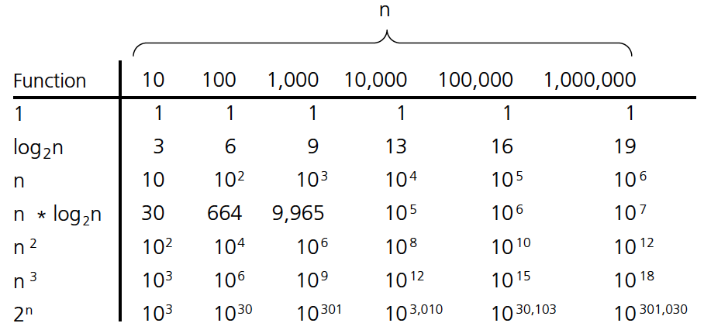
Comparison of Growth Rates
Problem size
Number
Of
Operat
ions

Slide 19
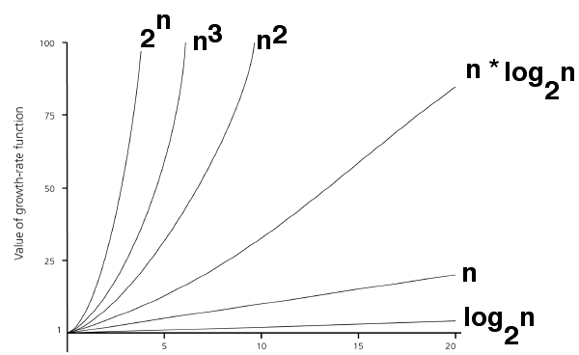
Comparison of Growth Rates

Slide 20
Properties of Big O
When considering the Big O for an algorithm, the Big O's can be combined e.g.
O(n²) + O(n) = O(n² + n)
O(n²) + O(n⁴) = O(n² + n⁴)
Notes:
Changing the hardware/ software environment
Affects T(n) by a constant factor, but
Does not alter the growth rate of T(n)
The linear growth rate of the running time T(n) is an intrinsic property of algorithm arrayMax

Slide 21
Properties of Big O
When considering the Big O for an algorithm, any lower order terms in the growth function can be ignored e.g.
= O(n³)
O(n³ + n² + n + 5000)
O(n + n² + 5000)
= O(n²)
O(1500000 + n)
= O(n)
Notes:
We can’t use it to accurately estimate how long the program will take to run because not only would we would need to know how long each of the basic operations take, but we really want our analysis to be machine independent. Therefore, the constants in the formula above are not relevant. Also, we are interested in the performance of the program when n is large, in which case the 3n term dominates the 3 term, so we simply ignore the 3.

Slide 22
Properties of Big O
When considering the Big O for an algorithm, any constant multiplications in the growth function can be ignored e.g.
O(254 * n² + n)
= O(n²)
O(546 * n)
= O(n)
O(n / 456)
= O( (1/456) * n)
= O(n)
Notes:
We can’t use it to accurately estimate how long the program will take to run because not only would we would need to know how long each of the basic operations take, but we really want our analysis to be machine independent. Therefore, the constants in the formula above are not relevant. Also, we are interested in the performance of the program when n is large, in which case the 3n term dominates the 3 term, so we simply ignore the 3.

Slide 23
Exercise
What is the Big O of the following growth functions?
a) T(n) = n + log(n)
b) T(n) = n⁴ + n*log(n) + 3000n³
c) T(n) = 300n + 60 * n * log(n) + 342
Notes:
Changing the hardware/ software environment
Affects T(n) by a constant factor, but
Does not alter the growth rate of T(n)
The linear growth rate of the running time T(n) is an intrinsic property of algorithm arrayMax
･ )log()( nnnf += this is O(n), because the log(n) term is of a lower example than n ･ 125.341000)( 24 +++= nnnnf this is O(n4), because the other terms are of a lower example ･ 10003)( += nnf this is O(n) again ﾐ the constant term can be ignored

Slide 24
Worst-case and average-case analyses
An algorithm can require different times to solve different problems of the same size. For example, search for a particular element in an array.
Best-case analysis: the minimum amount of time that an algorithm requires to solve problems of size n
Worst-case analysis: the maximum amount of time that an algorithm requires to solve problems of size n
Average-case analysis: the average amount of time that an algorithm requires to solve problems of size n
Average performance and worst-case performance are the most commonly used in algorithm analysis.
Notes:
In general, we may want to consider the best and average time requirements of a function as well as its worst-case time requirements. Which is considered the most important will depend on several factors. For example, if a function is part of a time-critical system like one that controls an airplane, the worst-case times are probably the most important (if the plane is flying towards a mountain and the controlling program can't make the next course correction until it has performed a computation, then the best-case and average-case times for that computation are not relevant -- the computation needs to be guaranteed to be fast enough to finish before the plane hits the mountain).On the other hand, if occasionally waiting a long time for an answer is merely inconvenient (as opposed to life-threatening), it may be better to use an algorithm with a slow worst-case time and a fast average-case time, rather than one with so-so times in both the average and worst cases.For addBefore, for a sequence of length N, the worst-case time is O(N), the best-case time is O(1), and the average-case time (assuming that each item is equally likely to be the current item) is O(N), because on average, N/2 items will need to be moved.Note that calculating the average-case time for a function can be tricky. You need to consider all possible values for the important factors, and whether they will be distributed evenly.
Worst-case analysis = find the maximum number of operations an algorithm can execute in all situations
Worst-case analysis is easier to calculate
More common
Average-case analysis = enumerate all possible situations, find the time of each of the m possible cases, total and divide by m
Average-case analysis is harder to compute
Yields a more realistic expected behavior
In real-time computing, the worst-case execution time is often of particular concern since it is important to know how much time might be needed in the worst case to guarantee that the algorithm would always finish on time.

Slide 25
Exercise
What is the big-O running time for the code:
(a) O(1)
(b) O(logn)
(c) O(n)
(d) O(n²)
(e) None of the above
def question(n):
count = 0
for i in range(n):
count += 1
for j in range(n):
count += 1
return count

Slide 26
Exercise
What is the big-O running time for the code:
(a) O(1)
(b) O(logn)
(c) O(n)
(d) O(n²)
(e) None of the above
def question(n):
count = 0
for i in range(n):
count += 1
for j in range(n):
count += 1
return count

Slide 27
Exercise
What is the big-O running time for the code:
(a) O(1)
(b) O(logn)
(c) O(n)
(d) O(n²)
(e) None of the above
def question(n):
count = 0
for i in range(n):
count += 1
for j in range(10):
count += 1
return count

Slide 28
Exercise
What is the big-O running time for the code:
(a) O(1)
(b) O(logn)
(c) O(n)
(d) O(n²)
(e) None of the above
def question(n):
count = 0
for i in range(n):
count += 1
for j in range(i+1):
count += 1
return count

Slide 29
Exercise
What is the big-O running time for the code:
(a) O(1)
(b) O(logn)
(c) O(n)
(d) O(n²)
(e) None of the above
def question(n):
i = 1
count = 0
while i < n:
count += 1
i = i * 2
return count

Slide 30
Exercise
What is the big-O running time for the code:
(a) O(1)
(b) O(logn)
(c) O(n)
(d) O(n²)
(e) None of the above
def question(n):
i = 1
count = 0
while i < n:
count += 1
i = i + 2
return count

Slide 31
Exercise
What is the big-O running time for the code:
(a) O(1)
(b) O(logn)
(c) O(n)
(d) O(n²)
(e) None of the above
def question(n):
count = 0
for i in range (n):
j = 0
while j < n:
count += 1
j = j * 2
return count

Slide 32
Exercise
What is the big-O running time for the following function?
def exampleA(n):
s = "PULL FACES"
for i in range(n):
print("I must not ", s)
for j in range(n, 0, -1):
print("I must not ", s)
Notes:
N

Slide 33
Exercise
What is the big-O running time for the following function?
def exampleB(n):
s = "JUMP ON THE BED"
for i in range(n):
for j in range(i):
print("I must not ", s)
Notes:
n2

Slide 34
Exercise
What is the big-O running time for the following function?
def exampleC(n):
s = "WHINGE"
i = 1
while i < n:
for j in range(n):
print("I must not ", s)
i = i * 2
Notes:
N log n

Slide 35
Exercise
What is the big-O running time for the following function?
def exampleD(n):
s = "PROCRASTINATE"
for i in range(n):
for j in range(n, 0, -1):
outD(s, n / 2)
def outD(s, b):
number_of_times = int(b % 10)
for i in range(number_of_times):
print(i, "I must not ", s)
Notes:
N squared

Slide 36
Exercise
What is the big-O running time for the following function?
def exampleF(n):
s = "FORGET MY MOTHER’S BIRTHDAY"
i = n
while i > 0:
outF(s)
i = i // 2
def outF(s):
for i in range(25, 0, -1):
print(i, "I must not ", s)
Notes:
Log(n)

Slide 37
Challenge Question
If a particular quadratic time algorithm uses 300 elementary operations to process an input of size 10, what is the most likely number of elementary operations it will use if given an input of size 1000.
(a) 300 000 000
(b) 3 000 000
(c) 300 000
(d) 30 000
(e) 3 000

Slide 38
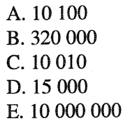
Challenge Question
You know that a given algorithm runs in O(2^{n}) time. If your computer can process input of size 10000 in one year using an implementation of this algorithm, approximately what size input could you solve in one year with a computer 1000 times faster?

Slide 39
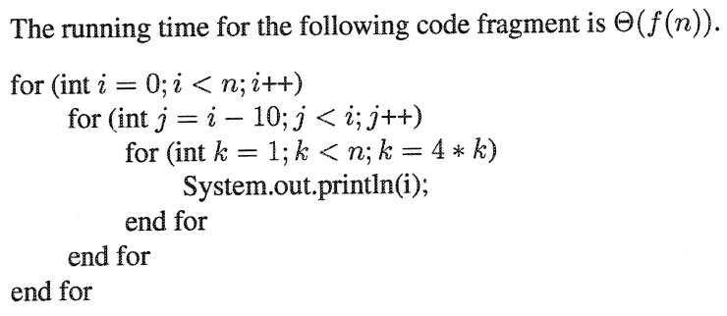
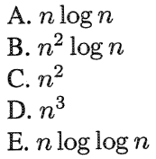
ChallengeQuestion

