Slide 1
COMPSCI 107 Computer Science Fundamentals
Lecture 08 – Documentation, debugging

Slide 2
Documentation
docstring
A special kind of string (text) used to provide documentation
Appears at the top of a module
Appears at the top of a function
Uses three double-quotes to surround the documentation
All modules , and all functions should include a docstring
Using the help function returns the docstring for that function
"""Converts a length in inches to a length in centimetres.
Author: Andrew Luxton-Reilly
"""
length_in_inches = 100
length_in_cm = length_in_inches * 2.54
print(length_in_cm)

Slide 3
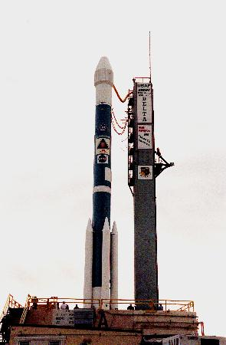
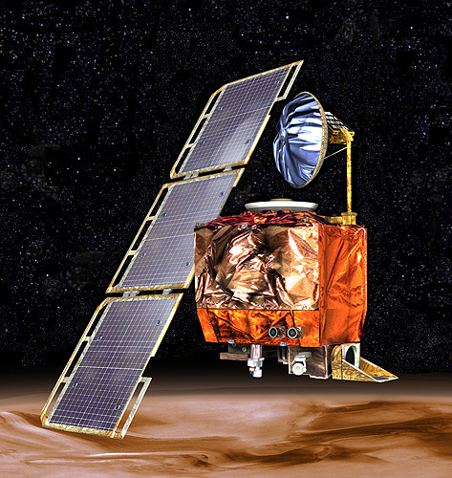
Lost in Space (1999)
The NASA subcontractor that built the Mars Climate Orbiter used English units instead of the intended metric system.
This confusion led the Orbiter’s thrusters to fire at the wrong time, causing it to crash on its arrival at Mars in 1999.
This embarrassing error wasted $327 million, not to mention the year needed for the Orbiter to reach Mars.
Notes:
http://en.wikipedia.org/wiki/Mars_Climate_Orbiter

Slide 4
Comments
Comment
A programming comment is a note to other programmers
Anything between a # and the end of the line is ignored by the computer
Add comments sparingly to explain code that is difficult, or tell other programmers something they need to know about the code.
"""Converts a length in inches to a length in centimetres.
Author: Andrew Luxton-Reilly
"""
length_in_inches = 100 #Alter this value to convert a different length
length_in_cm = length_in_inches * 2.54
print(length_in_cm)

Slide 5
Exercises
Improve the function that calculates the area of a circle by adding a docstring specifying the purpose of the code, the arguments and the return value.

Slide 6
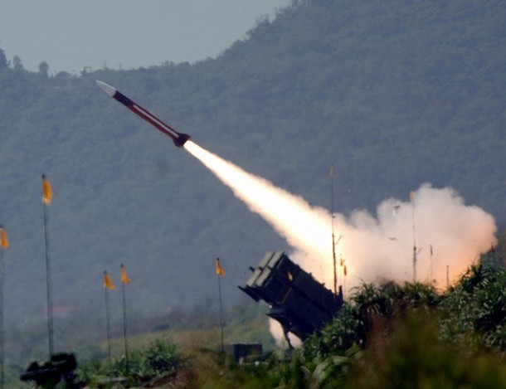
Turning a Blind Eye (1991)
During the 1991 Gulf War, the U.S. deployed its Patriot missile system to protect its troops, allies, and civilians from Iraqi SCUD missile attacks.
A software rounding error in the system calculated time incorrectly, causing it to ignore some incoming missiles.
A missile battery in Saudi Arabia failed to intercept an incoming SCUD that destroyed a U.S. Army barracks, killed 28 soldiers, and injured 100 others.

Slide 7
How do you know if your code works?
Syntax errors
Easy to identify
Static analysis possible
The compiler tells you
Runtime errors
Occur while the program is running
Provide feedback about when the program caused the error
Often harder to fix than syntax errors but easier than logic errors
Logic errors
Difficult to identify
Program does exactly what you told it
Not always what you meant

Slide 8
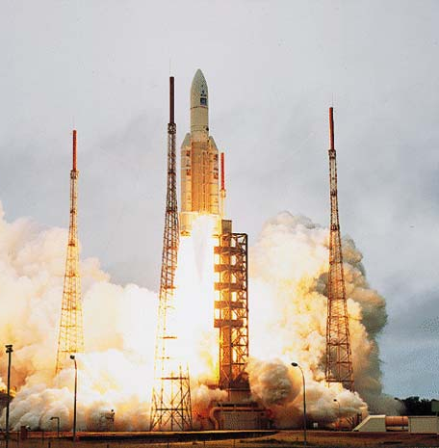
Expensive Fireworks (1996)
In 1996, code from the Ariane 4 rocket is reused in the Ariane 5, but the new rocket’s faster engines trigger a bug in an arithmetic routine inside the flight computer.
The error is in code to convert 64-bit floating-point numbers to a 16-bit signed integers. The faster engines cause the 64-bit numbers to be larger, triggering an overflow condition that crashes the flight computer.
As a result, the rocket's primary processor overpowers the rocket's engines and causes the rocket to disintegrate only 40 seconds after launch.

Slide 9
Test cases
Before you write the code, figure out what output you expect
Example: Write a function that calculates the area of a triangle
Height | Base | Area
20 | 123 | 1230
2 | 2 | 2
0 | 10 | 0
Notes:
ONLY GOT TO HERE

Slide 10
Exercise
Write a function that calculates the area of a triangle.
How can you check if your code works correctly?

Slide 11
doctest
doctest is a simple system for testing code
Not as sophisticated as unit testing
Tests are included in the docstring for a function
Any line that begins with the Python prompt >>> will be executed
The output from executing the code will be compared with the line following
To test the code, include the following statements in the module
>>> circle_area(1)
3.1415927
include this inside your docstring for the circle_area function
import doctest
doctest.testmod()

Slide 12
Example
def triangle_area(base, height):
"""Returns the area of a triangle.
Arguments:
base -- a number (float) or (int) representing the length of the triangle base
height -- a number (float) or (int) representing the length of the triangle height
Returns:
The area of the triangle (float)
>>> triangle_area(10, 5)
25.0
>>> triangle_area(1, 1)
0.5
>>> triangle_area(2.5, 2)
2.5
"""
return base * height / 2

Slide 13
More doctest
The output from the function is compared against the doctest output line by line until a blank line is encountered
SO if your output includes blank lines you need to use:
<BLANKLINE> in the doctest output
"""
>>> print_many_lines()
The first line
<BLANKLINE>
The last line
"""

Slide 14
Issues with doctests
Testing with floating point values is tricky
Why? Use round(value, dp)
Round is tricky. Why?
Testing with long output
Use a doctest directive (essentially option flags)
Misdirected confidence
Tests are only as good as you make them
>>> math.pi # doctest: +ELLIPSIS
3.1415926...

Slide 15
Alternative use of doctest
Put the tests in an external file
#This code can be in any module
#When you want to run the tests, simply load this module
import doctest
doctest.testfile('tests.txt')
This is the tests.txt file
It can contain any text, including working notes and other examples
Assume XXX is the name of a file (module), and get_seed_words is the name of the function that you want to test
>>> from XXX import get_seed_words
>>> get_seed_words('This is a test.')
['This']
etc.

Slide 16
Choosing test cases
Example: 'seed' words
Given a string of text, output a list containing the first word of each sentence.
A word is defined as a sequence of one or more characters separated by whitespace. A word may include punctuation.
A sentence consists of a sequence of words in which the last word terminates with a full stop, or the end of the string.
In each of the following cases, state the number of words and sentences (spaces indicated with ^, tab with \T and newline with \n)?
abc
abc.
^abc
abc.def
abc.def
abc^def
abc-def
a.b.c...
a^b.^c.
a\Tb
a.\nb.
a.\nb.
a.\T^\n^b^.
^

Slide 17
Exercise
Define a set of test cases for a function that returns a list of seed words for a given string of text.
def seed_words(text):

Slide 18
Program Development
Start by thinking of the different kinds of input and the output
Test Cases
Work on the solution, keeping the test cases in mind
Test your code after each development advance

Slide 19
Debugging
Debugging and tracing code are closely linked skills
To debug your code, you need to know:
what your code *should* produce
what your code *does* produce
why is there is a difference

Slide 20
Debugging
Example:
seedBank += [wordBank[0]]
IndexError: list index out of range
def gsw(text):
sentenceBank = []
wordBank = []
seedBank = []
text.replace('!','.')
text.replace('?','.')
if (text[len(text)-1] == '.'):
text = text[:-1]
sentenceBank = text.split('.')
for i in range(0,len(sentenceBank)):
if (sentenceBank[i] != ''):
wordBank = sentenceBank[i].split()
seedBank += [wordBank[0]]
return seedBank

Slide 21
Summary
Comments are directed towards programmers and ignored by the computer
Docstrings are used to convey the purpose of modules and functions
Doctest is a simple system to automate the testing of code

