Slide 1
Cryptographic Standards and Protocols
An Overview

Slide 2
Overview
Kerberos
X.509
X.500
IPv6
SSL
TLS
IPSec

Slide 3
Kerberos
Kerberos is a network authentication protocol. It is designed to provide strong authentication for client/server applications by using secret-key cryptography.
Before a network connection is opened between two entities, Kerberos establishes a shared secret key through a Ticket Granting Server (TGS) that is used for authenticating the parties in the subsequent communications
Versions of Kerberos also have extensions to utilize public/private keys for authentication
Versions 4 and 5 (RFC 1510) are in use today
  v4 has technical deficiencies
    http://www.isi.edu/div7/publication_files/evolution_of_kerberos.pdf
Category: Authentication

Slide 4
Kerberos
It provides a centralized private-key third-party authentication in a distributed network
  Allows users access to services distributed through a network without needing to trust all workstations
  All trust is handled through a central authentication server
    Implemented using an authentication protocol based on Needham-Schroeder

Slide 5
Kerberos
Kerberos environment consists
  A Kerberos server
  A number of clients, all registered with the server
  Application servers, sharing keys with the Kerberos server
    Termed a realm
  Typically a single administrative domain
    If multiple realms, their Kerberos servers must share keys and trust
  Authentication Server (AS)
    Users initially negotiate with AS to identify self
    AS provides a non-corruptible authentication credential
      Ticket Granting Ticket (TGT)
    Ticket Granting server (TGS)
      Users subsequently request access to other services from TGS on basis of users TGT
    Uses a complex protocol using DES

Slide 6
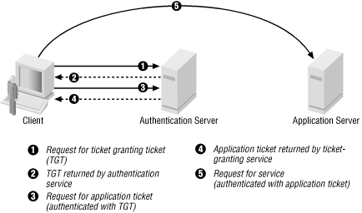
Kerberos

Slide 7
X.509
To facilitate the identification and security of keys in PKI, a Certificate Authority (CA) is used to authenticate the public key by digitally signing it
  This is known as a digital certificate
The validation and invalidation process (authentication) of digital certificates is handled by the Certificate Authority, and is governed by the X.509 de-facto standard.
  Specifies the semantics of certificates and certificate revocation lists for the Internet PKI
Category: Authentication

Slide 8
X.500
The X.500 standard is a global directory service that is based on a replicated distributed database
Programs access the directory services using the X/Open Directory Service (XDS) API’s.
The XDS API’s permit programs to read, compare, update, add, and remove directory entries; list directories; and search for entries based on attributes, while authenticating these activities.
There are varieties of X.500 products (i.e. Directory Access Protocols) available, and the latest version is LDAP.
  Lightweight Directory Access Protocol (LDAP) provides the same functions as DAP except it reduces overheads through bypassing much of the session and presentation layers using Distinguished Names (DN)
Category: Authentication

Slide 9
LDAP
The Lightweight Directory Access Protocol is an open, vendor-neutral, industry standard application protocol for accessing and maintaining distributed directory information services over an Internet Protocol network.
Directory services play an important role in developing intranet and Internet applications by allowing the sharing of information about users, systems, networks, services, and applications throughout the network.
  provide any organized set of records
  often with a hierarchical structure such as a corporate email directory
A common usage of LDAP is to provide a single-sign-on where one password for a user is shared between many services
http://www.ietf.org/rfc/rfc4511.txt
Category: Authentication

Slide 10
LDAP
LDAP Data Interchange Format (LDIF)
    dn: cn=John Doe,dc=example,dc=com
    cn: John Doe
    givenName: John
    sn: Doe
    telephoneNumber: +1 888 555 6789
    telephoneNumber: +1 888 555 1232
    mail: john@example.com
    manager: cn=Barbara Doe,dc=example,dc=com
    objectClass: inetOrgPerson
    objectClass: organizationalPerson
    objectClass: person
    objectClass: top

Slide 11
IPv6
The proposed standard Internet Protocol version 6 (IPv6) is the next generation of IP and will eventually replace IPv4.
  Currently being transitioned throughout the Internet and is backward compatible with version 4.
IPv6 provides the following added features
  An increase from the 32-bit address space to 128-bit
  Provisions for unicast, multicast, and anycast
  An extension Authentication Header (AH) which provides authentication and integrity (without confidentiality) to IPng datagrams
  An IPng Encapsulating Security Header (ESH) which provides integrity and confidentiality to datagrams
http://tools.ietf.org/html/rfc2460
Category: Data Integrity

Slide 12
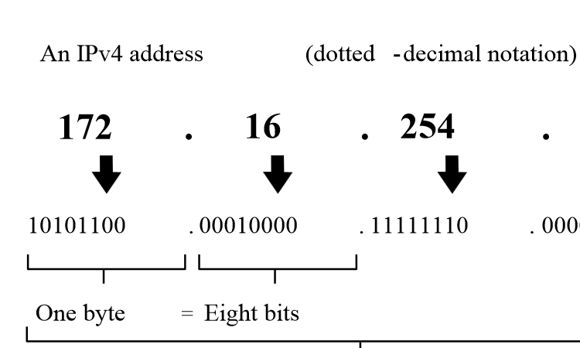
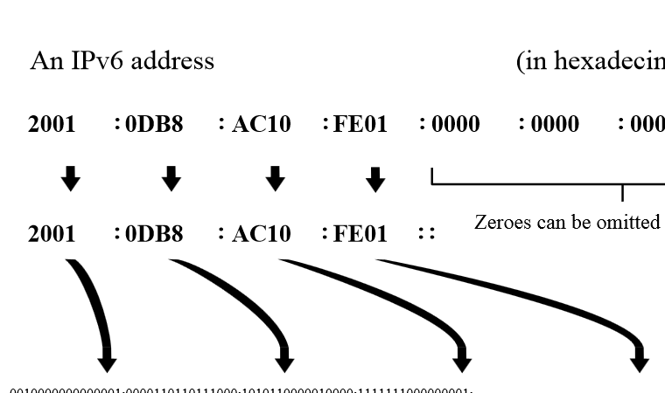
IPv6

Slide 13
IPv6

Slide 14
SSL
Secure Socket Layer (SSL) is a security socket connection that provides a security layer at the transport level between the TCP/IP transport and sockets.
The objective is to securely transmit from one site to another without involving the applications that invoke it
The SSL protocol provides a certificate-based server authentication, private client-server communications using Rivest Shamir Adleman (RSA) encryption and message integrity checks.
The SSL client generates a secret key for one session that is encrypted using the server’s public key.
  The session key is forwarded to the server and used for communication between the client and the server.
http://tools.ietf.org/html/rfc6101
Category: Data Confidentiality

Slide 15
SSL
Basic properties
  The connection is private.
    Encryption is used after an initial handshake to define a secret key.
    Symmetric cryptography is used for data encryption.
      DES, 3DES, RC4
  The peer's identity can be authenticated using asymmetric, or public key, cryptography.
    RSA, DSS
  The connection is reliable.
    Message transport includes a message integrity check using a keyed Message Authentication Code (MAC) [RFC2104].
    Secure hash functions (e.g., SHA, MD5) are used for MAC computations.

Slide 16
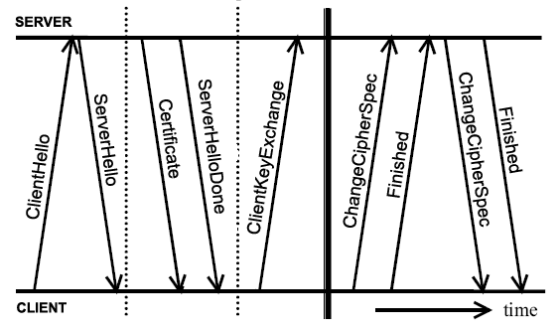
SSL

Slide 17
Transport Layer Security (TLS)
“TLS versions 1.0, 1.1, and 1.2, and SSL 3.0 are very similar” [http://tools.ietf.org/html/rfc5246, The Transport Layer Security (TLS) Protocol, Version 1.2, 2008].
  There are many minor differences between these protocols, but browsers and servers are often configured to “rollback” to an earlier protocol in this family – if their communication partner requests this.
  Attackers may exploit the differences and the rollbacks, see http://en.wikipedia.org/wiki/Transport_Layer_Security#Version_rollback_attacks
Most experts advise against using the older protocols.
  Qualys gives a “fail” to any server that accepts SSL2.0, see https://www.ssllabs.com/downloads/SSL_Server_Rating_Guide_2009e.pdf
“SSL/TLS is a deceptively simple technology.
  “It is easy to deploy, and it just works . . . except that it does not, really.
  The first part is true—SSL is easy to deploy—but it turns out that it is not easy to deploy correctly.” [https://www.ssllabs.com/projects/best-practices/]

Slide 18
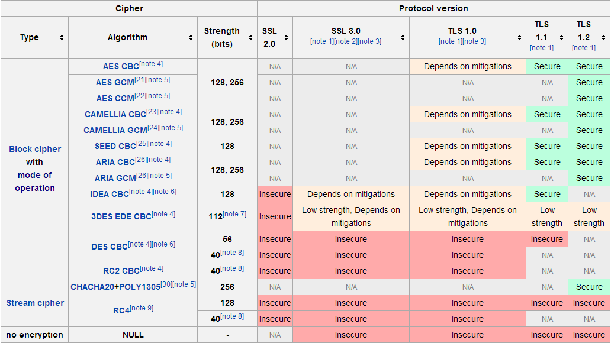
Wikipedia’s Current Advice on Cipher Selection in SSL/TLS
http://en.wikipedia.org/wiki/Transport_Layer_Security, 1 August 2014

Slide 19
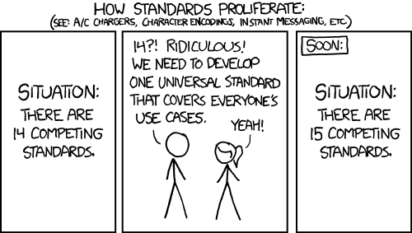
A Lighthearted View
Question at https://www.schneier.com/blog/archives/2013/02/really_clever_t.html:
  “It's probably fair to say that TLS has accrued too many options and versions to remain secure overall.
  “Time to throw it out and build a new protocol that avoids all the problems identified with TLS over the years.
  “Who'll go first?”
Answer: … Time for obligatory xkcd: http://xkcd.com/927/

Slide 20
IPSec
Short for IP Security, a set of protocols developed by the IETF to support the secure exchange of packets at the IP layer.
  IPsec has been deployed widely to implement Virtual Private Networks (VPNs).
For IPsec to work, the sending and receiving devices must share a public key.
  Internet Security Association and Key Management Protocol/Oakley (ISAKMP/Oakley) protocol.
  Allows the receiver to obtain a public key and authenticate the sender using digital certificates.
http://tools.ietf.org/html/rfc4301
Category: Data Confidentiality

Slide 21
IPSec
IPSec may be used to protect one or more paths between two of any combination of hosts and/or security gateways (routers, firewalls, etc).
  This is facilitated through the use of its Authentication Header (AH), and its Encapsulating Security Payload (ESP), both of which are algorithm independent.
  The AH is used to authenticate the origin of the packets and the ESP encapsulating the content within the packets
IPsec supports two encryption modes
  Transport mode encrypts only the data portion (payload) of each packet, but leaves the header untouched.
  Tunnel mode encrypts both the header and the payload.
  On the receiving side, an IPSec-compliant device decrypts each packet.

Slide 22
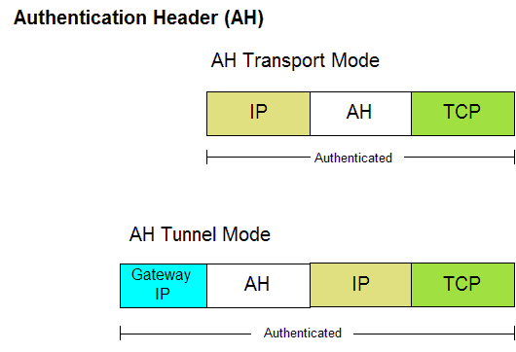
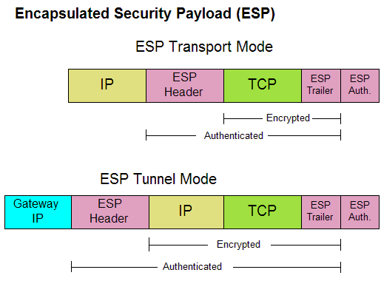
IPSec

Slide 23
IPSec
IKE-Related Output (VeriSign CA enrollment)
    dt1-45a#show crypto key mypubkey rsa
    % Key pair was generated at: 11:31:59 PDT Apr 9 1998
    Key name: dt1-45a.cisco.com
    Usage: Signature Key
    Key Data:
    305C300D 06092A86 4886F70D 01010105 00034B00 30480241 00C11854 39A9C75C
    4E34C987 B4D7F36C A058D697 13172767 192166E1 661483DD 0FDB907B F9C10B7A
    CB5A034F A41DF385 23BEB6A7 C14344BE E6915A12 1C86374F 83020301 0001
    % Key pair was generated at: 11:32:02 PDT Apr 9 1998
    Key name: dt1-45a.cisco.com
    Usage: Encryption Key
    Key Data:
    305C300D 06092A86 4886F70D 01010105 00034B00 30480241 00DCF5AC 360DD5A6
    C69704CF 47B2362D 65123BD4 424B6FF6 AD10C33E 89983D08 16F1EA58 3700BCF9
    1EF17E71 5931A9FC 18D60D9A E0852DDD 3F25369C F09DFB75 05020301 0001
http://www.cisco.com/c/en/us/support/docs/security-vpn/ipsec-negotiation-ike-protocols/16439-IPSECpart8.html

Slide 24
Final Thoughts
Many many many more protocols and standards than presented here…
  You can spend an entire lifetime on this stuff
    Because many have…
Lots of discussion….which is the point.
  These protocols are based on standards
    Standards can be vague, biased or ineffective
Don’t take anything as absolute
  Read the source material
    http://www.ietf.org/

Slide 25
Questions?

