Slide 1
Self-service Cloud Computing
Presented by:
Yu Bai (ybai181)
Butt, S., Lagar-Cavilla, H. A., Srivastava, A., & Ganapathy, V. (2012, October). Self-service cloud computing. In Proceedings of the 2012 ACM conference on Computer and communications security (pp. 253-264). ACM.

Slide 2
What is a Self-service Cloud(SSC)?
SSC is a new cloud computing model that improves client security and privacy, and gives clients the flexibility to deploy privileged services on their own VMs (Butt, 2012).
A security framework of cloud that considers providers(amozon, google, ebay) and administrators(people who work at provider’s Lab or have access to it) as different roles(my point of view).

Slide 3
Framework of traditional cloud
Hardware
Hypervisor
Dom0
VMs
Virtual machine
Microkernel(Fiasco.OC)
Dom0, Hypervisor, and Hardware (three grey components) consist of trusted computing base(TCB).
Hypervisor directly control hardware and runs at the highest privilege level
- Dom0 as a special VM used by administrators has the privileges to schedule, configure, control, monitor on other VMs.

Slide 4
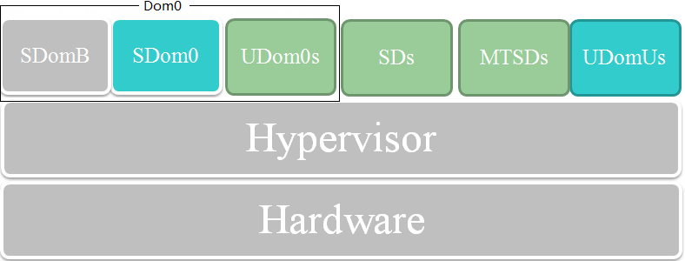
Framework of SSC
Virtual machine
Microkernel(Fiasco.OC)
Reducing the privilege of administrators
- SDom0 can no longer spy on user domain.
- SDom0 is out of TCB.
SDom0(System Domain 0) SDomB(System Domain Builder) UDom0(User Domain 0) SD(Service Domain) MTSD(Mutually-trusted service Domain)

Slide 5
Background of Self-service Cloud(SSC)
Cloud Layers
-Software as a Service (SaaS)
-Platform as a Service (PaaS)
-Infrastructure as a Service (IaaS)
Which kind of threats?
-User-to-user threat
-User-to-infrastructure threat
-Provider-to-user threat

Slide 6
Reason behind SSC framework
Provider-to-user threat
-Clients want to protect their privacy and sensitive data, and
-Providers value their reputation, but
-Administrators could be malicious , driven by personal interest.

Slide 7
Appreciation
Fine grained of analysis on roles
- Recognize administrators are different from providers.
- A feasible and delicate model to limit the power of administrators.

Slide 8
Limitation
Lose the main advertised feature of cloud - administration free.
-Clients need put more effort into non-functional part.
-Suggested app store seems not plausible(need to trust third party software and seems no enough market requirement).

Slide 9
Limitation
Practical security (Lampson, 2004) or shifting responsibility?
-Looks like balancing the cost of protection and the risk of loss. But
-Still need to trust providers, and there will still be somebody who has access to supervisor, hardware, i.e. TCB.
-If providers cannot trust their administrators, should clients trust their own administrators?
-Whatever clients have to trust some individuals.
-Wouldn’t a Bell-La Padula confidentiality model be better ?
Lampson, B. W. (2004). Computer security in the real world. Computer, 37(6), 37-46.

Slide 10
Question
If security is really important, what would clients prefer SSC or their own servers?
Can we come up a way someday to finally get rid off the problem caused by people in a security system?

Slide 11
Thank you!
Yu Bai (ybai181)

